Slide 1
Data assimilation single neural cell 2

Slide 2
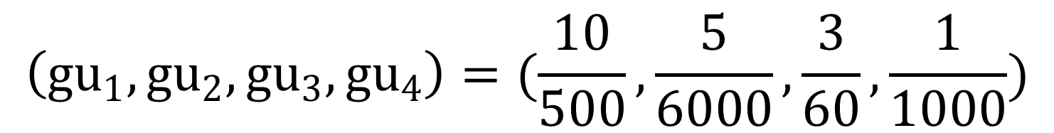
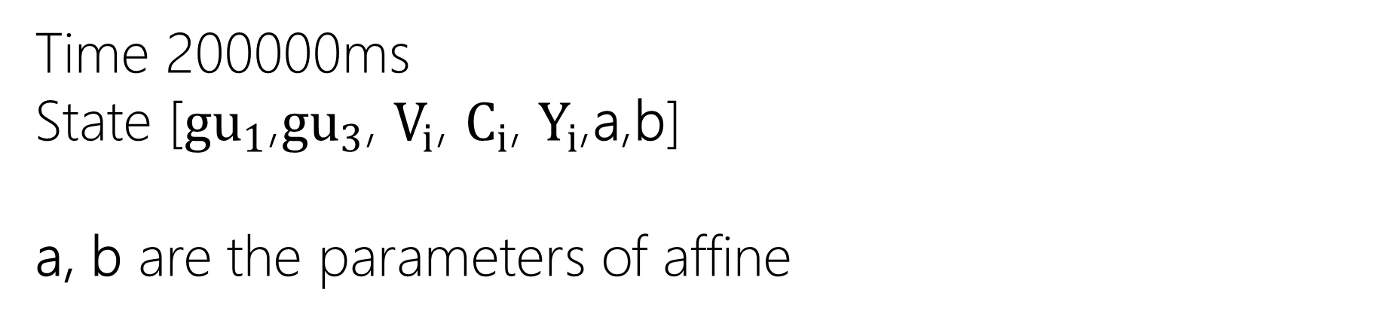

Settings
Time 200000ms
State [${gu}_{1}$,${gu}_{3}$, $V_{i}$, $C_{i}$, $Y_{i}$,a,b]
a, b are the parameters of affine
We have dropped ${Ju}_{i}$
$$\left({gu}_{1},{gu}_{2},{gu}_{3},{gu}_{4}\right)=(\frac{10}{500},\frac{5}{6000},\frac{3}{60},\frac{1}{1000})$$
Size of samples 10

Slide 3
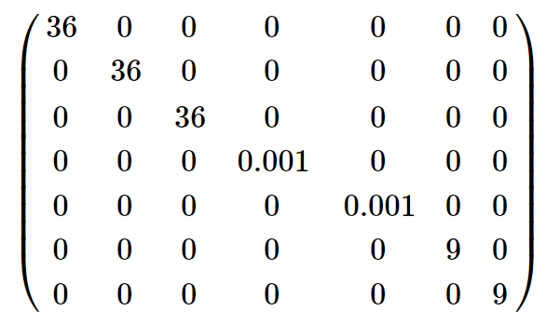

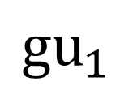
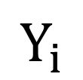
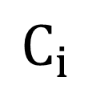
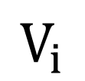
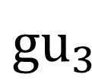
covariance matrix in the process of EnKF
$${gu}_{1}$$
Transformed
To $ℝ$
$${gu}_{3}$$
$$V_{i}$$
$$C_{i}$$
free
$$Y_{i}$$
a
b
Transformed To $ℝ$

Slide 4
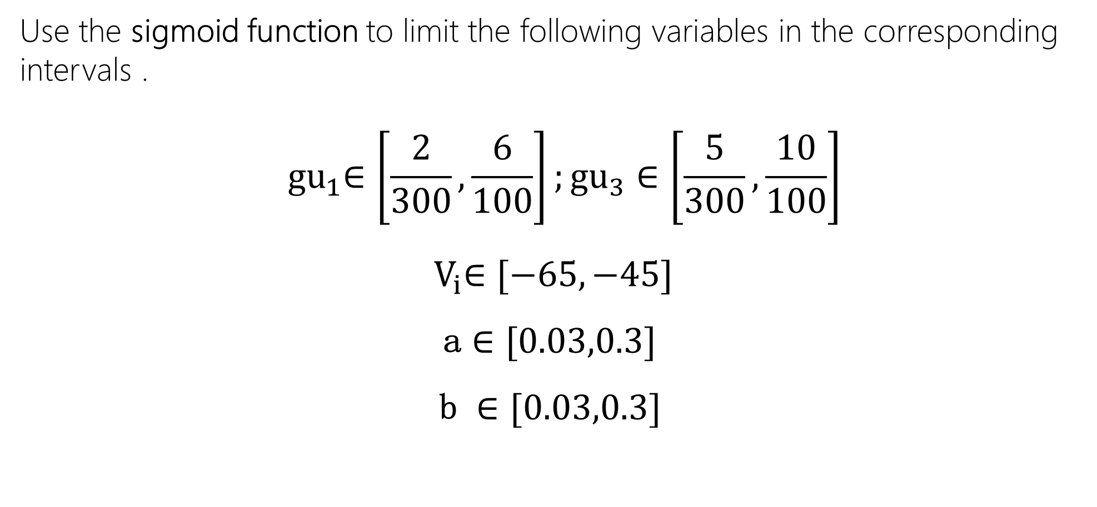
Dealing with bounded variables
Use the sigmoid function to limit the following variables in the corresponding intervals .
$${ gu}_{1}∈\left[\frac{2}{300},\frac{6}{100}\right];{gu}_{3}∈\left[\frac{5}{300},\frac{10}{100}\right]$$
$${ V}_{i}∈[−65,−45]$$
a $∈[0.03,0.3]$
b $∈[0.03,0.3]$

Slide 5
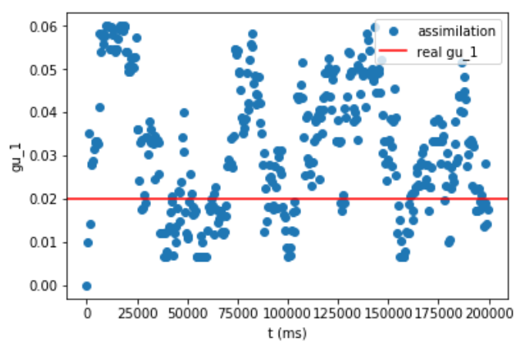
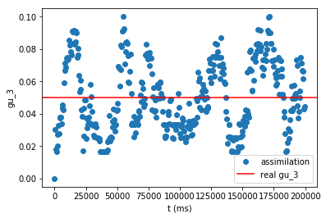
Result: no noise version

Slide 6
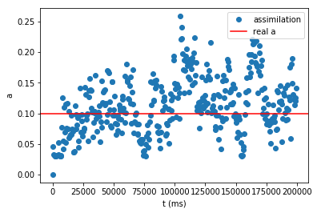
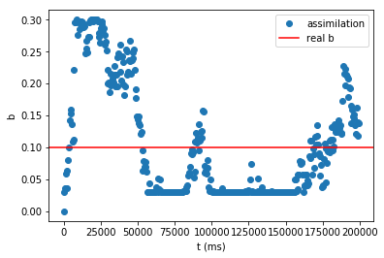

Slide 7
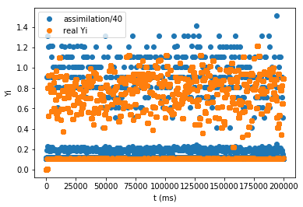
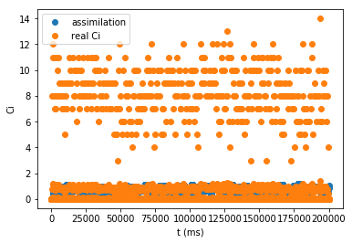

Slide 8
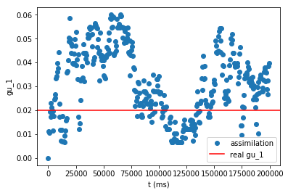
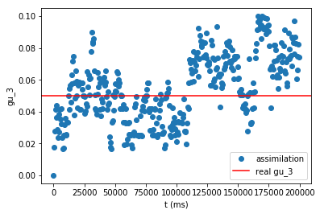
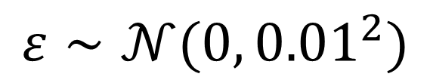
Result: noise version
Noise： add to the updating process of Vi
$$ε∼𝒩(0,{0.01}^{2})$$

Slide 9
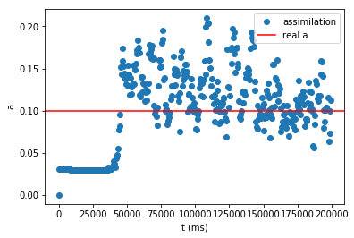
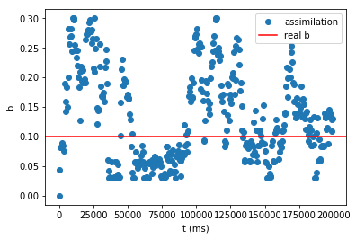

Slide 10
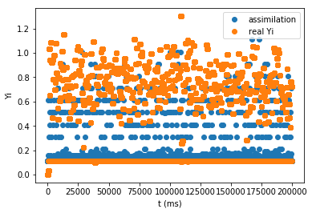
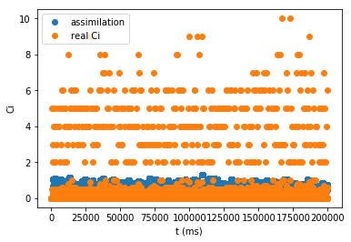

Slide 11
Discussion
Difficulties we encounter during the experiment and what we can do:
Absorbing boundaries or wrong areas —— higher variances, wider boundary
No convergence —— lower variances, longer time
The choices of which variables to be bounded —— Control variable experiment

Slide 12
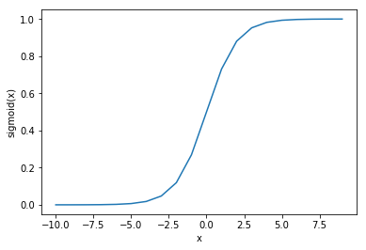
The bad behavior of sigmoid function near its “boundaries”
Hard to move
—— truncated sigmoid function(examining the boundary areas)

Slide 13
Thank you

