Slide 2
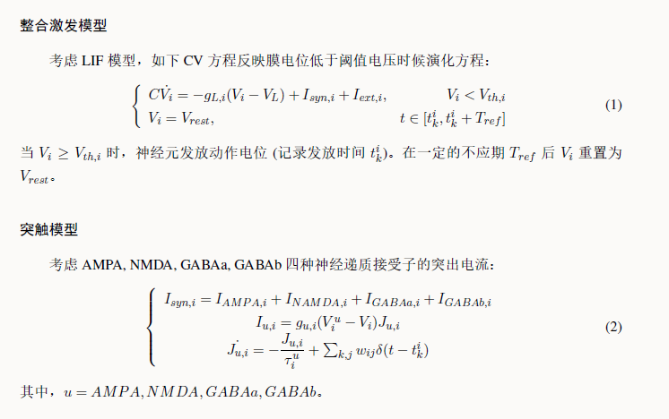
model

Slide 3
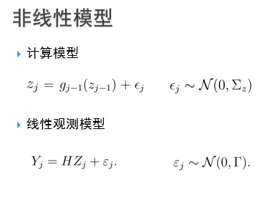

Slide 4
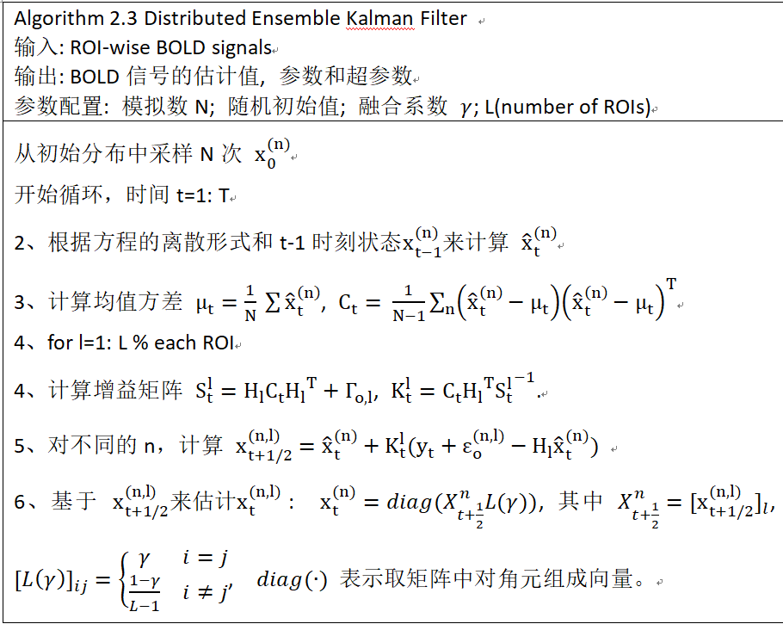
Data assimilation

Slide 5
Step1: passion input
Step2: spike number
Step3: ct
Step4: yt

