Slide 1

Prediction of Credit Solvency
NHÓM 5:
GVHD: Ths Quách Đình Hoàng
Thành Viên | MSSV
Nguyễn Thanh Tùng | 19133065
Ngô Phi Lít | 18133024
Hồng Tiến Hào | 19133022
Đô Lê TIến Đạt | 17133012

Slide 2
Goal of the study
Analyze the Prediction of Credit Solvency (Prediction) Data Set
Predict: Credit classification algorithms, which make predictions about the probability of default, are methods banks use to determine whether a loan has been granted.
Importance: Build a model that lenders can use to help make the best financial decisions.
Classiﬁcation methods
KNN
Naive Bayes
Random Forest
Data source: https://www.kaggle.com/competitions/GiveMeSomeCredit

Slide 3
The main technological questions
How to compare diﬀerent machine learning models
How missing value decisions can aﬀect accuracy
How to ﬁnd the most important features

Slide 4
DATA
1. ID number
2. People who have experienced 90 days or more of their due date (target y)
3. Total credit card balance and personal line of credit
4. Borrower's age
5. Monthly income
6. Monthly debt payment, alimony, living expenses divided by the total monthly income

Slide 5
DATA
7 - 9. Number of times the borrower has been overdue
30-59 days
60-89 days
over 90 days
10. Number of loans open and line of credit
11. Number of mortgages and real estate loans
12. Number of dependents in the family excluding yourself

Slide 6
DATA
Rows: 150,000
Columns: 12
Missing Value:
Monthly Income: 29731
Number of Dependents: 3924

Slide 7
Approach
For each classiﬁcation method, split the data:
Training set (build the model)
validate set (validate performance)
test set (predict)

Slide 8
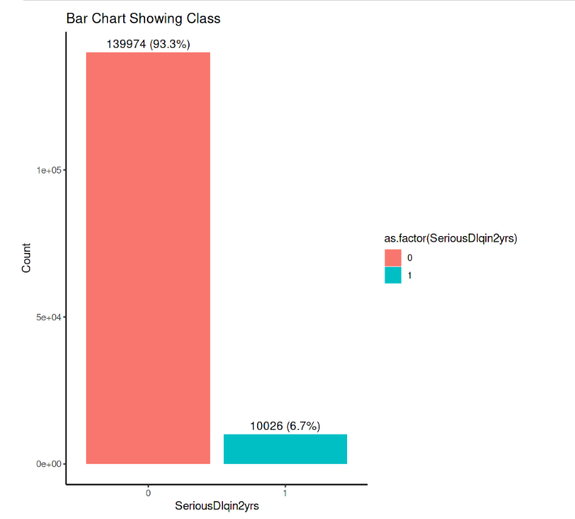
Approach
Compare classifier’s predictions with the actual outcomes (F-score)

Slide 9
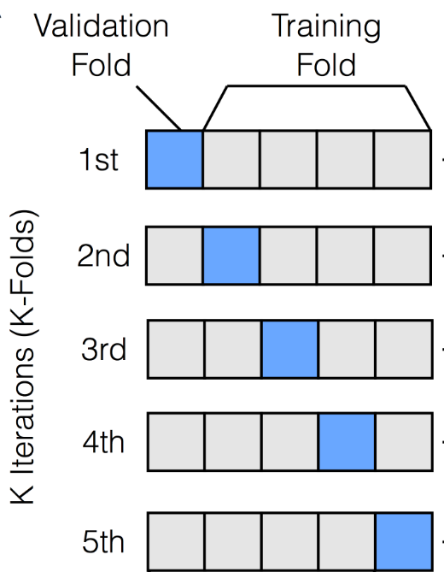
Approach
Evaluate classifier’s robustness by 10-fold cross validation

Slide 10
MISSING DATA
Remove NA
Replace by median
Discrete variables

Slide 11
K-NEAREST NEIGHBOR
1. Set hyperparameter:
Try K with increasing values: 50, 100, 150, 200
2. Training
3. choose K for best F1 result

Slide 12
NAIVE BAYES
Set hyperparameter
Apply Gaussian and kernel distribution for continuous variables
Apply method smoothly (avoid the conditional probability of 0)
Training
choose parameter for best F1 result

Slide 13
RANDOM FOREST
Set hyperparameter
Amount of selected attributes try from 4 to 8
Amount of trees generated will try the following values ​​500, 1000, 1500
Training
Choose hyperparameter for best F1 result

Slide 14
Train Score
Method | Remove | Median | Discrete
K-Nearest Neighbor | 0.9641 | 0.9668 | 0.9669
Naïve Bayes | 0.9642 | 0.9672 | 0.9649
Random Forest | 0.9642 | 0.9674 | 0.9661

Slide 15
Validate Score
Method | Remove | Median | Discrete
K-Nearest Neighbor | 0.964 | 0.97 | 0.966
Naïve Bayes | 0.965 | 0.969 | 0.962
Random Forest | 0.997 | 0.996 | 0.98

Slide 16
COMPARISION
Private Test Score
Method | Remove | Median | Discrete
K-Nearest Neighbor | 0.78 | 0.80 | 0.84
Naïve Bayes | 0.82 | 0.83 | 0.82
Random Forest | 0.82 | 0.85 | 0.82

Slide 17
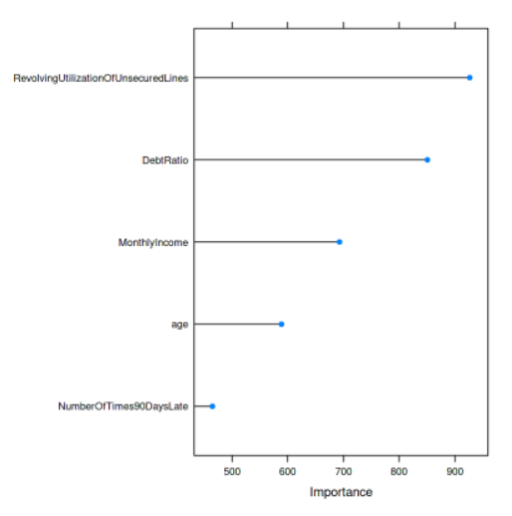
IMPORTANT FEATURES
The ranking of the features that are most important from Random Forest classiﬁer

Slide 18
Conclusion
Compare diﬀerent machine learning with F-score
random forests do very well when there are relatively few features
How missing value decisions can aﬀect accuracy
imputation can work very well
How to ﬁnd the most important features
machine learning methods (e.g., random forest) can tell us

Slide 19
THANKS FOR WATCHING

