Slide 1
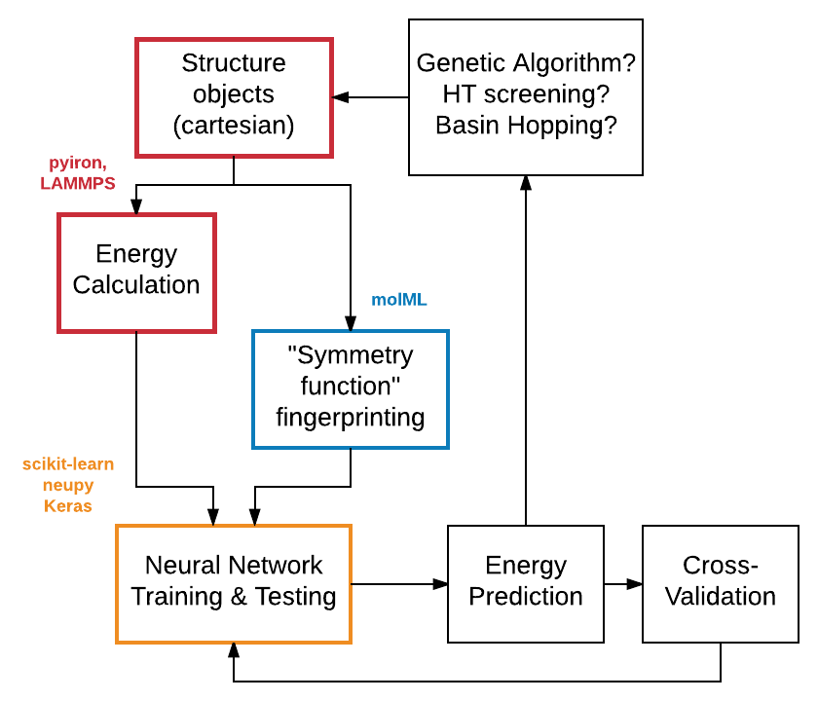
Goal: Modular Python Framework to fit neural networks to energy landscapes

Slide 2

PyIron: flexible IDE for joining all parts and facilitating user modification
Structure objects
pymatgen or ase
Lists of Species : Coordinates
Gold Clusters for proof of concept
Relaxation or single-point calculations using LAMMPS or VASP through PyIron workflow
Sutton potentials for proof of concept

Slide 3
Behler and Parrinello method
List of Cartesian coordinates → List of fingerprints
each fingerprint = one atom’s chemical environment
includes pair and triplet interactions
distance-cutoff function
sum of Gaussians
molML
Python implementation by Chris Collins, (David Yaron’s group (comp. chem.) at Carnegie Mellon)

Slide 4
Theano
Python library for handling multi-dimensional arrays
Scikit-Learn
Workflow for transforming data sets and other general-use functions
Handles many ML models
Neupy
Works on top of Scikit-Learn and Theano
Includes code for many neural network methods
Keras
“neural layers, cost functions, optimizers, initialization schemes, activation functions, regularization schemes are all standalone modules”

Slide 5
General Regression Neural Network
Donald F Specht, Stanford

Slide 6
Cross-Validation or Sensitivity Tests with scikit-learn?
Genetic Algorithm
GASP
HT screening
Spacegroups
Chemical Substitution
Random placement
Basin Hopping

