Slide 1
Image Processing Project: Background Removing/Blurring
Nguyễn Xuân Hào – EEACIU19005

Slide 2
TABLE OF CONTENTS
01
Project’s Goal
03
GUI Designing
02
Procedure
04
Demonstration

Slide 3
INTRODUCTION
We have a image with the bad background.
You only need to keep an object in the image for some specific situation.
➔ We need to remove the background or blur it.

Slide 4
01
Project’s Goal

Slide 5
PROJECT’S GOAL
Create an application used to remove or blur the background of an image.
Create some sub-function such as adjusting values of color layers or brightness of an image.

Slide 6
02
Procedure

Slide 7
Removing background
Blurring background
Zone the region containing the object.
Create a mask.
AND 2 images together.
Zone the region containing the object.
Create a mask.
Split original image into 2 images.
Blur the background-only image.
Combine blurred background-only image and object-only image.

Slide 8
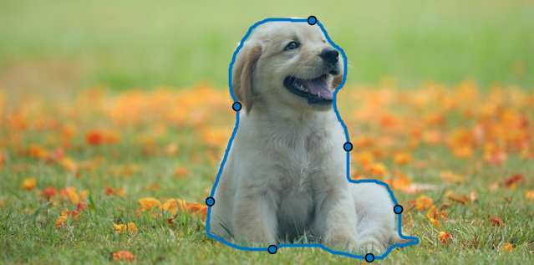


Slide 10



Slide 13
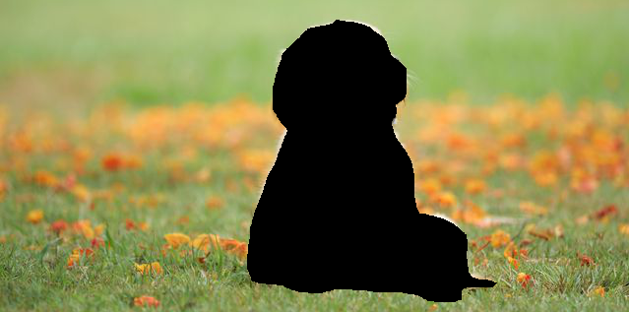


Slide 14



Slide 15
03
GUI Designing

Slide 16
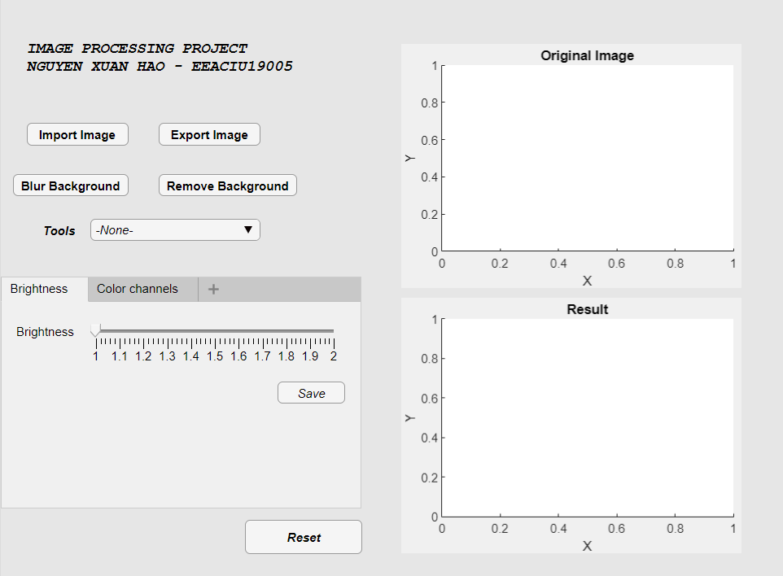
Select shape
for zoning

Slide 17
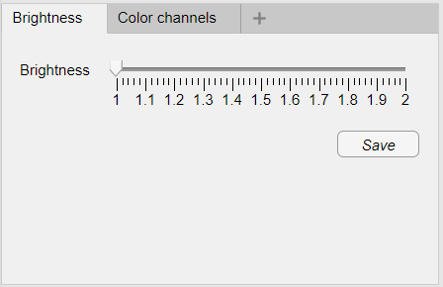
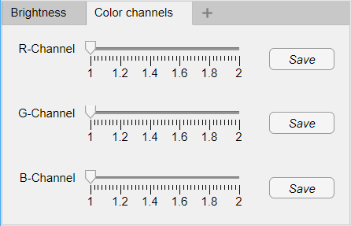

Slide 18
04
Demonstration

Slide 19
THANKS FOR LISTENING!

