Slide 1
PROJECT PRESENTATION
Topic:
Adversarial Text Generation for Social Bots
Presenters:
Haris Habibullah
Jiarong Pan
Qiang Ma
Vishal Sukumar

Slide 2
Presentation Outline
1.Introduction to SeqGAN
2.Working Principle
3. Algorithm
4. Dataset & Results
5. Evaluation
6. Disucssion

Slide 3
Aims of this Project
Explore the problems that stimulate the need for SeqGAN.
To generate real-like tweets, which can fool a Discriminator.
Mimic the basic working of a social bot.
Notes:
Most twitter bots are retweeting and dealing with the text

Slide 4
Why SeqGAN?
Objective:
Given a dataset of real-world structured sequences, train a θ-parameterized generative model Gθ to produce a sequence Y1:T = (y1, . . . , yt, . . . , yT ), yt ∈ Y, where Y is the vocabulary of candidate tokens.
Problem:
Contrary to images, text tokens do not have a continuous value.
For example the word “computer” is represented by the real-valued vector v = [0.11143, -0.97712, 0.445216 ….., 0.7221240]. Now, v + 0.08 is another vector which need not necessarily represent a word in the vocabulary.
GAN give the loss for an entire sequence. We need intermediate rewards.
Notes:
Typically text tokens (say, words) are represented by an “embedding-vector” of real-values. These vectors, though composed of continuous real-values, are discrete!
Suppose that the word “computer” is represented by the real-valued vector v = [0.11143, -0.97712, 0.445216 ….., 0.7221240]. Now, v + 0.08 is another vector which need not necessarily represent some word in the vocabulary.
So utilising the gradient of the loss from D with respect to the outputs of G to guide its parameters makes little sense.
Secondly, D can only classify and give the loss for an entire sequence. For partial sequences, it cannot provide any feedback on how good the partial sequence is and what the future score of the entire sequence might be.
In a stochastic parameterized policy, the actions are drawn from a distribution that parametrizes your policy.
As the gradients cannot pass back to G due to discrete outputs, G is regarded as a stochastic parametrized policy. The policy is trained using policy gradient.
This action-value function is estimated by the discriminator. However, D only provides a reward at the end of a finished sequence. Yet, it is important that at every time-step, the fitness of both previous tokens as well as future outcome are considered. For this, the policy gradient used in SeqGANs employs a Monte Carlo (MC) search with a roll-out policy (P) to sample the unknown remaining tokens and approximates the state-action value at an intermediate step.

Slide 5
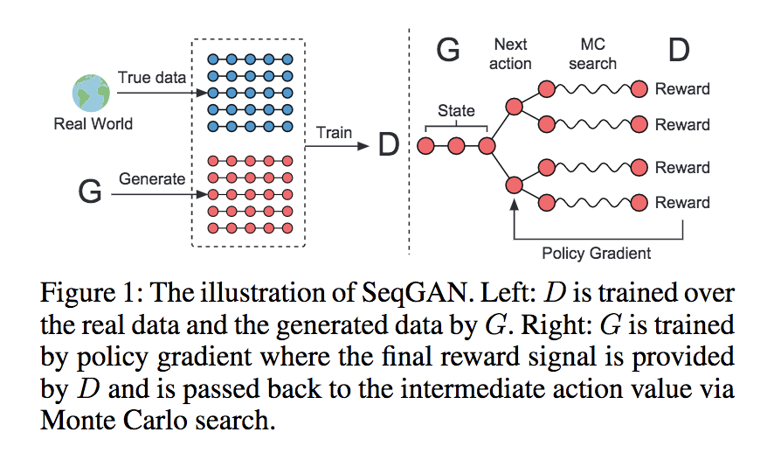
SeqGAN Working Principle

Slide 6
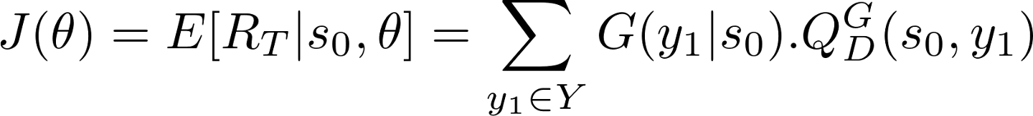
Objective of the generative model
R_T is the reward
s0 is the start state
Y is the vocabulary
probability if that value occurs
possible values of the reward
Notes:
Now the objective of the generator model (policy) is to generate a sequence from the start state s0 in such a way that maximises the expected end reward. R_T is the end reward that is determined by D.
Here term 2 is the action-value function. This function returns the reward value for taking an action (y1) from the state s0 following the policy G.
This action-value function is estimated by the discriminator. However, D only provides a reward at the end of a finished sequence. Yet, it is important that at every time-step, the fitness of both previous tokens as well as future outcome are considered. For this, the policy gradient used in SeqGANs employs a Monte Carlo (MC) search with a roll-out policy (P) to sample the unknown remaining tokens and approximates the state-action value at an intermediate step. An N-time MC search is represented as follows:

Slide 7
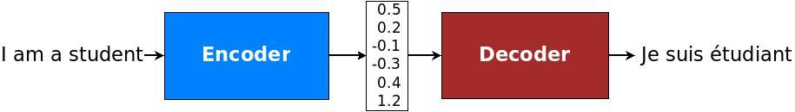
Generator
[Working Principle]
Pre-train
Initialize
Pre-train
Train
What architecture did we use?
Notes:
Initialize randomly, then doing pre-train for 100 epochs.
Then alternately train the Generator and Discriminator (2 times gen and 1 time dis then repeat) . The encoder-decoder architecture means we first encode our source sentence into a vector (max_length, embed_dim), then input to the decoder which can generate a new sentences. If the input is random, then we are generating random new sentences. So here, we just need to focus on the decoder, because the encoder’s ouput is random anyway.
A natural choice for sequential data is the recurrent neural network (RNN). Usually an RNN is used for both the encoder and decoder. We use LSTM cells for decoder.

Slide 8
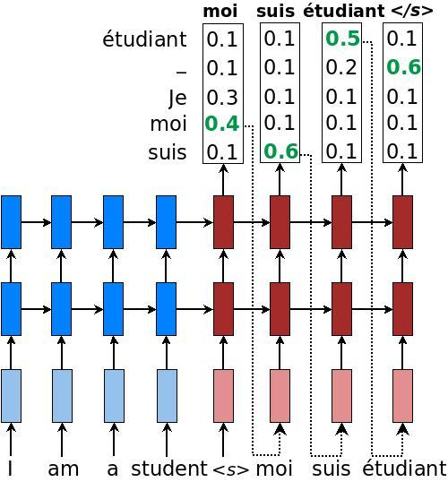
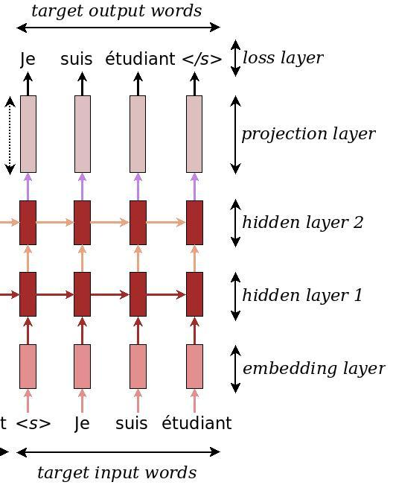
Text Generation:
Seq2Seq
Model
Random
Cell states and Hidden states
Notes:
For generating (like generating negative samples), we do not have the target sentence.

Slide 9
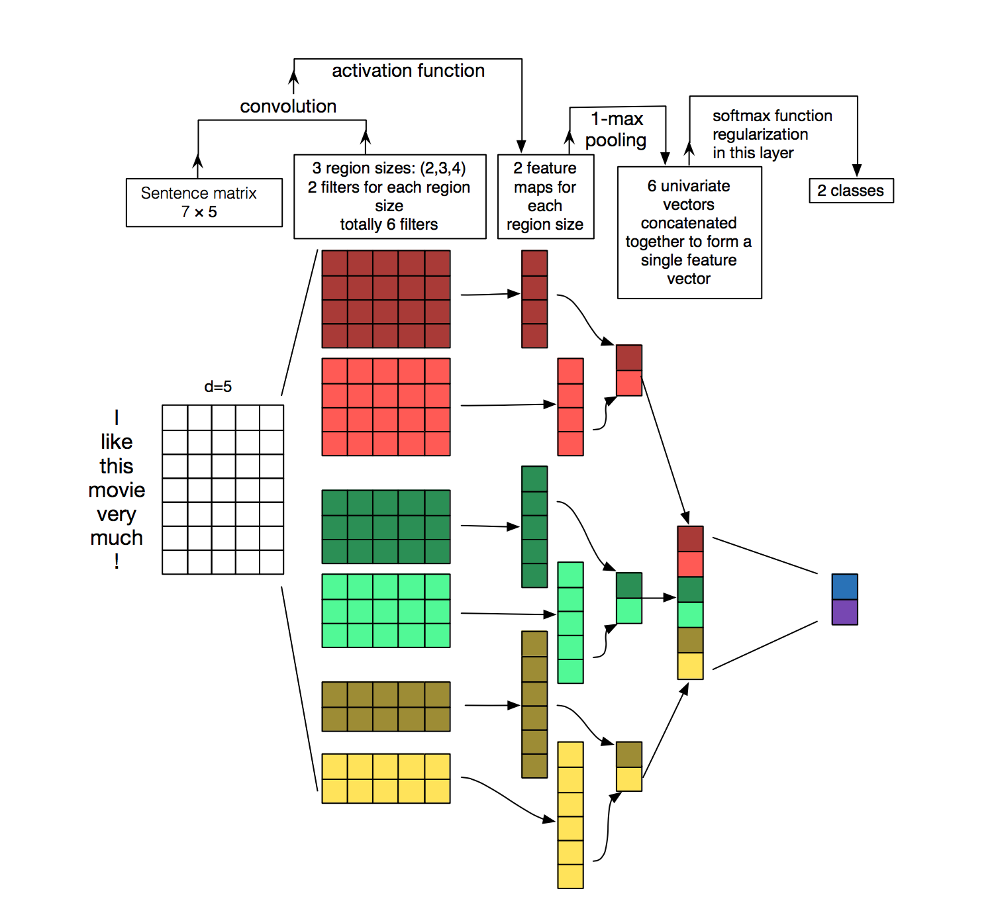
Discriminator
Notes:
The man, who …., is a king.
The lady, who …., is a queen.
dis_filter_sizes = [1, 2, 3, 4, 5, 6, 7, 8, 9, 10, 15]
dis_num_filters = [100, 200, 200, 200, 200, 100, 100, 100, 100, 100, 160]

Slide 10
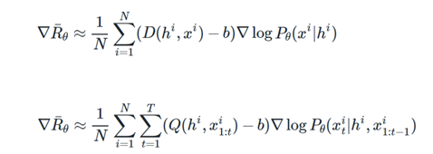
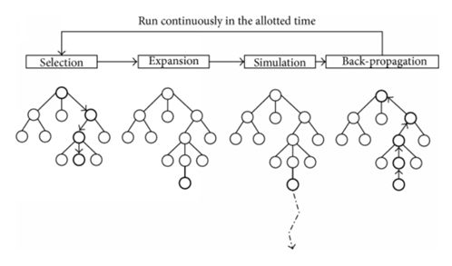
The Reward Function
The reward function needs to generate Intermediate Rewards, for partial sequences.
A Monte Carlo Tree Search algorithm is used to generate random roll outs, and a reward is generated for each word in the.
Notes:
Generator loss is based on the rewards generated from the Discriminator

Slide 11
Code Snippet
x = self.pad_input_data(input_x)
for i in range(rollout_num):
for given_num in range(1, self.max_sequence_length):
rollout_next_id = []
for _item in x:
rollout_next_id.append(_item[given_num])
mc_samples = sess.run(self.sample_id_MC, feed)
fix_samples = np.array(input_x)[:, 0: given_num]
samples = np.concatenate((fix_samples, mc_samples), axis=1)

Slide 12

Discriminator Loss
Cross Entropy Loss Function
It measures the difference between the labels and the prediction probabilities.
As the difference between the true label and the predicted probability increases, the Discriminator loss increases.

Slide 13
Experiment (Pre-Training)
The Honeypot Dataset was used, comprising of more than 3M tweets from legitimate (real) users and approximately 2M bot tweets.
http://infolab.tamu.edu/data/
The real tweet data was reduced to ~100k tweets for computational ease.
The Pre-Training Stage:
A vocab file was created for the tweets (txt) file using the One-Hot Vector method.
It was then used to pre-train the discriminator and the generator.

Slide 14
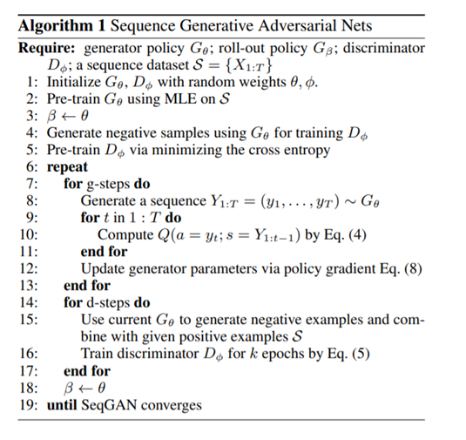
Algorithm

Slide 15
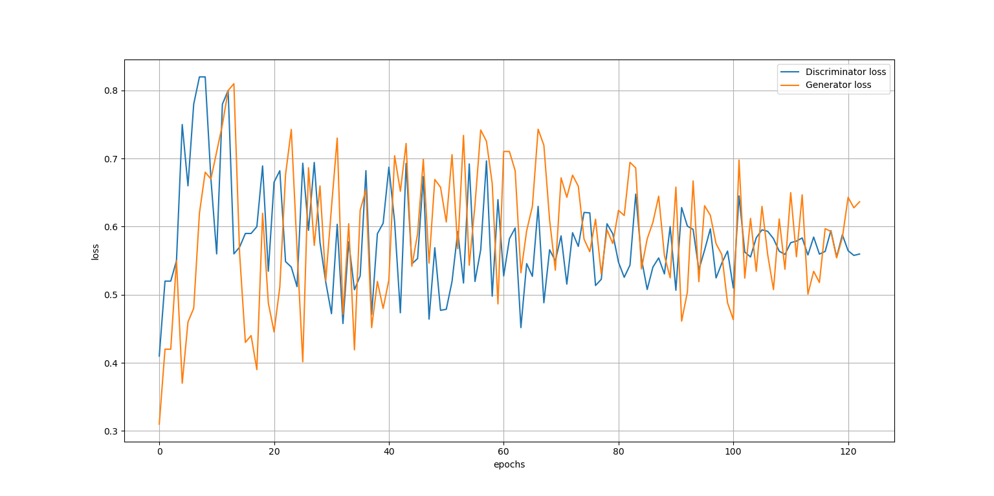
Results

Slide 16
Generator Sample
breathing is frightening , then bad
[5579, 8, 1548, 6, 119, 93]
[0.6849271 0.5034764 0.70320356 0.35842383 0.51580244 0.5771549
0.61102873 0.74537563 0.02554902 0.02554902 0.02554902 0.02554902
0.02554902 0.02554902 0.02554902 0.02554902 0.02554902]

Slide 17
Discussion and Improvements
The algorithm is dependent on the initial parameters. If we pre-train with a large (actual) dataset, the generator memorizes everything.
In the final epoch, the generator still produces <UNK> labels for unknown/ rare words → This can be replaced by related words using the embedded maps.
Add the retweet functionality to the GUI, if needed.

Slide 18


Any Questions / Doubts / Suggestions? Feel free to ask & comment ☺

