Slide 1
SentiGAN: Generating Sentimental Texts via Mixture Adversarial Networks
Ma Qiang
Jiarong Pan

Slide 2
Outline
1. Introduction
2. Related Works
3. SentiGAN
4. Experiments
5. Conclusion and future works

Slide 3
Outline
1. Introduction
2. Related Works
3. SentiGAN
4. Experiments
5. Conclusion and future works

Slide 4
Introduction
Generating texts of different sentiment labels is getting more and more attentions in the area of natural language generation.
Emotional intelligence is an important part of text generation
poor quality
lack of diversity
wrong sentiment
Challenges
Notes:
Hello, everyone.

Slide 5
Motivation
Use sentiment classifier to guide the generation of the sentimental text.
Try to improve the accurate of the sentiment label texts generated by multi-class classification.
Contributions
They propose a novel framework SentiGAN to generate generic, diversified and high-quality sentimental texts of different sentiment labels
They propose a new peanlty based objctive to make each generator in SentiGAN produce diversified texts of a specific sentimental label.
Extensive experiments are performed on four datasets and the results. demonstrate the efficacy and superiority of their proposed model.

Slide 6
Outline
1. Introduction
2. Related Works
3. SentiGAN
4. Experiments
5. Conclusion and future works

Slide 7
2. Related Work
Unsupervised text generation
GAN (Generative Adversarial Networks)
SeqGAN
SentiGAN
RNNLM
Variational Autoencoders (VAE)

Slide 8
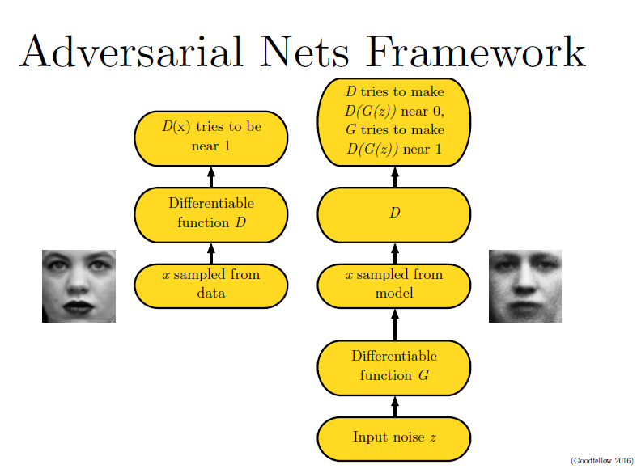

Slide 9
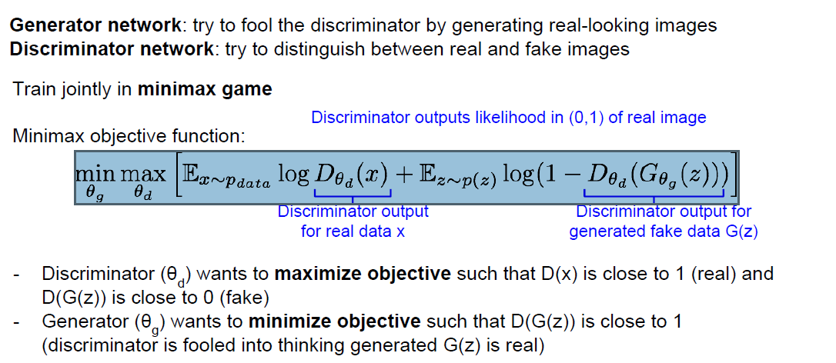

Slide 10
Outline
1. Introduction
2. Related Works
3. SentiGAN
4. Experiments
5. Conclusion and future works

Slide 11
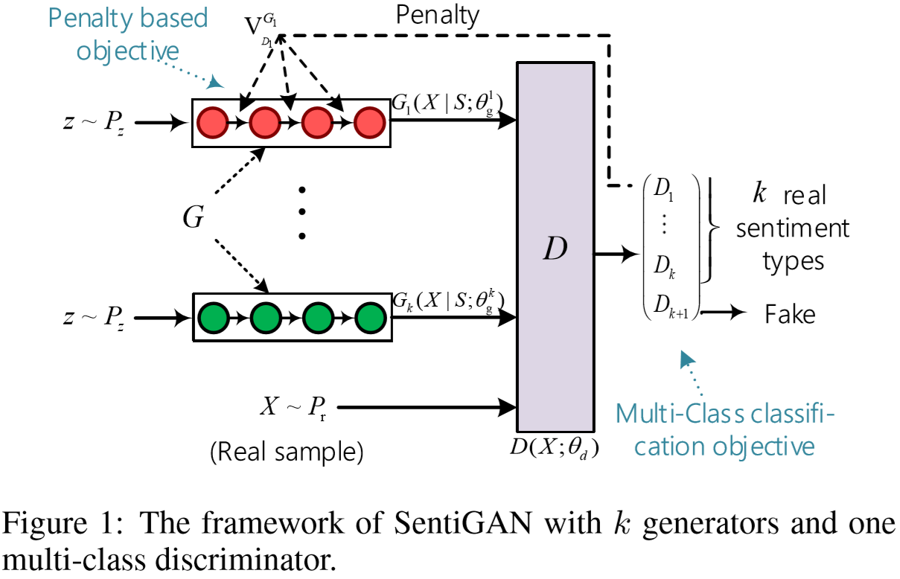
Structure
Notes:
The structure of SentiGAN is shown in the figure. There are basically two parts, one is the k Generators, and the other one is the Discriminator.
At the input, each Generator G_i corresponds to a type of sentiment. The parameter of the G_i is theta_g^i. z is the noise sampled from the distribution P_z, which would be a Gaussian distribution. We use z as the initial input of the network. Besides, we have the real samples X.
At the output, the Discriminator should give us the probability of text is fake or real. Fake means the text is generated by the Generator, and real means the text is from our real data. Therefore, we have k+1 classes. K for k types of sentiments and 1 for fake.

Slide 12

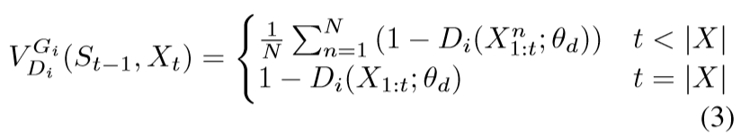
Generator Learning
The Generation problem could be formalized to a sequential decision-making process.
The Penalty Function is defined as:
Loss Function:
Notes:
To solve the problem that the gradient cannot pass back to the generative model when the output is discrete, they formalize the Generation to a sequential decision-making process. It means, at each timestep t, we train a generator G_i to produce a sequence X_(1:t) = {X_1, …, X_t}. X_t is a word in the given volcabulary C.
Since we are using GANs here, so we need to define a reward function or a penalty function to train the model. Here we can see it has two parts. It is due to the discriminator can only judge on a complete sequence, they apply N times Monte Carlo search with roll-out policy G_i to sample the rest of the tokens (unknown last |X|−t tokens).

Slide 13
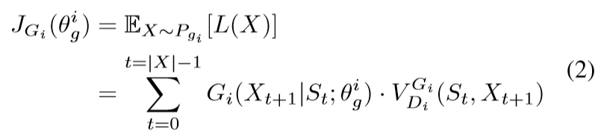
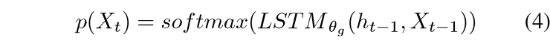
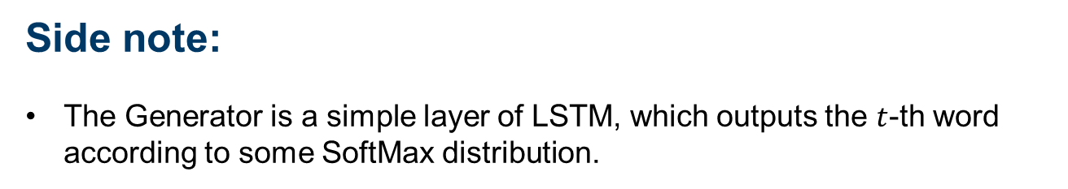
Generator Learning
The objective of our generator is to minimize the total penalty-based value
Side note:
The Generator is a simple layer of LSTM, which outputs the $t$-th word according to some SoftMax distribution.
Notes:
The Generator is a simple layer of LSTM, which outputs the t-th word according to some softmax distribution. It can also use other network to replace the LSTM.

Slide 14
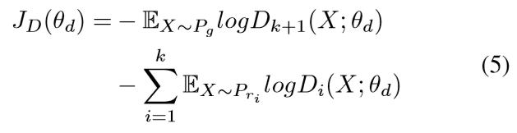
Discriminator Learning
We use a multi-class classiﬁcation objective that requires the discriminator to distinguish the real texts with each sentiment type and the generated texts.
Notes:
The Discriminator produces a softmax probability distribution over k + 1 classes. D_i is the score at i-th index. It represents the probability that it belongs to the real i-th type sentimental texts, and the score at (k + 1)-th index represents the probability that the sample is generated by generators.
P_g is texts generated by all generators, P_ri is real i-th type sentimental texts. D_i(X; θ_d) represents the i-th index of D(X ;θ_d).
-log is from +inf to 0, when the D(X; θ_d) = 1, which means our possibility is 1, it is optimal and have the lowest value 0. It force the discriminator to classify the generator’s text and real text correctly.

Slide 15
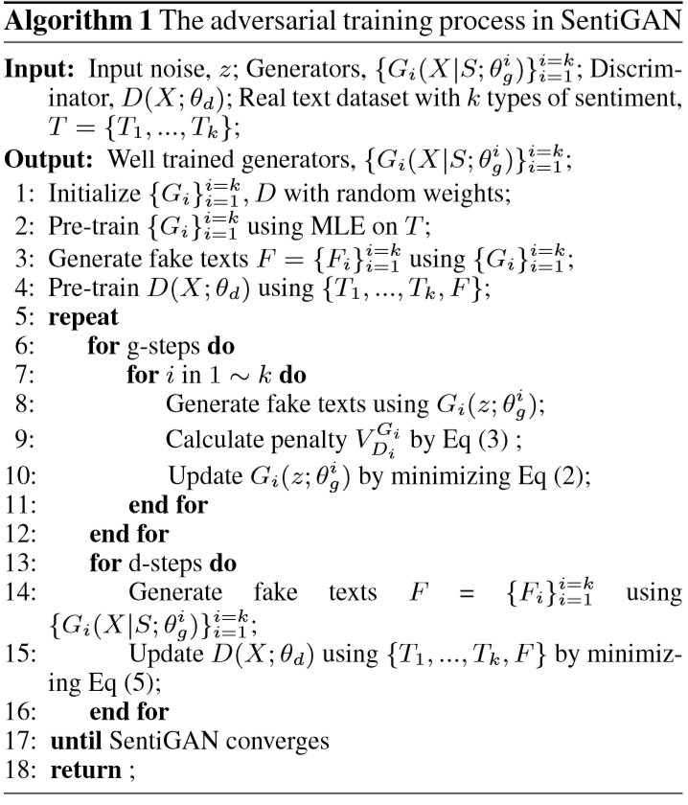
Algorithm

Slide 16
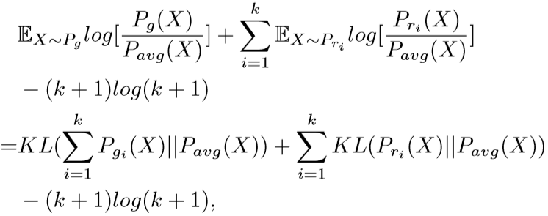



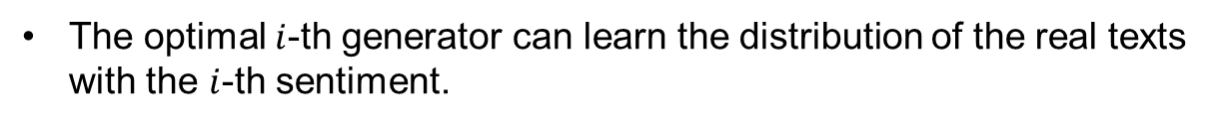
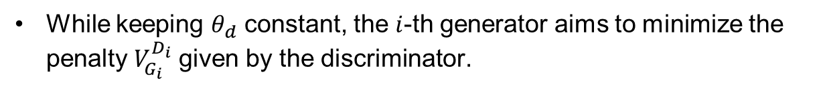
Multi-Class Classiﬁcation Objective
Multi-class classiﬁcation objective can force each generator to focus more on generating its own sentimental texts that are far from sentimental texts generated by other generators
The optimal $i$-th generator can learn the distribution of the real texts with the $i$-th sentiment.
obtains its global minimum when $P_{g_{i}} =P_{r_{i}}$!
While keeping $θ_{d}$ constant, the $i$-th generator aims to minimize the penalty $V_{G_{i}}^{D_{i}}$ given by the discriminator.
Notes:
First, we can see the above objective obtains its global minimum when P_gi = P_ri.
Intuitively, in order to get low penalties from the discriminator, the text generated by the i-th generator must be more consistent with the i-th sentiment type and be far away from other sentiment types.

Slide 17
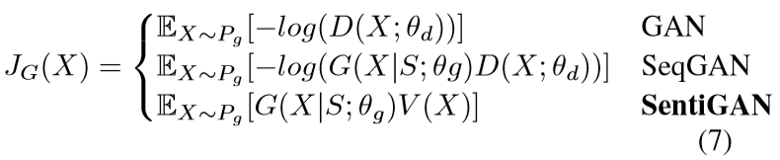
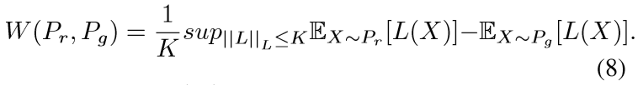

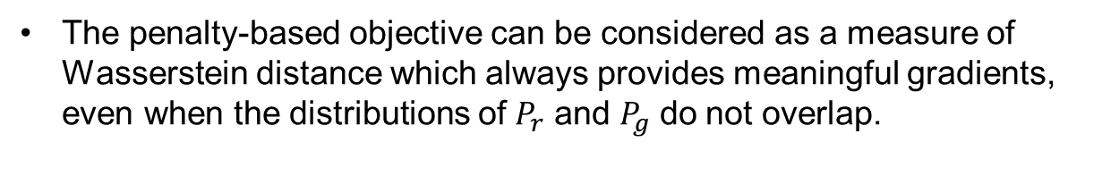
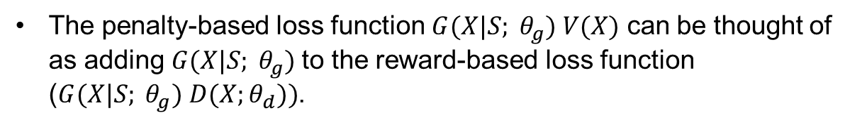
Penalty-based Objective
The penalty-based objective can be considered as a measure of Wasserstein distance which always provides meaningful gradients, even when the distributions of $P_{r}$ and $P_{g}$ do not overlap.
The penalty-based loss function $G(X|S; θ_{g}) V(X)$ can be thought of as adding $G(X|S; θ_{g})$to the reward-based loss function ($G(X|S; θ_{g}) D(X;θ_{d}))$.
Increase diversity!
Notes:
The Discriminator produces a softmax probability distribution over k + 1 classes. D_i is the score at i-th index. It represents the probability that it belongs to the real i-th type sentimental texts, and the score at (k + 1)-th index represents the probability that the sample is generated by generators.
P_g is texts generated by all generators, P_ri is real i-th type sentimental texts. D_i(X; θ_d) represents the i-th index of D(X ;θ_d).
-log is from +inf to 0, when the D(X; θ_d) = 1, which means our possibility is 1, it is optimal and have the lowest value 0. It force the discriminator to classify the generator’s text and real text correctly.

Slide 18
Outline
1. Introduction
2. Related Works
3. SentiGAN
4. Experiments
5. Conclusion and future works

Slide 19
Experiments
Focus on generating short sentences (length≤15 words) of two sentiment types (positive and negative) on three real datasets.
Datasets:
• MR: Movie Reviews [Socher et al., 2013], contains 2133 positive sentences and 2370 negative sentences.
• BR: Beer Reviews [Mcauley and Leskovec, 2013], contains 1437767 positive sentences and 11202 negative sentences.
• CR: Customer Reviews [Hu and Liu, 2004], contains 1024 positive sentences and 501 negative sentences.
Notes:
The Discriminator produces a softmax probability distribution over k + 1 classes. D_i is the score at i-th index. It represents the probability that it belongs to the real i-th type sentimental texts, and the score at (k + 1)-th index represents the probability that the sample is generated by generators.
P_g is texts generated by all generators, P_ri is real i-th type sentimental texts. D_i(X; θ_d) represents the i-th index of D(X ;θ_d).
-log is from +inf to 0, when the D(X; θ_d) = 1, which means our possibility is 1, it is optimal and have the lowest value 0. It force the discriminator to classify the generator’s text and real text correctly.

Slide 20
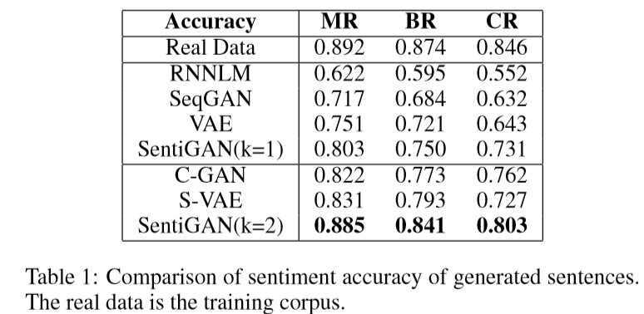
Experiments
Sentiment Accuracy of Generated Texts
Using state-of-the-art sentiment classiﬁer [Huetal.,2016] to automatically evaluate the sentiment accuracy of the generated
Notes:
The Discriminator produces a softmax probability distribution over k + 1 classes. D_i is the score at i-th index. It represents the probability that it belongs to the real i-th type sentimental texts, and the score at (k + 1)-th index represents the probability that the sample is generated by generators.
P_g is texts generated by all generators, P_ri is real i-th type sentimental texts. D_i(X; θ_d) represents the i-th index of D(X ;θ_d).
-log is from +inf to 0, when the D(X; θ_d) = 1, which means our possibility is 1, it is optimal and have the lowest value 0. It force the discriminator to classify the generator’s text and real text correctly.

Slide 21
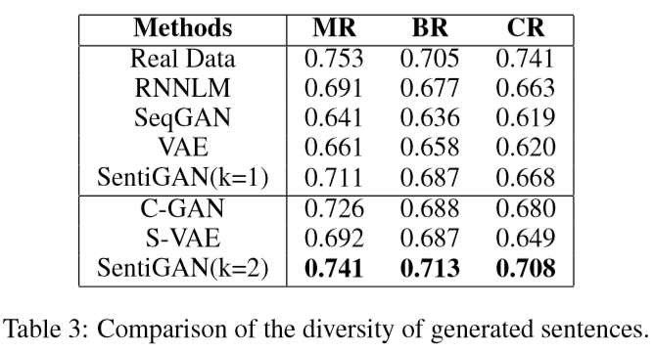
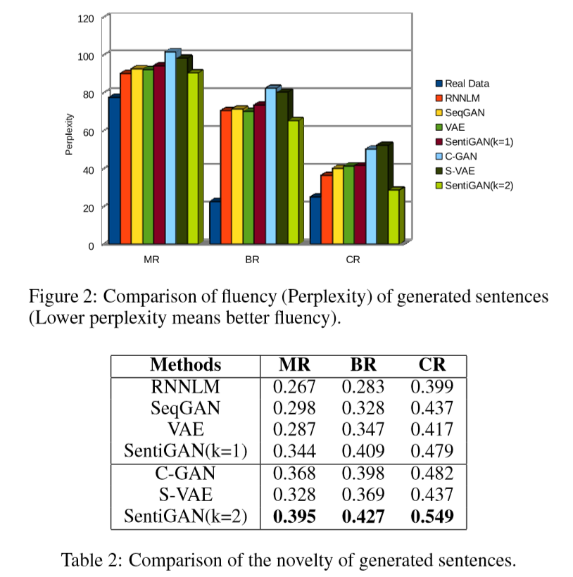
Experiments
Quality of Generated Sentences
Fluency
Novelty (How different from the training corpus)
Diversity
Intelligibility
Notes:
The Discriminator produces a softmax probability distribution over k + 1 classes. D_i is the score at i-th index. It represents the probability that it belongs to the real i-th type sentimental texts, and the score at (k + 1)-th index represents the probability that the sample is generated by generators.
P_g is texts generated by all generators, P_ri is real i-th type sentimental texts. D_i(X; θ_d) represents the i-th index of D(X ;θ_d).
-log is from +inf to 0, when the D(X; θ_d) = 1, which means our possibility is 1, it is optimal and have the lowest value 0. It force the discriminator to classify the generator’s text and real text correctly.

Slide 22
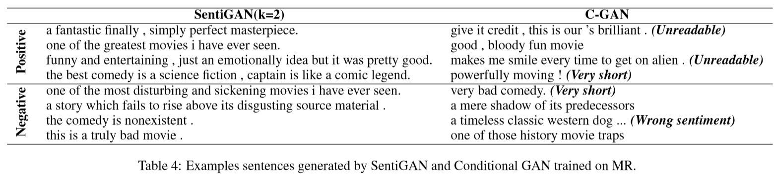
Experiments
Notes:
The Discriminator produces a softmax probability distribution over k + 1 classes. D_i is the score at i-th index. It represents the probability that it belongs to the real i-th type sentimental texts, and the score at (k + 1)-th index represents the probability that the sample is generated by generators.
P_g is texts generated by all generators, P_ri is real i-th type sentimental texts. D_i(X; θ_d) represents the i-th index of D(X ;θ_d).
-log is from +inf to 0, when the D(X; θ_d) = 1, which means our possibility is 1, it is optimal and have the lowest value 0. It force the discriminator to classify the generator’s text and real text correctly.

Slide 23
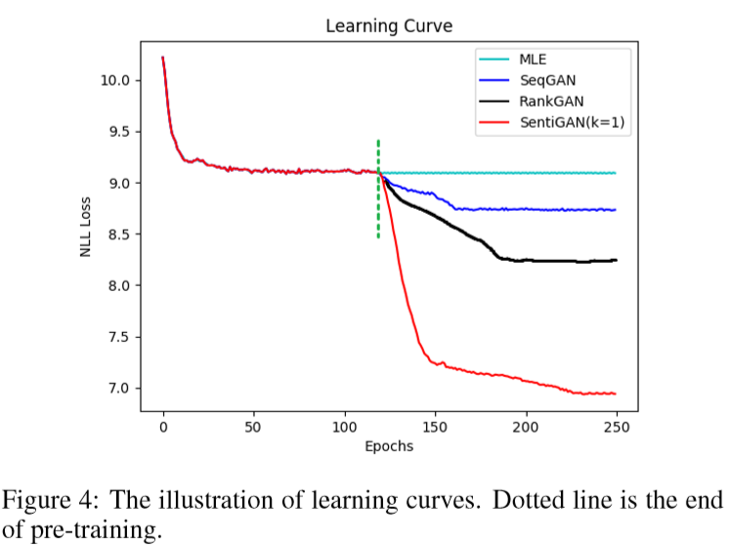
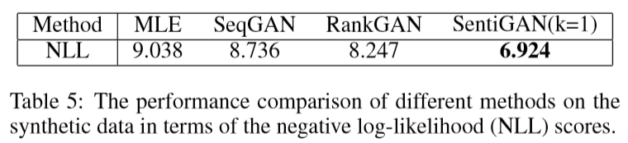
Experiments
Validation of Penalty-Based Objective
use a synthetic data set to test our proposed model in the mere use of the penalty based objective
Notes:
The Discriminator produces a softmax probability distribution over k + 1 classes. D_i is the score at i-th index. It represents the probability that it belongs to the real i-th type sentimental texts, and the score at (k + 1)-th index represents the probability that the sample is generated by generators.
P_g is texts generated by all generators, P_ri is real i-th type sentimental texts. D_i(X; θ_d) represents the i-th index of D(X ;θ_d).
-log is from +inf to 0, when the D(X; θ_d) = 1, which means our possibility is 1, it is optimal and have the lowest value 0. It force the discriminator to classify the generator’s text and real text correctly.

Slide 24
Outline
1. Introduction
2. Related Works
3. SentiGAN
4. Experiments
5. Conclusion and future works

Slide 25
Conclusion
Future Works
A novel framework SentiGAN to generate generic, diversiﬁed and high-quality sentimental texts of different sentiment labels.
A new penalty based objective to make each generator in SentiGAN produce diversiﬁed texts of a speciﬁc sentiment label.
Use of more complex and sophisticated generators.
Apply our model to generate texts with other kinds of labels (e.g., different writing styles).

Slide 26
Thank you!

