Slide 1
CFFormer: Cross CNN-Transformer Channel Attention and Spatial Feature Fusion for Improved Segmentation of Heterogeneous Medical Images
Author: Jiaxuan Li et al., 2025

Slide 2
Research Background & Problem Definition
The Importance of Medical Image Segmentation
Used in computer-aided diagnosis to locate tumors, lesions, organs, etc.
Requires pixel-level precise segmentation
However, medical images generally have the following issues:
Poor image quality (noise, blurriness, low contrast)
Large differences among different modalities (US/CT/MRI/endoscopy, etc.)
Blurred target boundaries and significant size variations
Core issue:
➡ The existing models perform poorly on "heterogeneous medical images", as CNN lacks global context and Transformer lacks local details.
➡ How can we combine the advantages of CNN and Transformer to enhance cross-modal robustness?

Slide 3
Method Introduction: CFFormer
CFFormer is a U-shaped CNN-Transformer hybrid encoder model.
Framework Structure
CNN Encoder (ResNet34): Extracts local details
Transformer Encoder (SwinV2): Extracts global dependencies
The two are complementarily integrated at each layer

Slide 4
Method Introduction: CFFormer
CFFormer is a U-shaped CNN-Transformer hybrid encoder model.
Core Module ①: CFCA - Cross-Channel Feature Attention Module
Function:
Establish a channel-level correlation matrix between CNN and Transformer features
Filter out redundant features and enhance semantic alignment
Enable CNN to obtain global information and Transformer to acquire local details

Slide 5
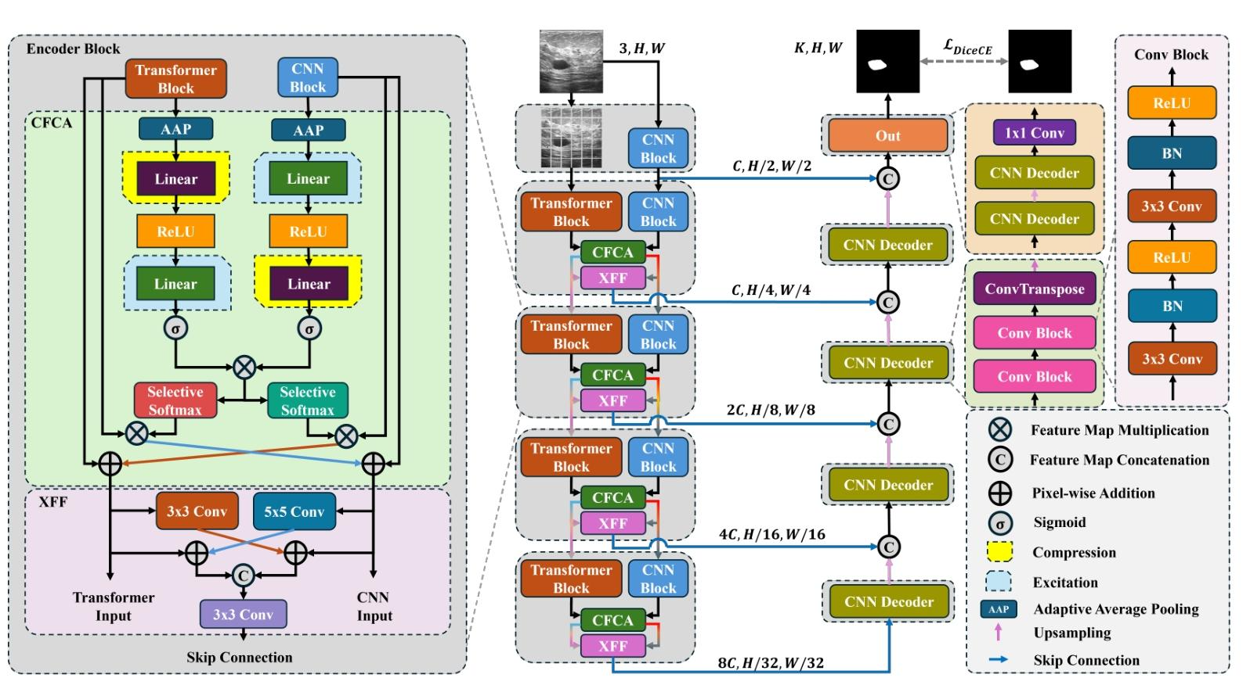

Slide 6
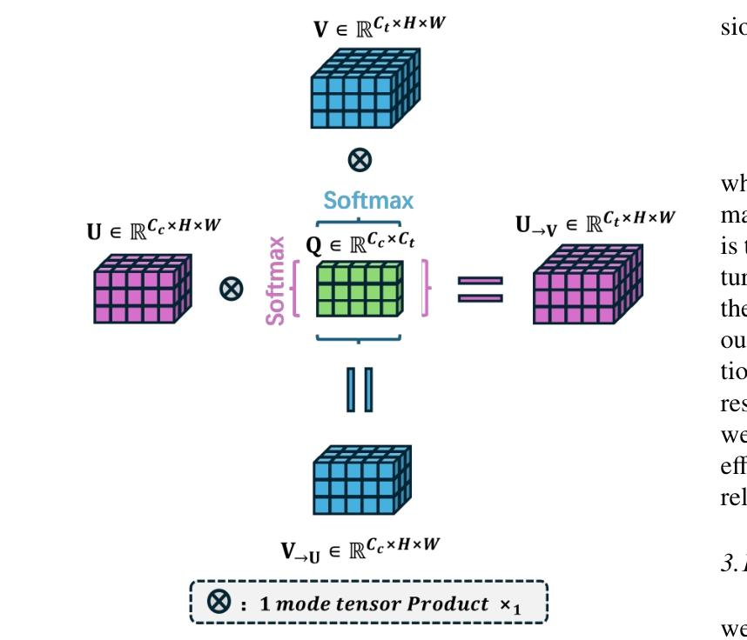

Slide 7
Method Introduction: CFFormer
CFFormer is a U-shaped CNN-Transformer hybrid encoder model.
2.3 Core Module ②: XFF - Spatial Feature Fusion Module
Function:
Merge local-global features of CNN/Transformer in the spatial dimension
Reduce spatial semantic differences using 3×3 and 5×5 convolutions
Output skip connections for the decoder

Slide 8
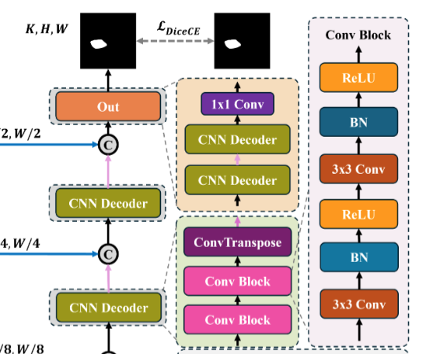

Slide 9
Method Introduction: CFFormer
CFFormer is a U-shaped CNN-Transformer hybrid encoder model.
Decoder
Similar to U-Net
Upsampling + concatenation with XFF output
Output segmentation mask

Slide 10
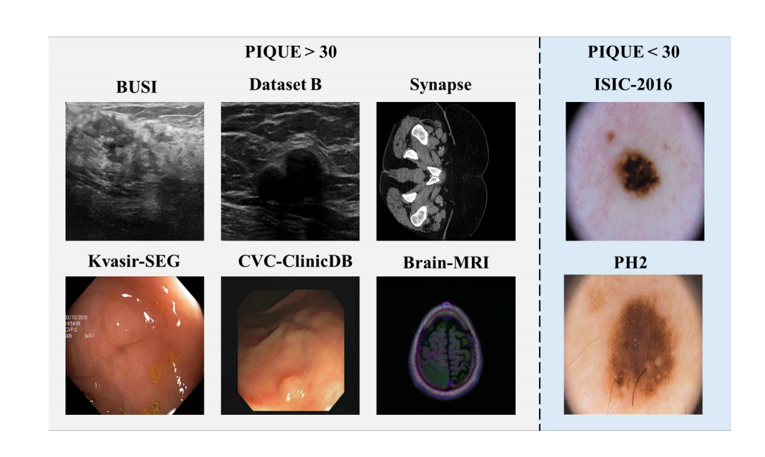
Dataset Introduction

Slide 11
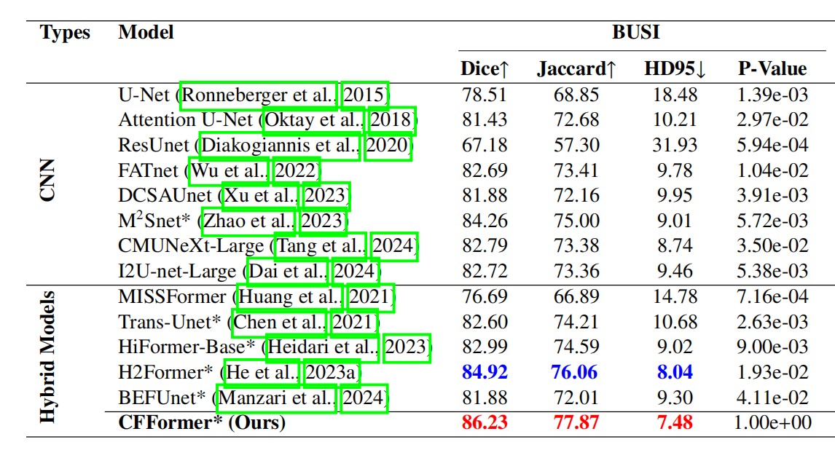
Experimental Result（BUSI）

Slide 12
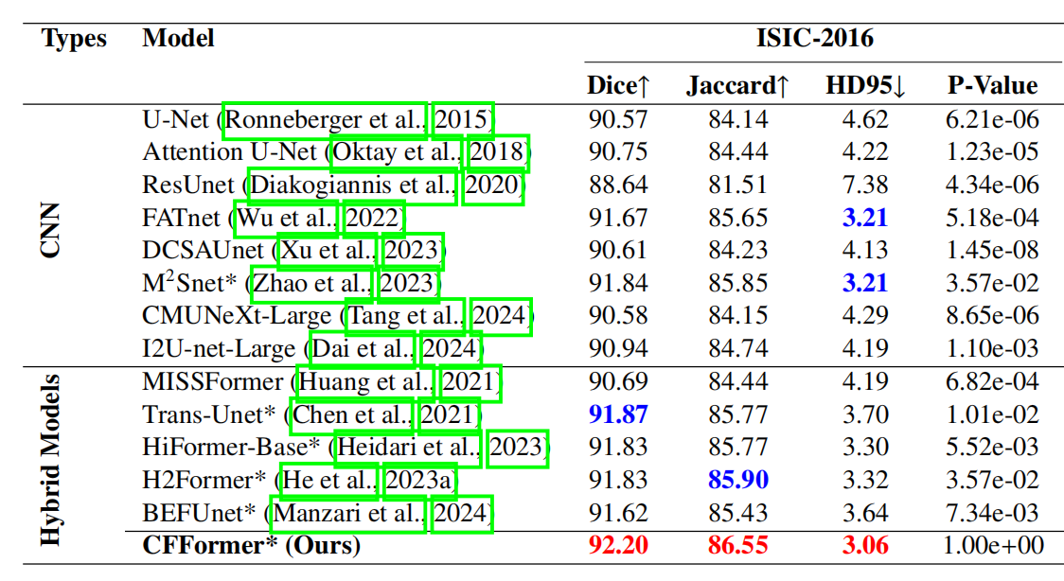
Experimental Result（ISIC）

Slide 13
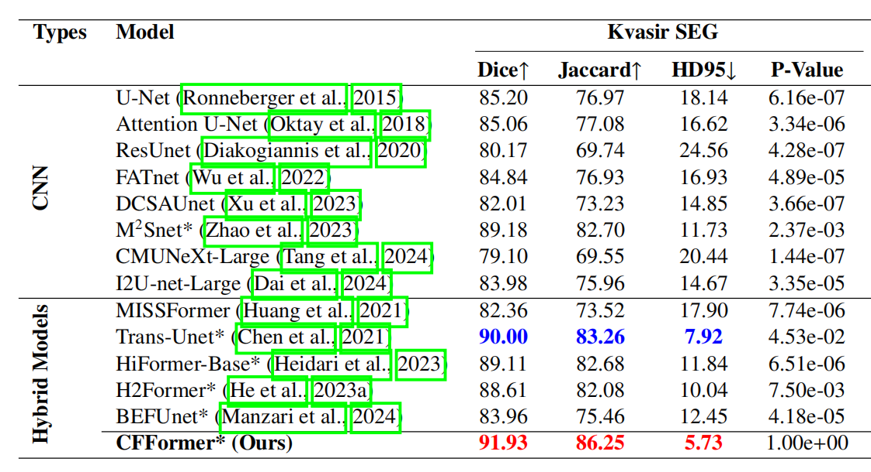
Experimental Result（Kvasir-SEG）

Slide 14
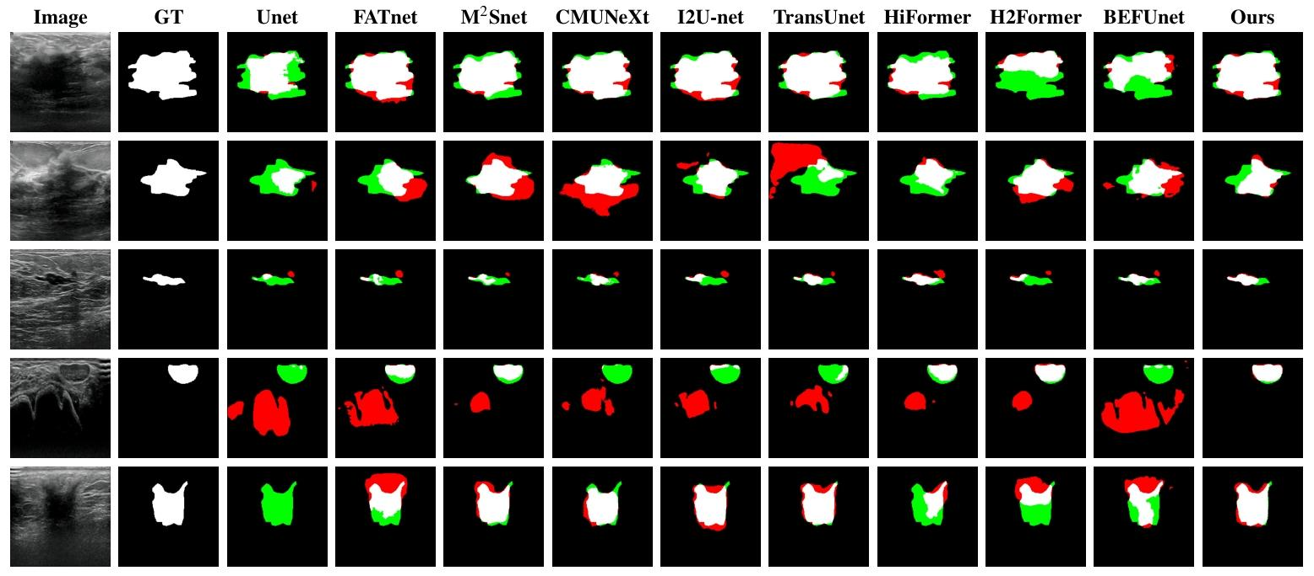
Visualized results

Slide 15
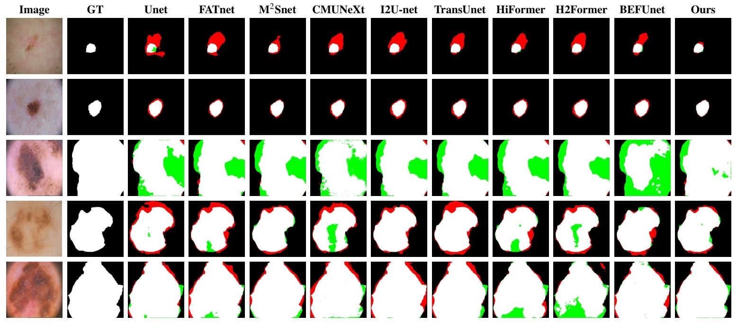
Visualized results

Slide 16
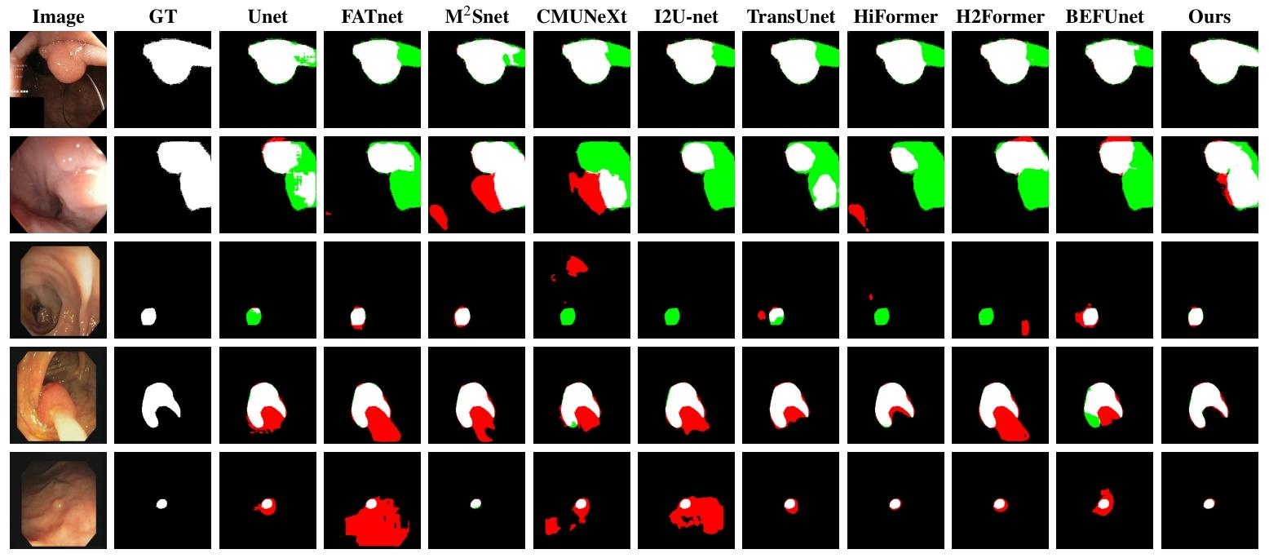
Visualized results

Slide 17
Summary
Summary of Contributions to the Paper
1. Proposed CFCA: Addressing the channel differences between CNN and Transformer
2. Proposed XFF: Integrating spatial local-global features
3. Multi-modal experiments cover US/CT/MRI/endoscopy/dermoscopy
4. Completely outperformed SOTA on 8 datasets
Model advantages: Strong robustness, excellent cross-modal generalization, outstanding performance on low-quality medical images
Potential limitations: The structure is relatively complex, the reasoning speed is lower than that of pure CNN, and the Transformer has high requirements for memory.

Slide 18
Thank you for listening.

