Slide 1
Copy File Tool
Presenter: Hao-Tse Cheng 鄭皓澤
2020/05/05

Slide 2
Outline
Layout
Implementation
Improvement Method
Result

Slide 3
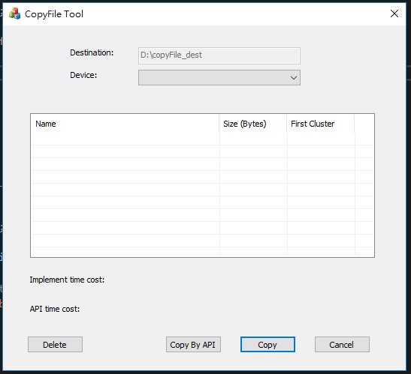
Layout

Slide 4
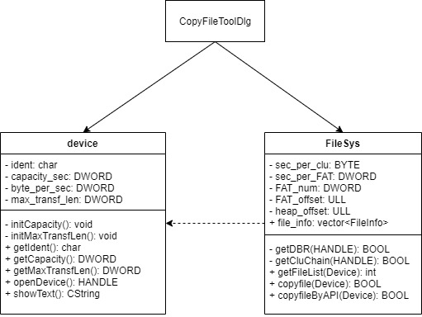
Implementation
Show device list
Select device
Show file list
Select file
Copy
Copy by API
Delete

Slide 5
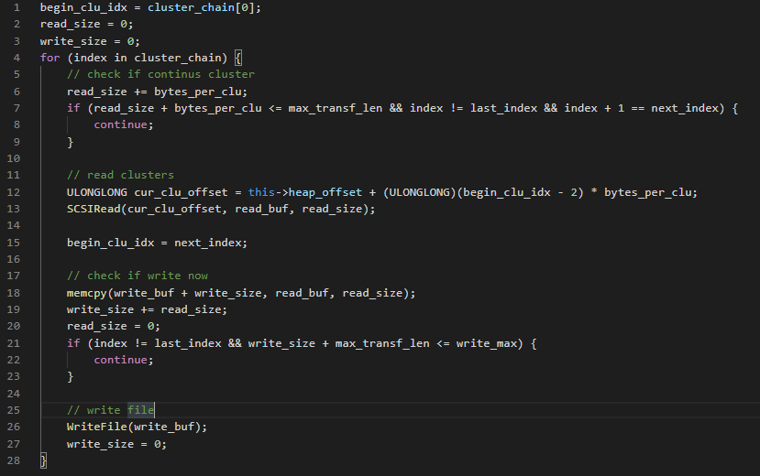
Implementation
Pseudo code
open destination file
get cluster chain
read file content
write file

Slide 6
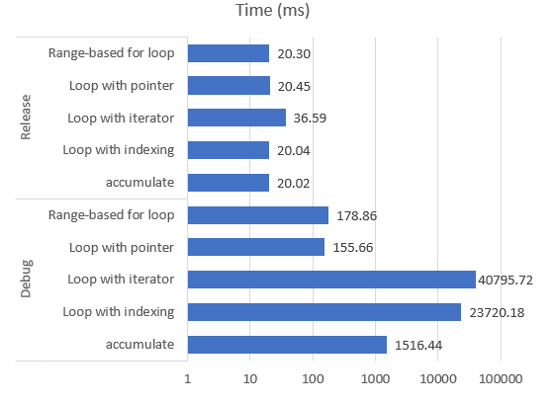
Improvement Method
Buffer length of SCSI Read command
Buffer length of Windows WriteFile API
Dynamic buffer based on std::vector
Dynamic size
Iteration
Notes:
Efficient way of using std::vector(https://www.asawicki.info/news_1691_efficient_way_of_using_stdvector)
Fast iteration over STL vector elements(http://fastcpp.blogspot.com/2011/03/fast-iteration-over-stl-vector-elements.html)

Slide 7
Result
Cluster size = 512 Bytes
 | Implementation | Windows API
1,036 KB PPT | 96.259 ms | 36.222 ms
1,177 KB TXT | 94.831 ms | 27.558 ms
512 MB ZIP | 3179.572 ms | 2878.877 ms
1GB ZIP | 6938.68 ms | 6645.571 ms
從 bus hound 發現 Windows API 沒有讀 FAT，估計事先存起來了
Implementation 中讀 FAT 的時間約 110 ms
Notes:
不管檔案大小去讀 FAT 都是以最大單位去讀，所以檔案越大，時間差距越少

Slide 8
Result
Cluster size = 64 KB
 | Implementation | Windows API
1,036 KB PPT | 80.173 ms | 24.066 ms
1,177 KB TXT | 62.408 ms | 21.067 ms
512 MB ZIP | 3180.528 ms | 3201.957 ms
1GB ZIP | 6530.953 ms | 6462.36 ms
Notes:
在 improvement 之前跟之後，在 64 KB 時候複製 1G 檔案速度差距不大，計算出來 SCSI read command 數量差了一倍，但這支隨身碟較快，所以沒什麼差距
有時 64KB 情況下速度會比 512Bytes 還要慢，推測跟這隻 usb 的特性有關 (且 512Bytes 時每次複製的速度變化好像比較大)

Slide 9
Thank You

