Slide 1
Format Tool
Presenter: Hao-Tse Cheng 鄭皓澤
2020/04/28

Slide 2
Outline
Review
Layout
Implementation
Discuss
Bus Hound
Demo

Slide 3
Review
可以有多少 FAT (0, 1, 3, 4…..)
SFN 的編碼? 如果檔名很短還需要 LFN 嗎?
DBR 需要 jump boot 嗎?
改掉 FAT 其中一個的值會怎樣

Slide 4
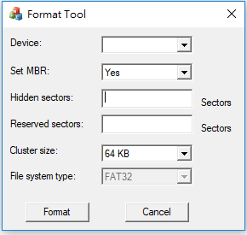
Layout

Slide 5
Layout
Error proof
empty value
setup MBR and hidden sector number
maximum of reserved sector number (65535, 2Bytes)
maximum of hidden and reserved sectors

Slide 6
Implementation
API
CreateFileA
DeviceIoControl
SCSI_PASS_THROUGH_DIRECT & IOCTL_SCSI_PASS_THROUGH_DIRECT

Slide 7
Implementation
Open a volume
HANDLE CreateFileA();
Lock the volume
FSCTL_LOCK_VOLUME
Format a volume
Dismount the volume
FSCTL_DISMOUNT_VOLUME
Unlock the volume
FSCTL_UNLOCK_VOLUME
Close the volume handle
CloseHandle

Slide 8
Implementation
Open a volume
Lock the volume
Format MBR
Format FAT
Format a volume
Format DBR, FSINFO, and backup (reserved)
Format 2nd cluster (ROOT)
Dismount the volume
Unlock the volume
SCSIReadCapacity
Close the volume handle
IOCTL_SCSI_GET_CAPABILITIES

Slide 9
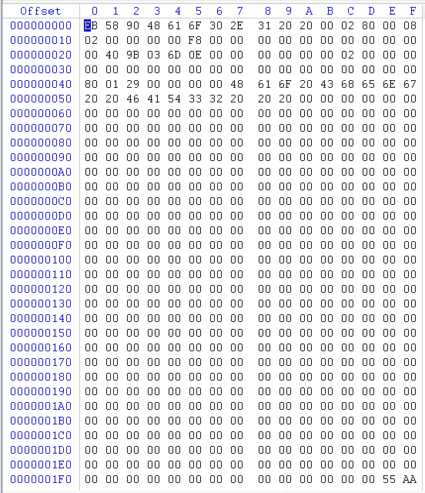

Discuss
DBR 0x41
Error FAT Entry
FAT entry

Slide 10
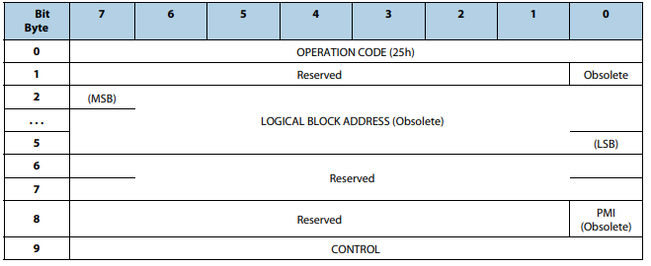
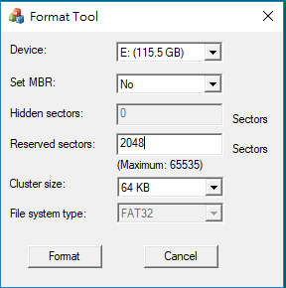
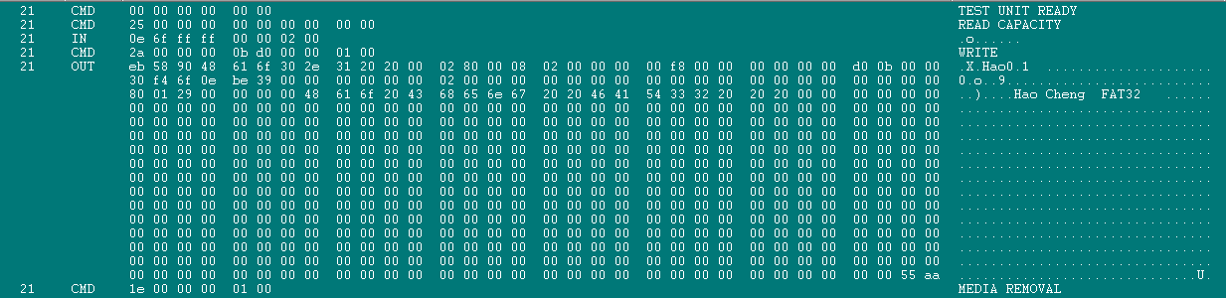
Bus Hound
READ CAPACITY (10)

Slide 11
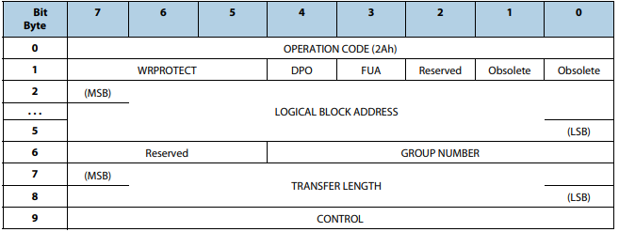
Bus Hound
WRITE (10)
CMD (2a 00 00 00 0b d0 00 00 01 00)
2a: Op code
00000bd0(3024): Logical block address
0001(1 block): Transfer length
OUT
write content (DBR)

Slide 12
Bus Hound
Hidden sector number 為 0，理論上 DBR 應該由 address 為 0 的地方開始寫入
Command 的內容卻是從 address 為 3024 的地方開始寫入
3024 為上一次格式化設定的 hidden sector number
Windows 會先照上一次格式化的設定寫入資料，之後才在此次設定的正確位置寫入，推斷應該是為了備份使用
2a 00 00 00 0b d0 00 00 01 00
2a: Op code
00000bd0(3024): Logical block address
0001(1 block): Transfer length

Slide 13
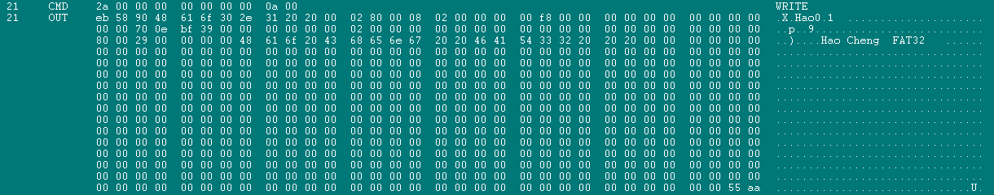
Bus Hound
CMD (2a 00 00 00 00 00 00 00 0a 00)
2a: Op code
00000000(0): Logical block address
000a(10 block): Transfer length
OUT
write content (DBR)
此處才是照 format tool 的設定正確將 DBR 寫入 address 為 0 的地方
一次寫入 10 個 block 是照 format tool 的設定，將 FSINFO 和 backup 一同清除

Slide 14
Demo

Slide 15
Thank You

