Slide 1
Format Tool Discuss
Presenter: Hao-Tse Cheng 鄭皓澤
2020/04/28

Slide 2
Outline
Windows recover some regions, including DBR, after formatting.
Error volume size when cluster size is 512 Bytes.

Slide 3
Windows recover some regions, including DBR, after formatting.

Slide 4
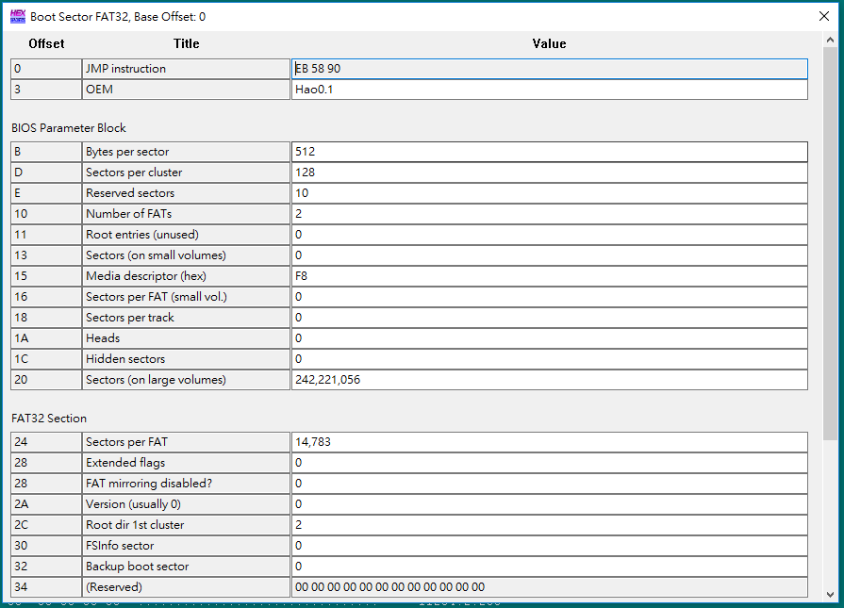
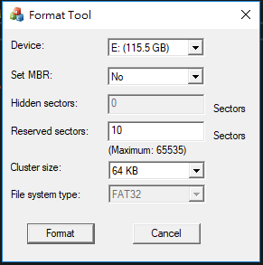
Last Setup

Slide 5
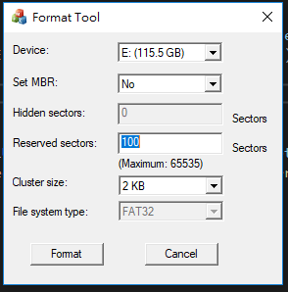
New Setup

Slide 6
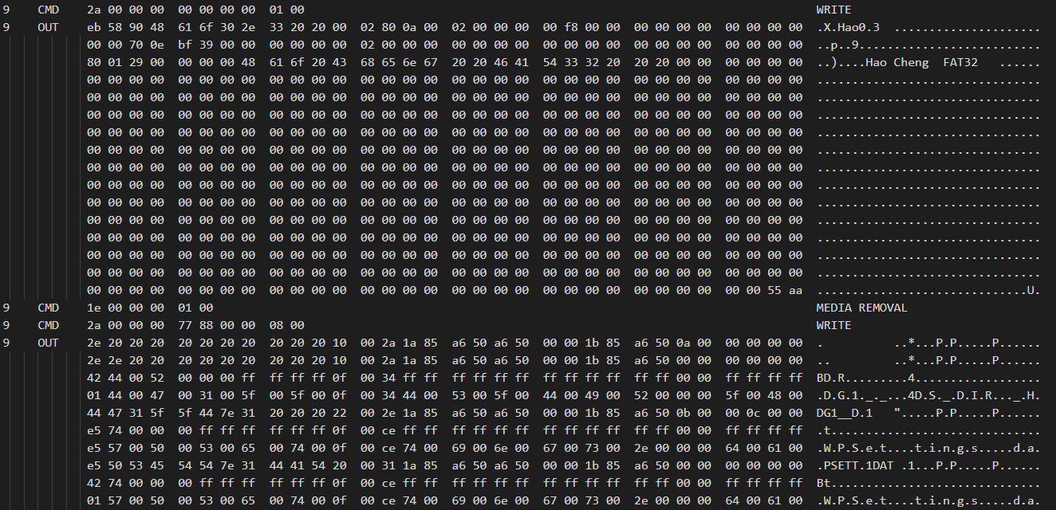
Debugger Mode

Slide 7
Debugger Mode
FSCTL_LOCK_VOLUME IOCTL
The system flushes all cached data to the volume before locking it. For example, any data held in a lazy-write cache is written to the volume.

Slide 8
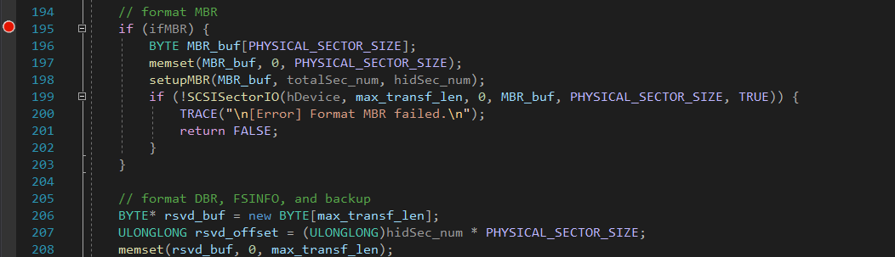
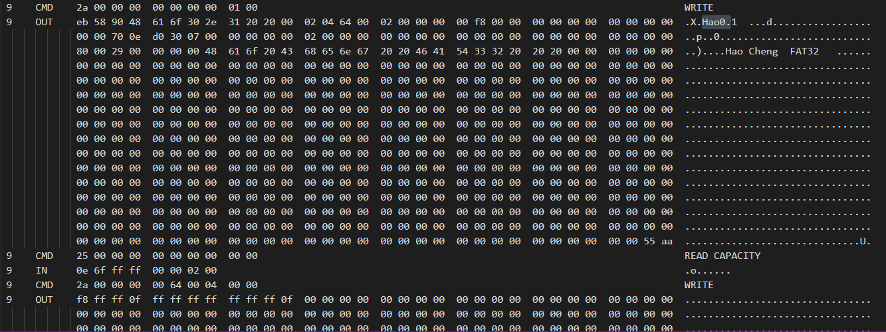
Debugger Mode

Slide 9
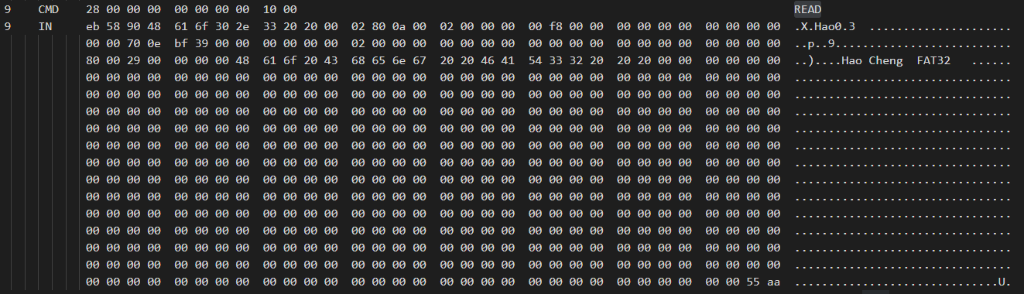
Debugger Mode
Notes:
有時 dismount 是沒有動作的? 待確認

Slide 10
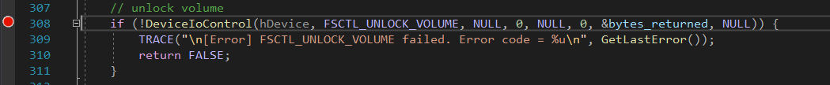
Debugger Mode

Slide 11
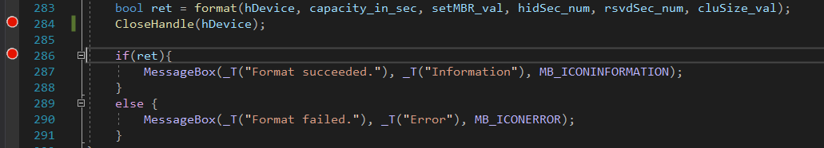
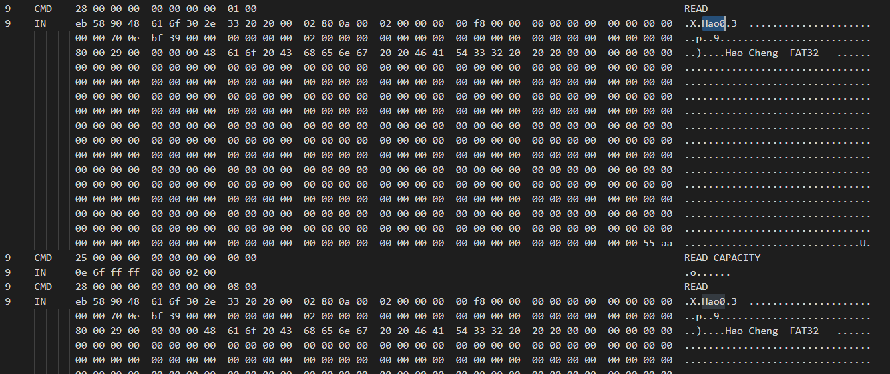
Debugger Mode

Slide 12
Discuss
會在 CloseHandle 時以舊的 DBR 覆蓋新的 DBR
目前發現只在 Cluster size 小於 8KB 時發生
重新開機清掉 cache 後可以正常 format，但 format 一次之後問題仍存在
無法知道 Windows 在 LOCK、DISMOUNT、UNLOCK、CLOSEHANDLE 時的行為
初判為 dismount 讀出的內容影響，將 dismount 往前移解決此問題

Slide 13
Discuss
Open a volume
To change a volume file system
https://docs.microsoft.com/en-us/windows/win32/api/winioctl/ni-winioctl-fsctl_dismount_volume
USB drive WriteFile to sectors outside volume
https://stackoverflow.com/questions/39891322/usb-drive-writefile-to-sectors-outside-volume
https://docs.microsoft.com/zh-tw/windows/win32/api/fileapi/nf-fileapi-writefileex?redirectedfrom=MSDN#remarks
Open a volume
Lock the volume
Lock the volume
Format a volume
Dismount the volume
Dismount the volume
Format a volume
Unlock the volume
Unlock the volume
Close the volume handle
Close the volume handle

Slide 14
Error volume size when cluster size is 512 Bytes.

Slide 15
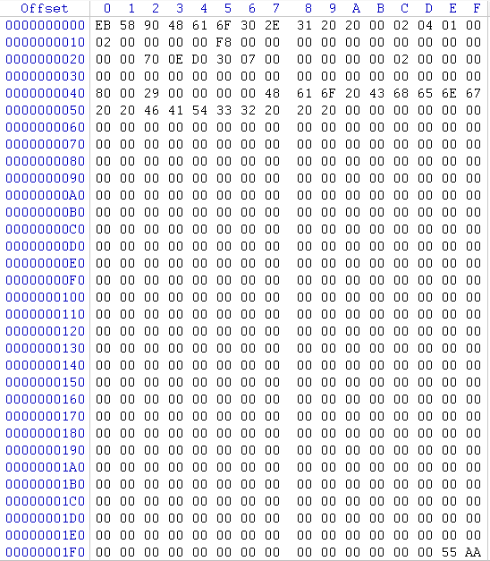
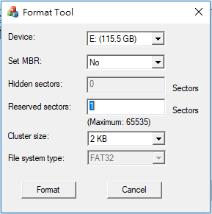

DBR
0xD: Sectors Per Cluster
Setup
Volume information

Slide 16
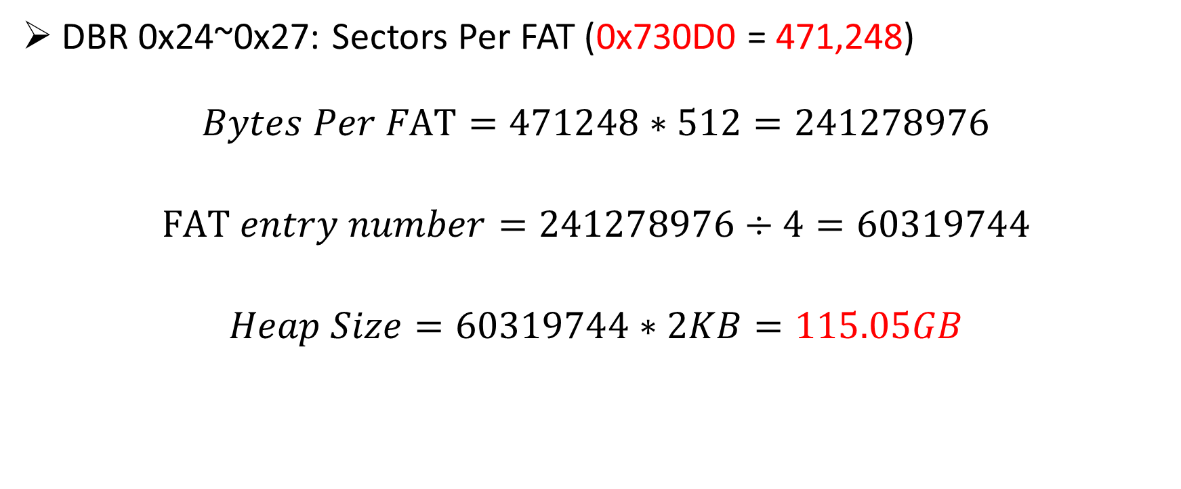
Volume Size
DBR 0x24~0x27: Sectors Per FAT (0x730D0 = 471,248)
$$Bytes Per FAT=471248∗512=241278976$$
$$FAT entry number=241278976÷4=60319744$$
$$Heap Size=60319744∗2KB=115.05GB$$

Slide 17
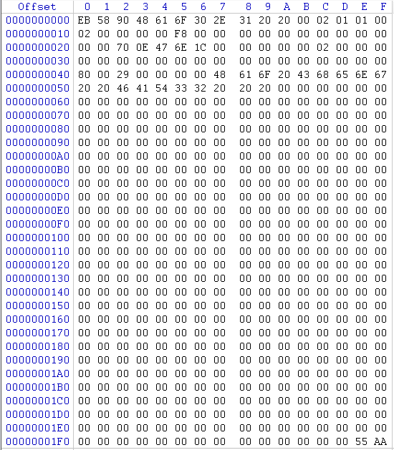
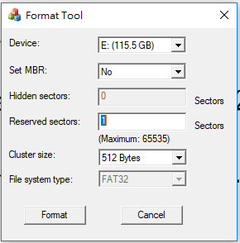

512 Bytes
DBR
0xD: Sectors Per Cluster
Setup
Volume information

Slide 18
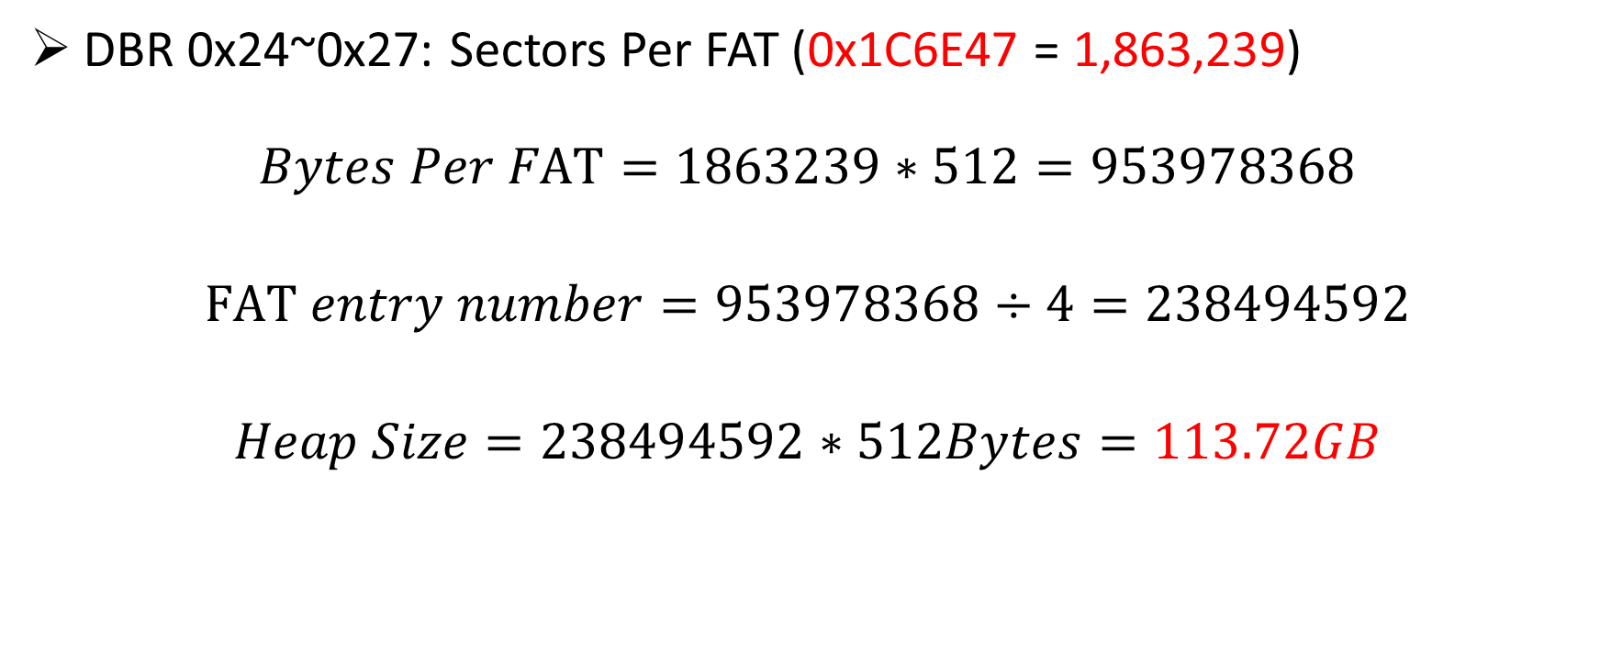
Volume Size
DBR 0x24~0x27: Sectors Per FAT (0x1C6E47 = 1,863,239)
$$Bytes Per FAT=1863239∗512=953978368$$
$$FAT entry number=953978368÷4=238494592$$
$$Heap Size=238494592∗512Bytes=113.72GB$$

Slide 19
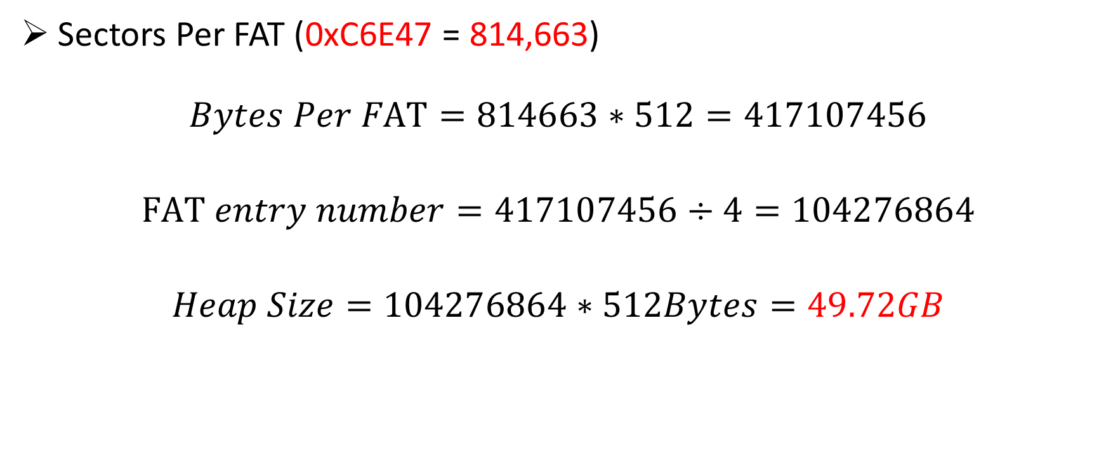
Error Volume Size
Sectors Per FAT (0xC6E47 = 814,663)
$$Bytes Per FAT=814663∗512=417107456$$
$$FAT entry number=417107456÷4=104276864$$
$$Heap Size=104276864∗512Bytes=49.72GB$$
Volume information
Conclusion: Windows Bug

Slide 20
Thank You

