Slide 1
StorTest Tool
Presenter: Hao-Tse Cheng 鄭皓澤
2020/06/02

Slide 2
Outline
Implement
Log Example
Result

Slide 3
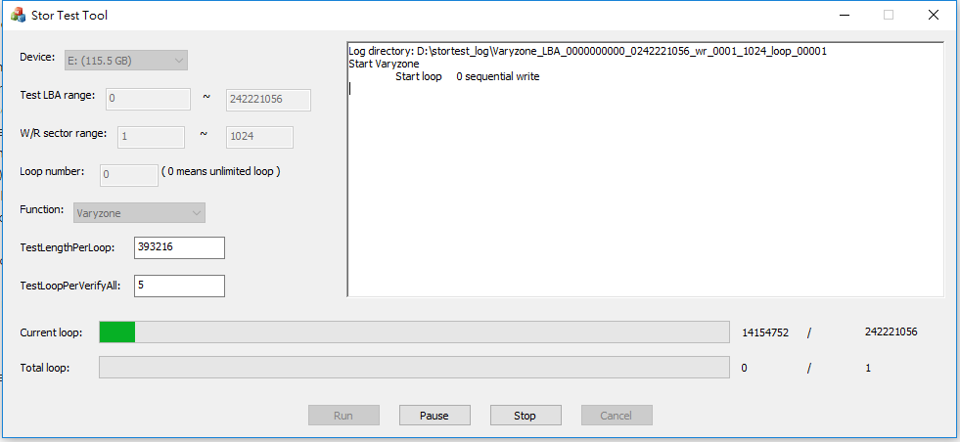
Implement - Layout

Slide 4
Implement
Main Thread
Progress Updating Thread
StorTest Thread
Dialog create
Run button click
AfxBeginThread
Run button click
Run stortest function
async
Update progress bar
Update current LBA & current loop
get value
Not finish
Check loop
Strotest finish
Show message box
get status

Slide 5
Implement
Progress Updating Thread Tasks
Update progress bar (Check if pause, terminate, or error pattern abort)
Write log message
StorTest Thread Tasks
Run test function
If error pattern occurring, abort function.
Update current LBA and current loop buffer
Set pause or terminate flag
Update log message buffer

Slide 6
Implement
Onewrite pseudo code
initial ran_gen (use mt19937 and uniform_distribution);
cur_LBA = start_LBA;
while(cur_LBA < end_LBA){
wr_sec_num = ran_gen();
wr_sec_num = (wr_sec_num < (end_LBA - cur_LBA)) ? wr_sec_num : (end_LBA - cur_LBA);
BYTE wr_data[wr_sec_num];
get_LBA_pattern(wr_data, cur_LBA, loop_num = 0);
SCSI_write(wr_data, cur_LBA, wr_sec_num);
cur_LBA += wr_sec_num;
}

Slide 7
Implement
Sequential a+c
Sequential a
Sequential b+c
Sequential b
Sequential c
Reverse a+c
Verify
Verify c
Reverse a
Reverse b+c
Reverse b
Reverse c
Testmode

Slide 8
Implement
cur_LBA = start_LBA;
while(cur_LBA < end_LBA){
wr_sec_num = ran_wr_sec_gen();
wr_sec_num = (wr_sec_num < (end_LBA - cur_LBA)) ? wr_sec_num : (end_LBA - cur_LBA);
// write
BYTE wr_data[wr_sec_num], expect_data[wr_sec_num];
get_LBA_pattern(wr_data, cur_LBA, cur_loop);
SCSI_write(wr_data, cur_LBA, wr_sec_num);
// read
SCSI_read(wr_data, cur_LBA, wr_sec_num);
// diff
get_LBA_pattern(expect_data, cur_LBA, cur_loop);
compare(wr_data, expect_data);
cur_LBA += wr_sec_num;
}
Sequential_a pseudo code

Slide 9
Implement
cur_LBA = end_LBA;
while(cur_LBA > start_LBA){
wr_sec_num = ran_wr_sec_gen();
wr_sec_num = (wr_sec_num < (cur_LBA - start_LBA)) ? wr_sec_num : (cur_LBA - start_LBA);
begin_LBA = cur_LBA - wr_sec_num;
// write
BYTE wr_data[wr_sec_num], expect_data[wr_sec_num];
get_LBA_pattern(wr_data, begin_LBA, cur_loop);
SCSI_write(wr_data, begin_LBA, wr_sec_num);
// read
SCSI_read(wr_data, begin_LBA, wr_sec_num);
// diff
get_LBA_pattern(expect_data, begin_LBA, cur_loop);
compare(wr_data, expect_data);
cur_LBA -= wr_sec_num;
}
Reverse_a pseudo code

Slide 10
Implement
Sequential_b = Sequential_a w/o read and diff
Sequential_c = Sequential_a w/o write
Reverse_b = Reverse_a w/o read and diff
Reverse_c = Reverse_a w/o write
Verify_c v.s Sequential_c
Verify_c read BYTE[16] and BYTE[17] as cur_loop when comparing.

Slide 11
Implement
varyzone pseudo code
WORD LBA_loop_map[end_LBA - start_LBA];
sequential_b();
sequential_c();
for(cur_loop = 1; cur_loop < loop_num; cur_loop++){
cur_LBA = 0;
vector<DWORD> write_LBA_record, write_len_record;
while(cur_LBA < test_len_pro_loop){
begin_LBA = ran_begin_LBA_gen(), wr_sec_num = ran_wr_sec_gen();
wr_sec_num = (wr_sec_num < (end_LBA - cur_LBA)) ? wr_sec_num : (end_LBA - cur_LBA);
write();
write_LBA_record.psuh_back(begin_LBA), write_len_record.push_back(wr_sec_num);
read_and_compare();
cur_LBA += wr_sec_num;
}
….

Slide 12
Implement
varyzone pseudo code
…. // reach TestLengthPerLoop
foreach(write_LBA_record, write_len_record){
read_and_compare();
}
// reach TestLoopPerVerifyAll
if(cur_loop % test_loop_per_verify_all == 0){
verify_all();
}
}

Slide 13
Log Example
Setup
Item | Value
LBA range | 0 ~ 1000
W/R sectors range | 1 ~ 1024
Loop number | 10

Slide 14
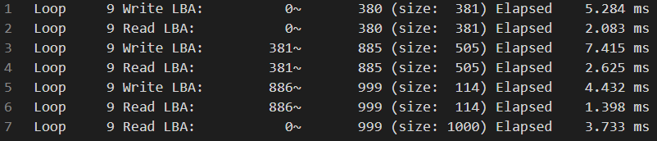
Log Example
Sequential a+c

Slide 15
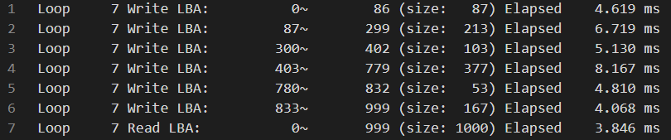
Log Example
Sequential b+c

Slide 16
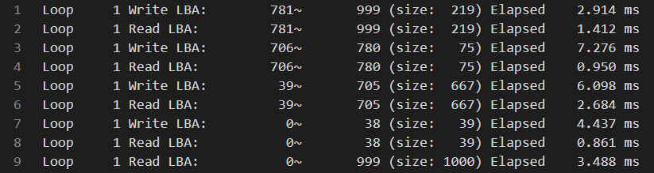
Log Example
Reverse a+c

Slide 17
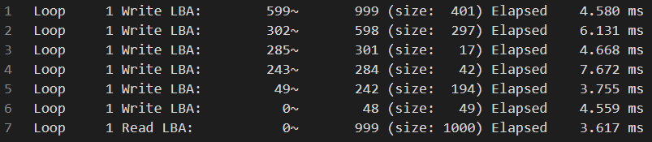
Log Example
Reverse b+c

Slide 18
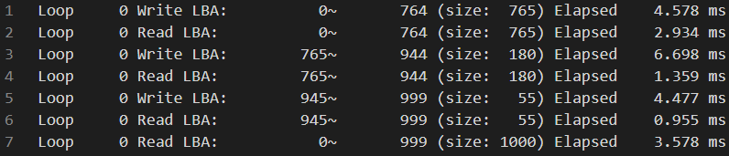
Log Example
Testmode - Sequential a+c

Slide 19
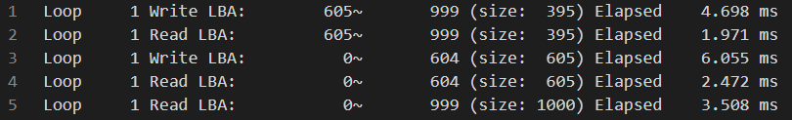
Log Example
Testmode - Reverse a+c

Slide 20
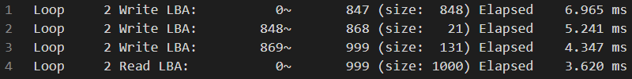
Log Example
Testmode - Sequential b+c

Slide 21

Log Example
Onewrite

Slide 22
Log Example
Verify

Slide 23
Log Example
Varyzone
TestLengthPerLoop = 3000
TestLoopPerVerifyAll = 2
Varyzone - Sequention b+c

Slide 24
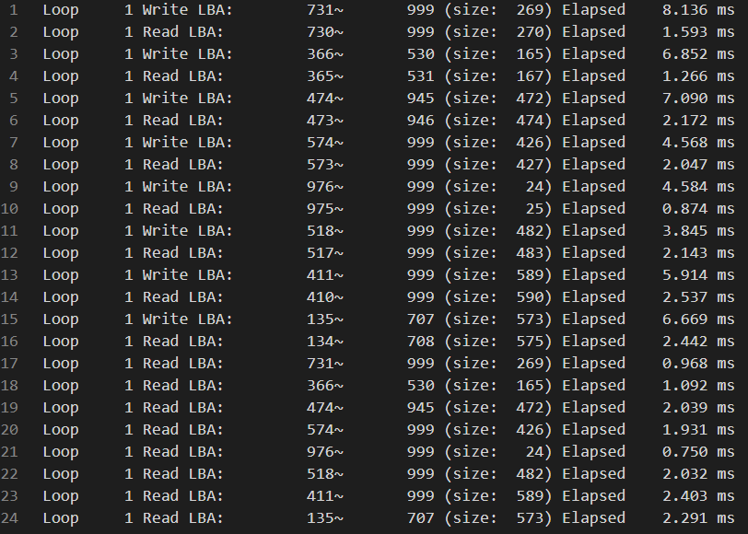
Log Example
Varyzone

Slide 25
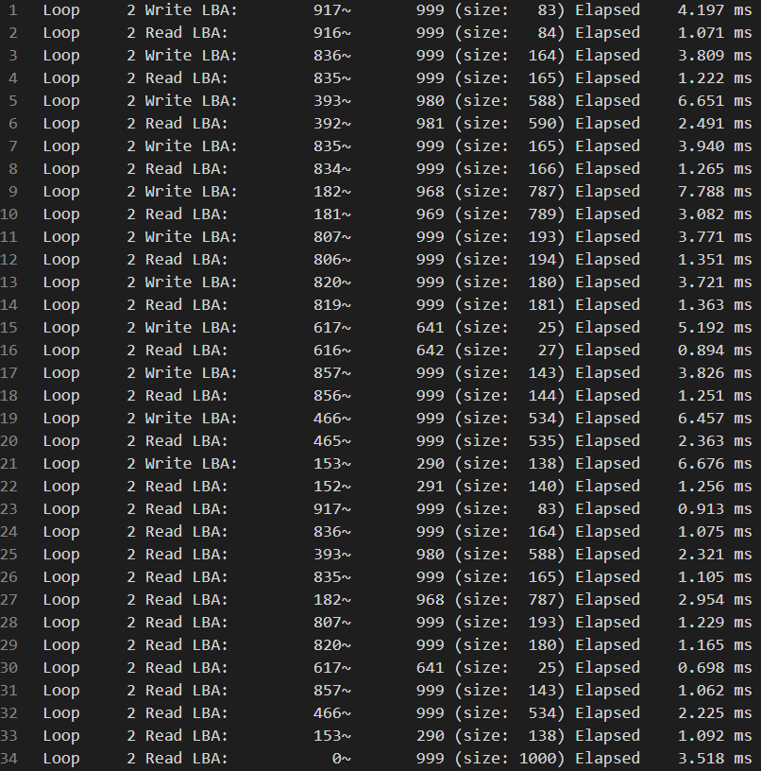
Log Example
Varyzone - VerifyAll

Slide 26
Log Example
Error log

Slide 27
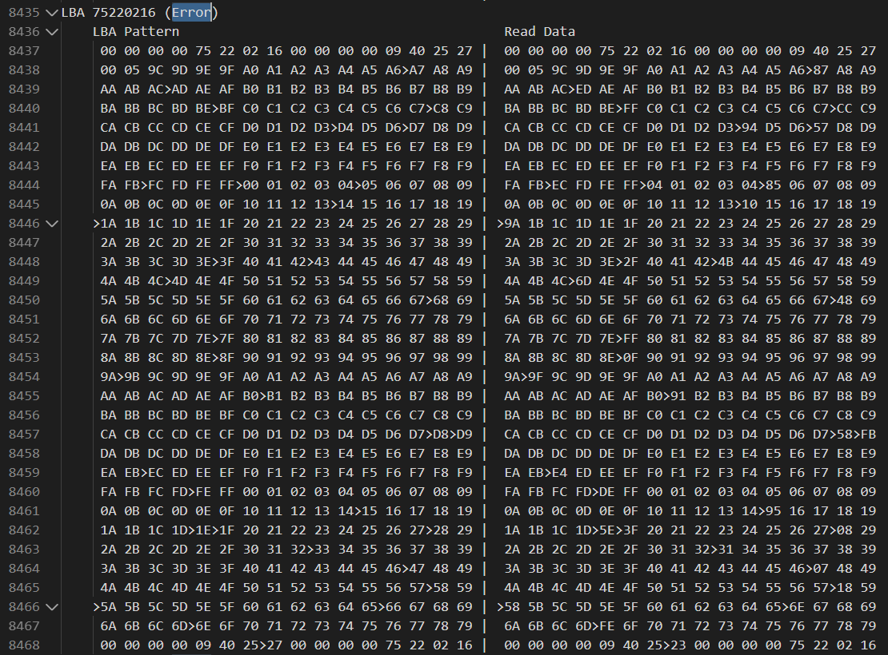
Log Example
Error log

Slide 28
Result
115.5G USB
Testmode (LBA: 0~242221056, W/R sector: 1~1024, Loop unlimited) 跑整個周末，完成 20個 loop，沒有出現 error pattern
Varyzone (LBA: 0~242221056, W/R sector: 1~1024, Loop unlimited, TestLengthPerLoop: Block size(96MB) * 2 = 393216 LBA, TestLoopPerVerifyAll: 5) 跑一個晚上，在第15個 loop 的 verify all 出現 error pattern

Slide 29
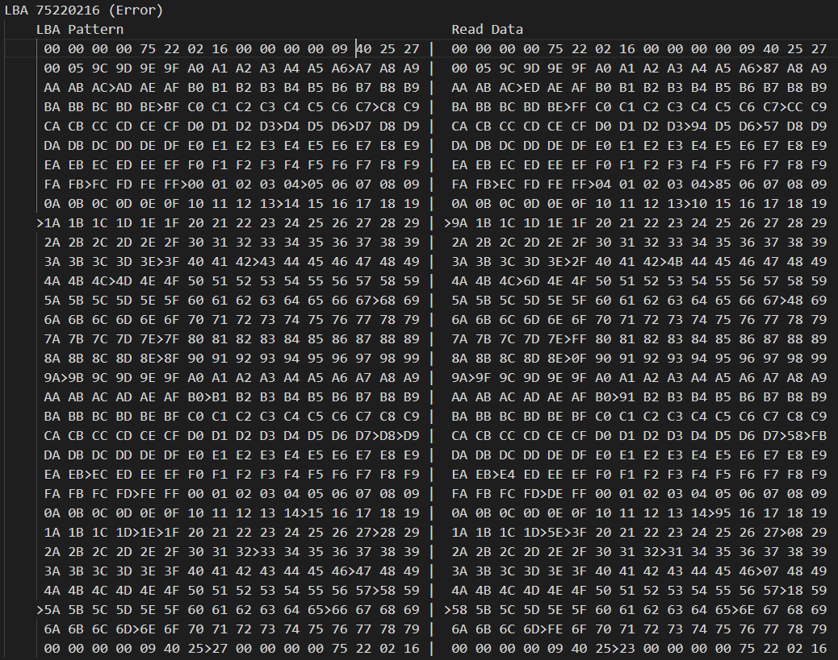
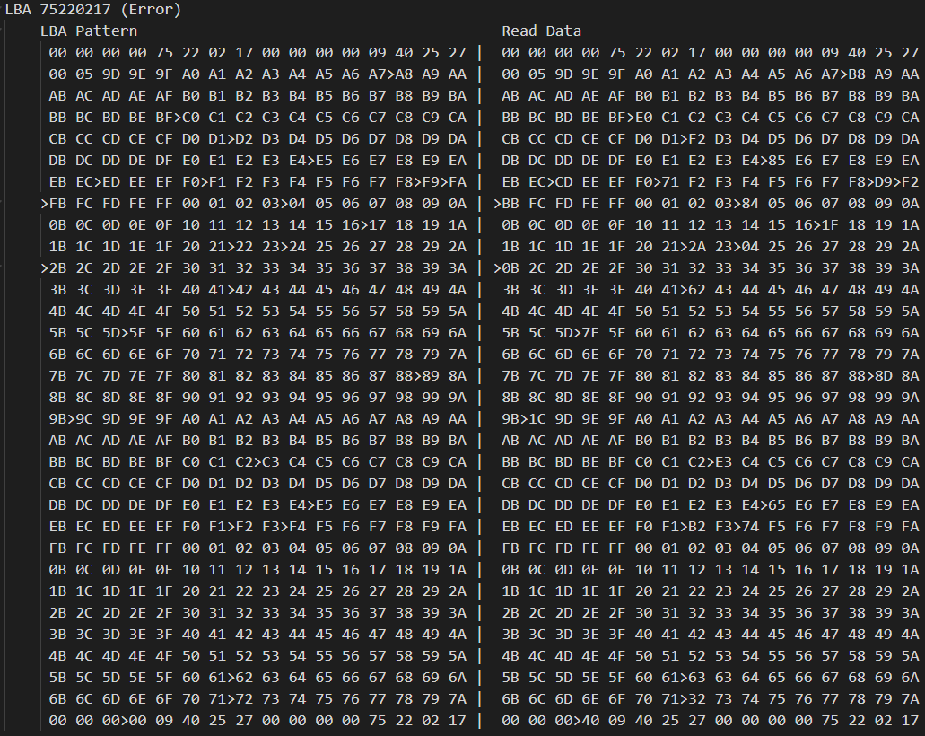
Result
Varyzone verifyall Loop: 15, LBA: 75219968, Size: 1024
Error LBA count: 2, Error Byte count: 59, Error bits count: 62

Slide 30
Result
Error 出現在連續兩個 LBA，同一條 command 前面跟後面的 LBA 都正常
大多一個 Byte 錯 1 Bit
錯的區域沒有固定，有兩個 byte 在 Byte[496] ~ Byte[503] LCA number，其餘都在 Byte[19] ~ Byte[495]
ECC 一次處理 1KB (2個 LBA)，因此有錯的話一次都出現連續2個 LBA
一般 ECC 處理上限為 64bits ，但這邊可能只開了 60bits，因此錯了 62bits 無法救回

Slide 31
Result
又重新跑了一次 varyzone，結果第25個 loop 的 verify all 在第 43620257 個 LBA 後都讀到 CD，且該筆 read 非常慢
重新 verify 同一個區塊，LBA 43620256 出現連續2個 LBA 共有 76個 error bits，與前述情況相同
尚未解出為何會讀到 CD，LBA 43620256 也不是 block 的起始位置，反而是 block 的最後一個 page

Slide 32
Result
7.2G USB
Testmode (LBA: 0~15130624, W/R sector: 1~1024, Loop unlimited) 跑一個晚上，在第1個 loop 的 Reverse read 出現 error pattern
Varyzone (LBA: 0~3782655, W/R sector: 1~1024, Loop: 1) 跑一個晚上，在第15個 loop 的 verify all 出現 error pattern
Reverse read Loop: 1, LBA: 7977984, Size: 1024
Error LBA count: 9, Error Byte count: 4325, Error bits count: 8609
Varyzone W/R Loop: 1, LBA: 2717472, Size: 514
Error LBA count: 1, Error Byte count: 480, Error bits count: 954

Slide 33
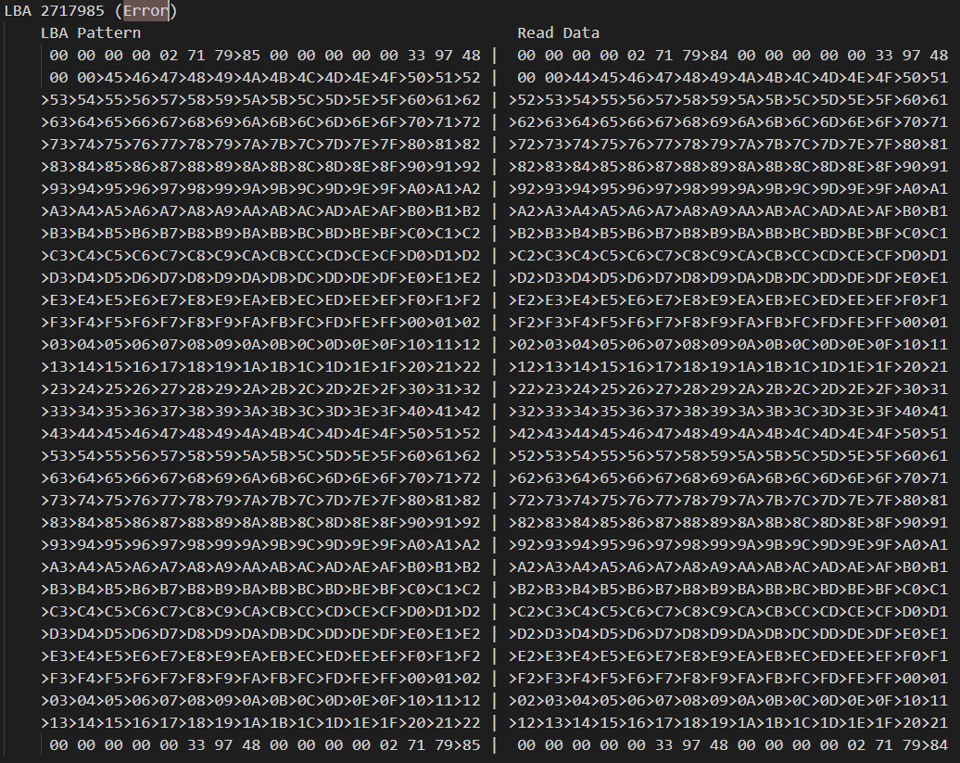
Result

Slide 34
Result
讀到前一個 LBA 被 write 前的內容
Error 的 LBA 都為奇數
Varyzone W/R sector 為 128 的倍數時必定發生
Write 前會先將該 page read 出來 LBA，Firmware 讀出來擺的時候放歪，但前面部分被 write 進新的 data，因此只有後面數個 LBA 會錯
無法得知 Firmware 寫回 block 的規則，會需要 w/r 128 個被數個 sector 的原因應該是 multi-plane 的機制，Firmware 在 ram 累積足夠的 data 後才寫進 block

Slide 35
Result
Write data
Write
Write data
Write data
RAM
Page
RAM
RAM
Page
New
Physical block
Physical block
Physical block
Read 歪掉
Page
Page
Page
New

Slide 36
Thank You

