Slide 1
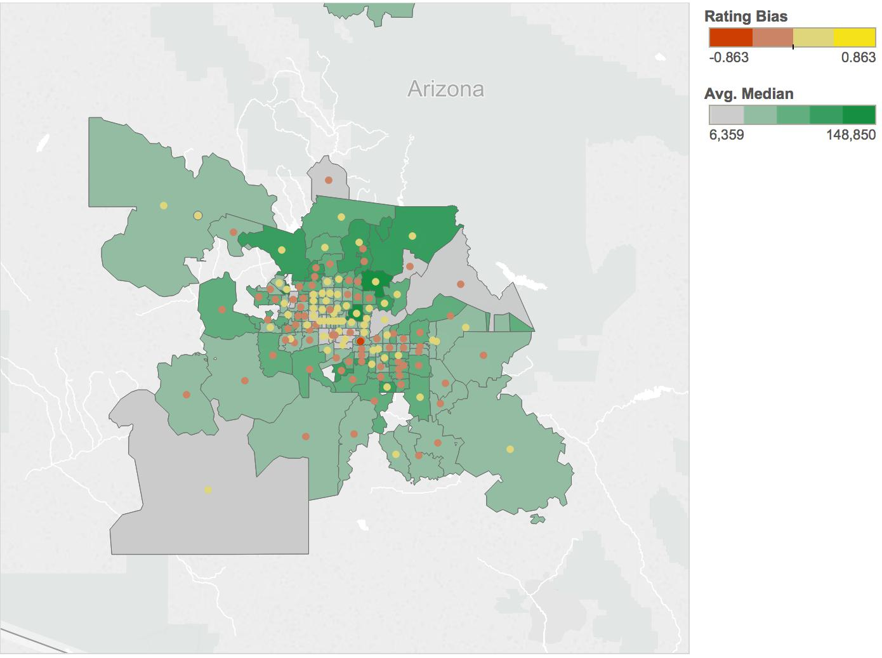
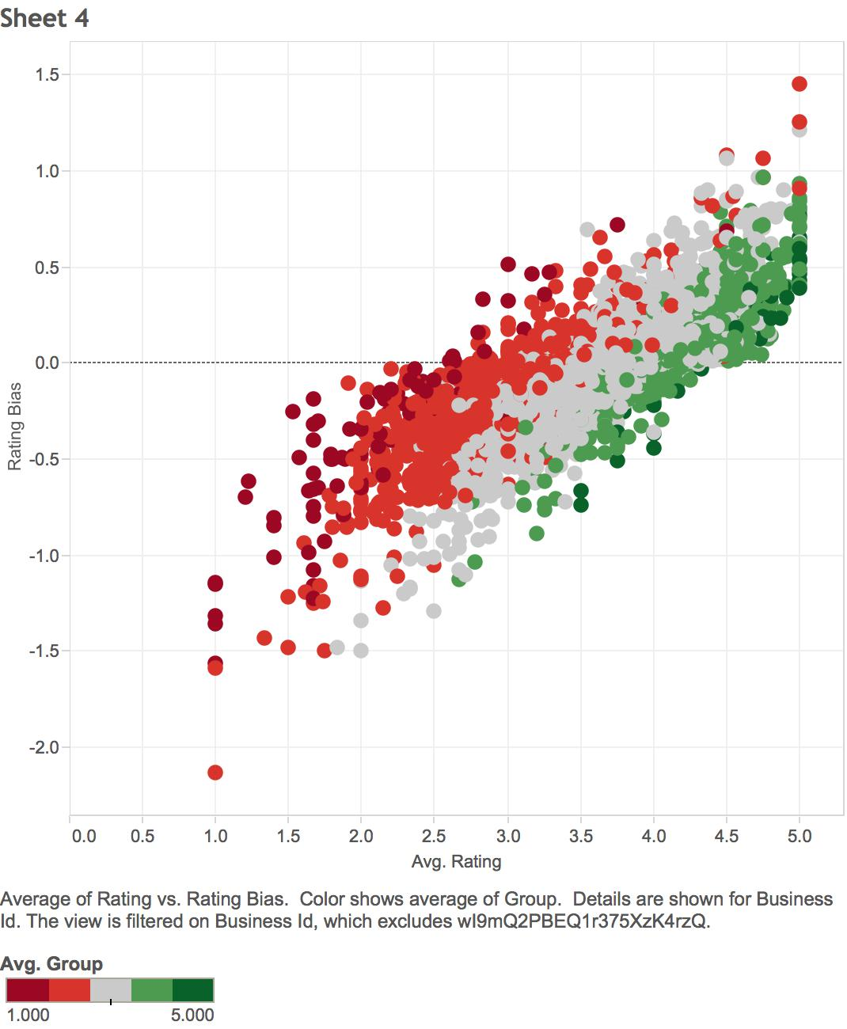
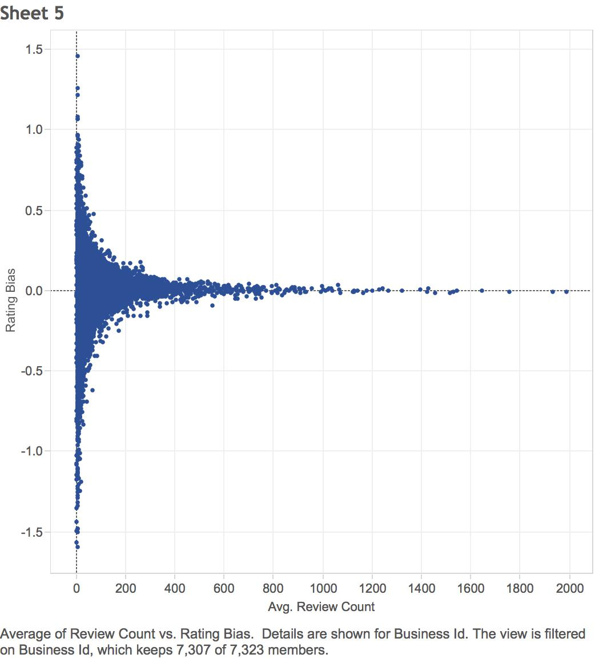
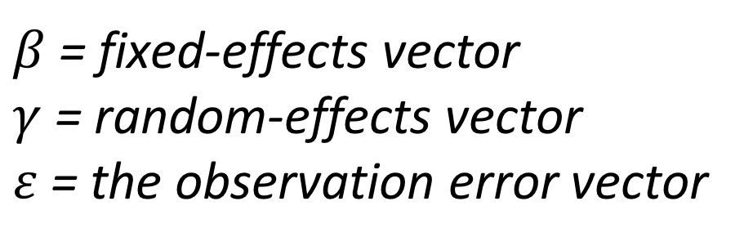
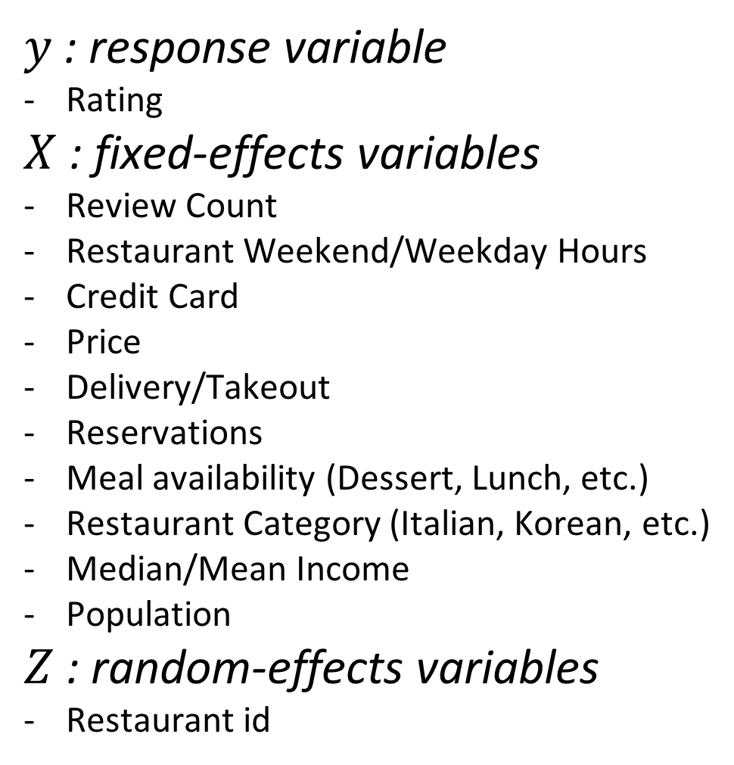
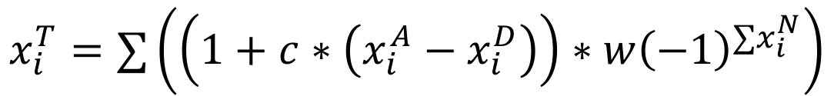

Yelp Customer Review Bias Analysis through Linear Mixed Effect Models with Natural Language Sentiment Polarity Scores
Alice Ni and Lavanya Sunder
Abstract
Mixed Effects Model
Applications to Yelp
Yelp is a primary source of restaurant reviews and information nationwide, with restaurants often depending on positive Yelp reviews for sustained business. However, there is speculation that the star rating in a Yelp review is influenced by bias and factors outside of the actual dining experience of a restaurant. In this paper we attempt to “un-Yelp” the reviews to find the true score (instead of a rating of one to five) of a given review. We attempt to do this by clustering customer reviews of restaurants by sentiment magnitude, as a proxy for clustering restaurants by similar overall quality. This procedure involves calculating the positive and negative sentiment of reviews, by using multiple lexicons and boosting our approach. We then created multiple linear mixed effects models on the clusters in order to isolate the biasing from number of restaurant factors.
General model in Matrix Notation
Given a restaurant, for each review made for that restaurant, first score its sentiment given the three sentiment lexicons, then plug it into the corresponding model to acquire the new unbiased rating for this review. Yelp can then average all of the new ratings for this restaurant and display the difference in the restaurant to the user, showing them the amount of bias that the given Yelp reviews have for that restaurant.
$$y=Xβ+Zγ+ε$$
Variables:
Model methodology:
$y$: response variable
Rating
$X$ : fixed-effects variables
Review Count
Restaurant Weekend/Weekday Hours
Credit Card
Price
Delivery/Takeout
Reservations
Meal availability (Dessert, Lunch, etc.)
Restaurant Category (Italian, Korean, etc.)
Median/Mean Income
Population
$Z$ : random-effects variables
Restaurant id
The model uses both fixed effects and random effects by estimating the effects of the covariates in X on y given the random effects of the category in Z. We therefore try to isolate the random effects due to a particular restaurant from the biasing effects of the covariates. Model selection was completed using step-wise AIC selection.
Median Income and Rating Bias
Approach
Other components:
Datasets utilized:
Yelp restaurants (n = 7323): Filtered based on restaurants in the U.S. that were open and attributes that weren’t sparse
Yelp reviews (n ~= 704,000): Filtered based on restaurants with attributes above
Sentiment Score:
Go to review level
Calculate and cluster into true sentiment level disregarding number of stars
Mixed Effects Model:
Within each cluster, run a mixed effect model with fixed effects being the covariates of interest and the random effects being the specific restaurant
$β$= fixed-effects vector
$γ$= random-effects vector
$ε$= the observation error vector
Assumptions
General assumptions:
Restaurant quality can be isolated through sentiment analysis of review
Fixed-effect variables have biasing effects on star rating
Assumptions of sentiment analysis:
Sentiment can be analyzed through relationship between positive and negative words
Online lexicons are accurate representations of positive and negative words
Assumptions of linear regression:
Independence of the covariates
Heteroscedasticity
Linear relationship between the response variable and the covariates
Assumptions of mixed effects model:
Business ID is the only random effect amongst the variables
Business ID does not have a non-random effect on rating
Sentiment Score
Sentiment scoring process:
Broke down each review into a Term Document matrix
Removed stop-words and stemmed
Removed punctuation and whitespace
Compared to three different lexicons
Created a weighted average of the result
Clustered into five groups based on quantiles
Polarity Formula:
$$C=x_{i}^{2}/\sqrt{n}$$
Figure 3:
The above map shows the data available from the greater metropolitan area of Phoenix. The shading is average median income by zip code, and the points are calculated bias from restaurants in that area. As shown, there appears to be an positive bias (i.e. the new rating is smaller) from larger zip codes, and a negative bias (i.e. the new rating is larger) from more affluent neighborhoods.
$$x_{i}^{T}=∑\left(\left(1+c∗\left(x_{i}^{A}−x_{i}^{D}\right)\right)∗w{\left(−1\right)}^{∑x_{i}^{N}}\right)$$
- Essentially, a context cluster is pulled from around the polarized word in a sentence to be tagged as neutral, a negator, amplifier, or de-amplifier and the word is weighted accordingly.
Conclusion
Bias by Sentiment and Review Count
Our analysis uncovered a number of interested relationships between our covariates and review bias. We found that review count was significant in all 5 models and that, in general, restaurants with a larger number of reviews experienced less overall bias. We also found that median income, also significant in all 5 models, had a positive coefficient in Clusters 4 and 5, and a negative coefficient in Clusters 1, 2, and 3, indicating, as shown in Figure 3, that restaurants in affluent neighborhoods experience a negative bias in reviews. The number of hours that restaurants were open on the weekend was also significant and had a negative coefficient in all 5 models, indicating that the more a restaurant is open on the weekend, the more artificially inflated its ratings are.
Some limitations we encountered were processing power, when dealing with data size, review analysis, when dealing with sarcasm and other language deviations during natural language processing, and model selection, when dealing with categorical variables with large dimensions. Next steps would be to implement a user-interface to allow users to access the “un-Yelp” versions of reviews and examine bias.
Thus, our paper shows that the Yelp rating given by users is biased by the characteristics of restaurants, and moreover, that this bias differs significantly between different sentiment clusters.
Diagram of Process
Lexicon 1:
# pos words/ # neg words
Lexicon 2:
Larger list of words each with different weights
Lexicon 3:
- Find the polarity score of the word with the words around it weighting the score as well
Weighted Average Lexicon Score
0% 20% 40% 60% 80% 100%
Cluster 1
Cluster 5
Cluster 2
Cluster 4
Cluster 3
Sample Lexicon:
Figure 1:
The chart above shows the linear relationship between Yelp user rating averages and the bias calculated by our linear mixed effects model. The colors represent the 5 sentiment clusters. As shown, our model appears to indicate that the bias within customer reviews is in same direction as the overall sentiment of the review; positive reviews become more positive, negative reviews become more negative.
Figure 2:
The chart above shows the relationship between review count and ratings bias. Review count was a significant fixed-effect covariate in all 5 mixed effect models, but the coefficient magnitude was not large. Yet, the chart shows that review count has strong relationship with review bias variance; the larger the review count, the less effected it was by covariate bias.
type | word | pos | stemmed | polarity
weaksubj | abjure | verb | y | negative
weaksubj | abilities | noun | n | positive
Acknowledgements
We would like to thank Yelp and the “Yelp Dataset Challenge” for giving us access to the Yelp Business and Customer Review Data set in order to complete this project. We would also like to thank the sources of the various positive/negative sentiment lexicons used: Bing Liu and Minqing Hu from University of Illinois at Chicago, Theresa Wilson, Janyce Wiebe, and Paul Hoffmann and the MPAQ at University of Pittsburgh. We would also like to thank our Professor, Sayan Mukherjee.

