Slide 2
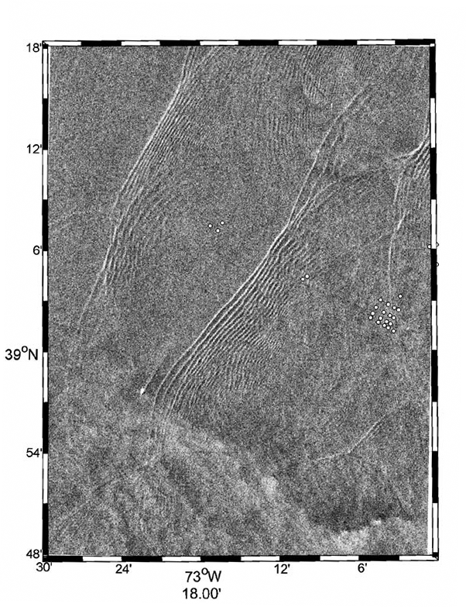
Satellite photo shows the IW in the area
Multiple IW package
Wave curvature
Approaching receiver array from different angles

