Slide 1
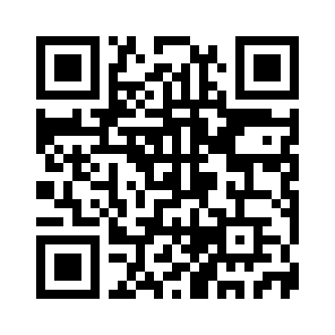
Course links
Open the command page and keep it beside your editor.
Copy commands
supersurf.rgoswami.me/commands
Course portal
coursemgr.advisorssrcdemo.src.surf-hosted.nl
Setup guide
Scan for commands
supersurf.rgoswami.me/setup
Download the presentation PDFs
Use your own private account-setup link to choose your password.

Slide 2
Jobs and output
Create the directory before submitting. Keep the printed job number.
mkdir -p logs
sbatch --partition=rome --cpus-per-task=1 \
--job-name=python-check \
--output='logs/%x-%j.out' \
--error='logs/%x-%j.err' python.sh
%x = job name %j = job ID %A_%a = array job and task
squeue --me
sacct -j JOBID --format=JobID,State,ExitCode
seff JOBID
Choose 1 core for VS Code. Stop its session when finished. No email notifications.

