Slide 1
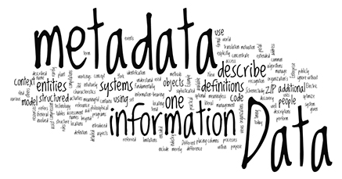
Image Metadata
Hao Zou
3/10/2017

Slide 2
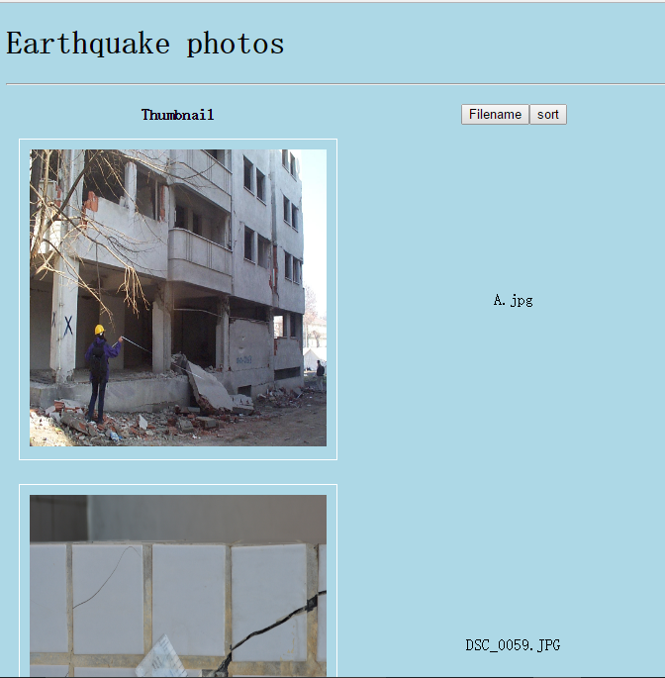
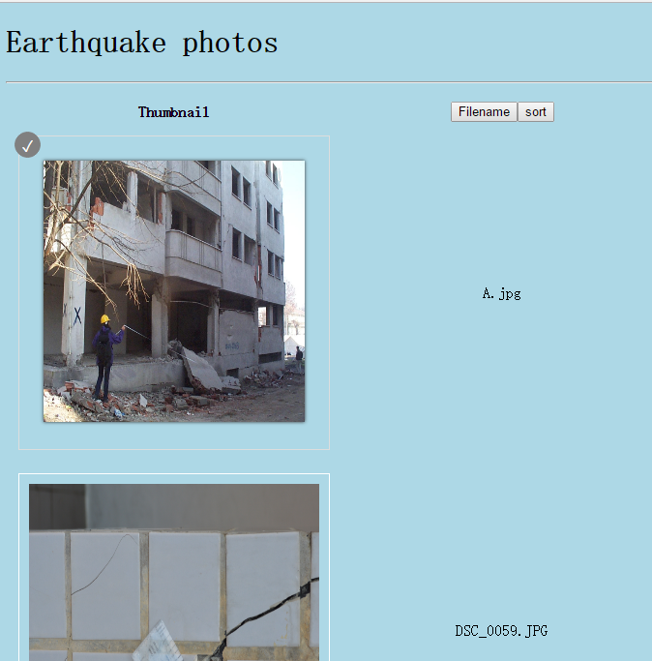

Slide 3

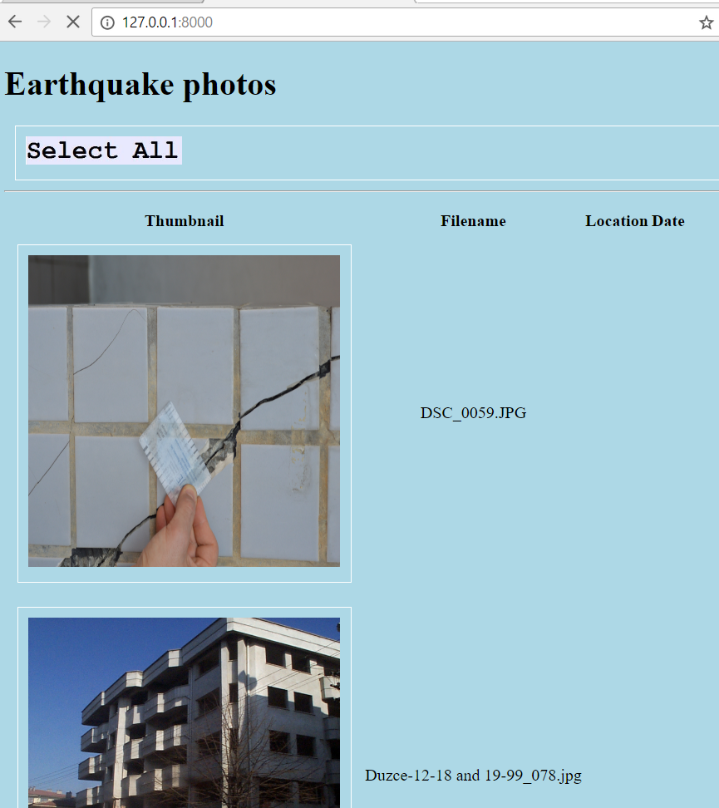

Slide 4



Slide 5



Slide 6
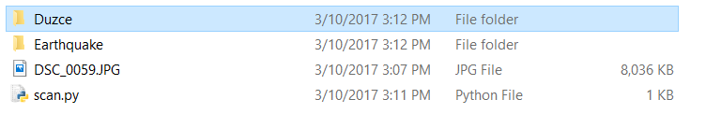

Slide 7
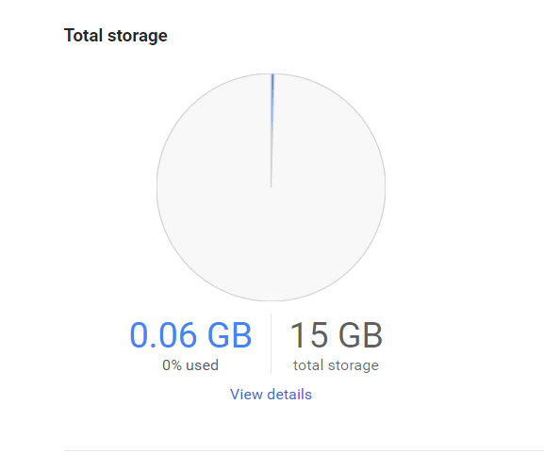
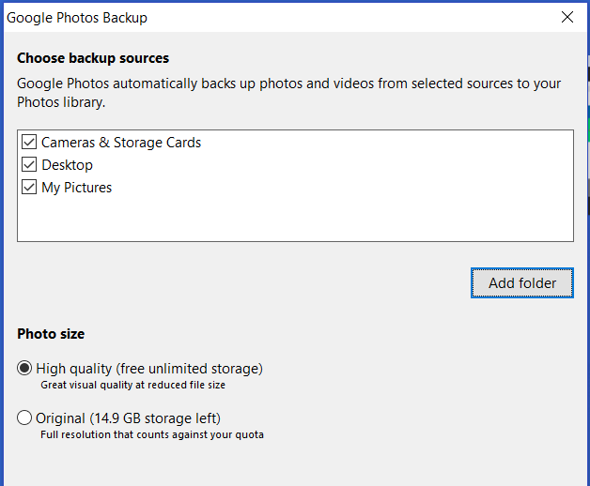

Slide 8

Tools to manipulate metadata

Slide 9

PIL: python image library
Pyexiv2

Slide 10
What to expect in the near future
CSV
XML
EXIV
Table/CSV

