Slide 1

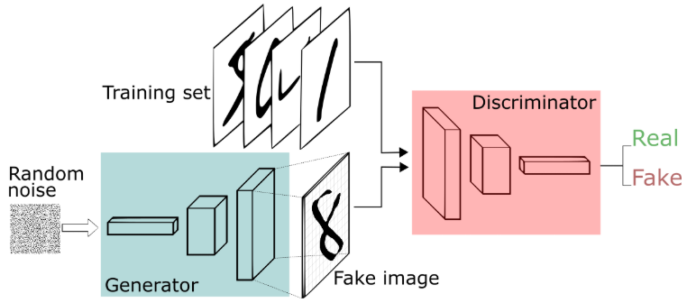
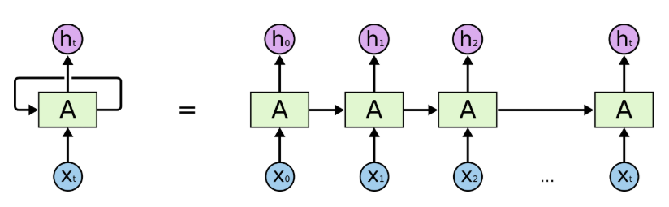
In this Course
1. DL basics, linear regression, logistic regression etc.
2. Multilayer neural networks, backpropagation
3. Convolutional Neural Networks and Applications
4. Generative Adversarial Networks
5. Recurrent networks and applications
Notes:
今天的课内容比较多。希望大家认真听，要不你听不懂。

Slide 2
Last Lecture
Tips for Gradient Descent
Logistic Regression

Slide 3
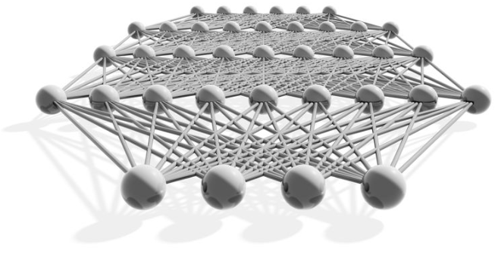
Lecture 3
Neural Networks
Multilayer Neural Networks
Backpropagation
Many slides adapted from Hungyi Lee

Slide 4
Three Steps for Deep Learning
Step 1: Define A Set of Functions
Step 2: Goodness of Function
Step 3:
Pick the Best Function
Neural
Network
Deep Learning is so simple. Don’t be afraid……

Slide 5
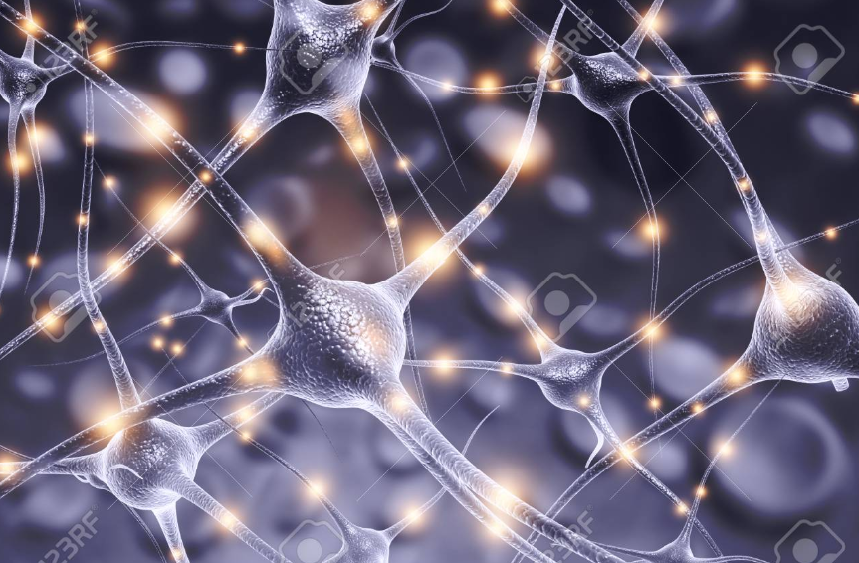
Neural Network
“Neuron”
Neural Network
Different connection leads to different network structures
Network parameter $θ$: all the weights and biases in all the “neurons”

Slide 6
Fully Connect Feedforward Network
1
4
0.98
1
-2
1
-1
-2
-1
1
0.12
0
1
Sigmoid Function
0.5
0

Slide 7
Fully Connect Feedforward Network
1
4
0.98
2
0.86
3
0.62
1
-2
-1
-1
1
0
-2
-1
-2
-2
-1
-1
1
0.12
-1
0.11
4
0.83
0
0
2
1
Sigmoid Function
0.5
0

Slide 8
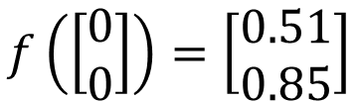
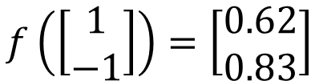
Fully Connect Feedforward Network
1
0.73
2
0.72
3
0.51
0
-2
-1
-1
1
0
-2
-1
-2
-1
0
1
0.5
-1
0.12
4
0.85
0
0
2
This is a function.
$$f\left(\left[\begin{matrix}1 \\ −1\end{matrix}\right]\right)=\left[\begin{matrix}0.62 \\ 0.83\end{matrix}\right]$$
$$f\left(\left[\begin{matrix}0 \\ 0\end{matrix}\right]\right)=\left[\begin{matrix}0.51 \\ 0.85\end{matrix}\right]$$
Input vector, output vector
Given network structure, define a function set

Slide 9






Fully Connect Feedforward Network
neuron
Input
Layer 1
Layer 2
Layer L
$$x_{1}$$
……
$$y_{1}$$
$$x_{2}$$
……
$$y_{2}$$
……
……
……
……
……
……
$$y_{M}$$
$$x_{N}$$
Input Layer
Output Layer
Hidden Layers
Each hidden layer can have a different number of neurons.

Slide 10
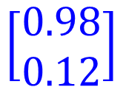


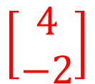

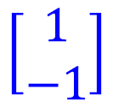

Matrix Operation
1
4
0.98
1
-2
1
-1
-2
-1
1
0.12
0
$$\left[\begin{matrix}1 & −2 \\ −1 & 1\end{matrix}\right]$$
$$\left[\begin{matrix}1 \\ −1\end{matrix}\right]$$
$$\left[\begin{matrix}1 \\ 0\end{matrix}\right]$$
$$=$$
$$\left[\begin{matrix}0.98 \\ 0.12\end{matrix}\right]$$
$$σ\left( \right)$$
$$+$$
$$\left[\begin{matrix}4 \\ −2\end{matrix}\right]$$
Notes:
那network 的运作呢
我们常常会把它用Matrix Operation 来表示

Slide 11




























Neural Network
Input
Layer 1
Layer 2
Layer L
$$x_{1}$$
……
$$y_{1}$$
$$x_{2}$$
……
$$y_{2}$$
……
……
……
……
……
$b^{1}$
$W^{2}$
$b^{2}$
$W^{L}$
$b^{L}$
$W^{1}$
……
$$y_{M}$$
$$x_{N}$$
$$x$$
$a^{1}$
$a^{2}$
$$y$$
$W^{1}$
$$x$$
+
$b^{1}$
$$σ\left( \right)$$
+
$W^{2}$
$a^{1}$
$b^{2}$
$$σ\left( \right)$$
$a^{L−1}$
+
$b^{L}$
$$σ\left( \right)$$
$W^{L}$
Notes:
介绍这个动画流程。基本上每一层都是矩阵运算。那把这件事情写成矩阵运算的好处就是你可以用GPU 加速。

Slide 12












Neural Network
Input
Layer 1
Layer 2
Layer L
$$x_{1}$$
……
$$y_{1}$$
$$x_{2}$$
……
$$y_{2}$$
……
……
……
……
……
$b^{1}$
$W^{2}$
$b^{2}$
$W^{L}$
$b^{L}$
$W^{1}$
……
$$y_{M}$$
$$x_{N}$$
$$x$$
$a^{1}$
$a^{2}$
$$y$$
Using parallel computing techniques to speed up matrix operation
$$y$$
$$x$$
$$=f\left( \right)$$
$$⋯$$
$$x$$
+
+
…+
$$σ\left( \right)$$
$W^{2}$
$$σ\left( \right)$$
$b^{L}$
$W^{1}$
$b^{1}$
$W^{L}$
$$σ\left( \right)$$
$b^{2}$

Slide 13



Output Layer as MultiClass Classifier
Feature extractor replacing feature engineering
Input
Layer 1
Layer 2
Layer L
$$x_{1}$$
……
$$y_{1}$$
$$y_{1}$$
……
$$y_{2}$$
$$x_{2}$$
SoftMax
$$y_{2}$$
……
……
……
……
……
……
$$y_{M}$$
$$x_{N}$$
$$y_{M}$$
Input Layer
Output Layer
Hidden Layers
= Multiclass Classifier

Slide 14
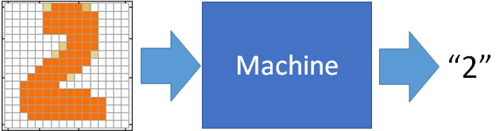



Example Application
“3”
Handwriting Digit Recognition
Input (Image Data)
Output (Dim Fixed)
$$x_{1}$$
y₁
0.1
is 1
$$x_{2}$$
The image is “3”
y₂
is 3
0.7
……
……
……
$$x_{N}$$
y₁₀
0.2
is 0
16 x 16 = 256
N=256
Each dimension represents the confidence of a digit.

Slide 15






Example Application
Handwriting Digit Recognition
$$x_{1}$$
$$y_{1}$$
is 1
$$x_{2}$$
Machine
Neural
Network
$$y_{2}$$
is 2
……
……
……
$$x_{N}$$
$$y_{M}$$
is 0
What is needed is a function ……
Input: Vector of 256 dimension
N=256
Output: Vector of 10 dimension
M=10 classes

Slide 16
Example Application
Output
is 1
A function set containing the candidates for
Handwriting Digit Recognition
is 2
……
is 0
You need to decide the network structure to let a good function in your function set.

Slide 17
FAQ
Q1: How many layers? How many neurons for each layer?
Q2: Can the structure be automatically determined?
e.g. automatic Network Architecture Search (NAS)
Q3: Can we design the network structure?
Trial and Error
+
Intuition
Convolutional Neural Network (CNN)

Slide 18
Three Steps for Deep Learning
Step 1: Define A Set of Functions
Step 2: Goodness of Function
Step 3:
Pick the Best Function
Neural
Network
Deep Learning is so simple. Don’t be afraid……

Slide 19
Output Layer as MultiClass Classifier
Input
Layer 1
Layer 2
$$x_{1}$$
……
$$y_{1}$$
$$y_{1}$$
……
$$x_{2}$$
SoftMax
$$y_{2}$$
$$y_{2}$$
……
……
……
……
……
$$y_{M}$$
$$x_{N}$$
$$y_{M}$$

Slide 20










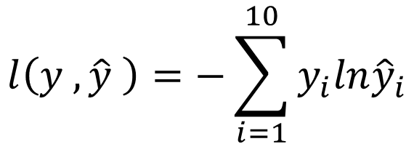


Loss for an Example
target
“1”
$$x_{1}$$
……
$${\hat{y}}_{1}$$
$$y_{1}$$
1
……
$$x_{2}$$
Given a set of parameters
SoftMax
$${\hat{y}}_{2}$$
$$y_{2}$$
0
……
……
……
……
Cross
Entropy
……
……
……
0
$$x_{N}$$
$${\hat{y}}_{10}$$
$$y_{10}$$
$$\hat{y}$$
$$y$$
$$l\left(y ,\hat{y} \right)=−\sum_{i=1}^{10}{y_{i}ln{\hat{y}}_{i}}$$

Slide 21




















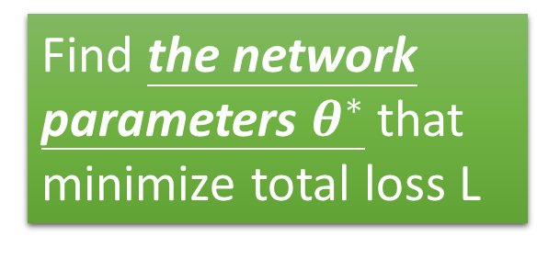


Total Loss
Total Loss:
$$L=\sum_{n=1}^{N}{l^{n}}$$
For all training data …
$$x^{(1)}$$
NN
$${\hat{y}}^{(1)}$$
$$y^{(1)}$$
$$l^{1}$$
NN
Find a function in function set that minimizes total loss L
$$x^{(2)}$$
$${\hat{y}}^{(2)}$$
$$y^{(2)}$$
$$l^{2}$$
$$x^{(3)}$$
NN
$${\hat{y}}^{(3)}$$
$$y^{(3)}$$
$$l^{3}$$
……
……
……
……
……
Find the network parameters $θ^{∗}$ that minimize total loss L
NN
$$x^{(N)}$$
$${\hat{y}}^{(N)}$$
$$y^{(N)}$$
$$l^{N}$$

Slide 22
Three Steps for Deep Learning
Step 1: Define A Set of Functions
Step 2: Goodness of Function
Step 3:
Pick the Best Function
Neural
Network
Deep Learning is so simple. Don’t be afraid……

Slide 23

Gradient Descent
This is the “learning” of machines in deep learning ……
Even alpha go using this approach.
People image ……
Actually …..
I hope you are not too disappointed.

Slide 24
Lecture 3
Neural Networks
Multilayer Neural Networks
Backpropagation

Slide 25
Backpropagation for Fully Connect Feedforward Network

Slide 26








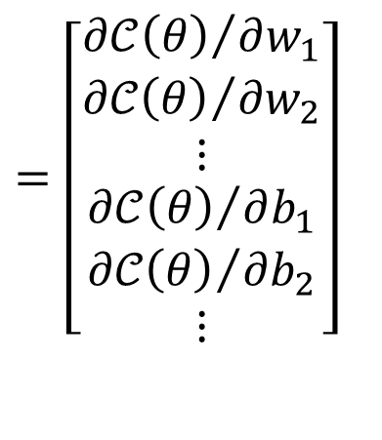
Gradient Descent
Network parameters
Starting Parameters
$$θ^{(0)}$$
$$θ^{(1)}$$
$$θ^{(2)}$$
……
$$∇𝒞\left(θ\right)$$
$$Compute ∇𝒞\left(θ^{(0)}\right)$$
$$θ^{(1)}= θ^{(0)}−η∇𝒞\left(θ^{(0)}\right)$$
$$=\left[\begin{matrix}\begin{matrix}{∂𝒞\left(θ\right)}/{∂w_{1}} \\ {∂𝒞\left(θ\right)}/{∂w_{2}} \\ ⋮\end{matrix} \\ \begin{matrix}{∂𝒞\left(θ\right)}/{∂b_{1}} \\ {∂𝒞\left(θ\right)}/{∂b_{2}} \\ ⋮\end{matrix}\end{matrix}\right]$$
$$θ^{(2)}= θ^{(1)}−η∇𝒞\left(θ^{(1)}\right)$$
$$Compute ∇𝒞\left(θ^{(1)}\right)$$
Millions of parameters ……
To compute the gradients efficiently, we use backpropagation.

Slide 27
Chain Rule
Case 1
Case 2

Slide 28


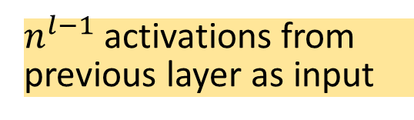







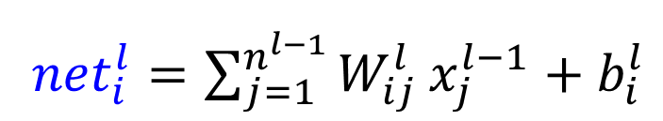






Recall: An Artificial Neuron
$$x_{1}^{l−1}$$
weights
$$b_{i}^{l}$$
$$W_{i1}^{l}$$
Output
(Activation)
$$x_{2}^{l−1}$$
Total input of unit 𝑖
$$W_{i2}^{l}$$
$${net}_{i}^{l}$$
$$x_{i}^{l}$$
$$x_{3}^{l−1}$$
$$∑$$
$$W_{i3}^{l}$$
$$⋯$$
$$W_{in^{l−1}}^{l}$$
unit $i$of layer $l$
$$x_{n^{l−1}}^{l−1}$$
${net}_{i}^{l}=\sum_{j=1}^{n^{l−1}}{W_{ij}^{l}}x_{j}^{l−1}+b_{i}^{l}$
Total input of unit 𝑖 :
$n^{l−1}$activations from previous layer as input
$$x_{i}^{l}=σ\left({net}_{i}^{l}\right)$$
Output of unit 𝑖 :
Notes:
解释upscript: layer number
Superscript:

Slide 29



































Fully Connect Feedforward Network
Layer 2
Layer L
Target t
$$W_{31}^{2}$$
Layer 1
$$⋯$$
$$x_{1}^{L}=y_{1}$$
$$t_{1}$$
$$x_{1}^{2}$$
Input
$$x_{1}^{1}$$
$$x_{1}^{0}$$
$$⋯$$
$x_{2}^{L}$ $=y_{2}$
$$t_{2}$$
$$x_{2}^{2}$$
$$x_{2}^{1}$$
$$⋯$$
$$x_{2}^{0}$$
$x_{3}^{L}$ $=y_{3}$
$$t_{3}$$
$$x_{3}^{2}$$
$$⋯$$
$$x_{3}^{1}$$
$$⋯$$
$x_{4}^{L}$ $=y_{4}$
$$t_{4}$$
$$⋯$$
$$x_{4}^{2}$$
$$x_{n^{0}}^{0}$$
$$⋯$$
$$⋯$$
$$⋯$$
$$⋯$$
$${\{W}_{ij}^{1}\}$$
$$x_{n^{1}}^{0}$$
$$⋯$$
$x_{c}^{L}$ $=y_{c}$
$${\{W}_{ij}^{2}\}$$
$$t_{c}$$
Hidden
$$x_{n^{2}}^{0}$$
Hidden
Output

Slide 30

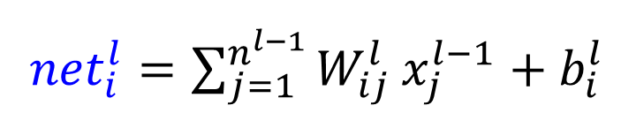
Fully Connect Feedforward Network
${net}_{i}^{l}=\sum_{j=1}^{n^{l−1}}{W_{ij}^{l}}x_{j}^{l−1}+b_{i}^{l}$
Total input of unit 𝑖 :
$$x_{i}^{l}=σ\left({net}_{i}^{l}\right)$$
Output of unit 𝑖 :
Notes:
对于任何一个unit，都可以这么表示

Slide 31

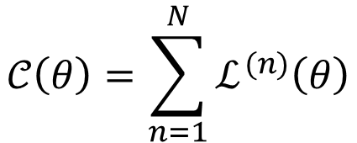



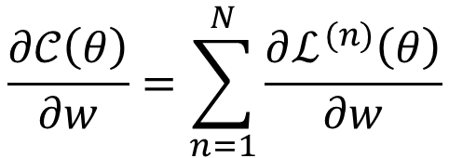
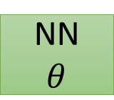
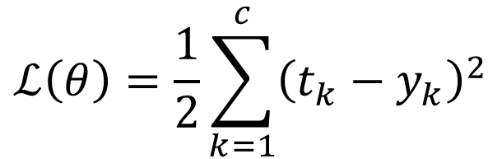
Backpropagation
NN
$$θ$$
$$x^{(n)}$$
$$y^{(n)}$$
$$t^{(n)}$$
$$ℒ^{(n)}$$
$$𝒞\left(θ\right)=\sum_{n=1}^{N}{ℒ^{(n)}\left(θ\right)}$$
$$\frac{∂𝒞\left(θ\right)}{∂w}=\sum_{n=1}^{N}{\frac{∂ℒ^{(n)}\left(θ\right)}{∂w}}$$
Choose squared error as training error measurement and sigmoid as activation function at the output layer
$$ℒ\left(θ\right)=\frac{1}{2}\sum_{k=1}^{c}{{\left(t_{k}−y_{k}\right)}^{2}}$$
Loss for one training sample

Slide 32
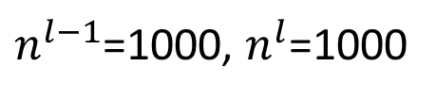
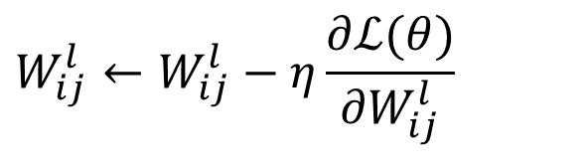




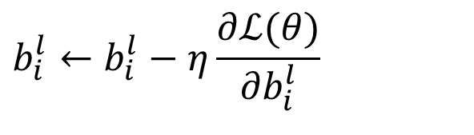
Gradient Descent
$$l=1,…,L$$
Network parameters
$$θ={\{W}_{ij}^{l},b_{i}^{l}\}$$
$$i=1,…,n^{l}$$
$$j=1,…,n^{l−1}$$
For example:
$n^{l−1}$=1000, $n^{l}$=1000
Then each layer has 10⁶ parameters
Tens of Millions of parameters ……
Need to compute partial derivative with respect to each parameter:
$$W_{ij}^{l}←W_{ij}^{l}−η\frac{∂ℒ(θ)}{{∂W}_{ij}^{l}}$$
$$b_{i}^{l}←b_{i}^{l}−η\frac{∂ℒ(θ)}{{∂b}_{i}^{l}}$$

Slide 33

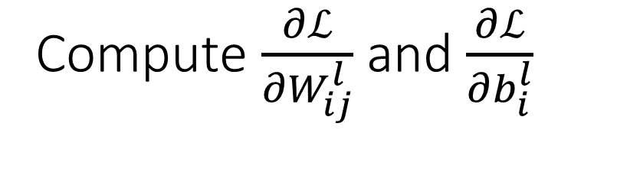
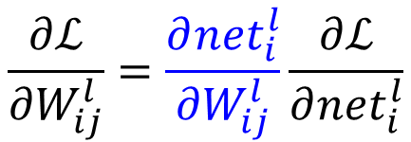


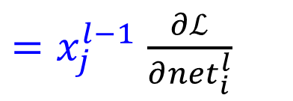
Compute $\frac{∂ℒ}{{∂W}_{ij}^{l}}$ and $\frac{∂ℒ}{{∂b}_{i}^{l}}$
${net}_{i}^{l}=\sum_{j=1}^{n^{l−1}}{W_{ij}^{l}}x_{j}^{l−1}+b_{i}^{l}$
Identify the relation between $W_{ij}^{l}$and ${net}_{i}^{l}$, because $W_{ij}^{l}$can only affect the network output through ${net}_{i}^{l}$
$$\frac{∂{net}_{i}^{l}}{{∂W}_{ij}^{l}}=x_{j}^{l−1}$$
Apply chain rule:
where：
$$\frac{∂ℒ}{{∂W}_{ij}^{l}}=\frac{∂{net}_{i}^{l}}{{∂W}_{ij}^{l}}\frac{∂ℒ}{∂{net}_{i}^{l}}$$
$=x_{j}^{l−1}$ $\frac{∂ℒ}{∂{net}_{i}^{l}}$
?

Slide 34
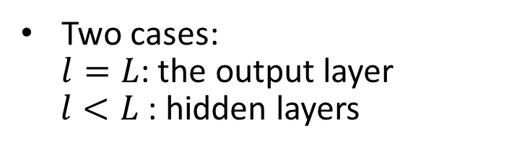


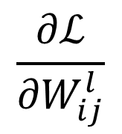
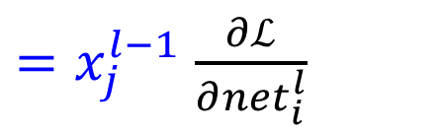
$$\frac{∂ℒ}{∂{net}_{i}^{l}}$$
$$\frac{∂ℒ}{{∂W}_{ij}^{l}}$$
$=x_{j}^{l−1}$ $\frac{∂ℒ}{∂{net}_{i}^{l}}$
Compute
Identify the relation between ${net}_{i}^{l}$ and those neurons connected to it in the immediate downstream (next layer)
Two cases:
$l=L$: the output layer
$l<L$ : hidden layers
Notes:
这里省去求和。$σ$表示any激活函数

Slide 35
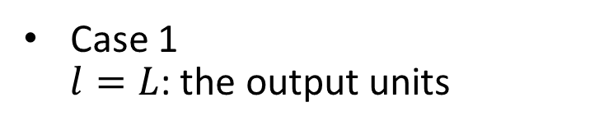


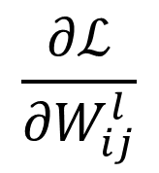
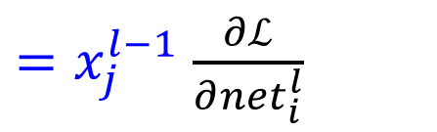
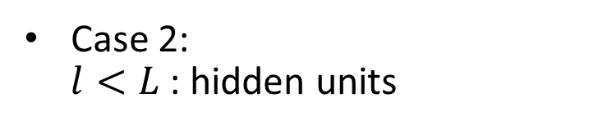
$$\frac{∂ℒ}{∂{net}_{i}^{l}}$$
$$\frac{∂ℒ}{{∂W}_{ij}^{l}}$$
$=x_{j}^{l−1}$ $\frac{∂ℒ}{∂{net}_{i}^{l}}$
Compute
Identify the relation between ${net}_{i}^{l}$ and those neurons connected to it in the immediate downstream (next layer)
Case 1
$l=L$: the output units
Case 2:
$l<L$ : hidden units
Notes:
提醒case2有downstream units，而case 1没有

Slide 36


$$\frac{∂ℒ}{∂{net}_{i}^{l}}$$
Compute
Sensitivity of unit $i$ at layer $l$
Describe how the overall error changes with the unit’s net activation:
$$δ_{i}^{l}=−\frac{∂ℒ}{∂{net}_{i}^{l}}$$
Notes:
$δ_{i}^{l}$ 只是一种定义。

Slide 37
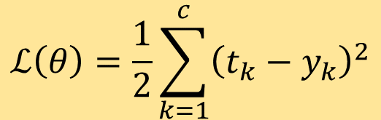
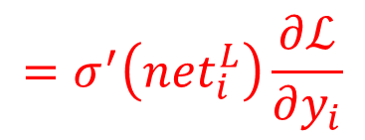
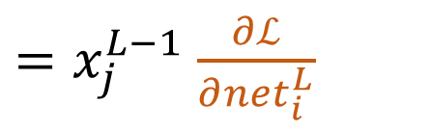

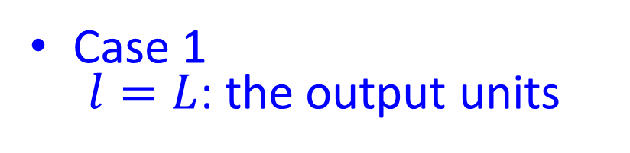

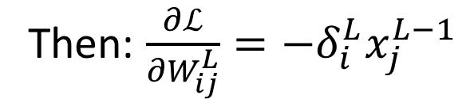
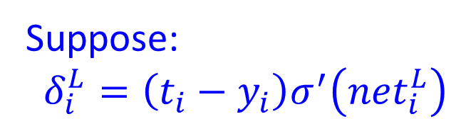
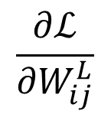
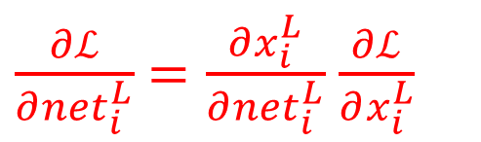

$$\frac{∂ℒ}{∂{net}_{i}^{l}}$$
$$ℒ\left(θ\right)=\frac{1}{2}\sum_{k=1}^{c}{{\left(t_{k}−y_{k}\right)}^{2}}$$
Compute
Case 1
$l=L$: the output units
$$x_{i}^{L}=σ\left({net}_{i}^{L}\right)$$
$$\frac{∂ℒ}{{∂W}_{ij}^{L}}$$
$=x_{j}^{L−1}$ $\frac{∂ℒ}{∂{net}_{i}^{L}}$
$$x_{i}^{L}=y_{i}$$
Chain Rule
$\frac{∂ℒ}{∂{net}_{i}^{L}}$ $=\frac{∂x_{i}^{L}}{∂{net}_{i}^{L}}$ $\frac{∂ℒ}{∂x_{i}^{L}}$
$$=σ^{′}\left({net}_{i}^{L}\right)\frac{∂ℒ}{∂y_{i}}$$
$$=−\left(t_{i}−y_{i}\right)σ^{′}\left({net}_{i}^{L}\right)$$
Suppose:
$$δ_{i}^{L}=\left(t_{i}−y_{i}\right)σ^{′}\left({net}_{i}^{L}\right)$$
Then: $\frac{∂ℒ}{{∂W}_{ij}^{L}}=−δ_{i}^{L}x_{j}^{L−1}$
output layer
Notes:
$σ$是激活$函数。δ_{i}$的意义可能稍后解释。

Slide 38

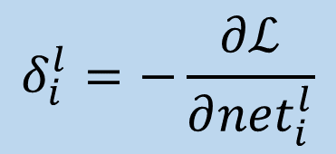









$$\frac{∂ℒ}{∂{net}_{i}^{l}}$$
$$\frac{∂ℒ}{{∂W}_{ij}^{l}}$$
$=x_{j}^{l−1}$ $\frac{∂ℒ}{∂{net}_{i}^{l}}$
Compute
$$x_{i}^{l}=σ\left({net}_{i}^{l}\right)$$
Case 2
$l<L$: hidden units
$$δ_{i}^{l}=−\frac{∂ℒ}{∂{net}_{i}^{l}}$$
Identify the relation between ${net}_{i}^{l}$ and those neurons connected to it in the immediate downstream (next layer)
Chain Rule
$$\sum_{k∈downstream({net}_{i}^{l}) }{\frac{∂{net}_{k}^{l+1}}{∂{net}_{k}^{l}}\frac{∂ℒ}{∂{net}_{k}^{l+1}}}$$
$\frac{∂ℒ}{∂{net}_{i}^{l}}$=
$$=\sum_{k=1}^{n^{l+1}}{\frac{∂{net}_{k}^{l+1}}{∂{net}_{i}^{l}}\frac{∂ℒ}{∂{net}_{k}^{l+1}}}$$
$$=\sum_{k=1}^{n^{l+1}}{\frac{∂{net}_{k}^{l+1}}{∂{net}_{i}^{l}}\left(δ_{k}^{l+1}\right)}$$
$$δ_{i}^{l}$$
Notes:
$δ_{i}$的意义可能稍后解释

Slide 39









$$\frac{∂ℒ}{∂{net}_{i}^{l}}$$
$$\frac{∂ℒ}{{∂W}_{ij}^{l}}$$
$=x_{j}^{l−1}$ $\frac{∂ℒ}{∂{net}_{i}^{l}}$
Compute
$$x_{i}^{l}=σ\left({net}_{i}^{l}\right)$$
Case 2
$l<L$: hidden units
$σ$ is the activation function
$δ_{i}^{l}$= $\sum_{k=1}^{n^{l+1}}{\frac{∂{net}_{k}^{l+1}}{∂{net}_{i}^{l}}δ_{k}^{l+1}}$
${net}_{k}^{l+1}=\sum_{i=1}^{n^{l}}{W_{ki}^{l+1}}x_{i}^{l}+b_{k}^{l+1}$
= $\sum_{k=1}^{n^{l+1}}{\frac{∂{net}_{k}^{l+1}}{∂x_{i}^{l}}\frac{∂x_{i}^{l}}{∂{net}_{i}^{l}}δ_{k}^{l+1}}$
= $\sum_{k=1}^{n^{l+1}}{W_{ki}^{l+1}σ^{′}\left({net}_{i}^{l}\right)δ_{k}^{l+1}}$
= $σ^{′}\left({net}_{i}^{l}\right)$ $\sum_{k=1}^{n^{l+1}}{W_{ki}^{l+1}δ_{k}^{l+1}}$
$$W_{1i}^{l+1}$$
$\frac{∂ℒ}{{∂W}_{ij}^{l}}$ $=−x_{j}^{l−1}$ $δ_{i}^{l}$
$$W_{n^{l+1}i}^{l+1}$$
Notes:
$δ_{i}$的意义可能稍后解释

Slide 40











Summary: Error Propagation
$$δ_{i}^{l}=−\frac{∂ℒ}{∂{net}_{i}^{l}}$$
Case 1
$l=L$: the output units
$σ$ is the activation function
$$\frac{∂ℒ}{{∂W}_{ij}^{L}}=−δ_{i}^{L}x_{j}^{L−1}$$
$$δ_{i}^{L}=σ^{′}\left({net}_{i}^{L}\right)\left(t_{i}−y_{i}\right)$$
Case 2
$l<L$: hidden units
error of output layer
error backpropagated
$\frac{∂ℒ}{{∂W}_{ij}^{l}}$ $=−δ_{i}^{l}x_{j}^{l−1}$
$δ_{i}^{l}$= $σ^{′}\left({net}_{i}^{l}\right)$ $\sum_{k=1}^{n^{l+1}}{W_{ki}^{l+1}δ_{k}^{l+1}}$
$δ_{i}^{l} :$an “error term” that measures how much that unit is “responsible” for any errors in the output.
$$W_{1i}^{l+1}$$
Case 1 and case 2 can be unified.
$$W_{n^{l+1}i}^{l+1}$$
Notes:
详细解释各个式子的含义

Slide 41





















Illustration of
Error Propagation
$δ_{i}^{l}$= $σ^{′}\left({net}_{i}^{l}\right)$ $\sum_{k=1}^{n^{l+1}}{W_{ki}^{l+1}δ_{k}^{l+1}}$
Layer
$l+1$
$$⋯$$
$$⋯$$
$$δ_{1}^{l+1}$$
$$δ_{2}^{l+1}$$
$$δ_{3}^{l+1}$$
$$δ_{k}^{l+1}$$
$$δ_{n^{l+1}}^{l+1}$$
$$W_{1i}^{l+1}$$
$$W_{3i}^{l+1}$$
$$W_{ki}^{l+1}$$
$$W_{n^{l+1}i}^{l+1}$$
$$⋯$$
$$δ_{i}^{l}$$
$$⋯$$
layer $l$
$$W_{ij}^{l}$$
layer $l−1$
$$⋯$$
$$⋯$$
The sensitivity at a hidden unit is proportional to the weighted sum of the sensitivities at the output units.
The output unit sensitivities are thus propagated “back” to the hidden units.

Slide 42









BP: Summary
${net}_{i}^{l}=\sum_{j=1}^{n^{l−1}}{W_{ij}^{l}}x_{j}^{l−1}+b_{i}^{l}$
$l=L$: the output units
$$x_{i}^{l}=σ\left({net}_{i}^{l}\right)$$
$$\frac{∂ℒ}{{∂W}_{ij}^{L}}=−δ_{i}^{L}x_{j}^{L−1}$$
$$δ_{i}^{L}=\left(t_{i}−y_{i}\right)σ^{′}\left({net}_{i}^{L}\right)$$
$0<l<L$: hidden units
$\frac{∂ℒ}{{∂W}_{ij}^{l}}$ $=−δ_{i}^{l}x_{j}^{l−1}$
$δ_{i}^{l}$= $σ^{′}\left({net}_{i}^{l}\right)$ $\sum_{k=1}^{n^{l+1}}{W_{ki}^{l+1}δ_{k}^{l+1}}$
Forward Pass
Backward Pass
…
…
…
…
$\frac{∂ℒ}{{∂W}_{ij}^{l}}$ $=−δ_{i}^{l}x_{j}^{l−1}$

Slide 43





BP: Summary
${net}_{i}^{l}=\sum_{j=1}^{n^{l−1}}{W_{ij}^{l}}x_{j}^{l−1}+b_{i}^{l}$
$l=L$: the output units
$$x_{i}^{l}=σ\left({net}_{i}^{l}\right)$$
$$\frac{∂ℒ}{{∂W}_{ij}^{L}}=−δ_{i}^{L}x_{j}^{L−1}$$
$$δ_{i}^{L}=\left(t_{i}−y_{i}\right)σ^{′}\left({net}_{i}^{L}\right)$$
$0<l<L$: hidden units
$\frac{∂ℒ}{{∂W}_{ij}^{l}}$ $=−δ_{i}^{l}x_{j}^{l−1}$
$δ_{i}^{l}$= $σ^{′}\left({net}_{i}^{l}\right)$ $\sum_{k=1}^{n^{l+1}}{W_{ki}^{l+1}δ_{k}^{l+1}}$
Implementation note
Need to compute: $σ^{′}\left({net}_{i}^{L}\right)$
Suppose sigmoid activation function: $σ\left(z\right)=\frac{1}{1+e^{−z}}$
$$σ^{′}\left(z\right)=σ\left(z\right)\left(1−σ\left(z\right)\right)$$
$$x_{i}^{l}=σ\left({net}_{i}^{l}\right)$$
Activations $\{x_{i}^{l}\}$ have already been stored away from the forward pass through the network.
$$σ^{′}\left({net}_{i}^{l}\right)=σ\left({net}_{i}^{l}\right)\left(1−σ\left({net}_{i}^{l}\right)\right)=x_{i}^{l}(1−x_{i}^{l})$$
Notes:
Implementation note: We need to compute $σ^{′}\left({net}_{i}^{L}\right)$ for unit. Assuming function $σ\left(z\right)$ is the sigmoid activation function, we would already have activations $\{x_{i}^{l}\}$ stored away from the forward pass through the network. Thus we can compute this as $σ^{′}\left({net}_{i}^{L}\right)=x_{i}^{l}(1−x_{i}^{l})$.

Slide 44


























An Example for Backpropagation
Forward Pass
Done!
Input
$$x_{1}^{1}(0.68)$$
$$x_{1}^{0}(0.35)$$
$$0.1$$
$$0.3$$
$$x_{1}^{2}(0.69)$$
$${=y}_{1}$$
$$0.8$$
$$t_{1}=0.5$$
$$0.4$$
$$0.9$$
$$x_{2}^{0}(0.9)$$
$$0.6$$
$$x_{2}^{1}(0.6637)$$
${net}_{i}^{l}=\sum_{j=1}^{n^{l−1}}{W_{ij}^{l}}x_{j}^{l−1}$
$$W_{11}^{1}=0.1$$
$W_{21}^{1}=0.$4
$$x_{i}^{l}=σ\left({net}_{i}^{l}\right)$$
$$W_{12}^{1}=0.8$$
$W_{22}^{1}=0.$6
$$σ\left(x\right)=\frac{1}{1+exp(−x)}$$
$$x_{1}^{1}=\frac{1}{1+exp⁡(−\left(0.1∗0.35+0.9∗0.8\right))}=0.68$$
$$x_{2}^{1}=0.6637$$
$$W_{11}^{2}=0.3$$
$$W_{12}^{2}=0.9$$
$$x_{1}^{2}=0.69$$
$${=y}_{1}$$
Notes:
假设这个例子没有bias term。括号里面表示的是它的具体取值。

Slide 45
















An Example for Backpropagation
Backward Pass
Done!
Input
$$x_{1}^{1}(0.68)$$
$$x_{1}^{0}(0.35)$$
$$0.1$$
$$0.3$$
$$x_{1}^{2}\left(0.69\right)=y_{1}$$
$$t_{1}=0.5$$
$$0.8$$
$$δ_{1}^{1}(−0.0027)$$
$$0.4$$
$$δ_{2}^{1}(−0.00082)$$
$$0.9$$
$$δ_{1}^{2}(−0.0406)$$
$$x_{2}^{0}(0.9)$$
$$0.6$$
$$x_{2}^{1}(0.6637)$$
$L=$2: the output units:
$$∂ℒ/{∂W}_{ij}^{L}=−δ_{i}^{L}x_{j}^{L−1}$$
$$δ_{i}^{L}=\left(t_{1}−y_{1}\right)σ^{′}\left({net}_{i}^{L}\right)$$
$$δ_{1}^{2}=\left(t_{1}−y_{1}\right)σ^{′}\left({net}_{1}^{2}\right)={\left(t_{1}−y_{1}\right)x}_{1}^{2}\left(1−x_{1}^{2}\right)$$
$$σ^{′}\left({net}_{i}^{l}\right)=x_{i}^{l}(1−x_{i}^{l})$$
$$=\left(0.5−0.69\right)∗0.69∗\left(1−0.69\right)=−0.0406$$
$0<l<2$: hidden units:
$$∂ℒ/{∂W}_{ij}^{l}=−δ_{i}^{l}x_{j}^{l−1}$$
$δ_{i}^{l}$= $σ^{′}\left({net}_{i}^{l}\right)$ $\sum_{k=1}^{n^{l+1}}{W_{ki}^{l+1}δ_{k}^{l+1}}$
$$δ_{1}^{1}=x_{1}^{1}\left(1−x_{1}^{1}\right)∗W_{11}^{2}∗δ_{1}^{2}=0.68∗\left(1−0.68\right)∗0.3∗\left(−0.0406\right)=−0.0027$$
$$δ_{2}^{1}=0.6637∗\left(1−0.6637\right)∗0.9∗\left(−0.0406\right)=−0.0082$$
Notes:
假设这个例子没有bias term。括号里面表示的是它的具体取值。
首先讲蓝色的是存着的激活值，通过forward pass计算得到的。

Slide 46




















An Example for BP: Summary
Input
$$x_{1}^{0}(0.35)$$
$$0.1$$
$$x_{1}^{1}(0.68)$$
$$0.3$$
$$x_{1}^{2}\left(0.69\right)=y_{1}$$
$$0.8$$
$$δ_{1}^{1}(−0.0027)$$
$$δ_{2}^{1}(−0.00082)$$
$$0.9$$
$$δ_{1}^{2}(−0.0406)$$
$$0.4$$
$$x_{2}^{0}(0.9)$$
$$0.6$$
$$x_{2}^{1}(0.6637)$$
layer 1
layer 2
$1≤l≤2$: hidden units:
$$∂ℒ/{∂W}_{ij}^{l}=−δ_{i}^{l}x_{j}^{l−1}$$
$$W_{11}^{1}=0.1$$
$W_{21}^{1}=0.$4
$$W_{11}^{2}=0.3$$
$$\frac{∂ℒ}{{∂W}_{11}^{1}}=−δ_{1}^{1}x_{1}^{0}=0.000945$$
$$W_{12}^{1}=0.8$$
$W_{22}^{1}=0.$6
$$W_{12}^{2}=0.9$$
$$\frac{∂ℒ}{{∂W}_{12}^{1}}=−δ_{1}^{1}x_{2}^{0}=0.00243$$
$$\frac{∂ℒ}{{∂W}_{11}^{2}}=−δ_{1}^{2}x_{1}^{1}=0.0406∗\left(0.68\right)=0.0276$$
$$\frac{∂ℒ}{{∂W}_{21}^{1}}=−δ_{2}^{1}x_{1}^{0}=0.00287$$
$$\frac{∂ℒ}{{∂W}_{12}^{2}}=−δ_{1}^{2}x_{2}^{1}=0.0406∗0.6637=0.0269$$
$$\frac{∂ℒ}{{∂W}_{22}^{1}}=−δ_{2}^{1}x_{2}^{0}=0.00738$$
Notes:
目前我们计算得到这些值，根据这些值来update weights.

Slide 47





































An Example for Backpropagation
Weights Update
Input
$$0.69$$
$$x_{1}^{0}(0.35)$$
$$0.1$$
$$0.0991$$
$$0.2724$$
$$0.682$$
$$0.3$$
$$0.7976$$
$$0.8$$
$$t_{1}=0.5$$
$$0.8731$$
$$0.3971$$
$$0.4$$
$$0.9$$
$$\frac{∂ℒ}{{∂W}_{11}^{1}}=0.000945$$
$$x_{2}^{0}(0.9)$$
$$0.6$$
$$0.5926$$
Suppose: learning rate $η=1$
$$\frac{∂ℒ}{{∂W}_{12}^{1}}=0.00243$$
$$W_{11}^{1}=0.1$$
$$−0.000945$$
$$=0.0991$$
$$\frac{∂ℒ}{{∂W}_{21}^{1}}=0.00287$$
$$W_{12}^{1}=0.8$$
$$−0.00243$$
$$=0.7976$$
$$\frac{∂ℒ}{{∂W}_{22}^{1}}=0.00738$$
$W_{21}^{1}=0.$4
$$−0.00287$$
$$=0.3971$$
$W_{22}^{1}=0.$6
Just Repeat!
$$−0.00738$$
$$=0.5926$$
$$\frac{∂ℒ}{{∂W}_{11}^{2}}=0.0276$$
$$W_{11}^{2}=0.3$$
$$−0.0276$$
$$=0.2724$$
$$\frac{∂ℒ}{{∂W}_{12}^{2}}=0.0269$$
$$W_{12}^{2}=0.9$$
$$−0.0269$$
$$=0.8731$$
Notes:
假设这个例子没有bias term。括号里面表示的是它的具体取值。

Slide 48
Next Lecture
Convolutional Neural Network

