Slide 1
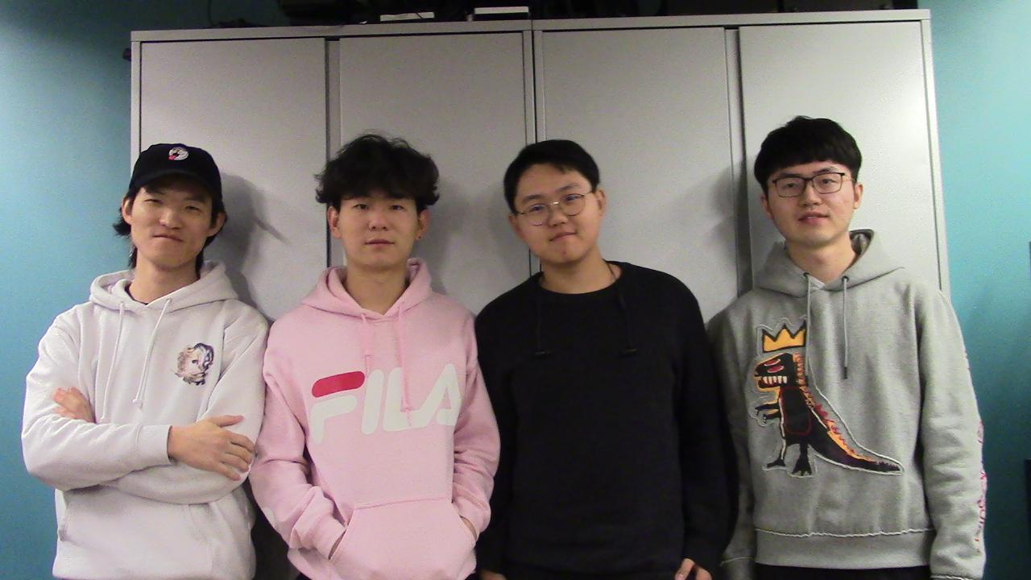

ECE 477 FINAL REVIEW:
TEAM 17 Face Tracking Drone

Slide 2
OUTLINE
Project Overview
Block Diagram
Design Challenges
Individual Contributions
Project Demonstration
Questions

Slide 3
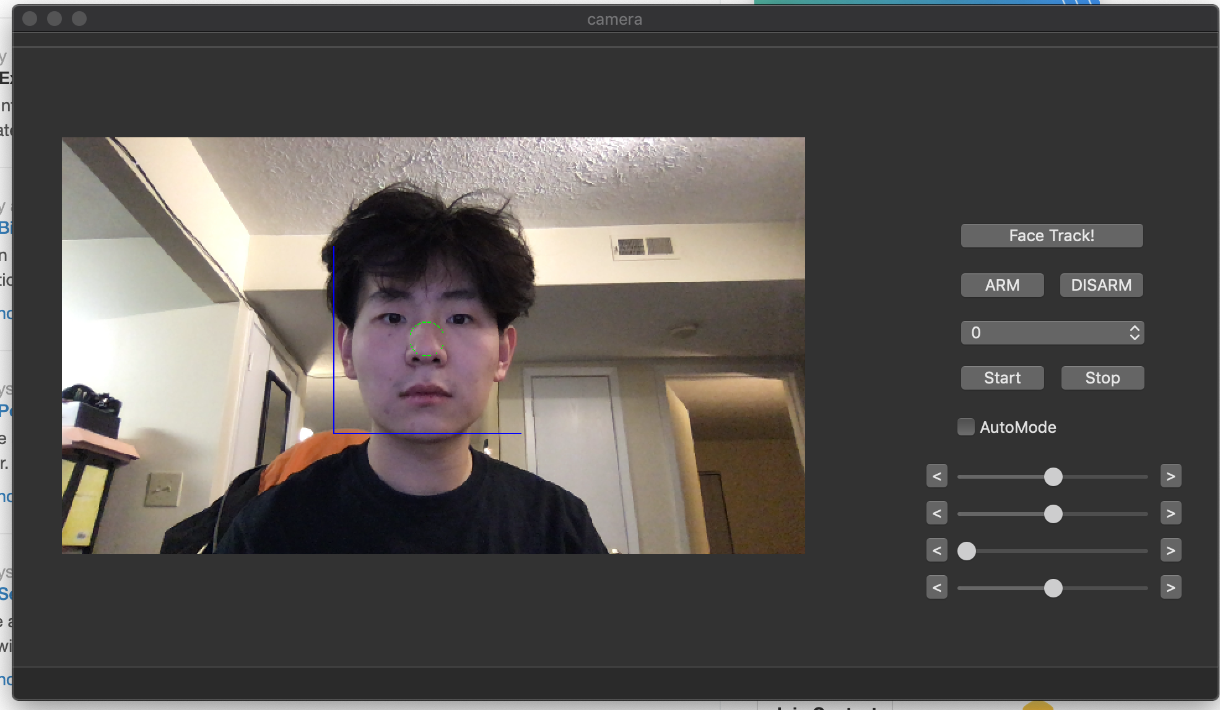
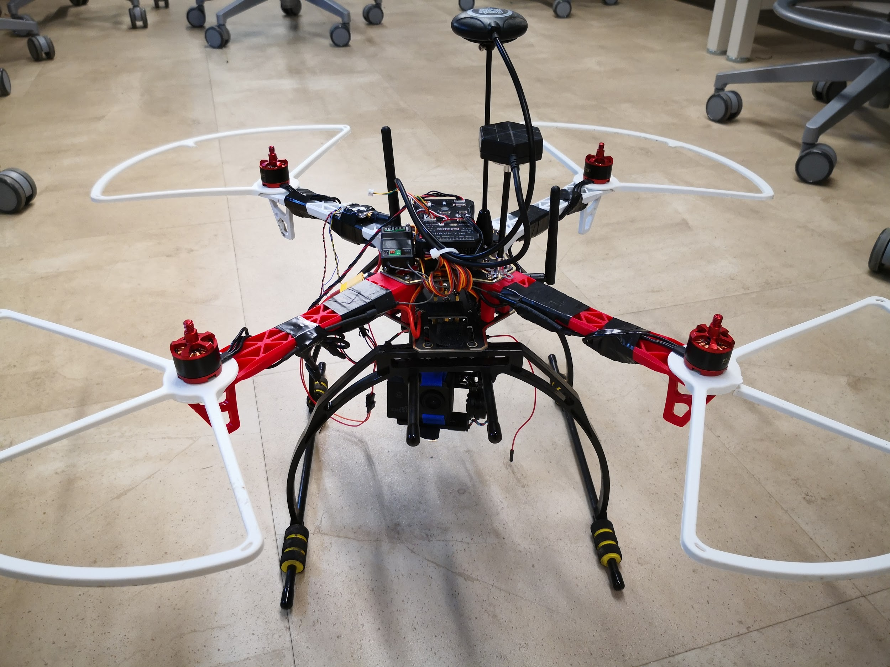
PROJECT OVERVIEW
Our project is a face recognizing drone which follows a person’s movement and records video.
Our drone is unique since it can analyze a person’s head pose and eye gaze direction and adjusts its own position in the air.

Slide 4
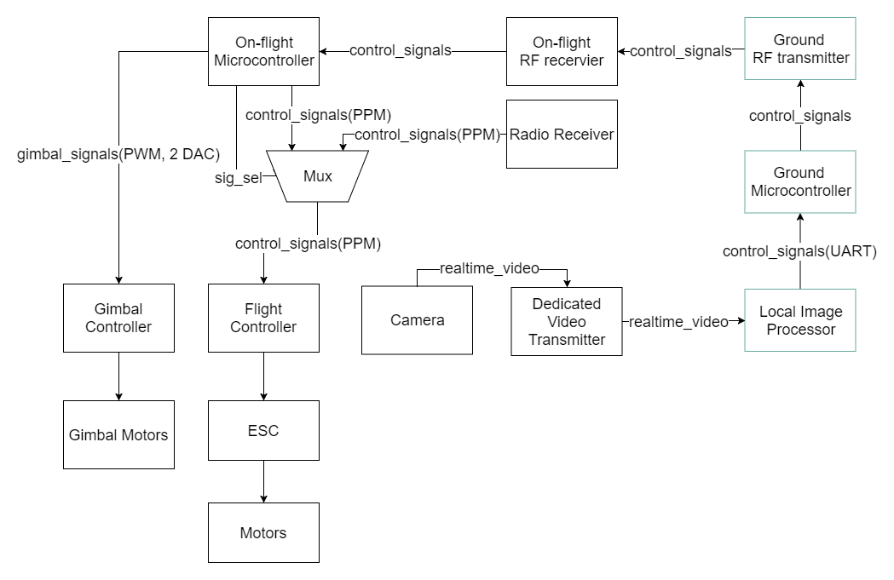
BLOCK DIAGRAM

Slide 5
DESIGN CHALLENGES
Hardware challenges:
Oscillator circuits
Power modules of the ground board
Software challenges:
Face tracking algorithm / Pose estimation algorithm
UART
Stable RF connection

Slide 6
INDIVIDUAL CONTRIBUTIONS
Xufei Gao
Software Engineer
Built the prototype of the drone
Studied and mastered the Cmake Build Tool
Used Qt as the GUI framework to build the Ground Station
Used Haar Cascade as our facial detection algorithm
Outfield testing and software debugging

Slide 7
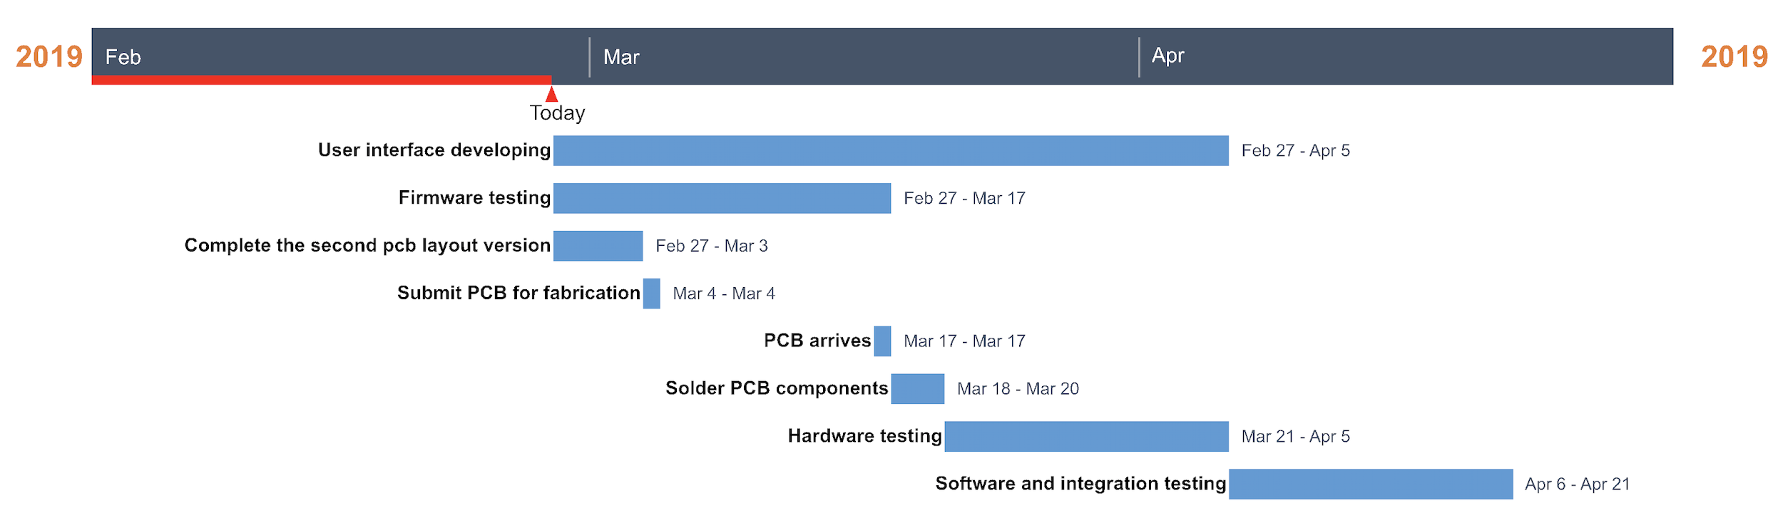
INDIVIDUAL CONTRIBUTIONS
Xingchen Wang
System Engineer:
Scheduled the timeline and monitored the process
Distributed and coordinated the work of each teammate
Worked on packaging and integration of the project

Slide 8
INDIVIDUAL CONTRIBUTIONS
Yi Qiao
Software Engineer:
Prototyped peripherals
Tested PCB
Wrote embedded firmwares
Explore and hack the face tracking algorithm
Helped with GUI application integration

Slide 9
INDIVIDUAL CONTRIBUTIONS
Haobo Chen
Hardware Engineer:
Did research on chip specifications
Designed and revised version 1 of PCB
Manufactured, tested and debugged PCB version 1
Fixed error on version 1 of PCB
Manufactured, tested PCB version 2

Slide 10
PROJECT DEMONSTRATION
An ability to communicate with flight control to perform desired movement such as moving in a specified direction for a certain distance.
An ability to communicate over RF/WiFi with the local host to receive commands so that the drone would perform the corresponding action/movement based on the commands.
An ability to control the gimbal on the quadcopter to point to a specific human face.
An ability to track face in the video and reach a reasonable framerate(above 30 fps).
An ability to detect one face precisely in a any given image frame.
https://www.youtube.com/watch?v=31_1_egfVZk

Slide 11
Questions?

