Slide 1
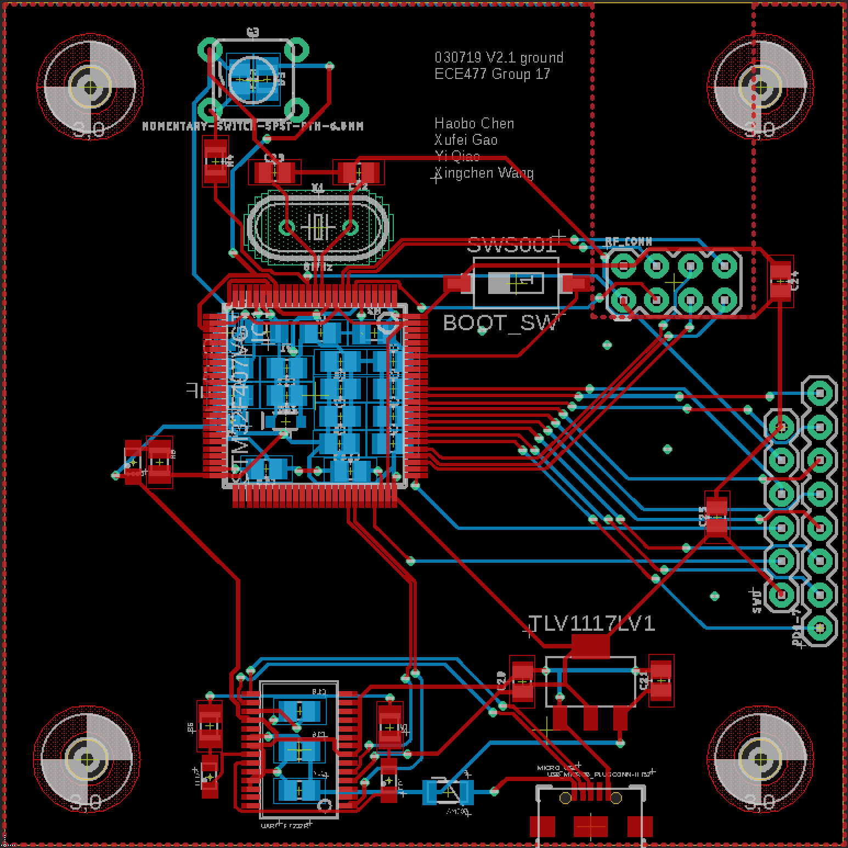
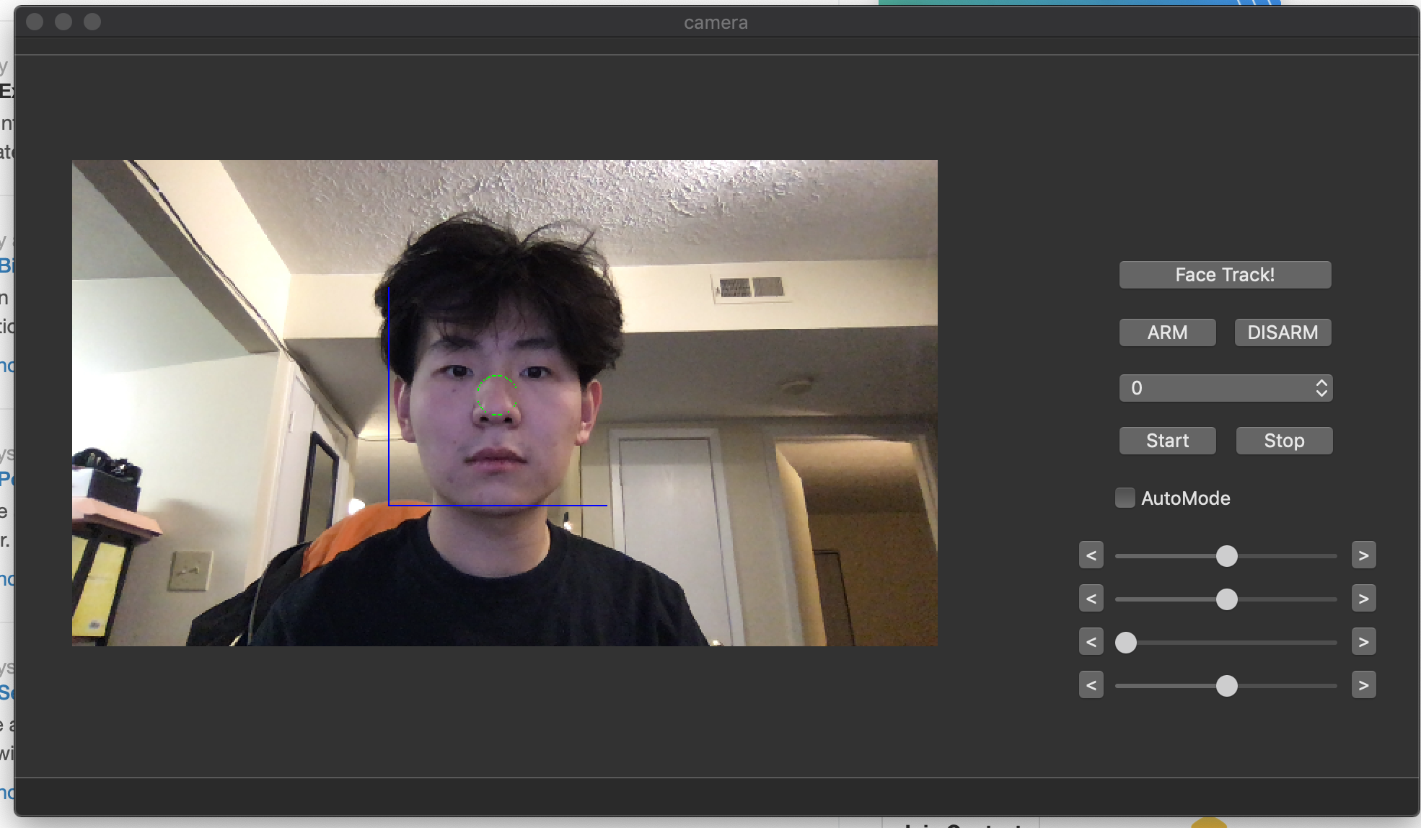
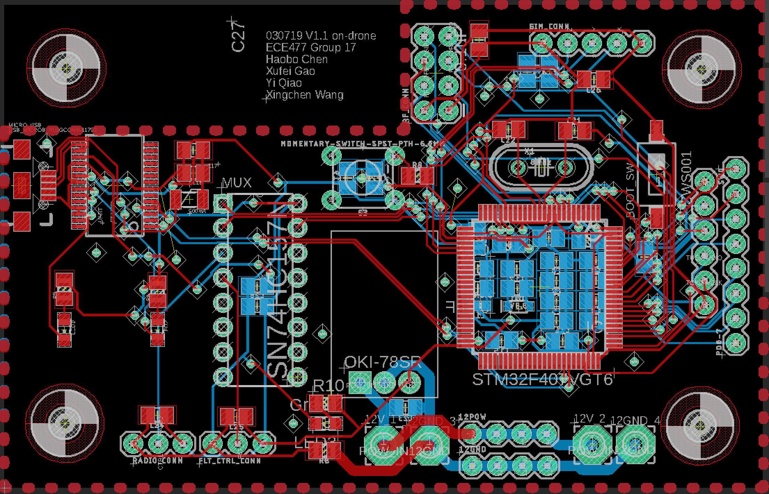
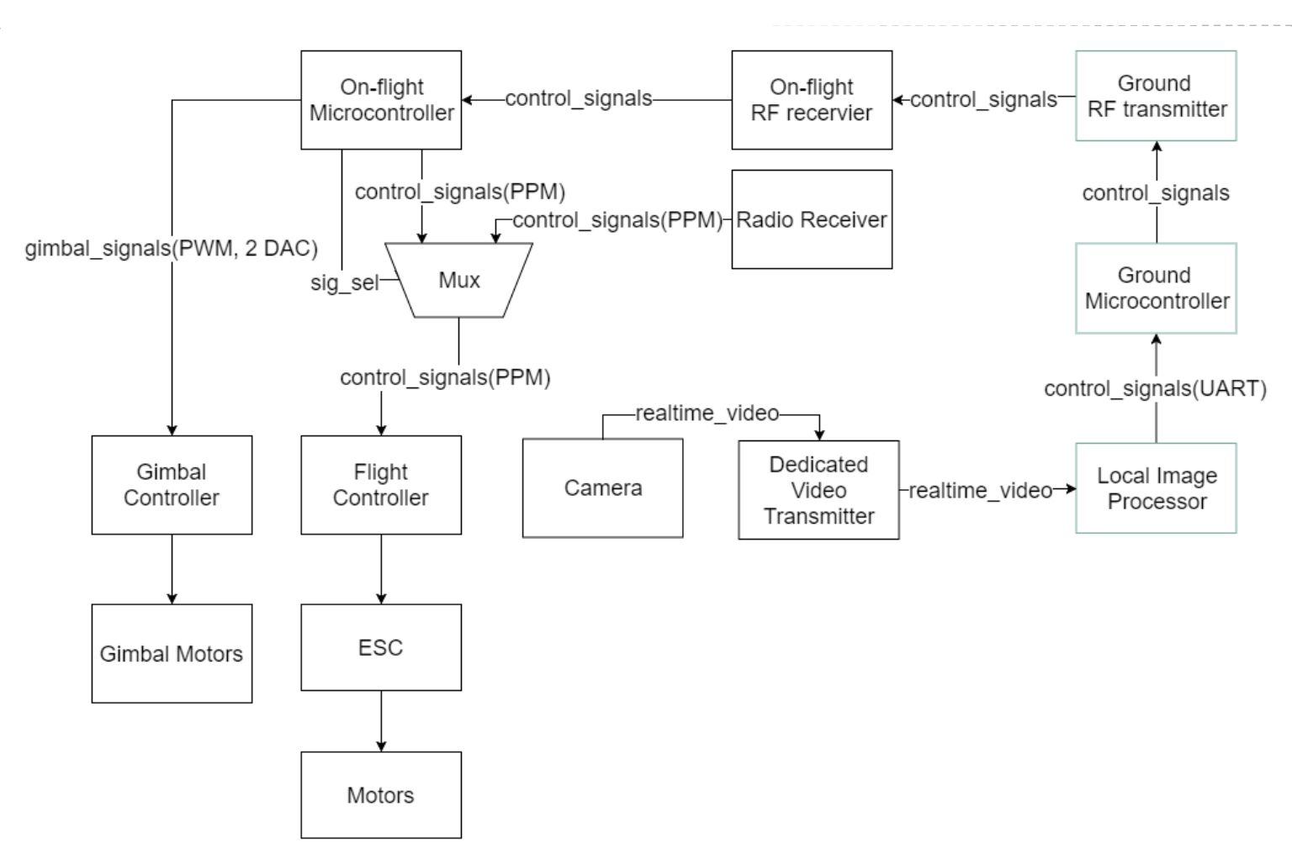
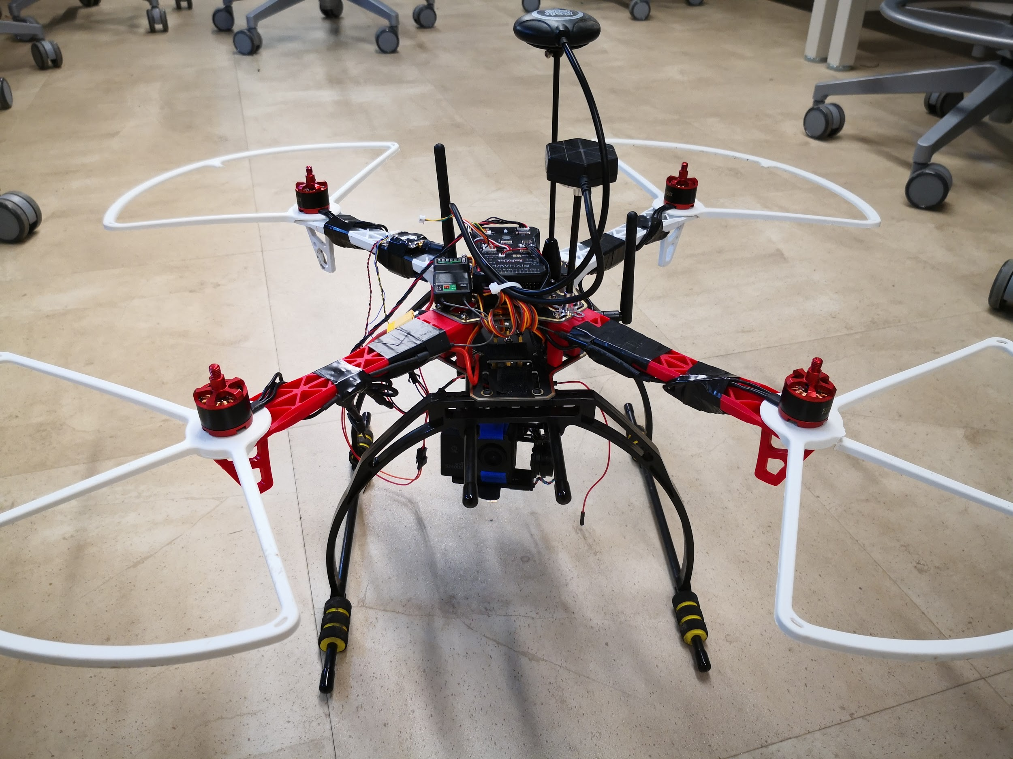
ECE477 Digital Systems Senior Design - Spring 2019
Team: AirForce17
Have you ever encountered a situation such that you couldn’t find someone holding your camera when you are ready to make some films or videos with some great ideas? This face recognizing drone can be your best support. This product is suitable for anyone who wants to make videos such as journalists, YouTubers, and performers. The drone can be toggled between manual mode and auto mode. While in auto mode, the human face is set to the center of the whole frame and the drone will adjust its own while you are moving.

