Slide 1
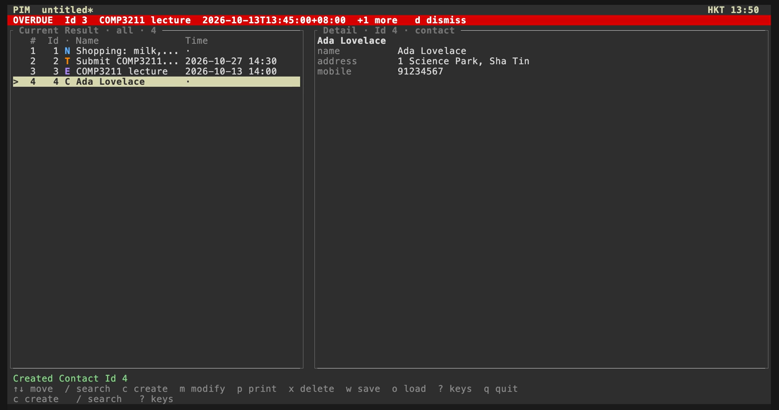
COMP3211 SOFTWARE ENGINEERING · FALL 2026
A Command-Line Personal Information Manager
Three requirements, the design, and one lesson learned
Group [number]
A [Member 1 name]
[Student ID]
C [Member 3 name]
[Student ID]
The full-screen interface: alarm band, Current Result, and details.
B [Member 2 name]
[Student ID]
D [Member 4 name]
[Student ID]
Notes:
SPEAKER A ([Member 1 name]) · about 10 seconds on this slide
[Hold your student ID card next to your face for about 5 seconds.]
Hello, we are Group [number]. In the next five minutes we present our command-line Personal Information Manager: three of its requirements, its design, and one lesson we learned while building it.

Slide 2
THE SYSTEM
One place for notes, tasks, events, and contacts
N
Note
T
Task
E
Event
C
Contact
text (required)
A quick plain-text note
description (required)
deadline (optional)
description, start (required)
Any number of alarms, relative or absolute
name (required)
address, mobile (optional)
Every record can be
create
modify
search
print
delete
save / load .pim
Each record keeps a permanent Id · Python 3 standard library only · runs in the macOS Terminal
COMP3211 Software Engineering · Group [number] · PIM System
Speaker A · [Member 1 name] 2 / 11
Notes:
SPEAKER A · about 15 seconds
Our PIM keeps four kinds of personal information record, or PIR: notes, tasks, events, and contacts. Users can create, modify, search, print, and delete them, and save everything in a dot-pim file. The whole system uses only the Python standard library.

Slide 3
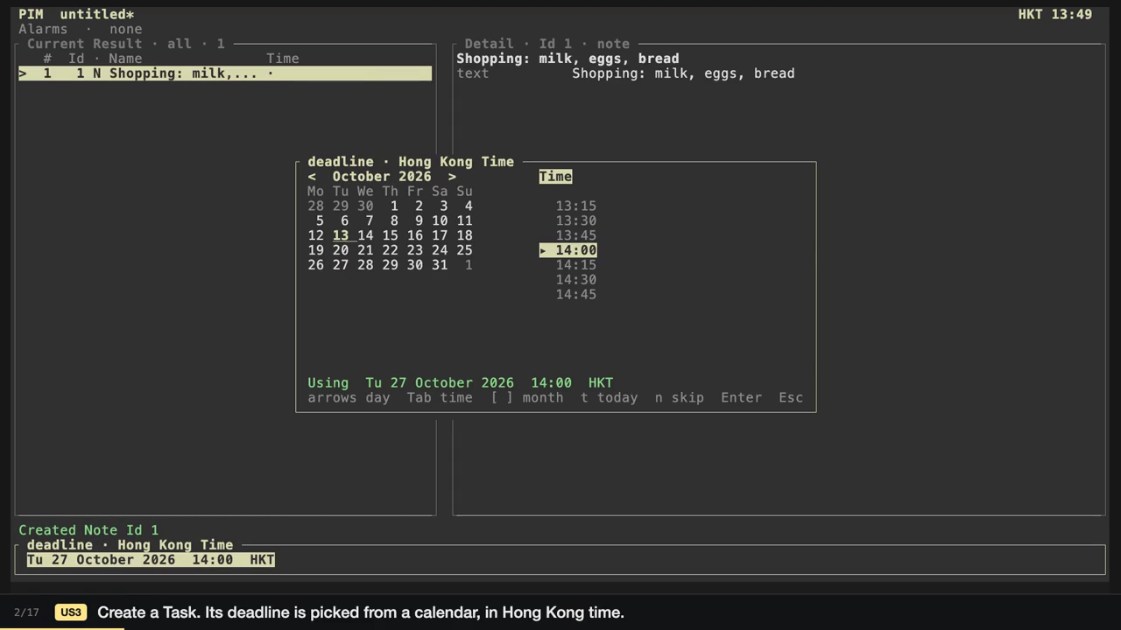
REQUIREMENT 1 OF 3
Creating a PIR
FR-1
create [type] starts a record of one of four types: Note, Task, Event, or Contact.
FR-3
The system asks for one field at a time; pressing Enter skips an optional field.
FR-10
A missing required field cancels the create and names the field: description is required.
FR-2
The new record gets the next Id (1, 2, 3 …), and an Id is never reused.
Clip (10 s, click to play): creating a Task. The deadline is picked from a calendar in Hong Kong Time.
FR-6
An Event can carry any number of alarms, relative to its start or at a fixed time.
COMP3211 Software Engineering · Group [number] · PIM System
Speaker A · [Member 1 name] 3 / 11
Notes:
SPEAKER A · about 40 seconds, including the 10-second clip
Requirement one is creating a PIR. The command create, followed by a type, starts a new record, and the system asks for one field at a time, so there is no syntax to remember. Each record gets the next Id, which is never reused. If a required field is empty, nothing is created, and the message names the field.
[Click the clip.] Here we create a Task and pick its deadline from a calendar, in Hong Kong time.
[Hand over to Speaker B.]

Slide 4
REQUIREMENT 2 OF 3
Defining a search criterion
FR-16
search <criterion> takes one line: tests on type, text, and time, joined by logic.
Type
Text
Time
type = event
description contains "COMP"
contains "ada"
deadline < 2026-11-20 20:00
alarm = 2026-11-13 13:45
Exactly one of the four types
Case-insensitive; without a field name, any text field
On deadline, start, or alarm, to the minute
Precedence
!
not: binds first
&&
and: binds next
||
or: binds last
Parentheses override the order: type = contact || !contains "comp" means type = contact || (!contains "comp")
COMP3211 Software Engineering · Group [number] · PIM System
Speaker B · [Member 2 name] 4 / 11
Notes:
SPEAKER B ([Member 2 name]) · about 35 seconds
[Hold your student ID card next to your face for about 5 seconds.]
Our second requirement defines what a search criterion is. It is a single line made of three kinds of test: the type of a record, whether a text field contains a string, and whether a time is before, after, or equal to a given instant. Tests are combined with not, and, and or. Not binds tightest, then and, then or, and parentheses can override that order.

Slide 5
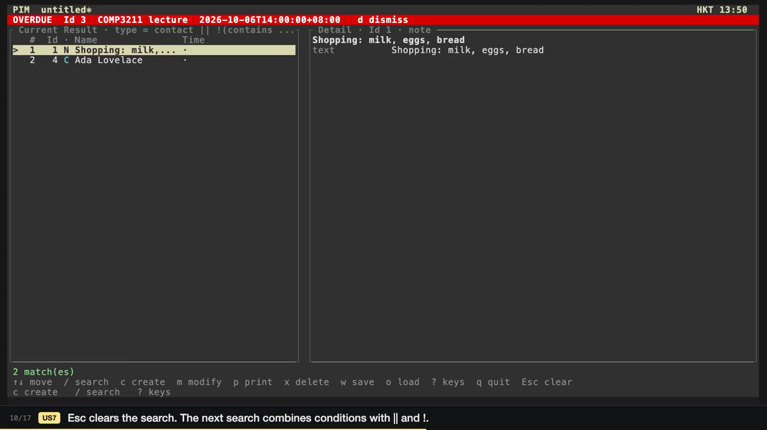
REQUIREMENT 3 OF 3
Searching for PIRs
FR-18
contains ignores case and matches any part of the text. It is never fuzzy.
FR-20
Times are compared as instants, to the minute. A missing field never matches; alarm matches if any one alarm does.
FR-22
The matches replace the list in Id order, and the first one is selected: 2 match(es).
FR-23
A syntax error changes nothing, and the typed line stays so it can be corrected.
Clip (13 s, click to play): every contact, plus every record that does not mention "comp".
COMP3211 Software Engineering · Group [number] · PIM System
Speaker B · [Member 2 name] 5 / 11
Notes:
SPEAKER B · about 40 seconds, including the 13-second clip
The third requirement says how searching behaves. Contains ignores case and is never fuzzy. Times are compared as instants, so the time zone of the input cannot change the answer, and a record without the field simply does not match. For alarms, one matching alarm is enough. The matches replace the list in Id order, and a syntax error leaves the list exactly as it was.
[Click the clip.] This search combines or with not: every contact, plus every record that does not mention "comp".
[Hand over to Speaker C.]

Slide 6
DESIGN · ARCHITECTURE
Model–View–Controller
User at a terminal
Why MVC
keys and lines
view
Terminal · CursesUI · widgets
1
The brief asks for all model code in a separate model package.
one call per action
controller
App · errors
2
It fits the program's loop: read an action, change the data, redraw.
model calls
3
Two front ends, full-screen and line-by-line, share one controller.
model
PIM · PIR classes · Criterion · pimfile
read · atomic write
4
The model is tested without a screen or a real clock.
PIM File (.pim, UTF-8 JSON)
COMP3211 Software Engineering · Group [number] · PIM System
Speaker C · [Member 3 name] 6 / 11
Notes:
SPEAKER C ([Member 3 name]) · about 30 seconds
[Hold your student ID card next to your face for about 5 seconds.]
For the design, we chose the Model–View–Controller pattern, for four reasons. First, the brief requires all model code in a separate package called model. Second, MVC fits the program's loop: read an action, change the data, redraw the screen. Third, our two front ends, full-screen and line-by-line, share one controller. And fourth, the model can be tested without a screen or a real clock.

Slide 7
DESIGN · INSTANTIATION
How the pattern is instantiated
# pim.py, the composition root
def main():
pim = PIM() # model
app = App(pim) # controller
Terminal(app).run() # view
model/
M
PIM, the PIR classes, alarms, Criterion, pimfile. Every rule and the file format.
controller/
C
App and errors. One completed user action becomes model calls and one status line.
Dependencies point one way
view
controller
model
view/
V
model imports neither view nor controller, so its unit tests need no interface at all.
Terminal, CursesUI, widgets. The event loop, prompts, Alarm Alerts, and drawing.
COMP3211 Software Engineering · Group [number] · PIM System
Speaker C · [Member 3 name] 7 / 11
Notes:
SPEAKER C · about 20 seconds
Here is how the pattern is instantiated. The file pim.py is the composition root: it creates the PIM, passes it to the App controller, passes that to the Terminal view, and runs it. Each component is a package, and dependencies point one way only, from view to controller to model.

Slide 8
DESIGN · MAIN CODE COMPONENTS
The main classes and how they relate
CursesUI
full-screen front end
drives
Terminal
prompts · line interface
calls
App
controller
calls
PIM
Working Collection
holds · uses
pimfile
JSON codec · atomic write
PIR
abstract base class
Criterion
Composite tree
inherit
Leaves: TypeIs · Contains · TimeCompare
Combinators: And · Or · Not
Note
Task
Contact
Event
Alarms
Relative · Absolute
owned by each Event
Arrows show calls and use; the bar under PIR joins its four subclasses; the diamond marks ownership. The design document lists every field and method.
COMP3211 Software Engineering · Group [number] · PIM System
Speaker C · [Member 3 name] 8 / 11
Notes:
SPEAKER C · about 25 seconds
These are the main classes. CursesUI drives the Terminal, which calls App, which calls PIM, the Working Collection. PIM holds the records: Note, Task, Contact, and Event all extend the abstract class PIR, and each Event owns its alarms. PIM searches with a Criterion tree and reads and writes files through pimfile.
[Hand over to Speaker D.]

Slide 9
DESIGN · SEARCH CRITERIA
A criterion is a tree built inside the model
search type = event && description contains "COMP"
1
Composite pattern. Leaves test one record; And, Or, and Not combine smaller criteria.
parse_criterion in model
And
2
The parser lives in the model. parse_criterion turns one line into the tree, with ! before && before ||.
TypeIs("event")
Contains("description", "comp")
3
So all of US7 can be unit-tested, grammar and matching, without the view.
PIM.search asks the root matches(pir) for every record; And asks its children.
COMP3211 Software Engineering · Group [number] · PIM System
Speaker D · [Member 4 name] 9 / 11
Notes:
SPEAKER D ([Member 4 name]) · about 20 seconds
[Hold your student ID card next to your face for about 5 seconds.]
One design detail turned out to matter most. A search criterion is a Composite tree: the leaves test one record, and And, Or, and Not combine smaller criteria. The parser that builds this tree, parse_criterion, lives in the model, not in the view.

Slide 10
LESSON LEARNED · UNIT TESTING
Put every rule where a unit test can reach it
Problem
Decision
Result
Takeaway
Search mixes field tests, three time operators, missing values, alarm lists, and operator precedence.
Alarms also depend on the clock. Testing all that through the terminal needs scripted keys and real time.
We decided early to keep every rule in model.
parse_criterion is a plain function, and due_alarms(now) takes the time as an argument.
The search tests share one six-PIR fixture.
100 %
If a rule cannot be tested through the model's interface, it is in the wrong place.
line coverage of model: 800 of 800 lines
Search is tested with plain unittest calls: no screen, no clock.
The model rules are tested directly, without a screen or clock.
COMP3211 Software Engineering · Group [number] · PIM System
Speaker D · [Member 4 name] 10 / 11
Notes:
SPEAKER D · about 40 seconds
That leads to our lesson about unit testing. Search mixes field tests, time operators, missing values, and precedence, and alarms depend on the clock. Testing that through the terminal would mean scripted keystrokes and waiting for real time. So we keep each rule in the model, expose the parser as a plain function, and pass the current time in as an argument. That lets unit tests check search and alarms directly, without the screen or the wall clock. Our takeaway: if a rule cannot be tested through the model's interface, it is in the wrong place.

Slide 11
SUMMARY
What we built and what we learned
11 / 11
53 / 53
800 / 800
4
user stories implemented
SRS requirements implemented
countable model lines covered
PIR types
1
Requirements
2
Design
3
Lesson
Create a PIR, define a criterion, and search, each stated so it can be tested.
MVC in three packages, with the model as the test surface and criteria as a Composite tree.
Testability decided where code lives: every rule sits where a unit test can reach it.
Thank you.
COMP3211 Software Engineering · Group [number] · PIM System
Speaker D · [Member 4 name] 11 / 11
Notes:
SPEAKER D · about 10 seconds
To sum up: all eleven user stories and every requirement in our SRS are implemented, and the unit tests execute every countable model line. Thank you for watching.

