Slide 1

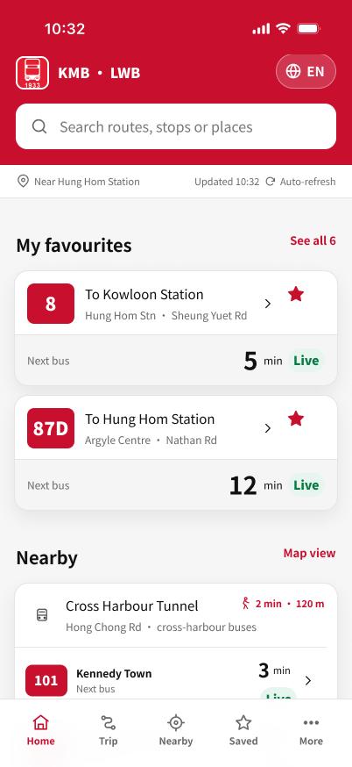
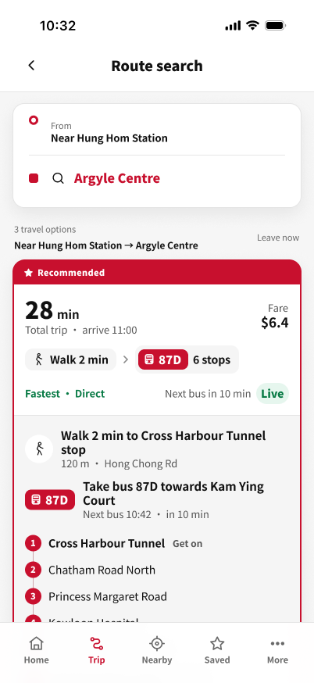
Re-designing App1933
COMP3423 Human Computer Interaction · Group A21
A new interface for KMB and LWB bus passengers, built around one question: when is my bus coming?
Haochen Fa
Project Lead & UX Strategist
Chenyang Zhang
User Researcher
Xulu Zhang
Interaction Designer
Li-En Lo
Visual & UI Designer
Moling Kong
Accessibility & Evaluation Lead
The Hong Kong Polytechnic University · Semester 1, 2026/27
Notes:
Presenter: Haochen Fa (Project Lead) · about 10 seconds.
Hello, we are Group A21. Our project redesigns App1933, the official app of KMB and Long Win Bus. Each of us will present the part we led.

Slide 2


Two groups of passengers, one question
When is my bus
coming?
Older passengers
Know places, not route numbers or stop codes
Find small text hard to read
May take a sudden full-screen advert for a scam
Most people open App1933, the official app of Kowloon Motor Bus and Long Win Bus, to answer that question. Less often they look up a route, plan a trip or look for a stop nearby.
Real-time arrival times help when riders trust them: riders who used them waited almost two minutes less (Watkins et al., 2011). Satisfaction rose less among older riders (Ferris et al., 2010).
Students and daily commuters
Confident phone users, short of time
Often use the phone one-handed while walking
Want their usual route and its next bus at once
We studied v2.3.38 for iOS and checked it on an iPhone running v2.3.39.
Notes:
Presenter: Haochen Fa · about 30 seconds.
Most people open App1933 for one reason: to see when their bus is coming. We designed for two groups. Older passengers often know where they are going but not the route number, and small text and sudden adverts put them off. Students and commuters are confident users who are short of time and often use the phone with one hand. Research on real-time information shows it shortens waits when riders trust it, though satisfaction rose less among older riders.

Slide 3
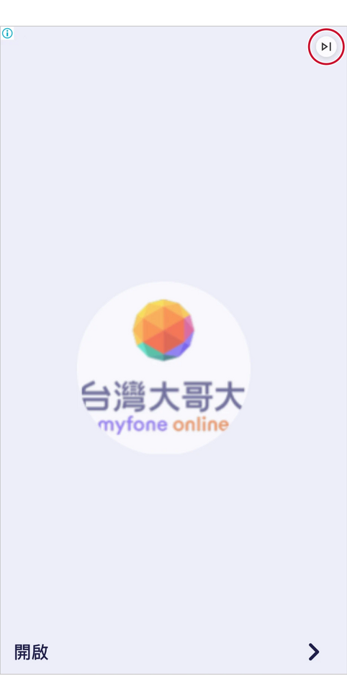
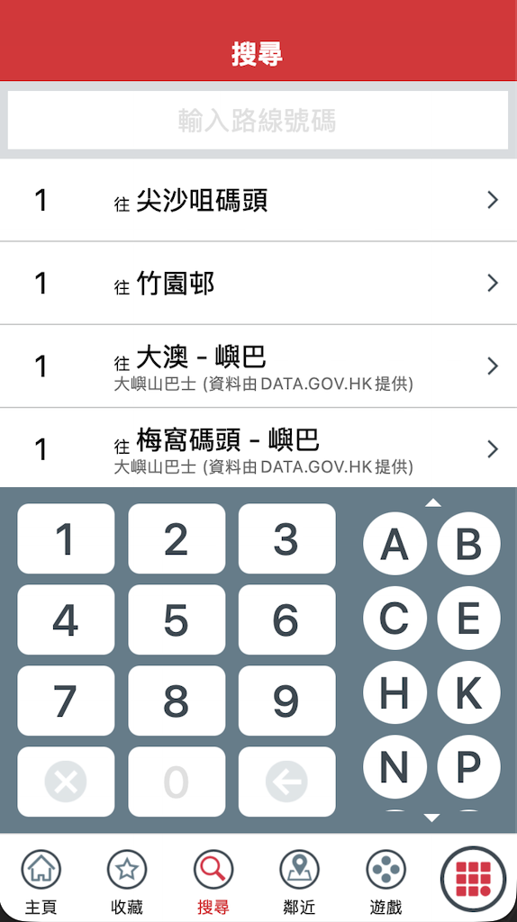
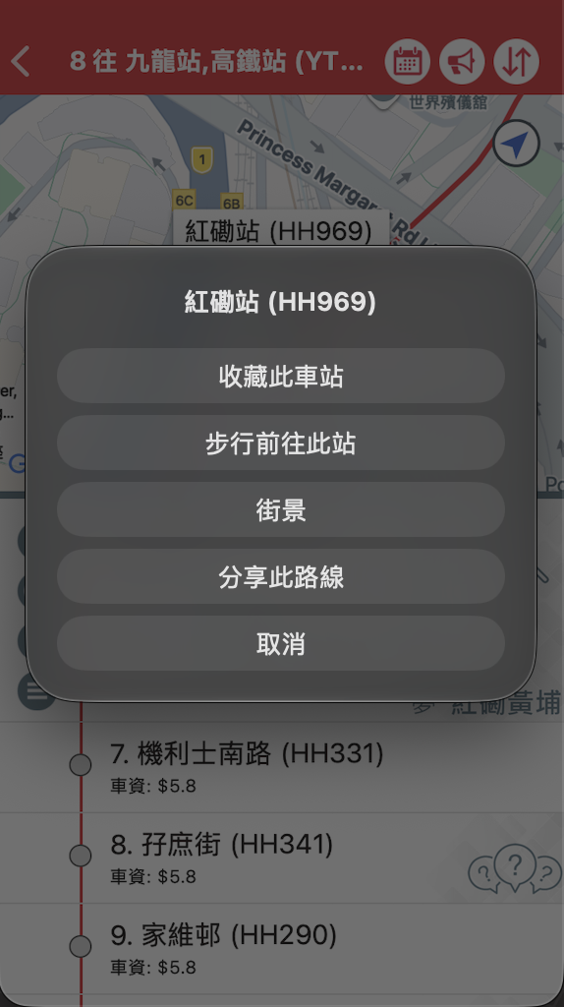
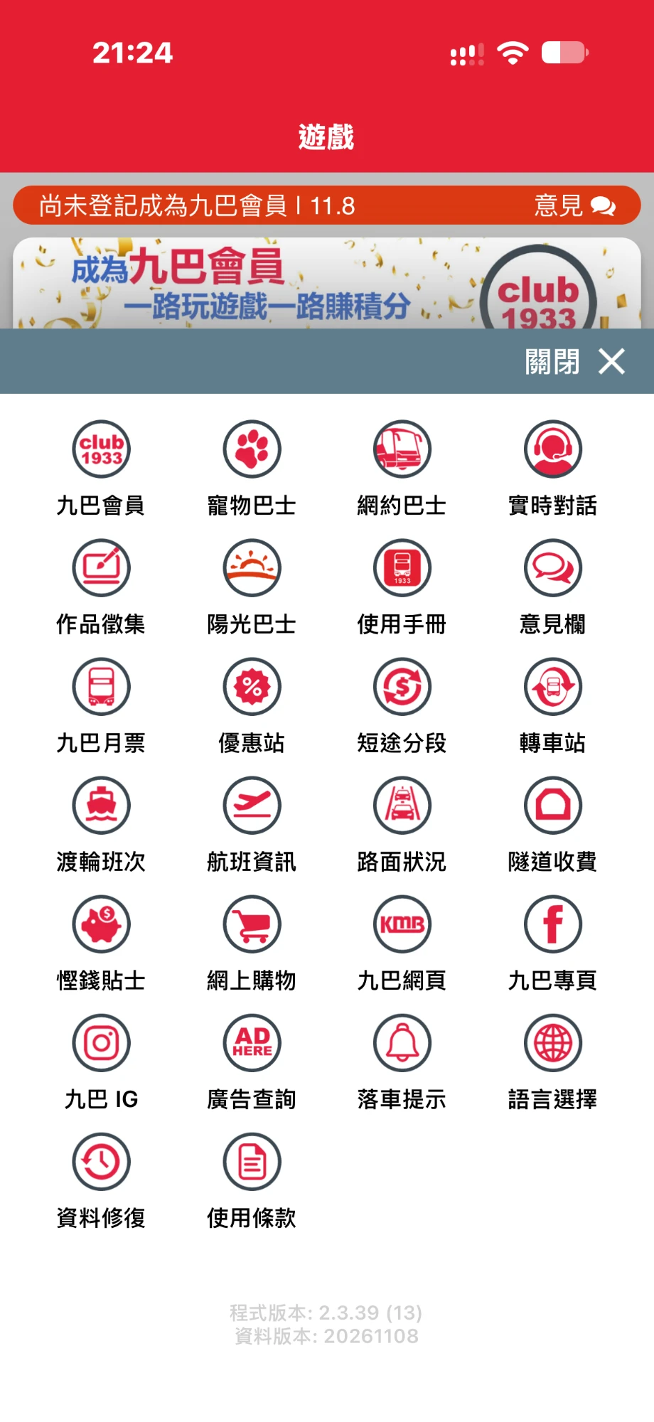
Today, both groups work hard for that answer
An advert comes first
Route numbers only
Seven taps to save a stop
26 unsorted icons
On opening, a full-screen advert whose only exit is a skip button about 6% of the screen wide.
Search accepts route numbers, so a passenger who knows the place but not the bus cannot start.
Save is hidden behind an unlabelled icon and a dark pop-up menu.
None changes the text size, and the app ignores the iPhone's own text size.
Real screenshots: App1933 v2.3.38 on a Mac, and v2.3.39 on an iPhone (advert and menu, 8 Nov 2026).
Notes:
Presenter: Haochen Fa · about 40 seconds.
These are real screenshots of the current app. It opens on a full-screen advert with a tiny skip button. Search only accepts route numbers. Saving a stop takes seven taps through an unlabelled icon and a pop-up. And the menu is 26 unsorted icons, none of which changes the text size; the app also ignores the iPhone's own text-size setting.

Slide 4
Both journeys bottom out at launch and at search
1 Opening the app
2 Searching
3 Reading and waiting
4 Afterwards
Emotion
0
Older passenger (observed)
−2
−2
−2
Commuter (app-store reviews)
−3
−3
−3
−3
−3
−3
Older passenger
Full-screen advert on launch; suspects the app is a scam
Asked for route numbers or stop IDs; place names fail
Small text; banner adverts over fares and times
Gives up; goes back to stop signs and asking people
Student / commuter
Forced 10–15 s advert with a tiny skip button
Smart Search changes the destination
Countdown jumps (5, then 8 min); buses vanish unexplained
Keeps using it reluctantly; tries other apps
Addressed by
F1 Home
F2, F3, F4
F1, F2, F5
All five
Dual-track journey map from our checkpoint research. Emotion runs from 0 (neutral) to −3 (very negative).
Notes:
Presenter: Chenyang Zhang (User Researcher) · about 50 seconds.
Our journey map follows both groups through four stages. The older passenger's track comes from observation, the commuter's from app-store reviews. Both reach their lowest point at launch, where an advert stands between them and the arrival time, and at search, where the app wants route numbers or stop codes and its smart suggestion can change what they typed. Reading arrival times is a smaller dip. The bottom row shows which feature answers each stage.

Slide 5
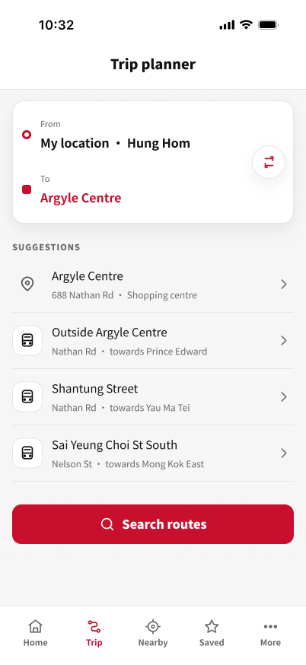
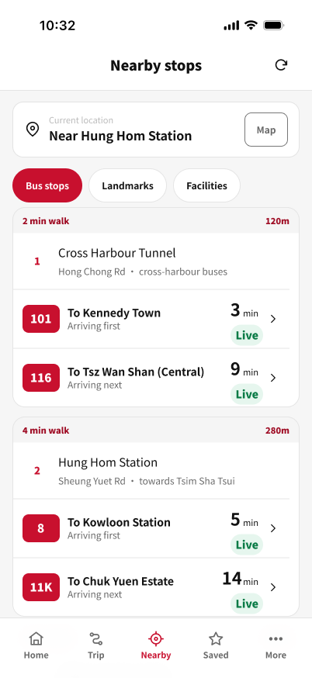
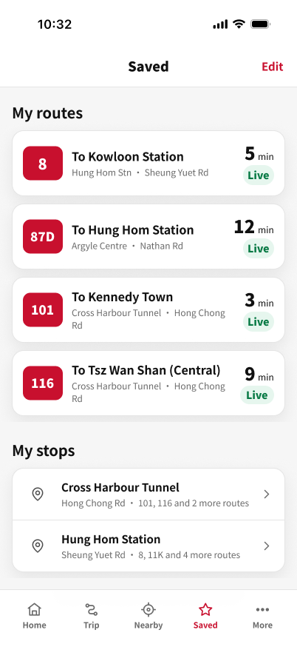
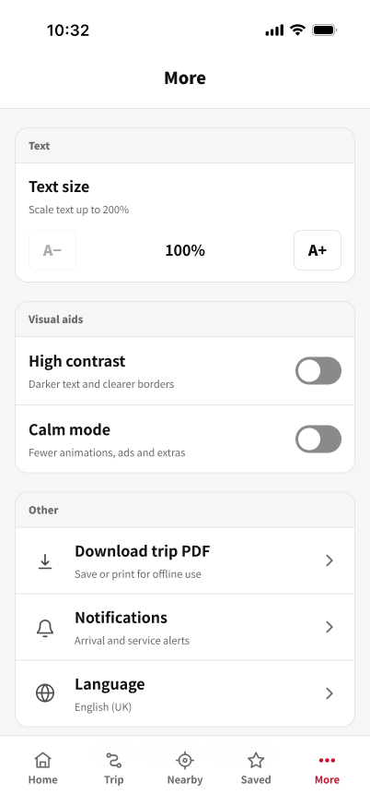
Five tabs, each answering one question
Home
Trip
Nearby
Saved
More
When is my usual bus coming?
How do I get to a place?
What can I catch from here?
Where are my routes and stops?
How do I change text size or language?
This replaces six bottom-bar items and a menu of 26 unsorted icons. Route detail opens from Home, Saved, Nearby and Landmarks, so a route looks and behaves the same wherever it is tapped.
Notes:
Presenter: Xulu Zhang (Interaction Designer) · about 20 seconds.
We cut the navigation to five labelled tabs, and each one answers a single question. Route detail is a shared screen: it opens the same way from Home, Saved, Nearby and Landmarks. Every screen keeps the tab bar, so you are always one tap from a known place.

Slide 6
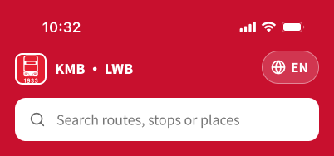
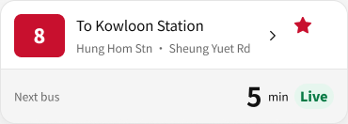


Red is for actions; status is always written out
Colour
Type · Noto Sans HK
Components (English screens)
Brand red #C8102E
28 pt
Arrival minutes
Header, route badges, primary buttons, active tab · white text 5.88:1
Ink #111111
20 pt
Section titles
Titles and arrival minutes
16 pt
Header, search
Secondary grey #696969
Streets and labels · 5.49:1
15 pt
Card titles
Background #F5F5F5
12 pt
Streets, labels
Neutral containers
Live #087A45
11 pt
Badges, tab labels
On #E6F6EE · 4.84:1
Scheduled / Diverted #9A4C00
Every arrival time is the largest text on its card. Status is always written out, never shown by colour alone.
On #FFF1DF · 5.55:1
Notes:
Presenter: Li-En Lo (Visual & UI Designer) · about 15 seconds.
We kept KMB's red but use it only where you can act: the header, route badges, primary buttons and the active tab. Content sits on white and light grey, arrival minutes are the largest text on each card, and every status is written out, never shown by colour alone.

Slide 7
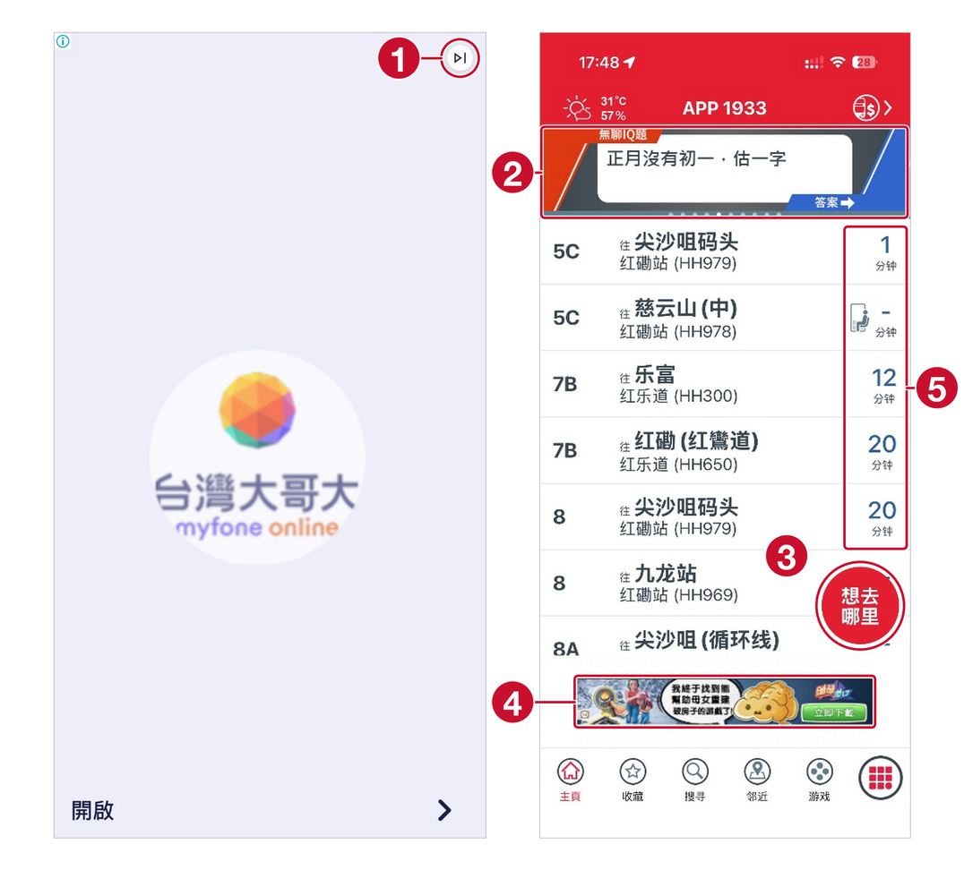
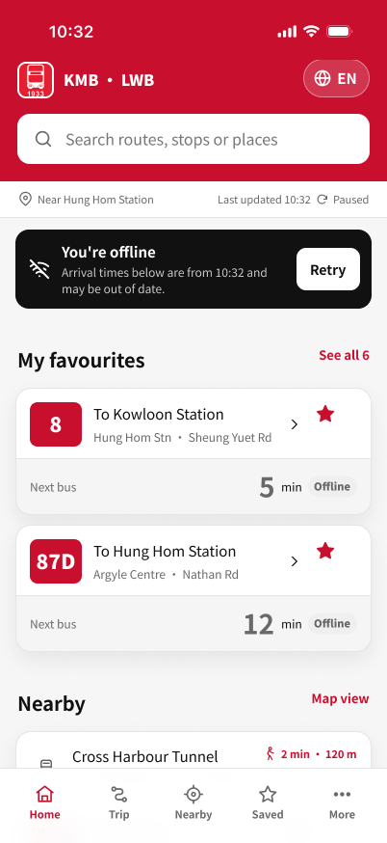

F1 Home: the next bus first, not an advert
Before App1933 on an iPhone (v2.3.39)
After redesign, English prototype
9/9
read the next Bus 8 correctly
8 of 9 rated reading bus information easy or really easy.
1
Advert on opening; only a small skip button
4
Banner advert inside the route list
F1 Home: saved routes first, every time labelled
S6 Offline: old times marked, with Retry
2
Rotating quiz and promotion banner
5
Minutes not labelled Live or Scheduled
H7 Flexibility and efficiency
H1 Visibility of system status
3
Floating button covers arrival times
H3 User control
H8 Minimalist design
Notes:
Presenter: Li-En Lo · about 15 seconds.
Before: an advert on opening, a promotion banner, a floating button over the times, and minutes with no sign of whether they are live. After: Home opens on your saved routes with the next bus in the largest type, every time is labelled Live or Scheduled, and the offline state says plainly that the times are old. All nine participants read the next Bus 8 correctly.

Slide 8
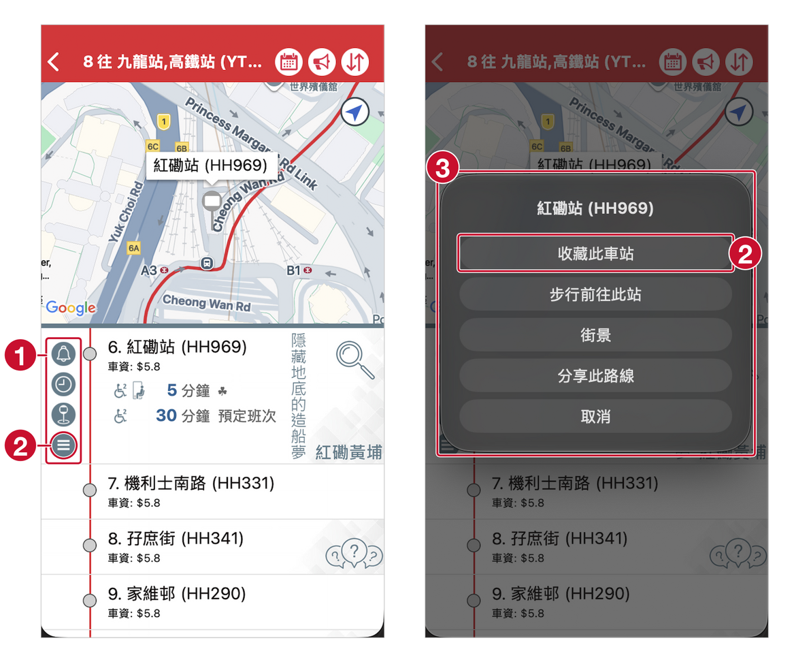
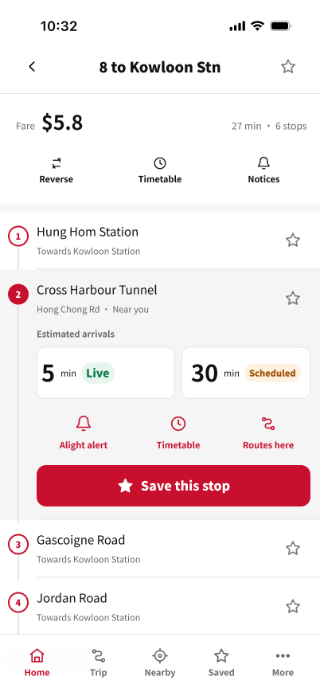
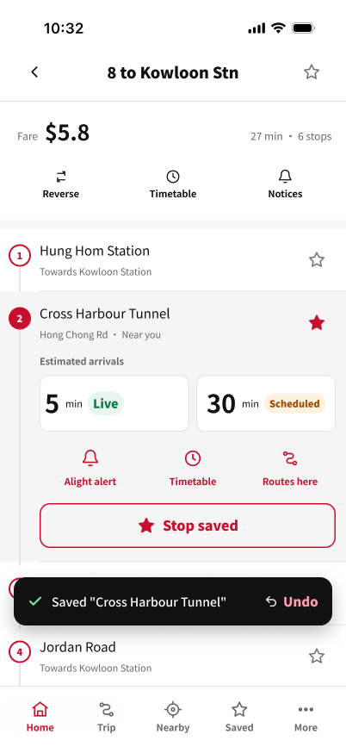
F2 Save: a star on every stop, and Undo
Before App1933 v2.3.38
After redesign, English prototype
8/9
saved the stop
But only 2 of 9 found the expected way to the route screen. More on this in the results.
1
Four stop tools shown as unlabelled round icons
F2 Route detail: a star on every stop, a Save button
F2A Saved: the star fills, Undo in a toast
2
Save hides behind one of them, in a menu
H6 Recognition rather than recall
Fitts' law
H3 Undo
3
A dark pop-up covers the stop list
Visible signifiers
Seven taps from Home to save a stop, in our count.
Notes:
Presenter: Xulu Zhang · about 15 seconds.
Before: four unlabelled icons, with Save hidden behind one of them in a pop-up menu. After: every stop has a large star, the nearest stop has a labelled Save button, and saving shows an Undo toast instead of a dialog. Eight of nine saved the stop, but only two found the expected way to the route screen; we come back to that in the results.

Slide 9
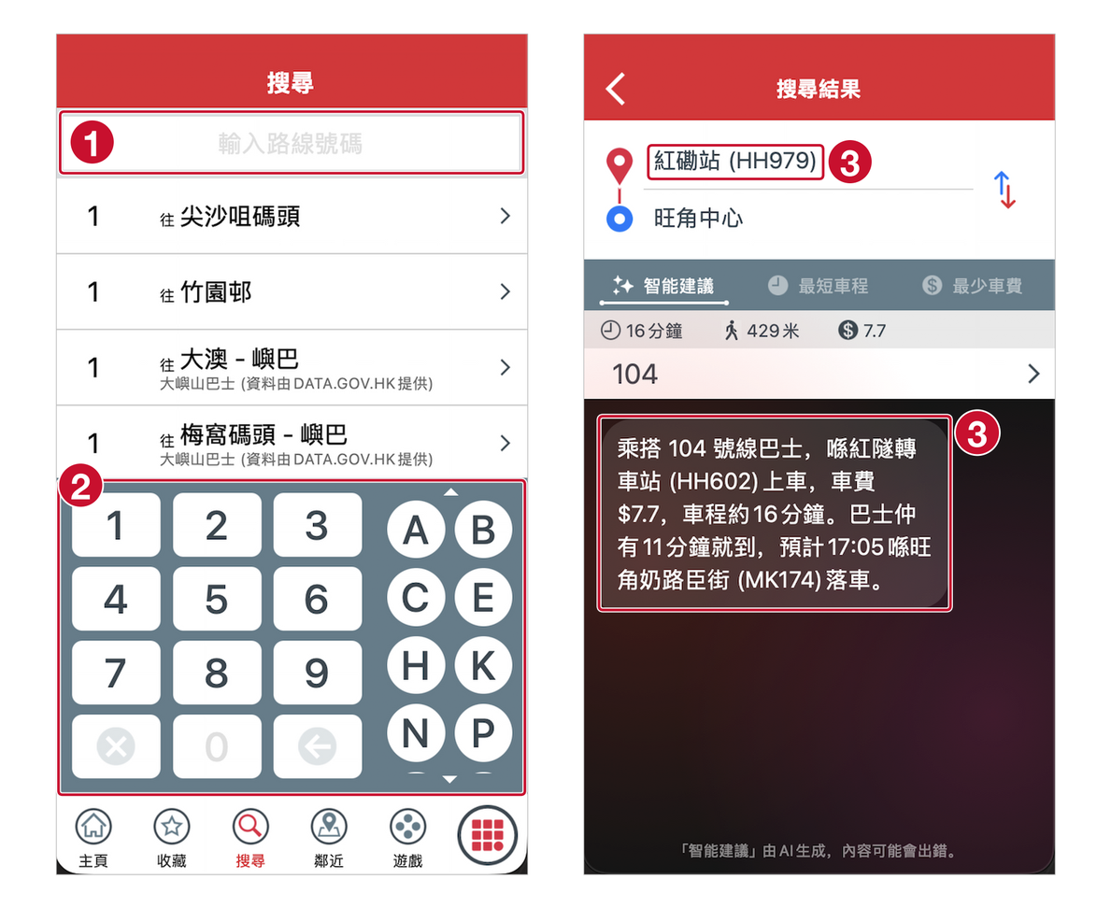
F3 Trip: search by place, starting from here
Before App1933 v2.3.38
After redesign, English prototype
8/9
planned the trip by the expected path
All 9 succeeded, and all 9 rated route search easy or really easy.
1
Search takes route numbers only
F3 Origin preset to your location
F3A Recommended option first, with legs and next bus
2
The keypad covers most of the screen
H2 Match with the real world
H6 Recognition
H5 Error prevention
3
The suggestion boards at HH602, not the HH979 you entered, and does not say so
H3 User control
Notes:
Presenter: Xulu Zhang · about 15 seconds.
Before: search by route number only, a keypad over most of the screen, and a smart suggestion that quietly boards you at a different stop. The planner's origin even starts as "null". After: the origin is preset to your location, you type a place name, and suggestions show the type and street of each place. All nine planned the trip, eight by the expected path.

Slide 10
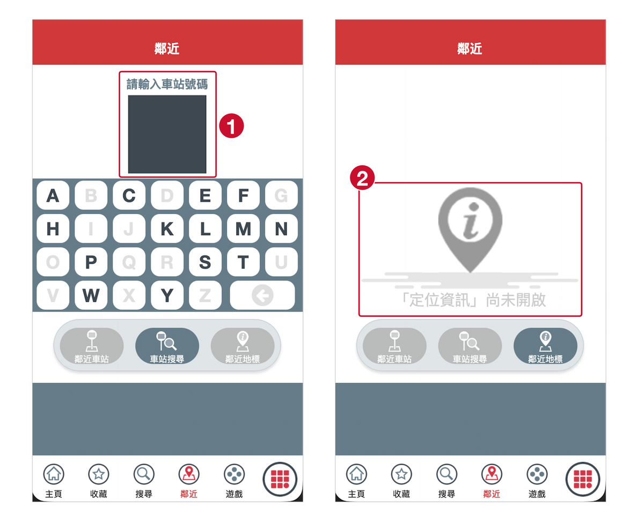
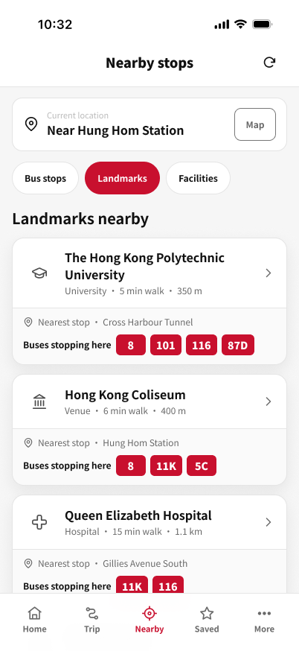
F4 Nearby: stops by street and walking time
Before App1933 v2.3.38
After redesign, English prototype
9/9
named both buses to Queen Elizabeth Hospital
All 9 found a nearby stop, and 8 of 9 picked the first bus correctly.
1
Stop search asks for a stop code on a letter keypad
F4 Stops with walking time, street and next buses
F4B Landmarks with their category and buses
2
Location off: one line of text and no way forward
H2 Match with the real world
H6 Recognition
H9 Recover from errors
H4 Consistent list and map
Notes:
Presenter: Li-En Lo · about 15 seconds.
Before: Nearby asks for a stop code, and with location off it shows one line of text and no way forward. After: each stop shows walking time, street and the next buses, and the Landmarks filter lists places with the buses that serve them. All nine named both buses to Queen Elizabeth Hospital.

Slide 11
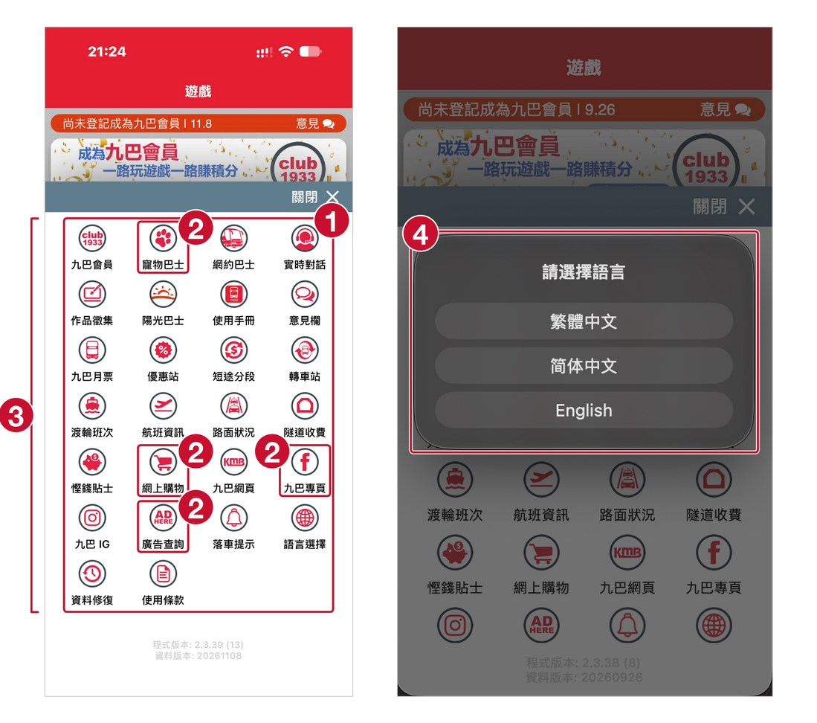
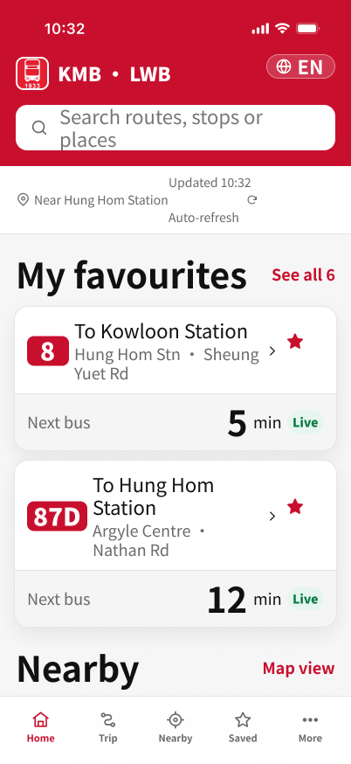
F5 More: grouped settings, text up to 200%
Before App1933 v2.3.39 (iPhone) and v2.3.38
After redesign, English prototype
9/9
read the next Bus 116 at the largest text size
7 of 9 went to More as their very first move.
1
26 icons in one unsorted grid
3
No text-size or display setting
F5 More: Text, Visual aids and Other
F1 Home at 200%: headings double, body about 1.5×
2
Promotions and social media among service tools
4
Language pop-up with no Cancel
Hick's law
H8 Minimalist design
H3 User control
WCAG 1.4.4 Resize text
Notes:
Presenter: Moling Kong (Accessibility & Evaluation Lead) · about 15 seconds.
Before: 26 unsorted icons mixing promotions with service tools, no text-size setting, and a language pop-up with no Cancel. After: three headed groups, with text size at the top of More. The steps are labelled 100, 150 and 200 percent; at the largest step headings double and body text grows about one and a half times. All nine read the next Bus 116 at that size.

Slide 12
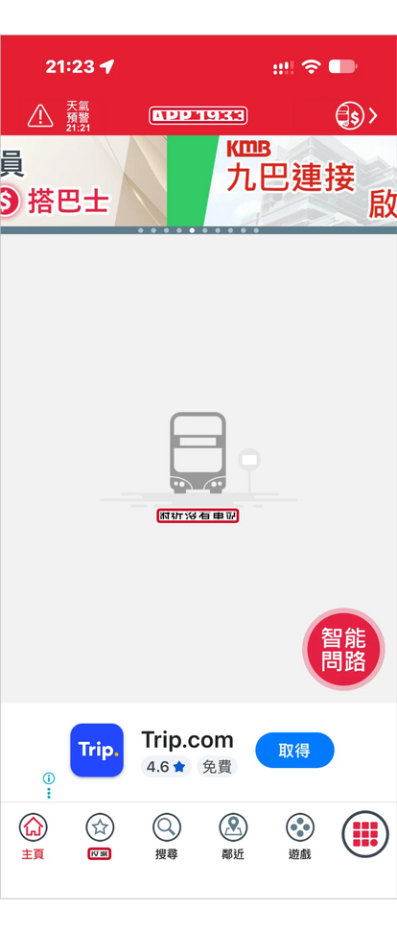
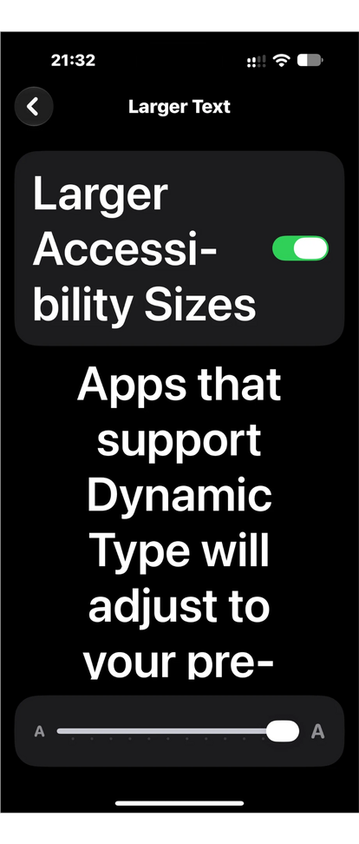
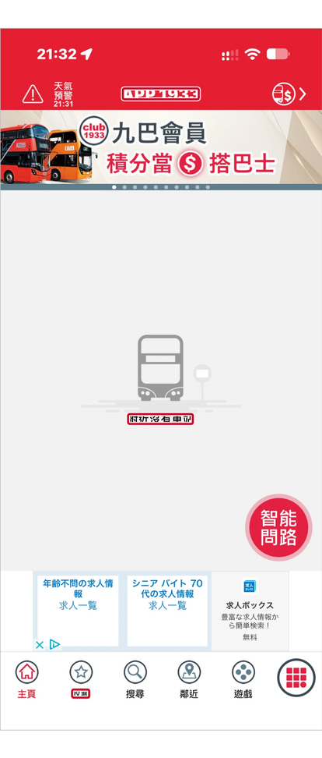
Accessibility: audited before, measured after
Home, 21:23
default text size
iOS Larger Text
slider at maximum
Home, 21:32
after the change
Check | Original app | Redesign
Contrast (1.4.3) | Search hint 1.4:1; Nearby buttons 1.9:1 | 1,155 of 1,169 text layers at 4.5:1 or more
Target size (2.5.8) | Stop icons 26 pt; advert skip button about 24 pt | None of 98 links under 24 pt; 84 (86%) at 44 pt or more
Text size (1.4.4) | No setting, and the phone's size is ignored | 100%, 150% and 200% steps at the top of More
Arrival status | Live and timetable minutes look the same | Live, Scheduled and Offline written out, not colour alone (1.4.1)
Screen reader | Most content not exposed to assistive technology | Labels specified in the design only; not tested
9/9
Redesign figures were computed by script from the Figma file, so they are close estimates rather than a formal audit.
The boxed text is the same size to the pixel before and after: App1933 ignores the iPhone's text size (WCAG 1.4.4). iPhone, v2.3.39, 8 Nov 2026.
read the next Bus 116 at 200% text in the test
Notes:
Presenter: Moling Kong · about 25 seconds.
We audited the original app against four WCAG basics. The clearest failure is text size: with the iPhone's Larger Text at maximum, Home stays exactly the same size, to the pixel. In the redesign, almost all text meets 4.5 to 1, no link is smaller than 24 points, and 86 percent reach 44. We could not test a screen reader in Figma, so labels are specified in the design only.

Slide 13
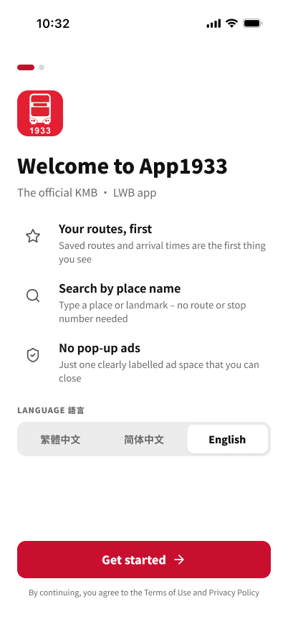
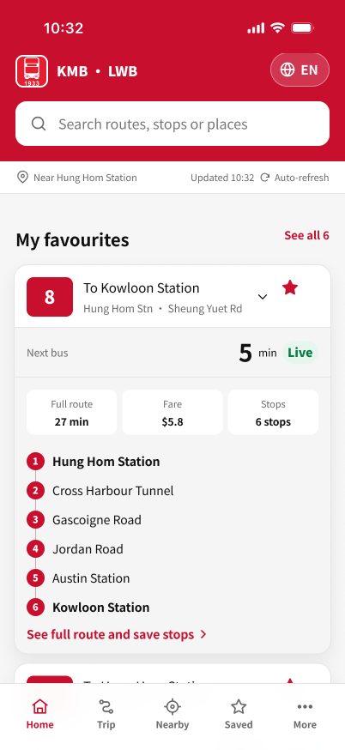
Live walkthrough of the tested prototype
A
Commuter
Check the bus, then save a stop and undo it
Welcome
Home
Expand route 8
Route detail
Save, then Undo
B
Older passenger
Plan by place name, find a landmark, enlarge the text
Prototype: flow "First launch (en-GB)"
Plan a trip
Results
Landmarks
More
Home at 200%
Notes:
Presenter: Xulu Zhang · about 1 minute 40 seconds.
Switch to Figma. Open the prototype in Present mode with the iPhone device frame and start the flow "First launch (en-GB)".
Scenario A: tap Get started, allow location, expand route 8 on Home, open the full route, save Cross Harbour Tunnel, then tap Undo.
Scenario B: open Trip, tap the Argyle Centre suggestion and look at the recommended result; open Nearby and choose Landmarks; then open More, press A+ twice and go back to Home.
Screens do not scroll in Present mode, so stay on what is visible.

Slide 14



Nine people tested the English prototype
9
21
9.2 min
Each person opened the Maze link alone, on their own device, with no moderator. Some talked to our User Researcher afterwards; the researcher's notes are the source of the quotes.
participants, 5–7 Nov 2026
Maze blocks in one study
median study time (6.7–22.4)
1
2
3
4
5
6
7
8
9
10
11
12
13
14
15
16
17
18
19
20
21
Start
F1
F2
F3
F4
F5
End
Task in the prototype (9)
Question on what they read (6)
Ease rating (5)
Overall rating (1)
Age 18 to 48, median 19
Device most taps were mouse clicks
Aged 60+: a target group, none tested
Laptop 5
Phone 3
Tablet 1
20
30
40
50
60
70
Touch-target size and thumb reach were therefore barely tested.
Notes:
Presenter: Chenyang Zhang · about 25 seconds.
Nine people took the test between 5 and 7 November, alone and remotely, with no moderator. The study had 21 blocks: nine tasks in the prototype, six questions checking what people read, five ease ratings and one overall rating. Participants were 18 to 48, and none was 60 or over, although older passengers are one of our target groups. Five used a laptop, so most taps were mouse clicks.

Slide 15
All nine finished; 78 of 81 attempts succeeded
71/100
Maze usability score
45/54
answers on what they read were correct (83%)
9/9
rated the redesign Good (8) or Very good (1)
10/24
direct successes for phone users, against 35/40 on laptops
Participants per mission (n = 9). Maze counts any route other than the single expected path as indirect, even a shorter one.
Notes:
Presenter: Chenyang Zhang · about 30 seconds.
Every participant finished. Of 81 task attempts, 78 succeeded: 59 by the expected path and 19 by another route, with three give-ups, each by a different person. The Maze usability score was 71, and all nine rated the redesign Good or Very good. Phone users took the expected path far less often than laptop users. Note that Maze calls any route other than the expected one indirect, even a shorter route we designed.

Slide 16
On the right screen, people read the times correctly
Questions answered correctly (out of 9)
Ease ratings after each task
The two duration questions scored lower. Their wording pointed to another number on the screen (slide 18).
No task was rated harder than "A little difficult". Both of those ratings were for saving a stop.
Notes:
Presenter: Chenyang Zhang · about 20 seconds.
When people reached the right screen, they read it correctly: the next Bus 8, the first bus at the nearest stop, both buses to the hospital, and Bus 116 at the largest text size. The two lower scores are the duration questions, which we come back to in a moment. Ease ratings were mostly Easy or Really easy; the only 'A little difficult' ratings were for saving a stop.

Slide 17
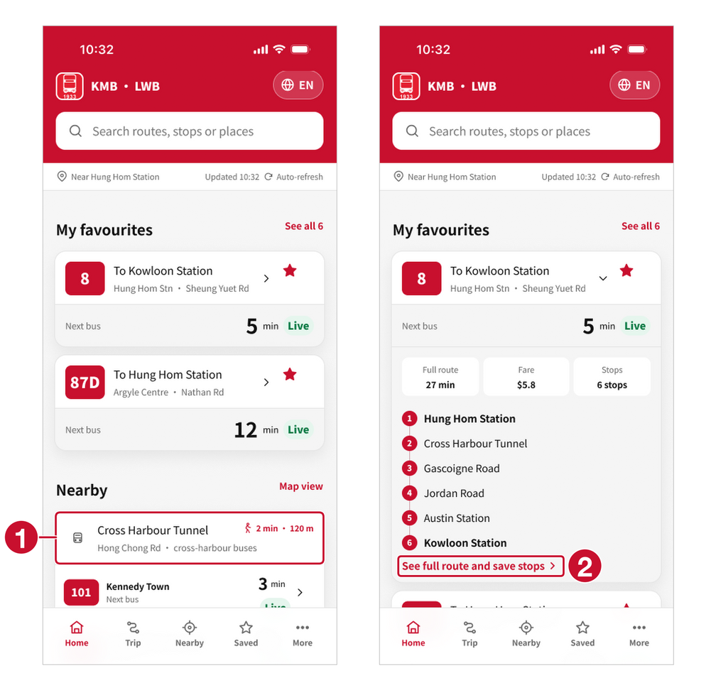
Saving a stop was the hardest task
2/9
43
4 + 4
took the expected path
Maze score, the lowest of nine tasks
reached the route screen from the Home card, or from Saved
Screens visited in the save task, by participant and ease rating
Really easy
Easy
Moderate
A little difficult
1
Stop card on Home: 13 taps from 3 people; it opens nothing
2
The only cue to the route screen is a small text link
"Not intuitive. Don't know that the station inside the column is interactive and can therefore lead to the saving process of target station."
Participant comment, from the researcher's notes. Once on the route screen, all eight saved the stop.
Notes:
Presenter: Chenyang Zhang · about 40 seconds.
Saving was our weakest task. Only two of nine took the expected path, and its score, 43, was the lowest. Half of those who reached the route screen came from the Home card and half from Saved. Three people tapped the stop card on Home 13 times, but it opens nothing, and the only cue on the expanded card is a small text link. The ratings follow the path length: the four with long paths are the ones who rated it harder. We accept this. It is a missing signifier, and it shapes our next step.

Slide 18


Where we keep the design, and why
Text size stays in More
The map stays one tap away
Walking time: the question, not the screen
7/9
8/9
6/9
tapped More as their very first move
reached the map in one or two taps
chose 28 min, the value labelled "Total trip"
Text size lives in settings on iOS, Android and almost every app, and a built app would also follow the phone's own setting. Pinch-to-zoom is a convention for maps and photos.
We accept that the Map view link on Home is easy to miss. A sixth tab would add a choice to every screen for a secondary task (Hick, 1952).
All nine chose the right bus, and the walk is shown twice as "Walk 2 min". Next time we would ask: "How many minutes do you walk before boarding?"
"Don't know they need to enter 'More' page to adjust text size."
"Forgot the small Map View button at the home page."
One participant asked for "a page with less distracting or redundant information".
Notes:
Presenter: Chenyang Zhang · about 35 seconds.
Some feedback we weigh against the data and keep the design. Two people did not expect text size under More, but seven of nine went there first, and that is where iOS and Android apps keep it. The map stays one tap from Home and Nearby: eight of nine reached it in one or two taps, and a sixth tab would add a choice to every screen. And the walking-time question mostly measured its wording: six chose 28 minutes, the value labelled Total trip.

Slide 19
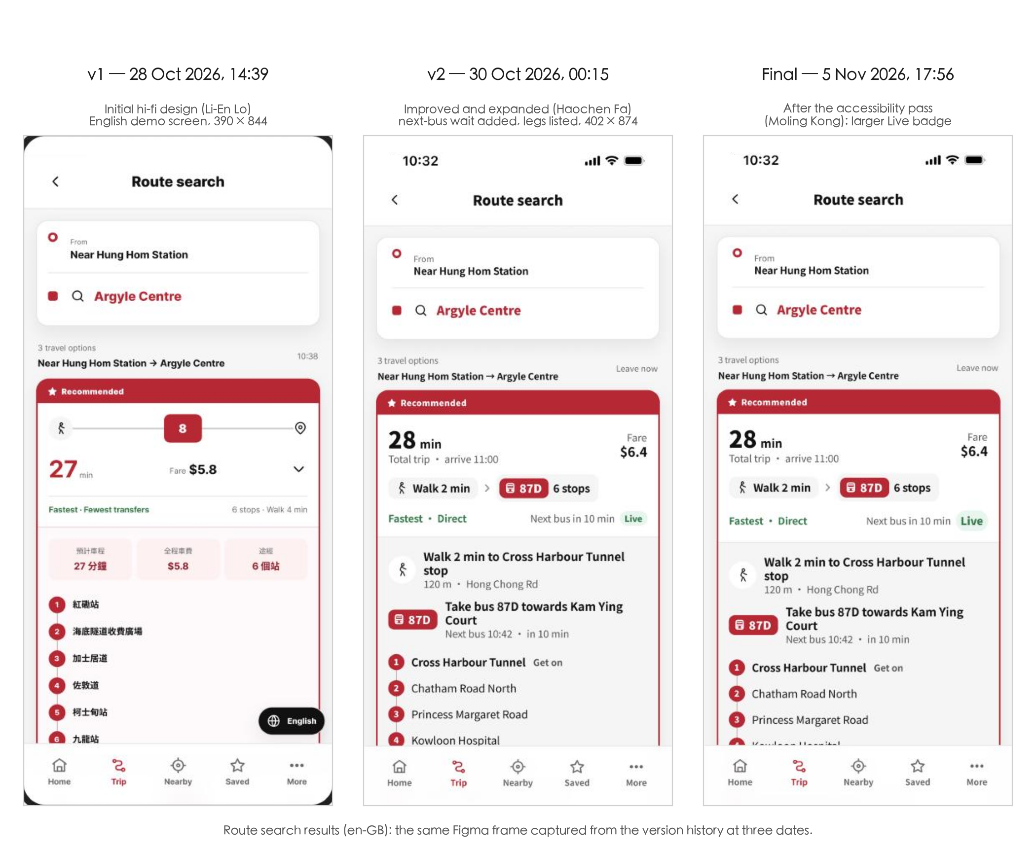
Three dated versions before testing
1 Oct Chenyang Zhang
Dual-track journey map
11–12 Oct Li-En Lo, with the team
Wireframe; mid-project checkpoint
28 Oct Li-En Lo
v1: first high-fidelity design, 13 screens
28–30 Oct Haochen Fa
v2: Chinese and English pages; 200% and contrast states
2 Nov Xulu Zhang
Variables for text size, contrast and language; 111 extra frames
3–5 Nov Moling Kong
200% checks, then arrival rows reworked. Frozen 5 Nov, 17:56
5–7 Nov Chenyang Zhang
Maze test with nine participants
No screen changed after the test. The changes the results point to are on the next slide.
Notes:
Presenter: Li-En Lo · about 20 seconds.
The design went through three versions before testing, and Figma's version history records each step. This is the route results screen on 28 October, 30 October and 5 November: the trip time gained a label, the next bus and its Live source were added, and the accessibility pass enlarged the badge. We froze the design before the first Maze session, so no screen changed after the test.

Slide 20





Next step: a stop page wherever a stop appears
Stop card on Home
Why
Three people tapped the Home stop card 13 times, and others looked for the stop in Nearby, on the map and in search.
How we would test it
The same save task against the current design, comparing the expected-path rate (now 2 of 9) and taps on the stop card.
Stop page
Stop in the Nearby list
Every route at that stop
Next arrivals, Live or Scheduled
A labelled Save this stop button
Stop pin on the map
Stop in search results
Smaller changes from the test
Finding | Change | Evidence
"Full route" read as the wait | Relabel it "Journey time", like the Chinese 全程需時 | Block 4: two answered "5 min"
Map view link easy to miss | Give the Map buttons on Home and Nearby more weight | Block 14: one person took eight steps
Saved stops expected on Home | Show saved stops as well as routes in My favourites | Block 7 comment
No participant aged 60 or over | Re-test in Cantonese with older passengers, on phones | Profile; blocks 4 and 10
Notes:
Presenter: Haochen Fa · about 25 seconds.
Our next step answers the save finding: a stop page that opens from every place a stop appears, the Home card, Nearby, the map and search, with every route at that stop and a labelled Save button. We would test it with the same task and compare the expected-path rate and the taps on the stop card. Four smaller changes come straight from the test results.

Slide 21
What we learned, and what we could not test
What we found
Limitations
78/81
task attempts succeeded, and every participant finished the study
Nine participants aged 18 to 48, none 60 or over, tested in English
Five used laptops, so touch and thumb reach were barely tested
Unmoderated sessions; the comments are the researcher's notes
The English prototype has links only: taps elsewhere count as misclicks
Frozen before testing, so the proposed changes are untested
9/9
read Bus 8's next arrival, and 9 of 9 read Bus 116 at 200% text: the information design works
2/9
found the expected way into saving. The Home card needs a visible signifier, and a stop page is our next step
Figma design file
figma.com/design/2JkOkm1pztoaZask0fDJeq
Clickable prototype
flow "First launch (en-GB)"
Maze report
app.maze.co/report/Kowloon_bus_redesign
Notes:
Presenter: Haochen Fa · about 30 seconds.
To sum up: the redesign answers 'when is my bus coming?' on the first screen, and the test shows that people can read it. The clearest weakness is the way into saving, and we have a concrete fix for it. Our main limitations are the sample, with no one over 60 and mostly laptops, and a prototype with plain links. Thank you for watching. The links to the Figma file, the prototype and the Maze report are on this slide.

