Slide 1
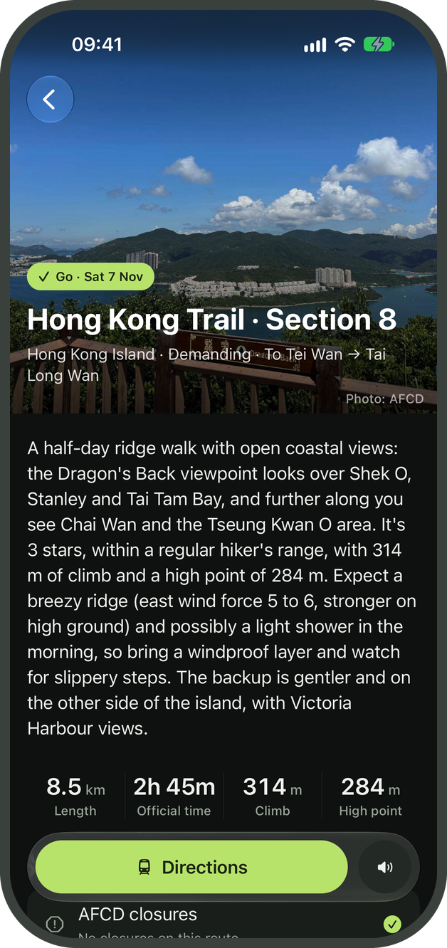
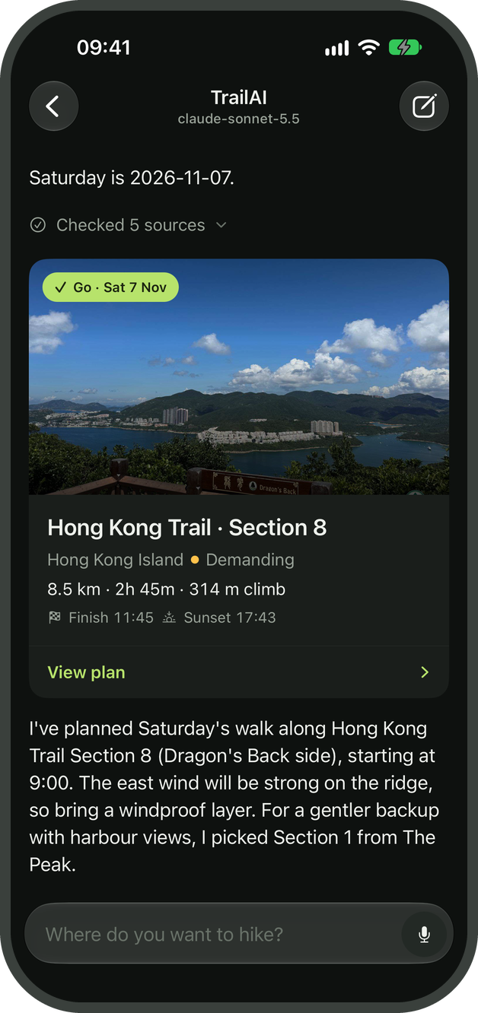
TrailAI
An LLM agent that plans day hikes in Hong Kong using official government data
COMP4431 Artificial Intelligence, Group Project 2026/27
[Group members: names and student IDs]
Notes:
[0:00-0:15] Good morning. Our project is TrailAI, a chatbot that helps people plan day hikes in Hong Kong. We built it as an LLM agent: the model answers by calling tools over official government data, and the server checks the answer before the user sees it.

Slide 2




Planning a hike depends on data that changes every day
MOTIVATION
A safe plan needs four official sources, and a language model on its own has none of them
AFCD trail data
Baseline: Claude Sonnet 5.5 without tools, on our 43 test scenarios
152 official trail sections with distance, walking time, difficulty and GPX tracks
26 / 90
distance, time and sunset figures it stated matched the official data
AFCD closure notices
Sections closed because of landslides or maintenance work
HKO forecast and warnings
7 / 43
answers recommended an unsafe hike: a closed trail, one beyond the user's ability, or one finishing after dark
Nine-day forecast, typhoon signals, rainstorm and thunderstorm warnings
HKO sunrise and sunset times
3
trails named that do not exist in the official AFCD list
These set the latest time a hiker should finish
Notes:
[0:15-0:50] To plan a hike safely in Hong Kong you need four official sources: the AFCD trail data, the AFCD closure notices, the Observatory's forecast and warnings, and the sunset time. These change every day, so a language model cannot know them from its training data. We tested this. We ran Claude Sonnet 5.5 without any tools on our 43 test scenarios. Only 26 of the 90 figures it gave matched the official data, 7 answers recommended an unsafe hike, and it named 3 trails that do not exist. This is why we built TrailAI as an agent that looks these facts up with tools.

Slide 3
Implemented features
FEATURES
Additional feature | How it is implemented
Tool-using agent | A tool-calling loop over 11 tools, on three provider APIs
Server-side guardrails | Every plan and refusal is checked in code before the app shows it
Retrieval (RAG) | bge-m3 embeddings over 230 official trail descriptions in Chinese
Clarifying questions | ask_user pauses the agent and shows a tap-to-answer form
Skills | Six Markdown procedures that the agent loads when it needs them
Voice input and output | iOS speech recognition with a live transcript; plans read aloud
Native iOS app | Plan pages, maps, GPX elevation charts and 152 trail pages
Evaluation suite | 43 graded scenarios on frozen data, with a no-tools baseline
Basic feature
An English chatbot for Hong Kong hiking. It understands requests, asks follow-up questions, and answers with trail suggestions, safety advice and day plans.
Domain and data
Day hikes in Hong Kong. Open data from the AFCD (trails, GPX tracks, closures, photos) and the Hong Kong Observatory (forecast, warnings, sunset).
Notes:
[0:50-1:25] The basic requirement is a chatbot that handles typical questions in one domain. Ours covers day hikes in Hong Kong, in English, using open data from the AFCD and the Observatory. On top of that we implemented eight additional features, listed here with how each one is implemented. The first two, the tool-using agent and the guardrails, are the core of the project, so the next two slides explain them.

Slide 4
System architecture
AGENT DESIGN
The iOS app is a client; the agent runs on a Python server
iOS app
Agent server (Python, FastAPI)
LLM provider adapters
Chat and question forms
Anthropic Messages, OpenAI Chat Completions and OpenAI Responses. Tested with Claude Sonnet 5.5, DeepSeek V4.1 Flash, Grok 4.6 and local qwen3:8b
Agent loop
Alternates model calls and tool calls until the model answers or asks the user
API
Plan and trail pages
Maps and elevation charts
Guardrails
WebSocket
Precondition, safety and number checks on every plan and refusal
Tools and data
Speech input and output
11 tools over AFCD trails, GPX tracks and closures, and HKO forecasts, warnings and sunset times. Cached, with offline snapshots
Skills and session state
Expo and React Native
tool calls
Six procedures loaded on demand; history and the checks already run
Notes:
[1:25-2:05] The app on the phone is only a client. It sends the user's messages to a Python server over a WebSocket and renders what comes back: streamed text, the agent's progress, question forms, and plan or refusal cards. The agent runs on the server. Its loop calls the model, runs the tools the model asks for, gives the results back, and repeats until the model answers. Skills are short written procedures, for example how to collect the user's requirements or how to write a plan, which the agent loads only when it needs them. The model is reached through adapters for three APIs, so we can switch between Claude, GPT, DeepSeek, Grok or a local model with one line of configuration.

Slide 5
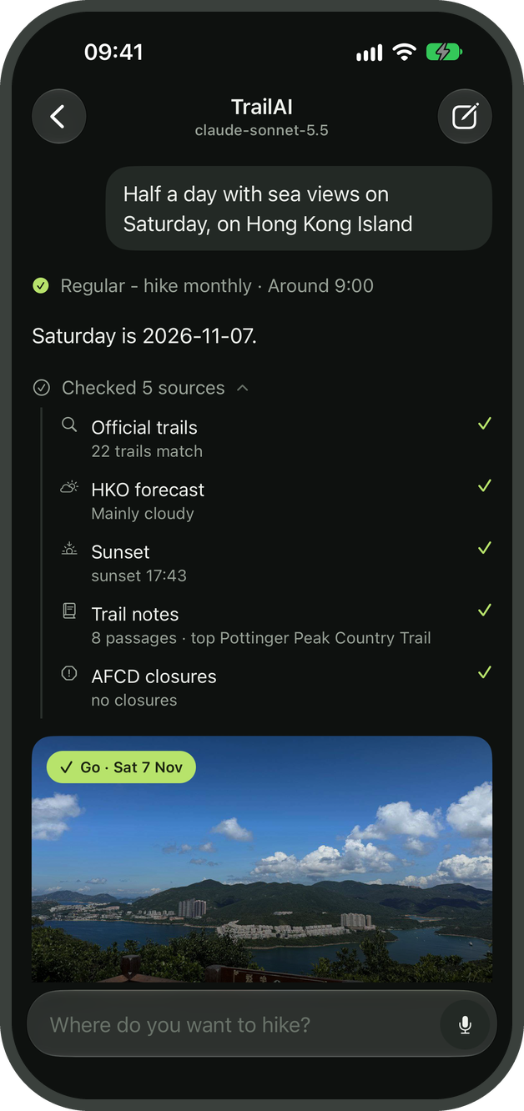
Tool use and server-side guardrails
AGENT DESIGN
A typical request goes through four steps; the server enforces the third
1
Clarify
The server rejects a plan if
ask_user shows a form when the fitness level, date or start time is missing
a required check has not been run for that trail and date;
the checks rule it out: a typhoon signal, a rainstorm warning, a heavy-rain forecast or a closed trail;
a distance, time or sunset figure differs from the tool results.
2
Retrieve
search_trails filters the official trail list; search_knowledge ranks trail descriptions by meaning
3
Verify
check_closures, get_weather and get_daylight for the chosen trails and date
The error goes back to the model as a tool result, so it can correct the plan. Refusals are checked in the same way.
4
Answer
present_plan or refuse, structured outputs that the app shows as cards
Notes:
[2:05-2:40] A typical request goes through four steps. The agent asks a question if something is missing, retrieves candidate trails, verifies closures, weather and sunset for the chosen date, and then presents a plan or refuses. We do not rely on the prompt to make the model follow these steps. The server blocks present_plan until the checks have been run, blocks it if the checks rule the hike out, and blocks it if any figure differs from what the tools returned. The model receives the error and has to fix its plan. In our evaluation, DeepSeek hit this guardrail in 4 scenarios and corrected the plan every time. On the right is what the user sees: the sources the agent checked, which they can open.

Slide 6
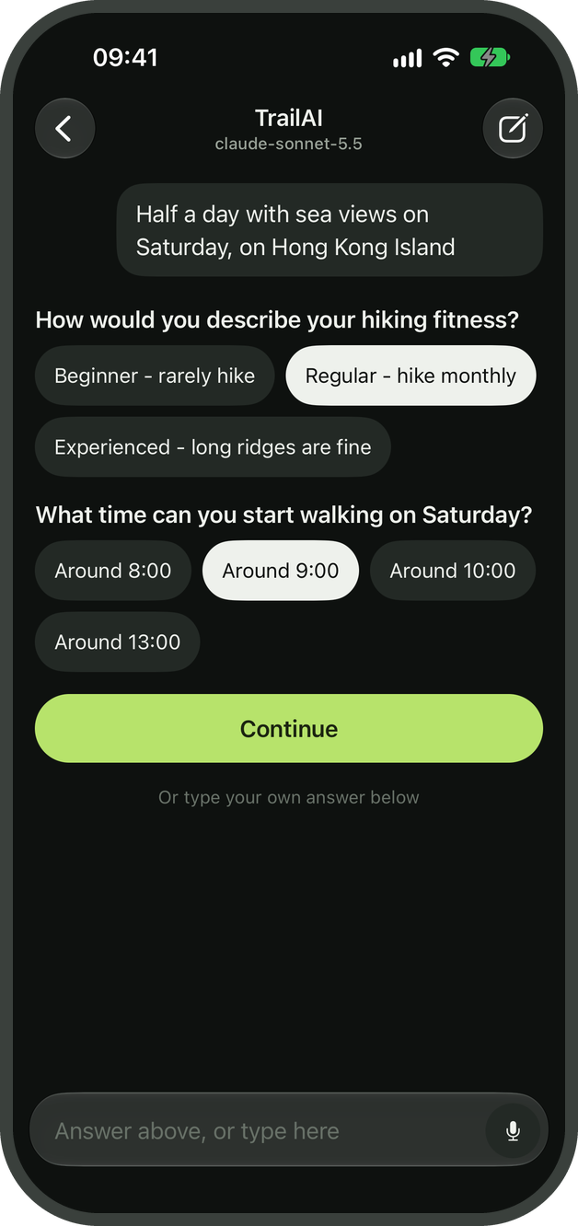
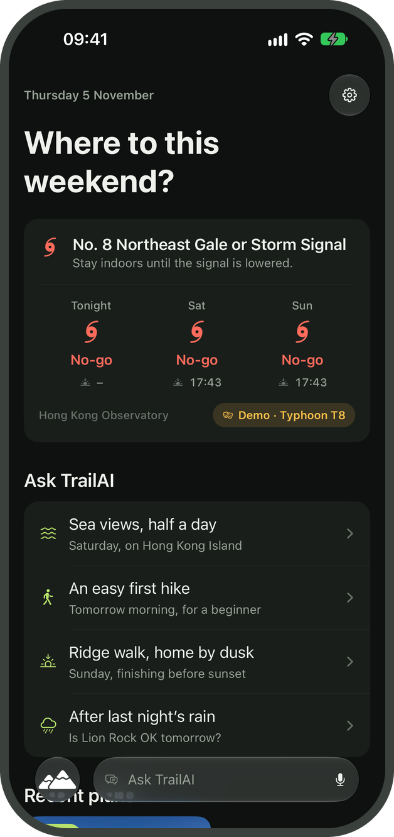
Demo scenarios
LIVE DEMONSTRATION
Run live on the iOS Simulator with Claude Sonnet 5.5 and live HKO and AFCD data
Scenario 1: planning a half-day hike, asked by voice
1
Ask by voice for a half-day hike with sea views on Hong Kong Island
2
Answer the two follow-up questions: fitness level and start time
3
Follow the tool calls: search, retrieval, closures, forecast, sunset
4
Open the plan: figures, safety checks, timeline, elevation, sources
Scenario 2: a typhoon signal
1
In Settings, switch the demo scenario to Typhoon Signal No. 8
2
Ask: "Can I hike Dragon's Back tomorrow morning?"
3
The agent declines, shows the evidence and suggests a later date
Follow-up questions
T8 scenario active
Notes:
[2:40-5:20 LIVE DEMO] Before the talk: start the backend with LLM_PROFILE=claude-sonnet, open the app on the Live data scenario, and start a new conversation.
Scenario 1 (about 1:45). Tap the microphone and say: 'Find me a half-day hike with sea views on Hong Kong Island this Saturday.' If speech recognition is unreliable in the room, type the same request. Answer the two question cards (Regular, around 9:00). While the agent works, point at the activity line: it is searching trails, retrieving descriptions, and checking closures, the forecast and sunset. When the plan card arrives, open the plan page and scroll through it: the official distance and time, the safety checks the server enforced, the timeline against sunset, the elevation chart, and the sources, including the Chinese AFCD passage behind 'sea views'.
Scenario 2 (about 0:50). Open Settings and choose Typhoon T8; the home screen shows the warning. Ask: 'Can I hike Dragon's Back tomorrow morning?' The agent checks the same sources and returns a no-go card with the reason and a later date. Switch the scenario back to Live data afterwards.
If the live demo fails, jump to the hidden backup slide at the end, which has recordings of both scenarios.

Slide 7
Evaluation on 43 test scenarios
EVALUATION
Each scenario runs the full agent on frozen weather and closure data; rules grade the final plan or refusal
43/43
Sonnet 5.5, tools
Passed; all 43 safe
38/43
DeepSeek, tools
All 43 safe; 4 plans rejected, then corrected
28/43
Sonnet 5.5, no tools
7 unsafe answers; none of the 6 closed-trail cases passed
21 s
Median per scenario
Sonnet with tools, 6 model calls
Pass: right outcome and the user's constraints met. Safe: no plan for a closed or unsuitable trail.
Notes:
[5:20-6:00] To evaluate the agent we wrote 43 test scenarios in seven categories, such as a closed trail, bad weather, a request beyond the user's ability, or a follow-up question. Each one runs through the real agent with frozen weather and closure data, so the result does not depend on the day, and a script answers the question forms. Rules grade the final plan or refusal; there is no LLM judge. With tools, Claude Sonnet 5.5 passed all 43. The much cheaper DeepSeek model passed 38: for some closed trails it suggested an open alternative instead of first saying the trail was closed, which we count as a fail, but all of its plans were safe. Without tools, the same Sonnet model passed only 28, and 7 of its answers were unsafe.

Slide 8






Technical challenges and solutions
DEVELOPMENT
Models state figures that are not in the data
Each provider stores reasoning differently
Official descriptions are only in Chinese
A number check compares each distance, time and sunset in a plan with the tool results and rejects any mismatch.
History is append-only and replayed in each provider's own format, including Anthropic thinking blocks and OpenAI reasoning items.
The multilingual bge-m3 model lets an English request such as "sea views" retrieve the relevant Chinese passages.
Raw GPX elevation overstates the climb
Smaller models make malformed tool calls
Live data feeds can fail during a demo
Hysteresis smoothing and removal of no-data points. Naismith's rule estimates the time for the 25 trails without an official one.
Flat JSON schemas, argument validation that returns the error to the model, and a retry when a turn has no usable output.
Every HKO and AFCD request is cached, with a committed snapshot as a fallback, so the agent also works offline.
Notes:
[6:00-6:30] These were the main technical problems. Models state figures that sound right, so the server compares every figure with the tool data. Each provider stores the model's reasoning in a different format, so we keep the history unchanged and replay it in each provider's own format. The official trail descriptions are only in Chinese, so we use a multilingual embedding model. Raw GPX elevation is noisy, so we smooth it. Smaller models make malformed tool calls, so the schemas are flat and invalid arguments come back to the model as errors. And the government feeds can fail, so every feed has an offline copy.

Slide 9







Limitations and future work
DISCUSSION
Limitations
Future work
No public transport routing
Public transport directions
Travel is shown as an approximate time block, and the agent does not state bus routes
Google Directions on the server, checked by the same guardrails
Regional, nine-day forecasts
Alerts for saved plans
HKO forecasts cover regions rather than trails; plans for later dates are marked provisional
Notify the user when a new warning or closure affects a planned hike
Slow on local models
Traditional Chinese
qwen3:8b runs offline but takes 7 to 10 seconds per model call
Interface and replies in Chinese as well as English
No user study yet
User study
The evaluation uses scripted answers; we have not yet tested the app with real hikers
Measure task success, trust and usability (SUS) with hikers of different experience
Notes:
[6:30-6:50] The main limitations: there is no public transport routing yet; the forecasts are regional and only cover nine days; local models are slow; and we have not yet run a study with real users. Next we would add transport directions checked by the same guardrails, alerts for saved plans, Chinese support, and a user study.

Slide 10
Summary
CONCLUSION
Tool use
Guardrails
Evaluation
The agent answers with 11 tools over official AFCD and HKO data, rather than from the model's memory.
The server rejects any plan whose checks are missing, rule the hike out, or disagree with the tool data.
Claude Sonnet 5.5 passed 43 of 43 test scenarios with tools, and 28 without them.
Thank you. We are happy to take questions.
Notes:
[6:50-7:00] To summarise: the agent answers with tools over official data, the server checks every plan, and the evaluation shows the effect of both. Thank you, we are happy to take questions.

Slide 11
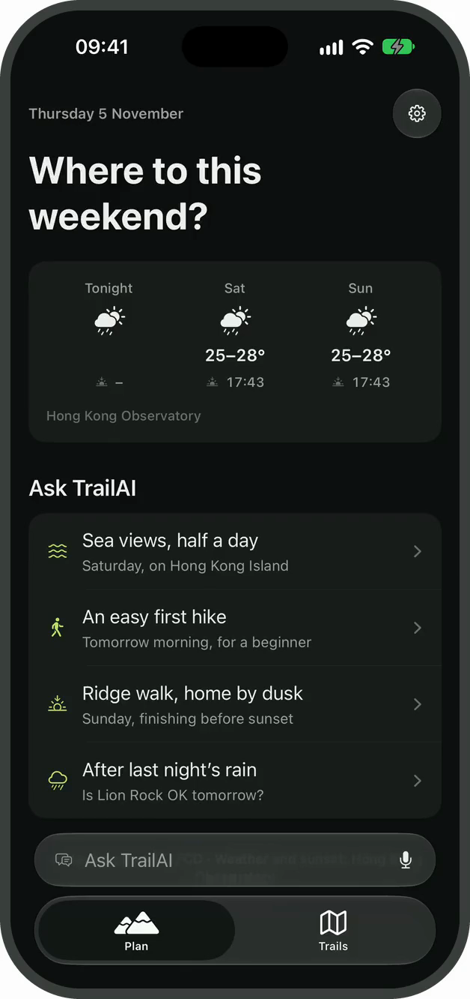
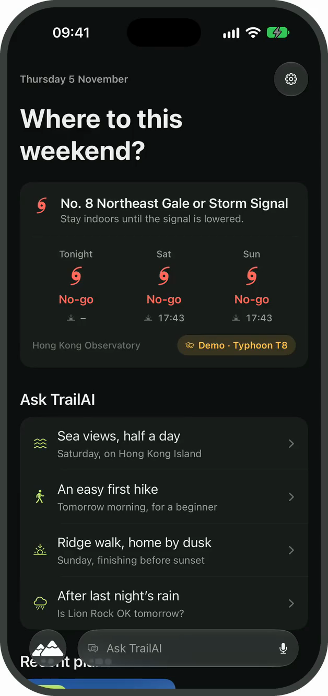
Recorded demonstration
BACKUP
Hidden slide: use only if the live demo fails
Scenario 1
Scenario 2
A half-day hike with sea views on Hong Kong Island. The agent asks two questions, checks five sources and presents Hong Kong Trail Section 8. 76 seconds, sped up while the agent works.
Typhoon Signal No. 8 is set as the demo scenario. The agent declines Dragon's Back, shows the evidence and suggests a later date. 31 seconds.
Notes:
Backup only. Both recordings were made with Claude Sonnet 5.5 on the iOS Simulator. Click a video to play it.

