Slide 1

Real-time Anomaly Detection, Root Cause Analysis & Human-in-the-Loop Review
Multi-Agent Powerplant Monitoring System
Live demo
https://app.powerplantagent.com/review
Github https://github.com/Haoj1/Powerplant-Multi-Agent

Slide 2
Outline
1. Why This Project?
2. Importance & Motivation
3. Problems We Solve
4. System Architecture
5. Agent Roles & Data Flow
6. Key Features & Demo
7. Technology Stack
8. Conclusion & Future Work

Slide 3
Why Chose This Project
• Combines multiple cutting-edge areas: Multi-Agent Systems, IoT, LLM/AI
• Practical industrial application: powerplant asset monitoring
• End-to-end pipeline: from raw sensors to human-approved tickets
• Human-in-the-loop design ensures safety and accountability
• Extensible: rules, RAG, Salesforce integration, multimodal (3D + VLM)

Slide 4
Importance & Motivation
• Industrial IoT generates massive sensor data; manual monitoring is costly
• Early anomaly detection prevents equipment failure and downtime
• Root cause analysis (RCA) reduces mean-time-to-repair (MTTR)
• Automated ticket creation streamlines maintenance workflows
• Human review loop maintains quality and builds trust

Slide 5
ProblemSolve
• Real-time anomaly detection from streaming telemetry
• Interpretable root cause diagnosis (not black-box)
• Automated ticket creation with evidence and recommended actions
• Human review interface with approve/reject/edit
• Integration with external systems (e.g., Salesforce)

Slide 6
• Low latency: detect and diagnose within seconds
• Explainability: evidence and rules, not just predictions
• Scalability: multiple assets, MQTT pub/sub
• Reproducibility: fault injection, scenario-driven testing
Key Challenges

Slide 7
Problem Domain: Industrial IoT
• Powerplants, pumps, bearings, valves generate continuous sensor data
• Pressure, flow, temperature, vibration, motor current, etc.
• Faults: bearing wear, clogging, valve stuck, sensor drift
• Early detection prevents costly downtime and safety incidents

Slide 8
Approach: Multi-Agent Pipeline
• 4 specialized agents + Simulator, coordinated via MQTT
• Agent A: Threshold / Z-score anomaly detection
• Agent B: Rule-based + LLM (ReAct) diagnosis
• Agent C: Ticket creation (GitHub Issues / local)
• Agent D: Human review, feedback, Salesforce Case creation

Slide 9
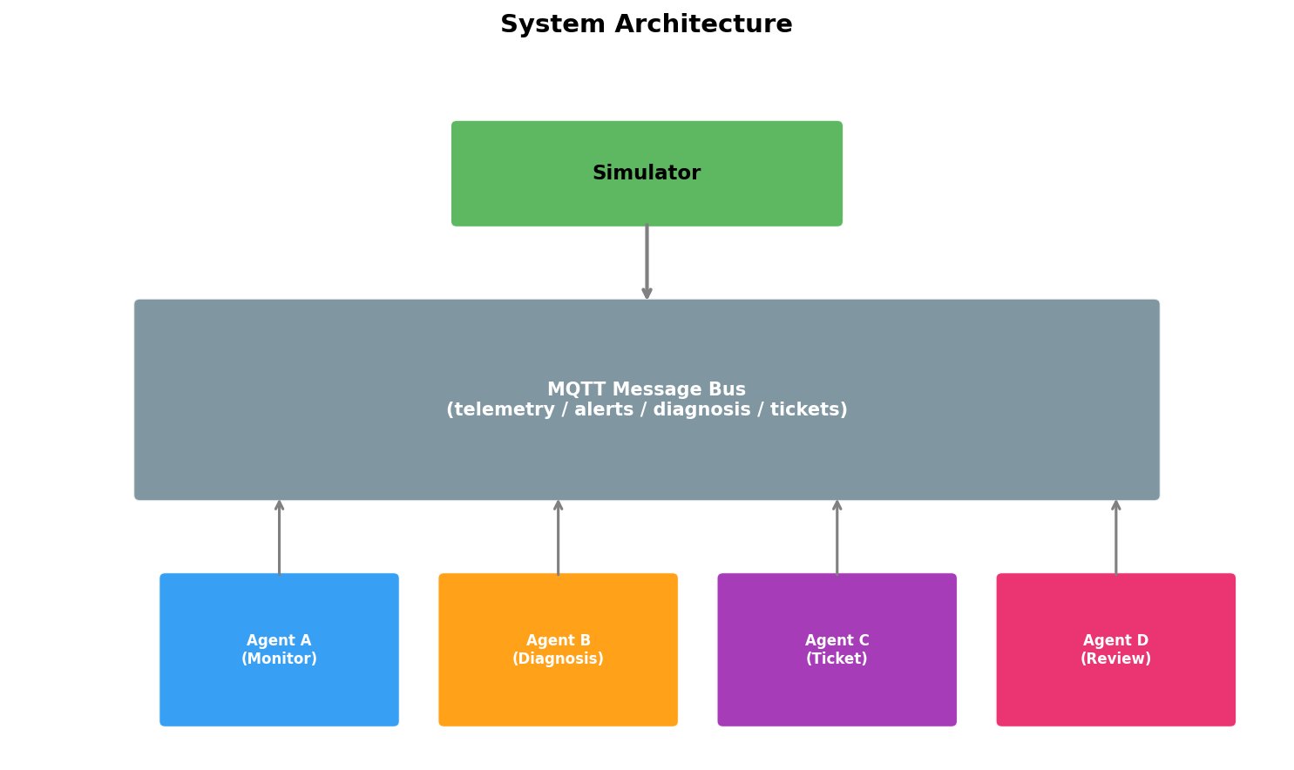
System Architecture
• Simulator: Generates telemetry, injects faults (bearing_wear, clogging, etc.)
• MQTT: Message bus for telemetry, alerts, diagnosis, tickets
• Agents: Subscribe/publish, stateless, scalable
• Agent D Dashboard: React frontend for review, chat, scenarios

Slide 10
Architecture Diagram
Simulator publishes telemetry to MQTT.
Agent A detects anomalies → alerts.
Agent B performs RCA → diagnosis.
Agent C creates tickets.
Agent D provides human review and feedback.

Slide 11
Agent A: Monitor
• Subscribes to telemetry/*
• Sliding window (60s/120s) features: mean, std, slope
• Z-score anomaly detection per signal
• Publishes AlertEvent with evidence to alerts/*

Slide 12
Agent B: Diagnosis
• Subscribes to alerts, fetches telemetry history
• Rule-based + LLM (ReAct) for root cause analysis
• Outputs: root_cause, confidence, recommended_actions, evidence
• Rules: bearing_wear, clogging, valve_stuck, sensor_drift

Slide 13
Agent C: Ticket
• Subscribes to diagnosis
• Creates tickets (GitHub Issues or local API)
• Publishes ticket_id to MQTT
• Queues for Agent D review

Slide 14
Agent D: Review
• Human review interface (approve / reject / edit)
• Chat assistant with RAG (similar cases, rules, feedback)
• Optional: Create Salesforce Case on approve
• Scenario management: load, start, stop fault scenarios

Slide 15
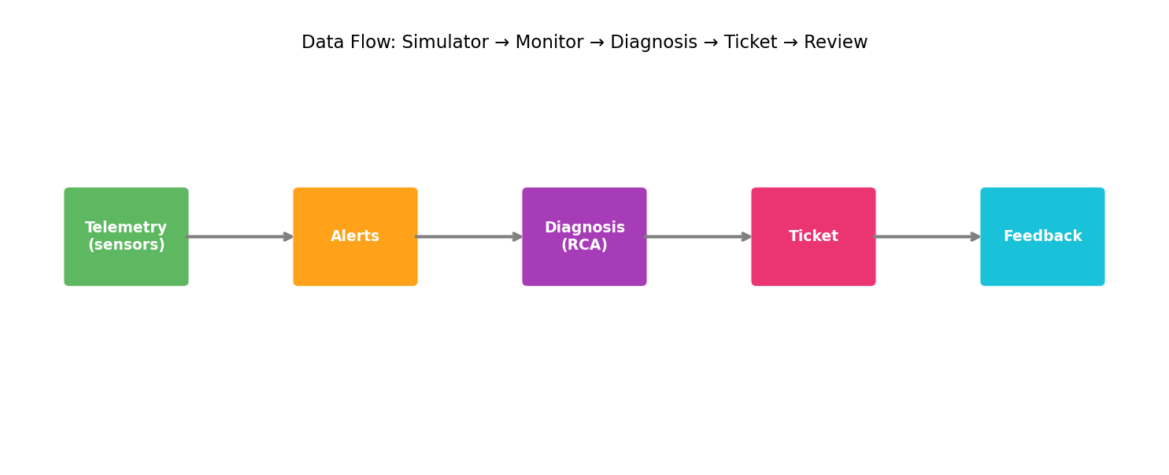
Data Flow
Telemetry → Alerts → Diagnosis → Ticket → Feedback
Each step adds structure and context.
Feedback can update rules and thresholds.

Slide 16
MQTT Message Bus
• Lightweight pub/sub for real-time streaming
• Topics: telemetry/{asset}, alerts/{asset}, diagnosis/{asset}, tickets/{asset}
• Decouples agents; each subscribes/publishes independently
• Mosquitto broker (Docker or standalone)

Slide 17
Simulator & Fault Injection
• Models pump/piping/bearing subsystem
• Fault types: bearing_wear, clogging, valve_stuck, sensor_drift
• JSON-driven scenarios, reproducible with seed
• Optional: 3D visualization + VLM for multimodal diagnosis

Slide 18
Supported Fault Types
• bearing_wear: Gradual increase in vibration, bearing temp
• clogging: Flow drops, pressure rises, current increases
• valve_stuck: Valve position unchanged, flow unresponsive
• sensor_drift: Single sensor offset, others consistent

Slide 19
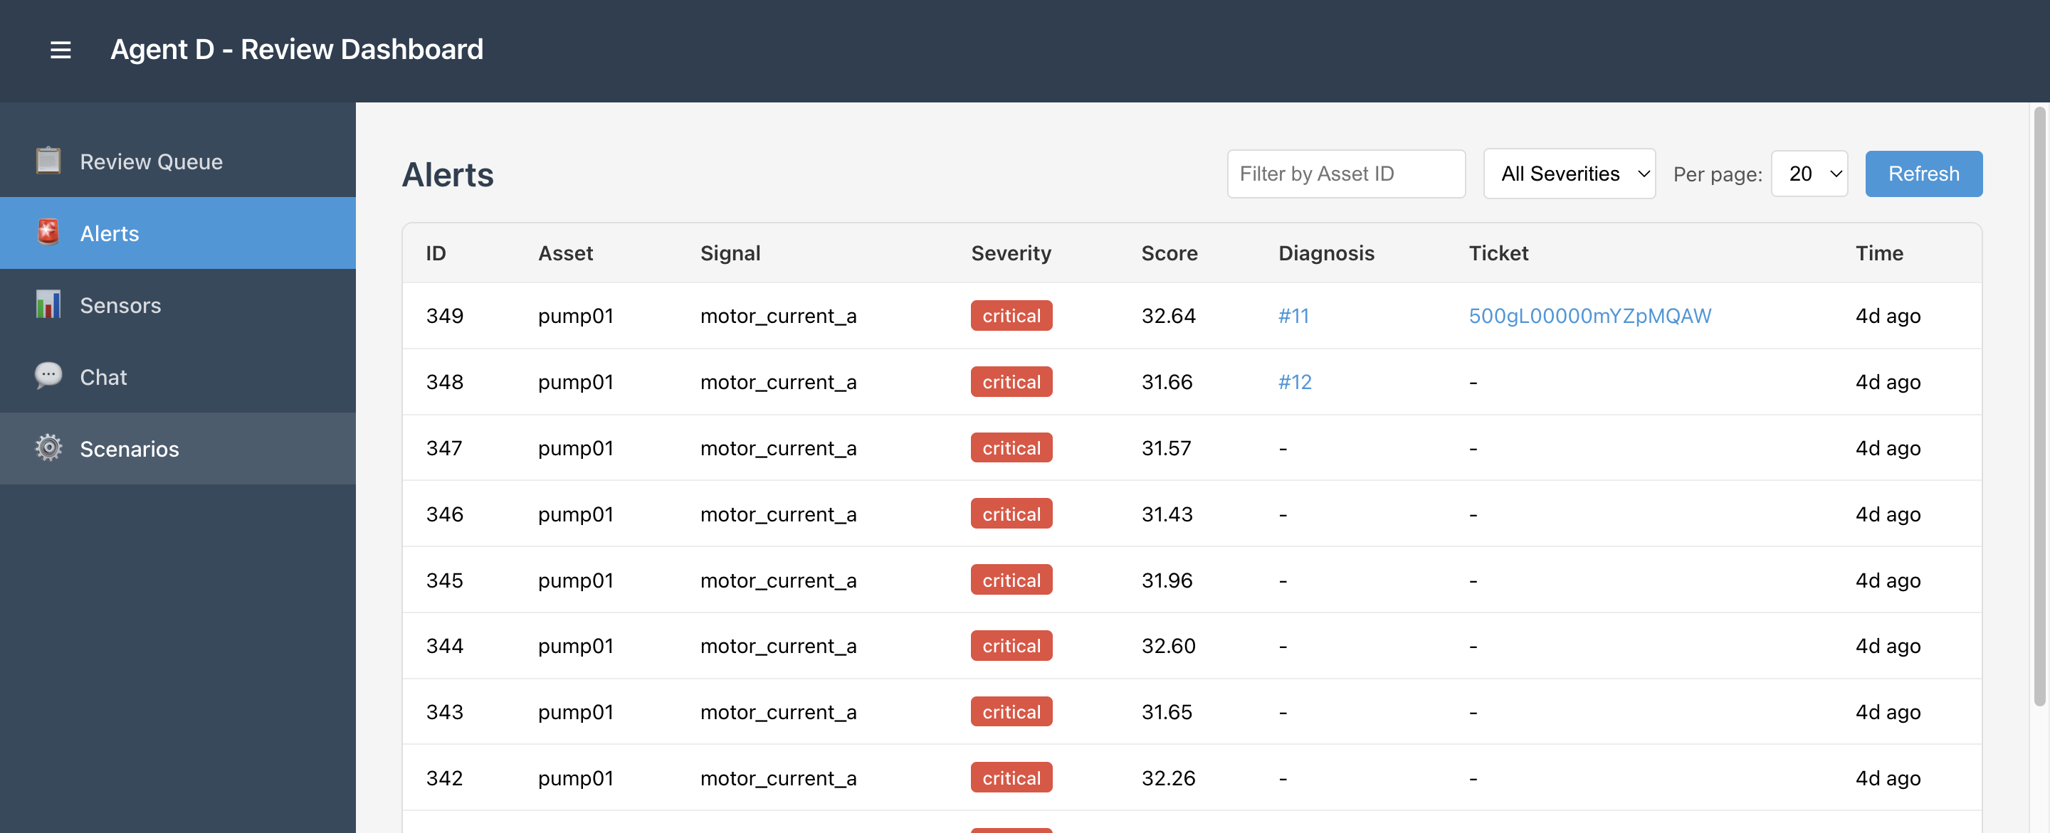
Agent D Dashboard Features
• Review Queue: Pending diagnoses, approve/reject
• Alerts: View, regenerate diagnosis, add to queue

Slide 20
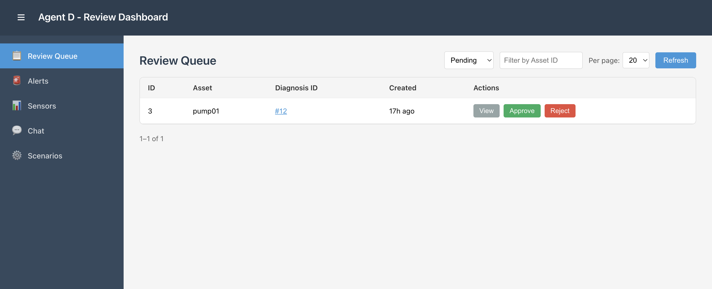
Agent D Dashboard Features
• Review Queue: Pending diagnoses, approve/reject

Slide 21
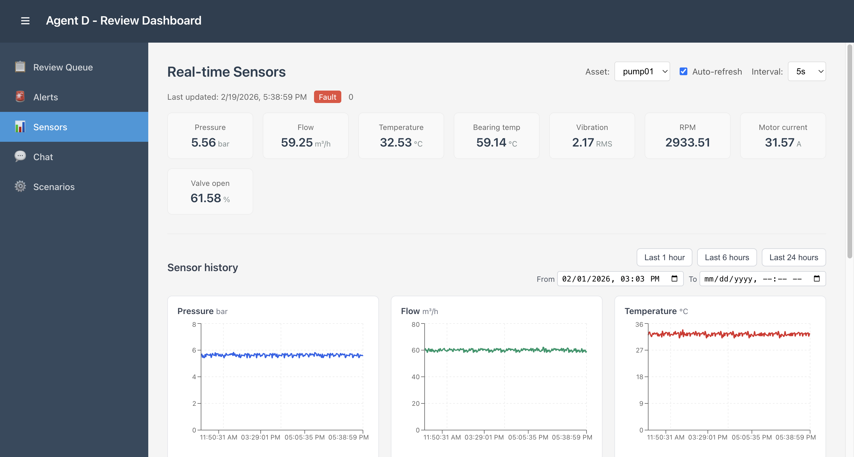
Agent D Dashboard Features
• Sensors: Real-time telemetry visualization

Slide 22
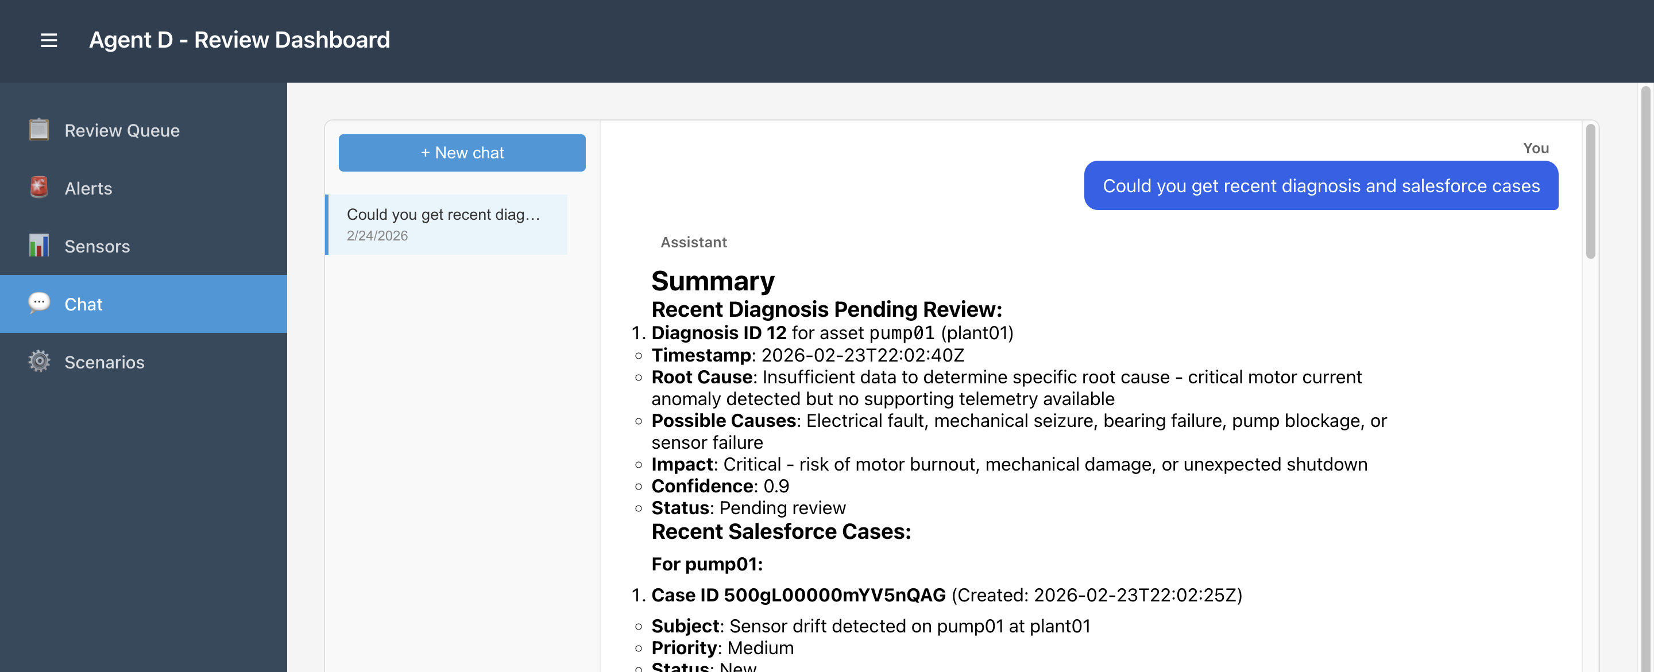
Agent D Dashboard Features
• Chat: ReAct assistant with RAG tools

Slide 23
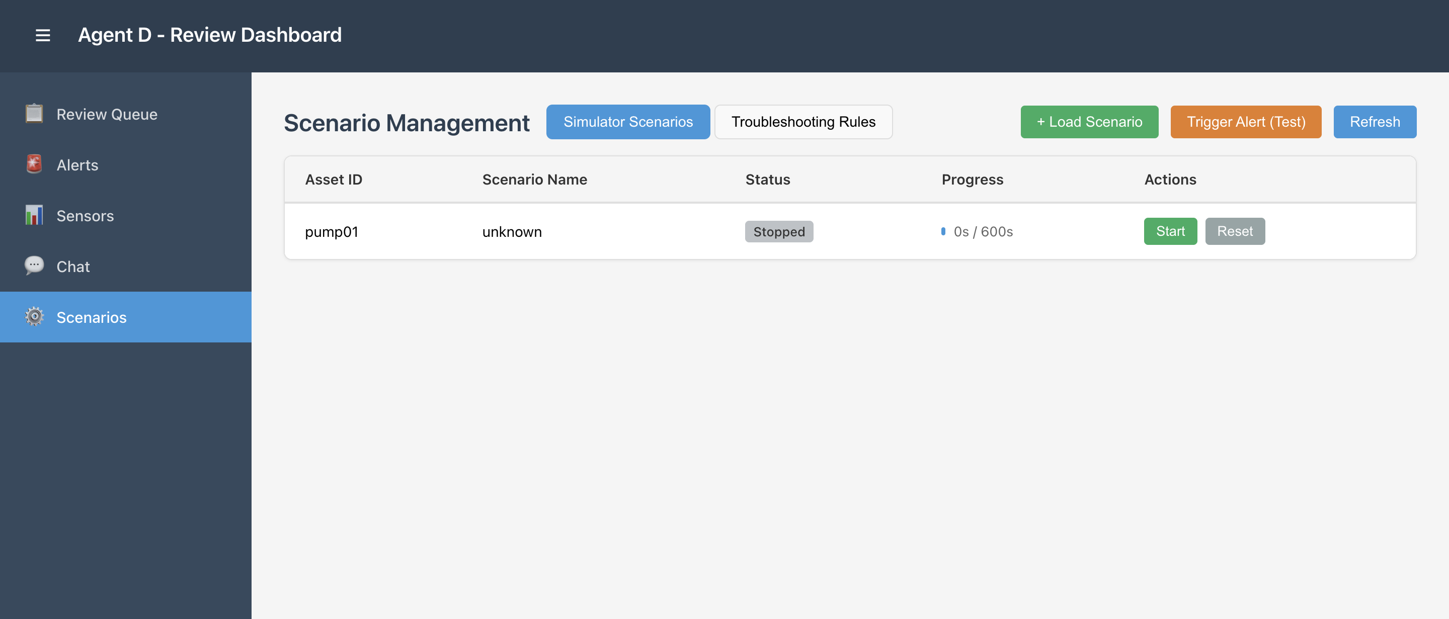
Scenarios: Load/start/stop simulator and trigger alarm
Create new rules using natural language or upload a flowchart

Slide 24
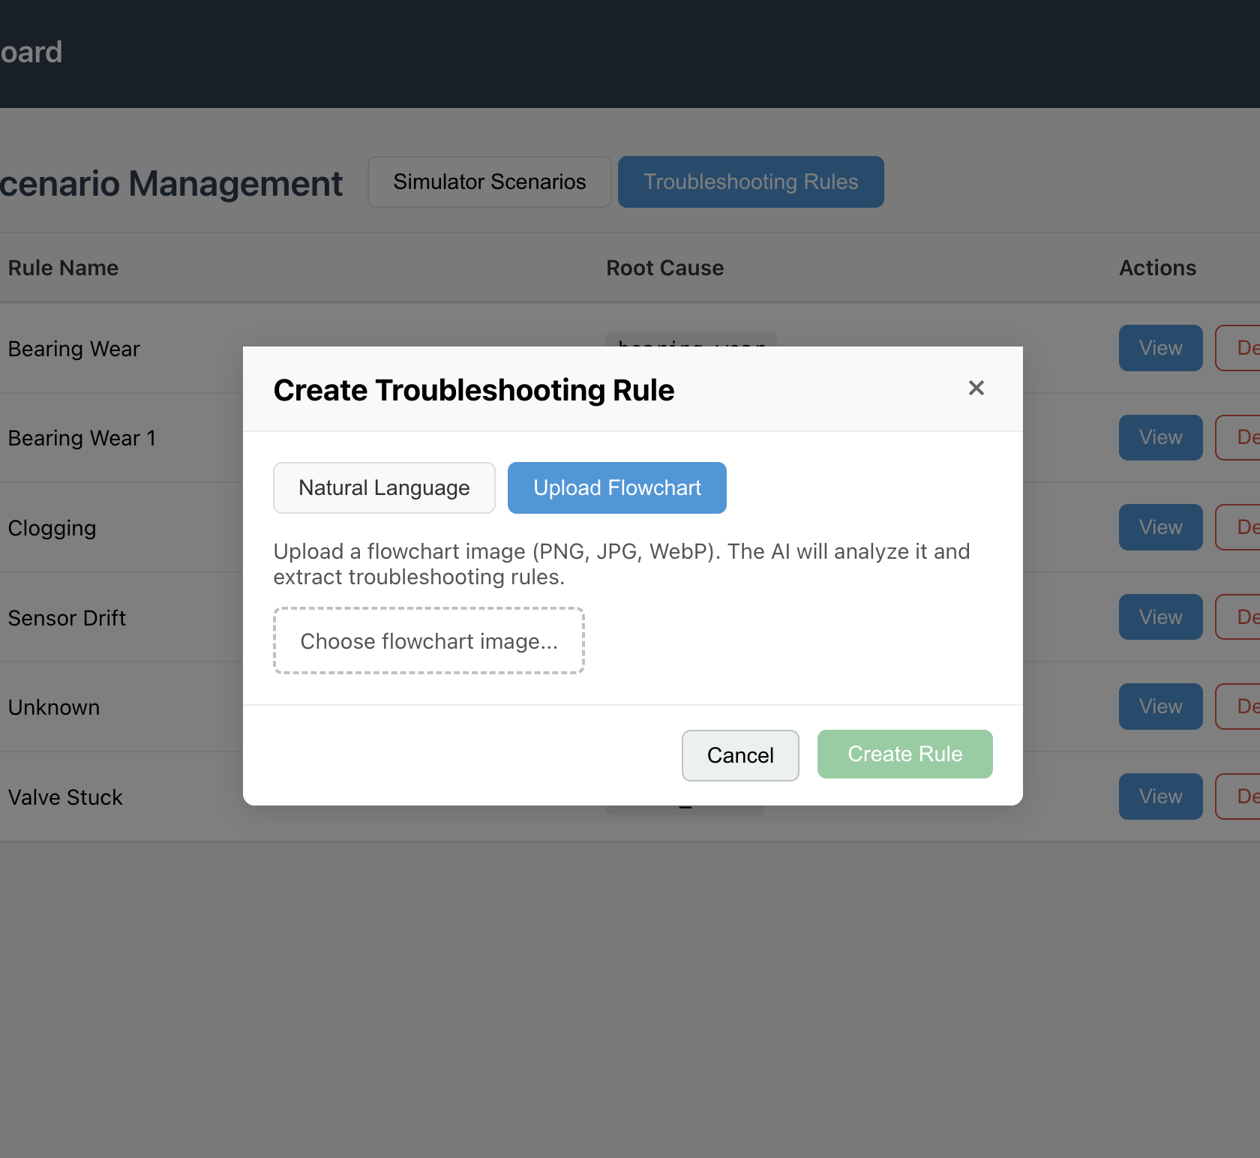
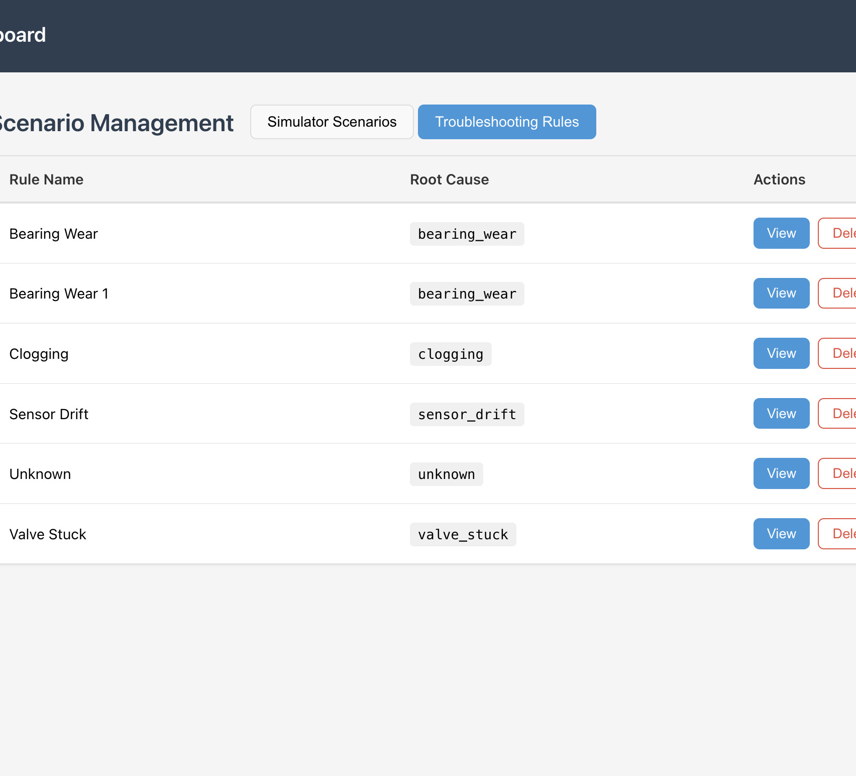
Create new rules using natural language or upload a flowchart

Slide 25
• Rules stored in agent-diagnosis/rules/*.md
• Create from natural language (LLM) or flowchart upload (VLM)
• RAG: query similar diagnoses, alerts, feedback, rules
• Vector index (sqlite-vec + sentence-transformers)
Troubleshooting Rules & RAG

Slide 26
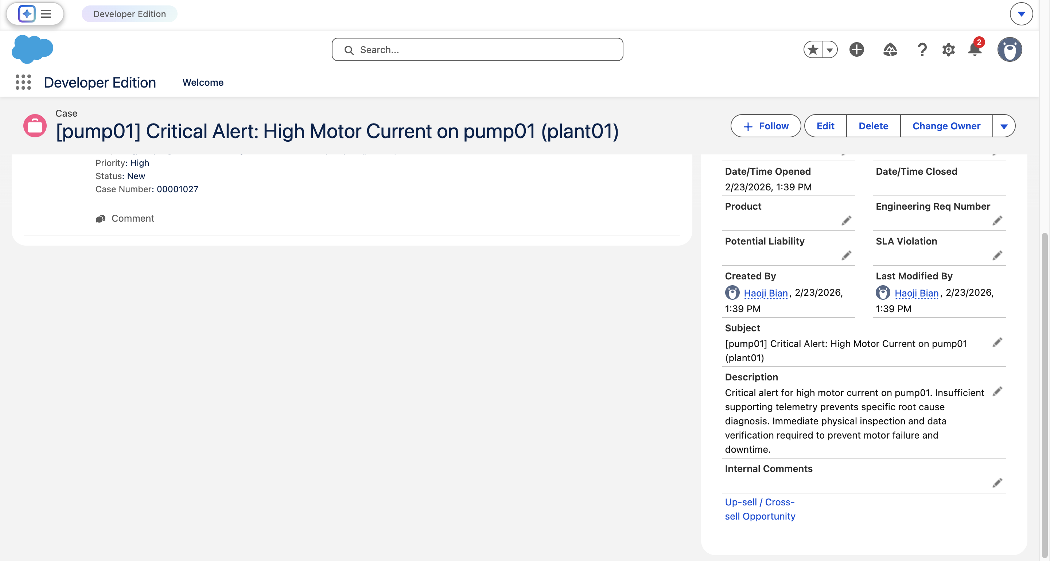
On approve: optionally create Salesforce Case
Pre-filled form: Subject, Description, Priority, Status, etc.
Picklist values fetched from Salesforce org
TicketConnector interface for extensibility
Salesforce Integration

Slide 27
Technology Stack
• Backend: Python 3.11, FastAPI, pydantic
• Message bus: MQTT (Mosquitto)
• LLM: LangChain, LangGraph, OpenAI/DeepSeek
• Frontend: React, Vite
• RAG: sqlite-vec, sentence-transformers

Slide 28
Demo Flow
1. Start MQTT, Simulator, Agents A/B/C/D
2. Load fault scenario (e.g., bearing_wear)
3. Simulator injects fault → Agent A detects → Agent B diagnoses
4. Agent C creates ticket → appears in Review Queue
5. Human approves, optionally creates Salesforce Case

Slide 29
Human-in-the-Loop Design
Agent D requires human approval before ticket closure
Approve / Reject / Edit with notes
Optional: Create Salesforce Case on approve
Feedback feeds back into rules and RAG for improvement

Slide 30
Key Benefits
End-to-end automated pipeline
Explainable diagnosis with evidence
Human-in-the-loop for safety
Extensible (rules, RAG, Salesforce)
Reproducible scenarios for evaluation

Slide 31
Evaluation & Metrics
Detection latency: fault injection → first alert
Precision/recall: event-level (truth.fault != one)
Ticket creation latency: diagnosis → ticket
False positive rate (planned)

Slide 32
Future Work
• Evaluation metrics: precision, recall, latency
• Fine-tuning LLM on diagnosis data
• Multi-asset dashboard enhancements
• Grafana integration for metrics

Slide 33
Conclusion
• Multi-agent system for powerplant monitoring
• Real-time anomaly detection → RCA → ticket → human review
• Combines rules, LLM, RAG, and external integrations
• Practical, extensible, and explainable

