Slide 1
e-Commerce user profile & User-Product recommendation system
Ting Ding, Haojia Li, Annuo Qian, Jing Zhu
May 08, 2020

Slide 2
Executive Summary
Dealing with e-Commerce user behavior data to understand customers better and bring more profits to business.
Three important analyses to e-Commerce users and products:
Data visualization: Four charts
User attribute generation and user clustering: Four clusters
User-product rating and recommendation system. Representative users from four groups.

Slide 3
CONTENTS
1
Business Problem
2
Dataset Description
Background
Problem Statement
Overview
Size
Variable
3
System Design
4
Data Preprocessing
Flow chart
6 new variables
5
Algorithm Development
6
Result and Evaluation
User Clustering
Rating Calculation
User-Product recommendation system
Data Visualization
Clustering
User-Product Recommendation System

Slide 4
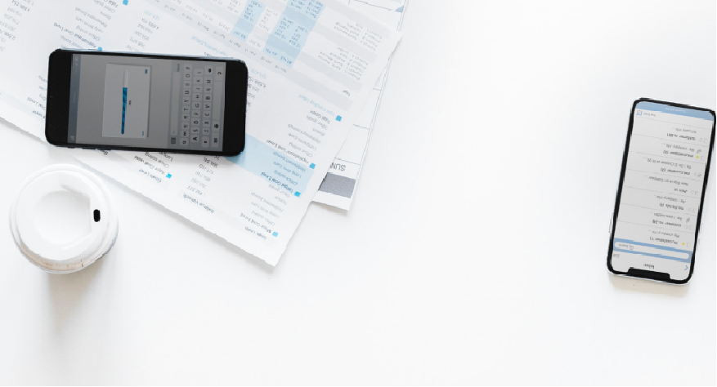

Business Problem
Background
Nowadays online shops generate tons of user session data on a daily basis.
Dealing with user behavior data to understand your customers better is a big issue for e-commerce.
Problem Statement
How a session or an event contributes to the website’s business.
The behaviors of users.
Which product is a specific user’s favorite?

Slide 5
Dataset Description
event_time | Time when event happened at (in UTC)
event_type | Events can be view, cart, removefromcart and purchase
product_id | ID of a product
category_id | Product's category ID
category_code | Product's category taxonomy (code name)
brand | Downcased string of brand name. Can be missed.
price | Float price of a product. Present.
user_id | Permanent user ID
user_session | Temporary user's session ID
Overview:
Customer Behavior data
Five months (Oct. 2019-Feb. 2020)
A medium cosmetics online store.
Size:
20,692,840 rows
2.0 GB
Varible:
9 features

Slide 6

System Design
Data Source
Data Preprocess
Data Visualization
Descriptive Analytics
User Attribute generation
User Profile & User Clustering
Result&Conclusion
Final Report
User-Product Rating Calculation
User-Product Recommendation System
Finally, we will have charts describing the dataset and find business issues, user profile about user behaviors and preferences, clustering model with different groups of users, a table including all the ratings a user give to a product and a recommendation system based on the ratings.

Slide 7
Data Preprocessing
user_id | event_hour | total_purchase | session_count | purchase_per_session | purchase_times_per_session | cart_per_view
9794320 | 4 | 12.68 | 19 | 0.667368 | 0.210526 | 0.667368
2963072 | 13 | 0 | 1 | 0 | 0 | 0.411764706
3571443 | 19 | 0 | 1 | 0 | 0 | 0
4103071 | 21 | 0 | 1 | 0 | 0 | 0.142857143
Generate a dataset that shows user behavior features.
Add 6 columns/variables that are calculated from the original data.
Each row in this processed dataset is a unique customer.

Slide 8

Algorithm Development
User-Product recommendation system
Alternating least square matrix factorization method(ALS algorithm), a collaborative filtering algorithm, which comes inbuilt in Spark.
recommendation system is based on the rating results. Only three variables are needed: user ID, product ID and overall rating (given by users to each product).
80% for training and 20% for testing.
Evaluated by computing the RMSE on the test data, the standard deviation of the residuals (prediction errors).
Generate top 10 products recommendations for each user.
User Clustering
Newly generated features in data preprocessing were then put into the clustering process.
Compared with models with other K values, the model whose K equaled to four performed the best.
Rating Calculation
There are four kinds of events in the dataset: view, cart, remove from cart and purchase.
Initially, we gave “view” 1 point, “cart” 2 points, “remove from cart” -2 points, and “purchase” 5 points.
We then upgraded our design to avoid negative rating, and made our program logically sound.

Slide 9
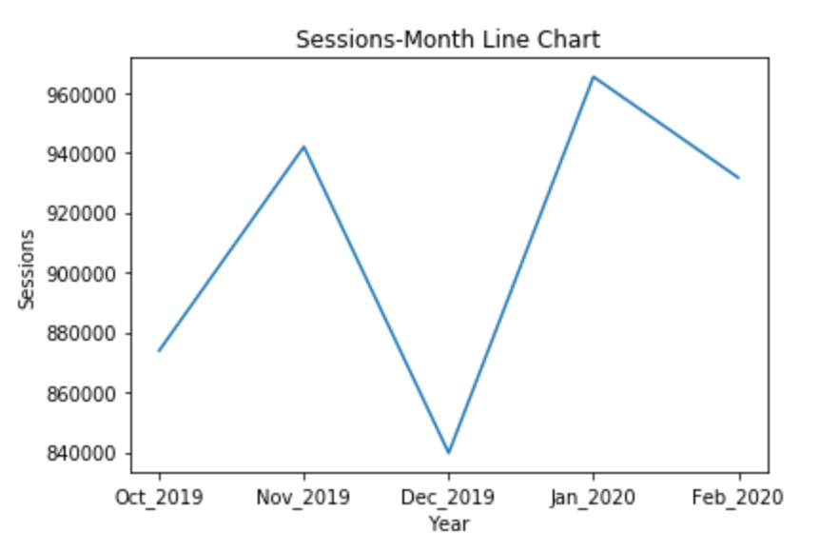
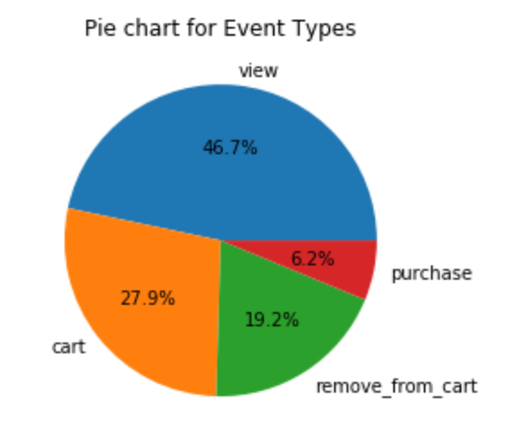
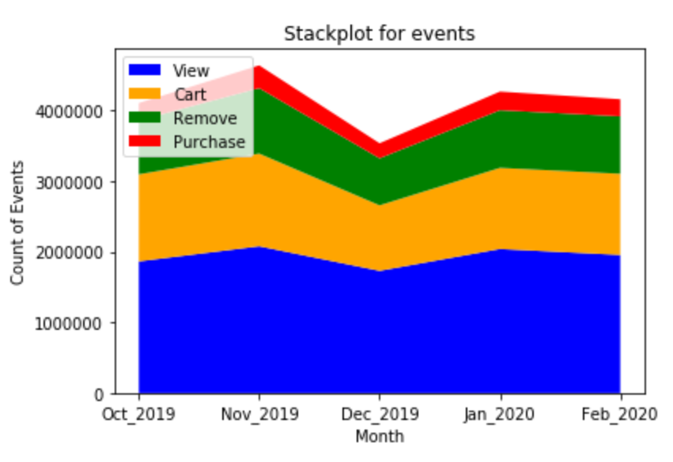
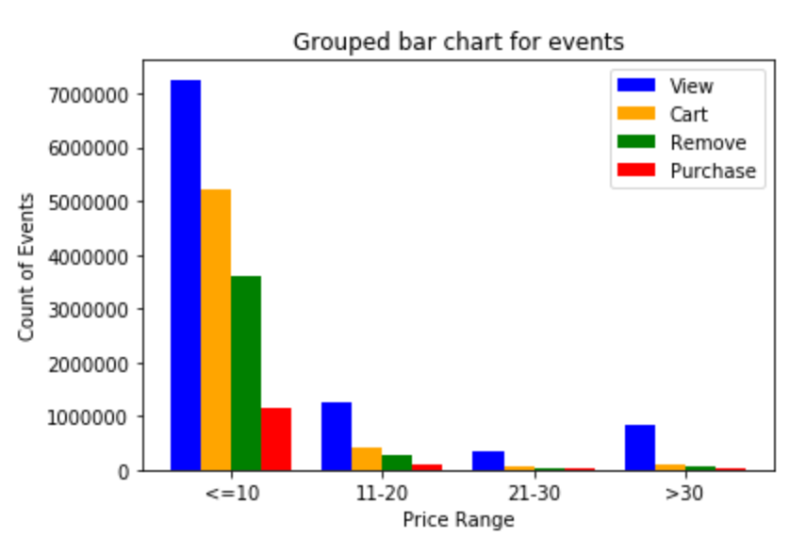
Results and Evaluation
Data Visualization
Sessions have an obviously decrease in Dec. 2019,
Purchase only occupies 6.2% in all the events
The variation of events follows the same trend with sessions
The amount of purchase is only 13.3% of that of view
Most events concentrate in the price range which is less than 10 dollars

Slide 10
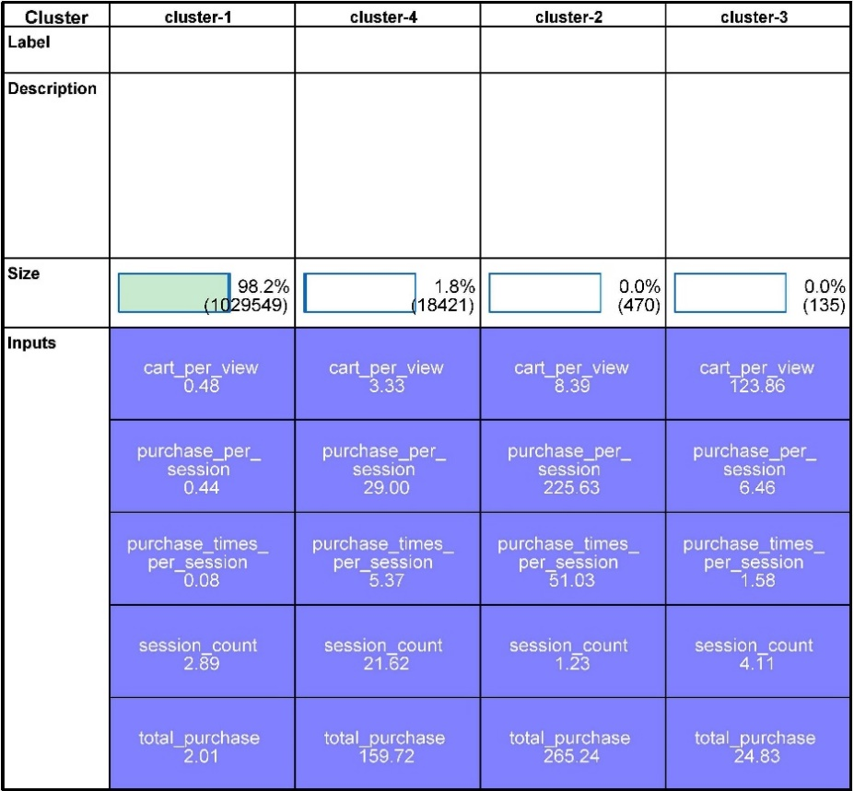
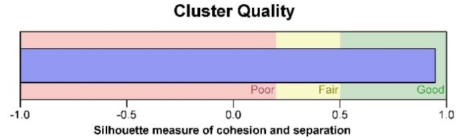
Clustering
We set K equal to four, the average silhouette was 0.9, which was good.
Cluster-1, was a cluster representing “light users.”
Cluster-4 on the second column was a cluster for active customers.
Customers in cluster-2 had a concrete target product.
users in cluster-3 had extremely high number of “cart” but few purchases.

Slide 11
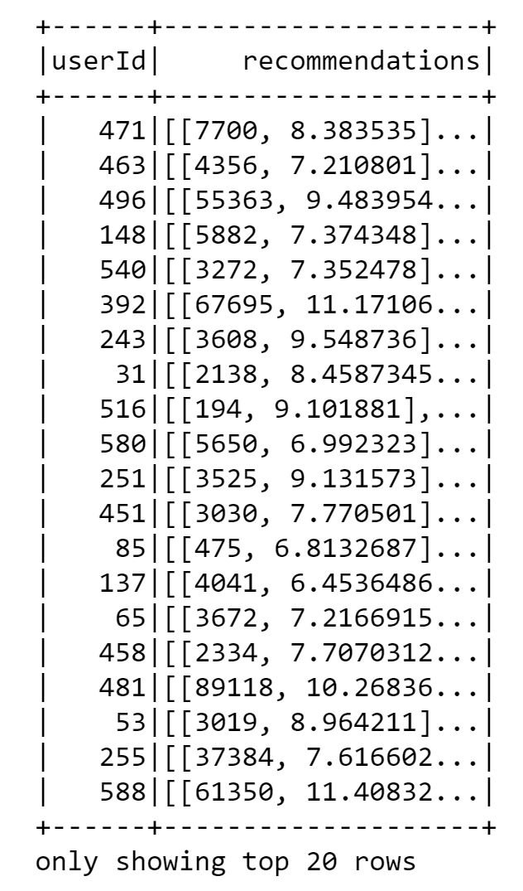
User-Product Recommendation System
User-Product Recommendation System
User-ID 40475278
Cluster-1
5688132, 5585632,
5882421, 5760801,
5882422, 5871060,
5837109, 5909066,
5914149, 5796102.
User-ID142798053
Cluster-4
5688132, 5882422,
5842139, 5877789,
5822423, 5779405,
5585632, 5770019,
5700165, 5685383.
5886761,5686099,
5842154, 5746637,
5700032, 5585632,
35756, 5760801,
5695580, 5867177.
User-ID 264116002
Cluster-2
5864578,5688132, 5700029, 5924417, 5882419, 59980, 5877788, 5797129, 72400, 5878243.
User-ID 142798053
Cluster-3

Slide 12
Conclusion & Lessons Learned
session data
Total session amount dropped in December 2019 and peaked at 2020.
only 6.2% are purchase event, most events are view and cart operations.
The most purchased products price range is 10 dollars and below. The average purchase times per session is 0.21.
user behavior patterns
Three peaks of online users: 5, 11, and 18 o’clock, these relate to different groups of people.
Four clusters of customers.
Rating generation formula and Recommendation system
Based on ALS algorithm
recommend the top 10 most suitable products for each costumer.
lessons learned
explore the user-item relation through developing our own formula of rate based on their shopping behavior online.
logic: rating shows customers' attitude toward each product, and the view, cart and purchase behavior shows that too.

Slide 13
Reference
https://www.kaggle.com/mkechinov/ecommerce-events-history-in-cosmetics-shop

Slide 14
THANKS
Group4: Ting Ding, Haojia Li, Annuo Qian, Jing Zhu

