Slide 1

IDS/Math 586: Data Science & Decision Optimization
Title
A Rolling-Window Framework Combining Factor-Based Return Prediction
with Long-Only Mean–Variance Optimization
Final Project Presentation · Duke University · Spring 2026
Ginger Gao | Jade Cheng | Tea Tafaj | Wenyi Dai

Slide 2





IDS/Math 586: Data Science & Decision Optimization
1. Problem Overview
Part 1: Problem Formulation & Business Context
Smart-beta systematic strategies attempt to capture factor risk premia at low costs.
The Core Challenge:
The expected return vector
is unobserved and noisy. Traditional Mean-Variance Optimization (MVO) is famously sensitive to estimation errors
Small estimation errors produce extreme, unstable weight vectors. Our end-to-end pipeline is specifically designed to mitigate these issues through rigorous data filtering and structural safeguards.
At each monthly rebalancing date T, using only historically available information, an investor must solve a selection and allocation problem under uncertainty:
Which small set of attractive stocks to hold?
How much capital to allocate to each?
Objective: Maximize the risk-adjusted return (Sharpe Ratio) in the following month.

Slide 3








IDS/Math 586: Data Science & Decision Optimization
2. Data & Methodology
Part 2: Data Sources & Target Formulation
CRSP Monthly Stock File (via WRDS): Provides the firm-level panel:
(return),
(price),
(volume).
Crucially, this dataset is free of survivorship bias.
Fama-French 5-Factor Dataset: Supplies the canonical macroeconomic risk factors:
and the risk-free rate
We first construct the current-month excess return for stock i:
The forward-looking target variable (y) for all our predictive models is the next-month excess return:

Slide 4


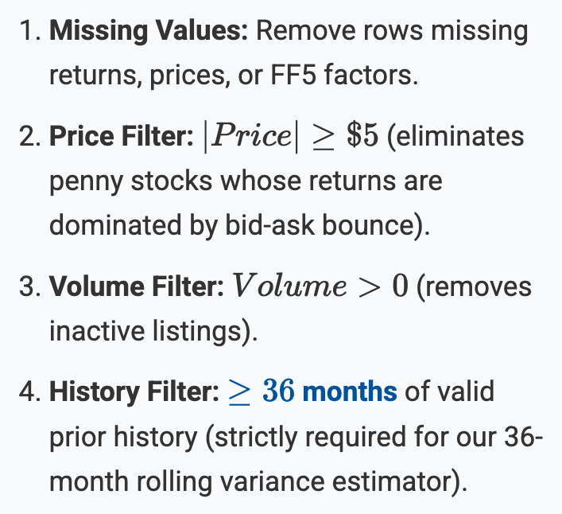
IDS/Math 586: Data Science & Decision Optimization
2. Data & Methodology
Part 2: Strict Investability Filters (Data Cleaning)
The raw CRSP universe is too noisy for optimization. We apply 5 sequential filters to build a realistic candidate pool:
After basic filters, stocks are dynamically ranked each month to form a Top 100 Candidate Pool based on Dollar Volume:
* Note: We take the absolute value of price because CRSP records closing price as negative when the last trade is unavailable and the bid-ask midpoint is used.

Slide 5
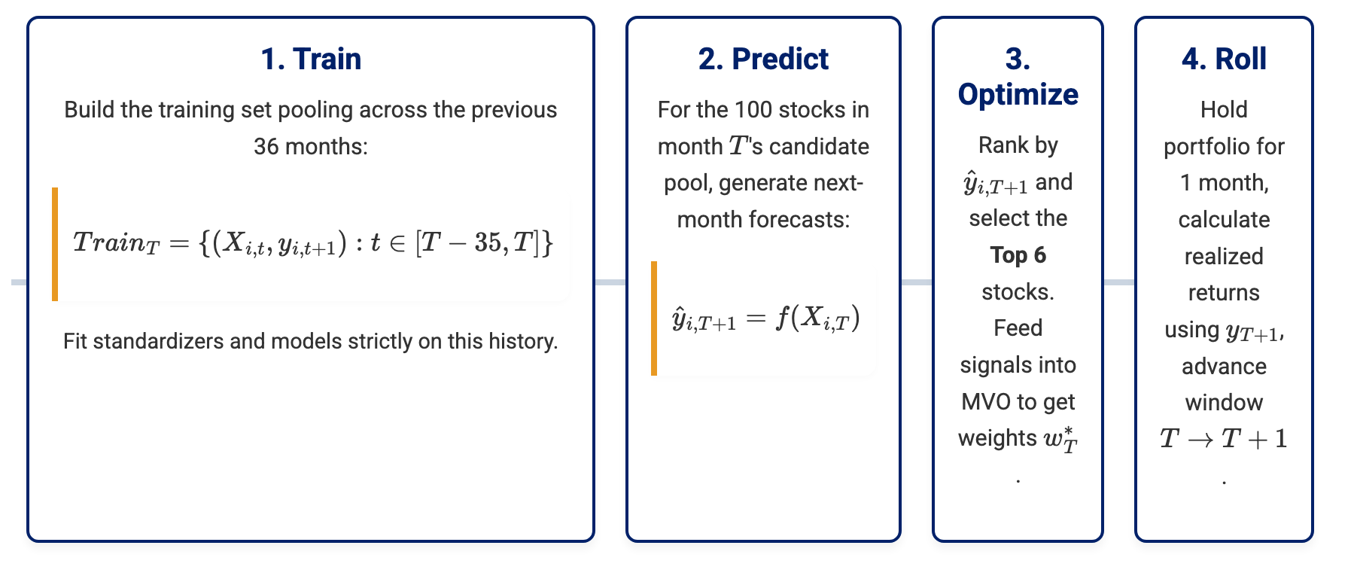
IDS/Math 586: Data Science & Decision Optimization
2. Data & Methodology
Part 2: 36-Month Rolling-Window Architecture
To strictly prevent look-ahead bias and account for non-stationarity, the pipeline re-estimates chronologically at every month T.

Slide 6

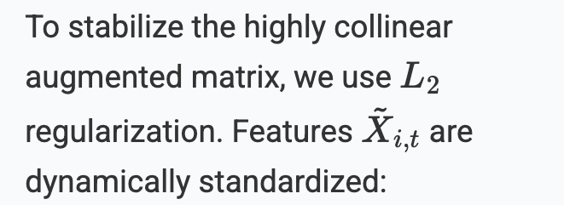


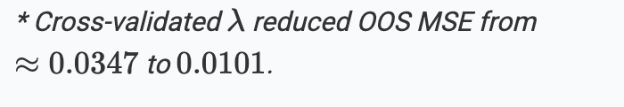
IDS/Math 586: Data Science & Decision Optimization
2. Data & Methodology
Part 2: Traditional Model — Enhanced OLS (RidgeCV)
Based on instructor feedback, plain OLS cannot capture Cross-Sectional & Time-Series (CSTS) structures. We expanded the features:
Non-Linear Momentum:
Added squared returns
to capture asymmetric reversal effects after extreme moves.
Factor-Size Interactions: Added
allowing factor sensitivities to vary with firm size (e.g., small-cap vs large-cap).

Slide 7



IDS/Math 586: Data Science & Decision Optimization
2. Data & Methodology
Part 2: Machine Learning Model — Random Forest Regressor
An ensemble of B = 200 regression trees, where is trained on a bootstrap resample. The prediction is the unweighted average:
Prediction Spread: RF produces a noticeably wider cross-sectional standard deviation (0.048) vs OLS (0.018).
Decisiveness: The wider spread makes RF far more decisive when ranking the 100 candidates to pick the Top 6.
Result: Stock selection quality from RF significantly outperforms OLS.
Trees recursively partition the space, naturally capturing non-linearities and complex interactions without manual engineering.

Slide 8

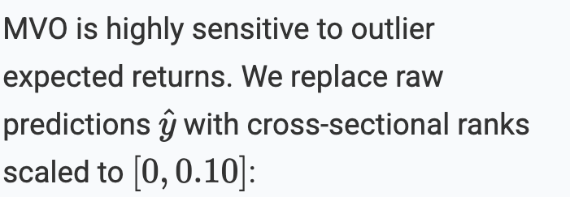
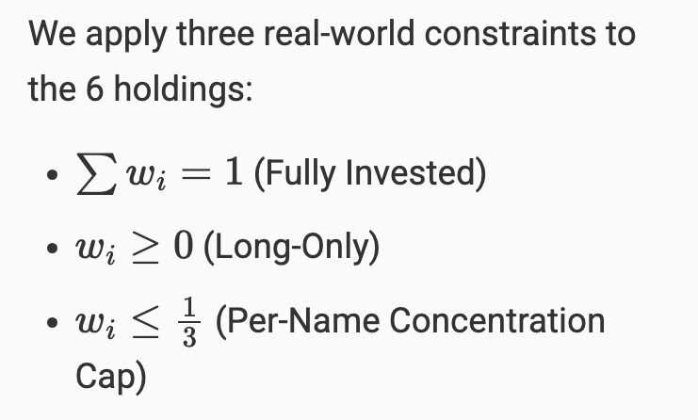
IDS/Math 586: Data Science & Decision Optimization
2. Data & Methodology
Part 2: Decision Optimization — MVO Design
Because Sharpe-maximizing weights are scale-invariant, this strictly preserves the model's ordinal conviction while capping extreme values.

Slide 9
IDS/Math 586: Data Science & Decision Optimization
2. Data & Methodology
Part 2: Covariance Estimation — Diagonal Matrix
Estimator
Why a Diagonal Approximation?
Instead of a full sample covariance matrix, we deliberately use a diagonal matrix:
Noise Reduction: On a 6-stock universe, off-diagonal covariances estimated from only 36 observations are highly noisy and cause extreme, unstable weights.
Robustness: The diagonal estimator is invariant to changes in off-diagonal true structures, which is exactly where the sample estimator fails most.

Slide 10
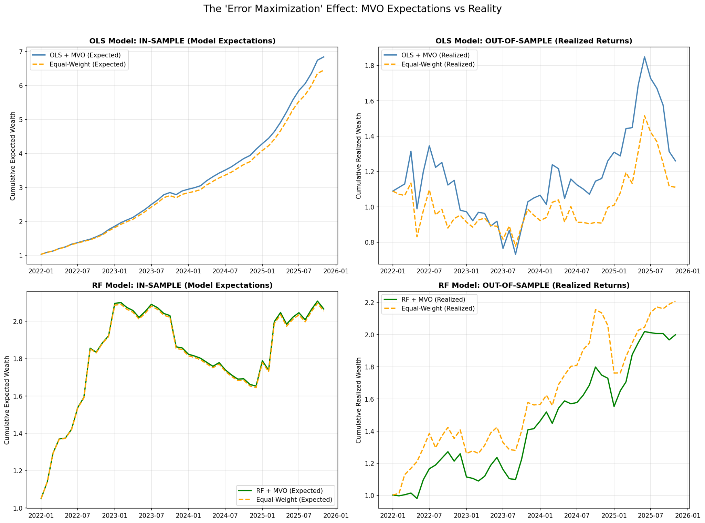
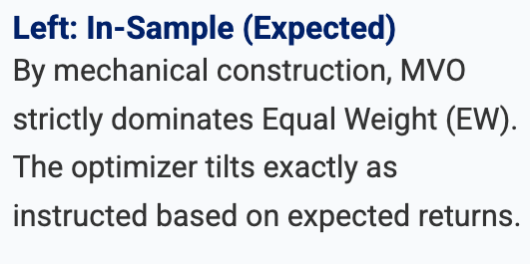
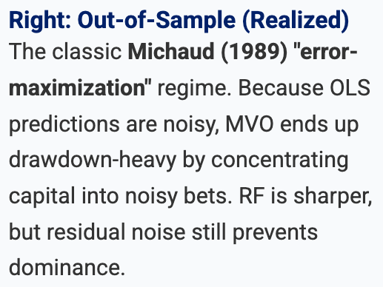
IDS/Math 586: Data Science & Decision Optimization
3. Results & Analysis
Part 3: Diagnosing the “Error-Maximization” Effect(IS vs OOS)
In-Sample vs. Out-of-Sample Tracking
We tracked (Expected) and (Realized):

Slide 11
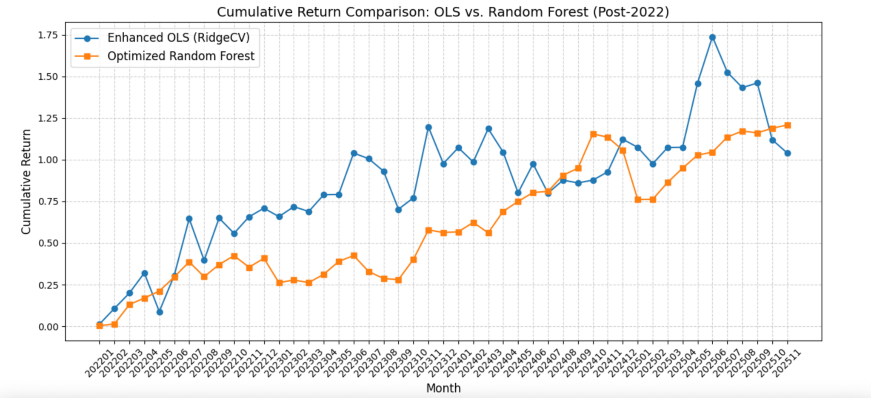
IDS/Math 586: Data Science & Decision Optimization
3. Results & Analysis
Part 3: Head-to-Head Comparison & Business Interpretation
Out-of-Sample Performance
January 2022–November 2025, 47 monthly rebalances.
Strategy
Return
Sharpe
Max DD
RF + MVO
19.34%
1.10
14.29%
OLS + MVO
6.08%
0.35
45.62%
RF Equal-Weight
22.42%
1.22
18.28%
Core Insight
"Selection-first, optimization-second."
Practitioners must prioritize the predictive model and treat MVO purely as a concentration risk control.

Slide 12
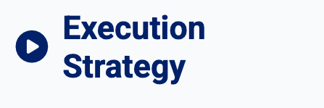


IDS/Math 586: Data Science & Decision Optimization
4. Recommendations & Implementation
Part 4: Recommendations & Implementation
Deploy the Random Forest variant as the core production strategy.
Execute pipeline on the last business day of each month after CRSP/FF5 data updates.
Retrain models strictly from scratch on the 36-month window to capture regime shifts.
Track realized portfolio return vs. the Equal-Weight benchmark to detect MVO-layer drift.
Monitor the OOS RMSE of model predictions over time.
Track the frequency of hitting the 1/3 concentration cap.
Account for transaction costs explicitly; transitions across volatile months introduce high friction.
Implement a discretionary human override mechanism during identified extreme market stress.

Slide 13


IDS/Math 586: Data Science & Decision Optimization
5. Conclusion
Part 5: Limitations & Future Work
Frictionless trading assumption overstates net returns.
Diagonal covariance discards valuable pairwise correlation information.
Parsimonious feature set (only FF5 + Lags) omits firm-specific fundamental signals.
Ledoit-Wolf Shrinkage: Safely incorporate correlation structure without extreme noise:
Turnover Penalties: Incorporate transaction costs directly into the MVO objective function to stabilize sequential weights.
Panel Estimators: Implement true CSTS panel models (e.g., Fama-MacBeth) instead of pooled OLS.

Slide 14
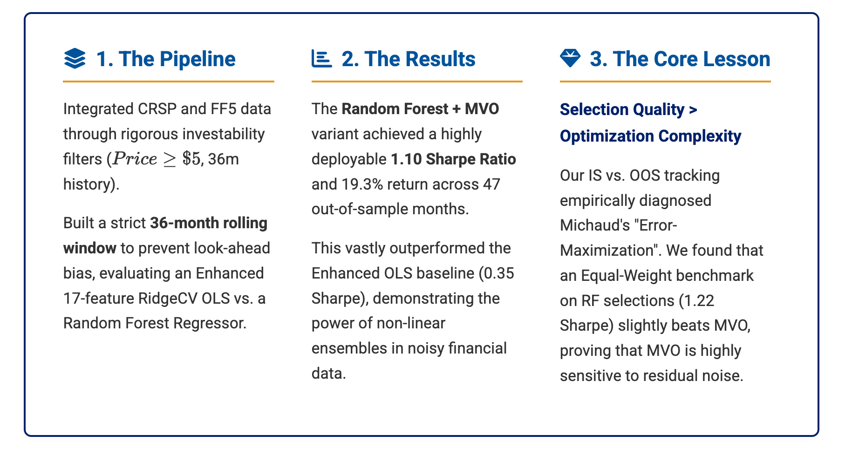
IDS/Math 586: Data Science & Decision Optimization
Summary
Executive Summary & Core Takeaways

Slide 15
IDS/Math 586: Data Science & Decision Optimization
Summary
Thank you!
Any Questions?

