Slide 1
10N_22 data analysis report
Qian Liu

Slide 2

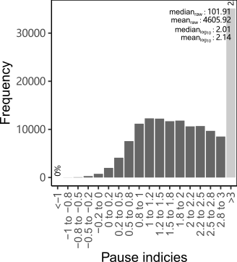
Pause index
10N-22
Sample looks ok

Slide 3

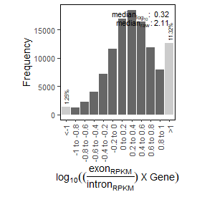
mRNA contamination
10N-22
Sample looks ok

Slide 4
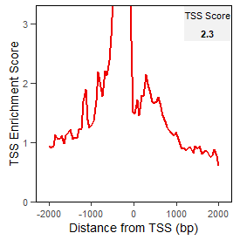
Plus TSS enrichment

Slide 5
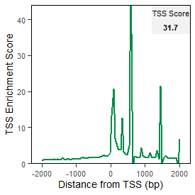

Minus TSS enrichment
10N-22
Sample looks ok, sequences are mainly concentrated on the negative strand

