Slide 1

Flask
Based on Python
By Jingxiong Liang

Slide 2
Overview
Hello World example
URL parameter
Request parameter
DB manipulate

Slide 3
Get what?
Python programing
Simple back-end Server for F-E and APP
Career in B-E

Slide 4
Get Ready
Install Python 2.7
pip install flask
pip install pymysql or MySQL_python
Test tools : postman、MySQL server

Slide 5
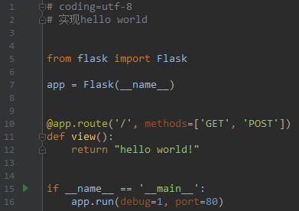
Hello World

Slide 6
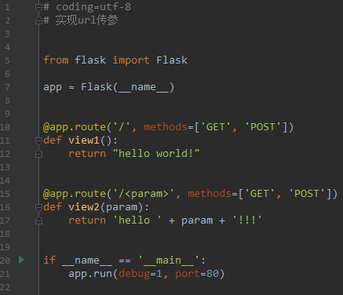
Try1:URL parameter

Slide 7
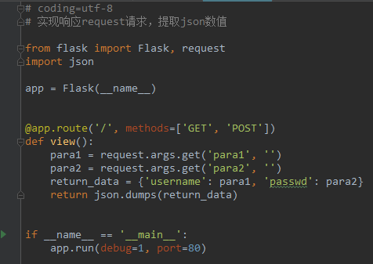
Try2:Request parameter

Slide 8
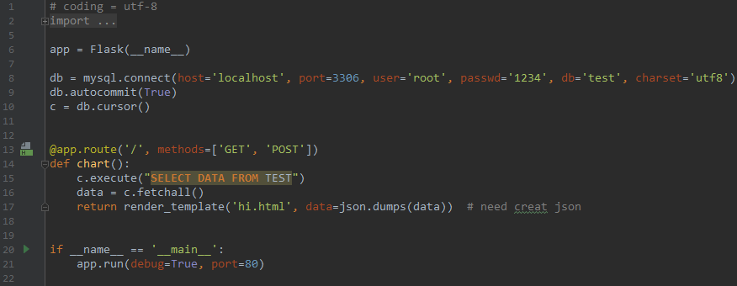
Try3:DB manipulate

Slide 9
Learn more
百度一下 flask document
廖雪峰Python教程
SQLAlchemy
Flask拓展

