Slide 1
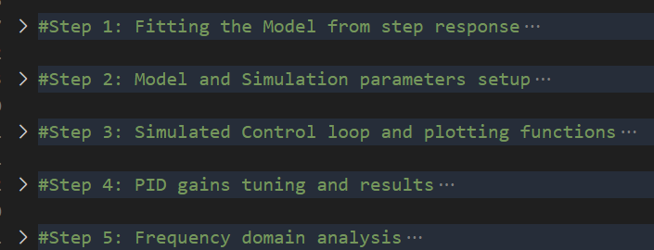
Road Map
Fast and Modular:
Only One Measurement Run Required to Fit and Obtain the TF Model
Instantaneous Simulation and Tuning
Frequency Domain Analysis to Show Ideal Performance

Slide 2
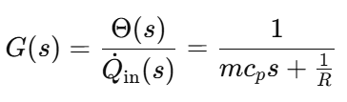



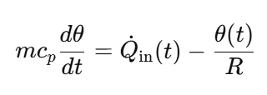

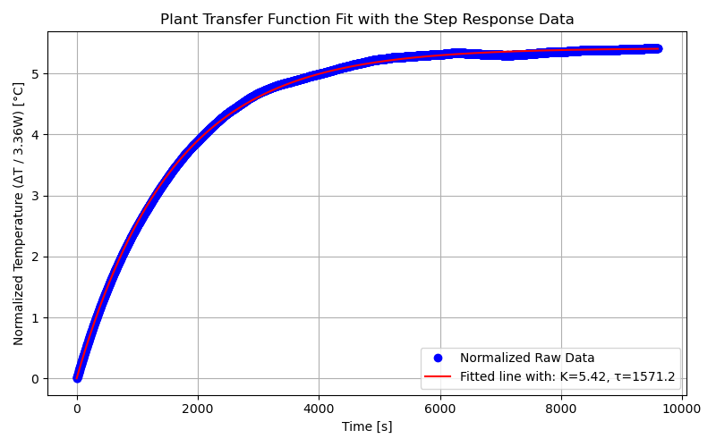
Fitting the Model
EOM:
Time Domain Response to Step Input:

Slide 3
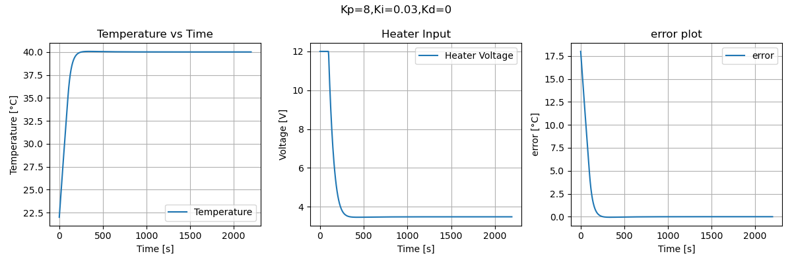
Tuning with Simulations
- Tune Kp first to get close to the desired goal
- then tune Ki to eliminate steady state error
- finally tune Kd if needed.

Slide 4
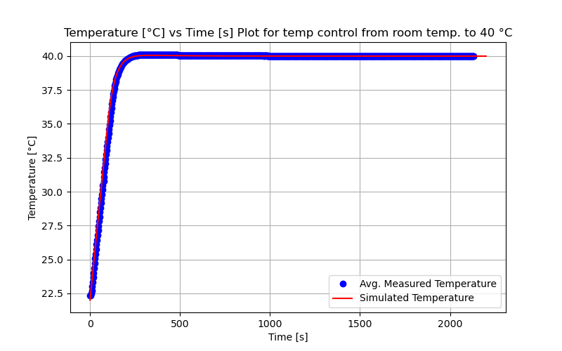
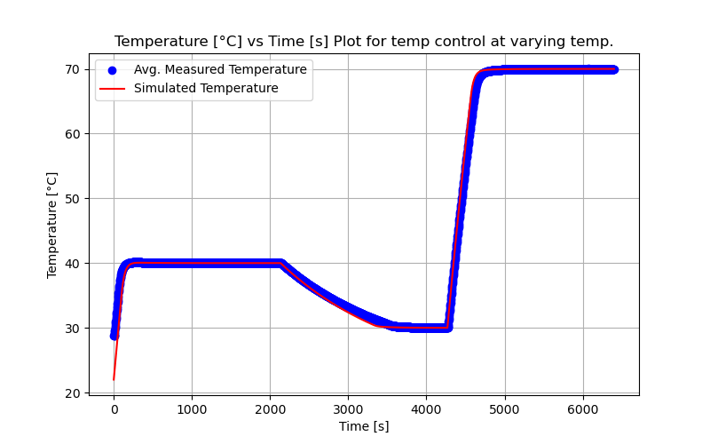
Validation with IRL Data
From Room Temp. to 40 C
Tracking at Varying Temps.

Slide 5
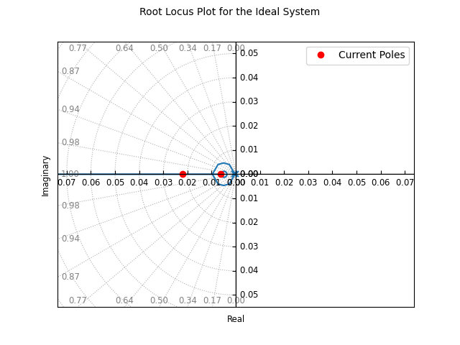
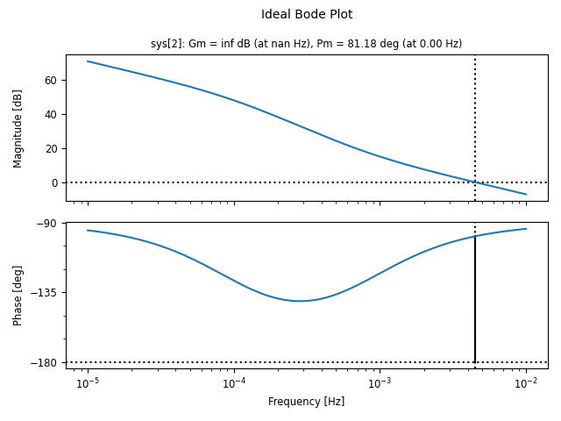
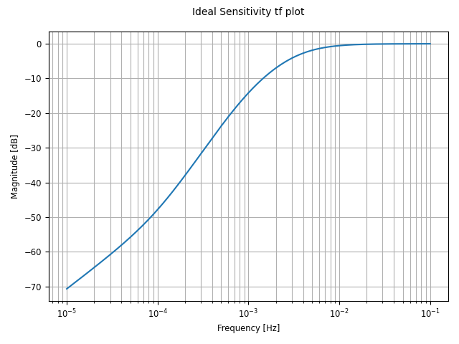
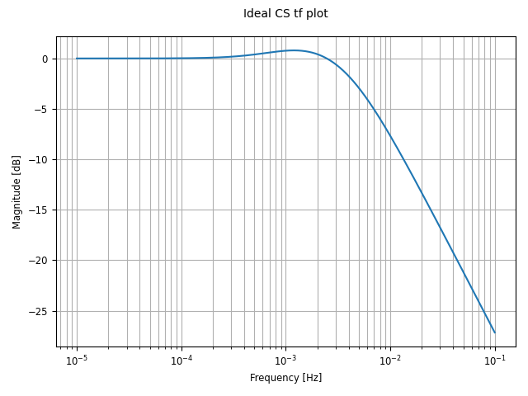
Frequency Domain Analysis (Ideal Best Case)
RL Plot for Stability Check: Bode Plot for Robustness Check:
Sen. tf and Comp. Sen. tf for disturbance and noise rejection check:

Slide 6
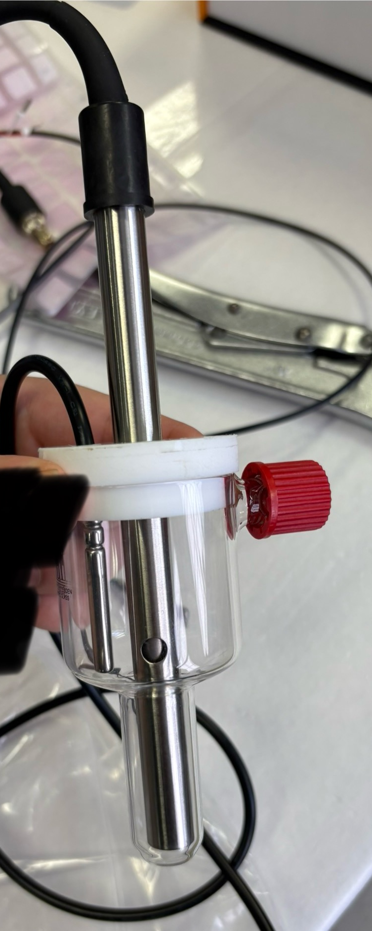
EC Update
Time [hr] | DI Water | Acetone | 2-Propanol | KCL (84 μS/cm)
0:00 | 3.572 | 0.19 | 0.02 | 75.574
4:00 | 3.318 | 0.358 | 0.028 | 73.088
12:00 | 3.166 | 0.502 | 0.03 | 72.218

