Slide 1
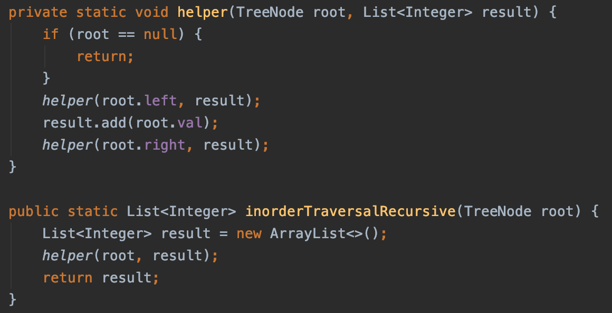
Inorder: Left, Root, Right
8
3
10
1
6
9
14
2
4
7
11
12
Result: [
11,
2,
1,
3,
12,
4,
6,
7,
8,
9,
10,
14 ]

Slide 2
Inorder: Left, Root, Right
8
3
10
1
6
9
14
2
4
7
11
12
Result: [
11,
2,
1,
3,
12,
4,
6,
7,
8,
9,
10,
14 ]

Slide 3
Inorder: Left, Root, Right
8
3
10
1
6
9
14
2
4
7
11
12
Reverse Print a linked list
Stack
Unless a node has right child
Add right child to stack

Slide 4

Print linked list values backward
head
8
3
2
9
5
6
null

Slide 5
8
3
10
1
6
9
14
2
4
7
11
12
6,
4,
12,
9,
8,
7,
14
3,
1,
2,
11,
Stack:
10,
Result:
11,
2,
1,
3,
12,
4,
6,
7,
8,
9,
10,
14

Slide 6
Loop: when stack is not empty
Pop a node from stack
Loop: Add all the left children till leaf
Loop: Pop each node from the stack
If the popped node has right child:
Add the right child to the stack,
and then break out this loop

Slide 7
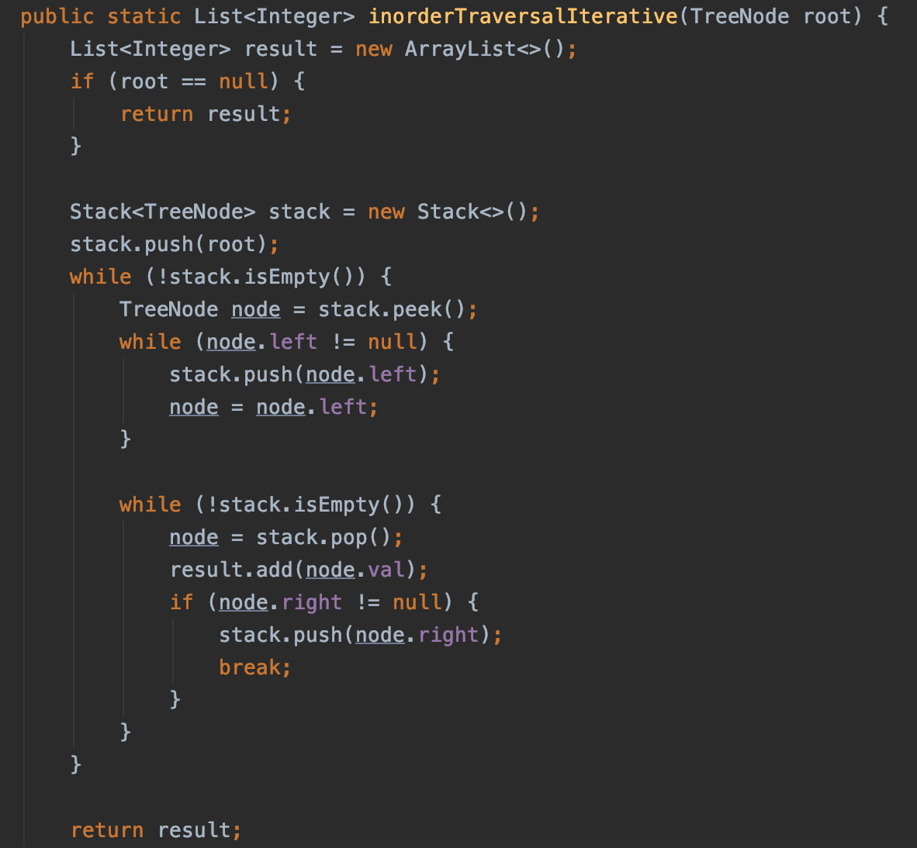
Inorder: Left, Root, Right
Loop: when stack is not empty
Pop a node from stack
Loop: Add all the left children till leaf
Loop: Pop each node from the stack
If the popped node has right child:
Add the right child to the stack,
and then break out this loop

