Slide 1
1
1
1
2
1
2
2
1

Slide 2
2
3
1
3
2
1
3
2
1
2
3
3
1
1
2
3
2
1

Slide 3


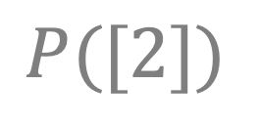
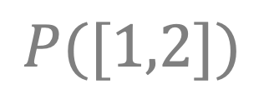
$$P([1])$$
1
1
1
2
$$P([2])$$
$$P([1,2])$$
1
2
2
1
$$P([1])$$

Slide 4
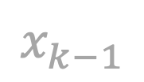
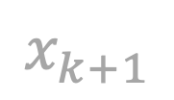
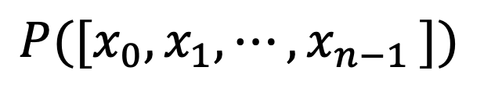

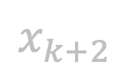
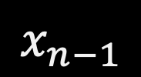

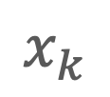
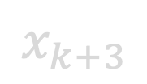
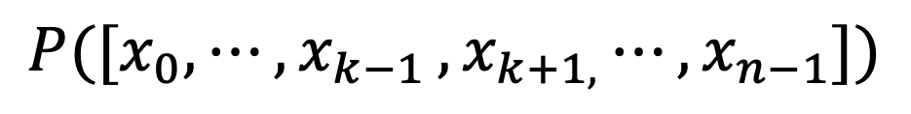

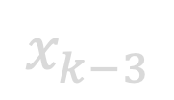

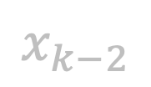

$$x_{0}$$
$$⋮$$
$$x_{k−3}$$
$$x_{k−2}$$
$$x_{k−1}$$
$$P([x_{0},x_{1},{⋯,x}_{n−1}])$$
$$=$$
$$x_{k}$$
$$,$$
$$P([x_{0},{⋯,x}_{k−1}{{,x}_{k+1,}⋯,x}_{n−1}])$$
$$x_{k+1}$$
$$x_{k+2}$$
$$x_{k+3}$$
$$⋮$$
$$x_{n−1}$$

Slide 5
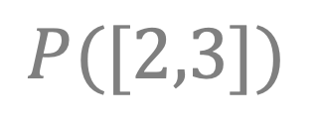

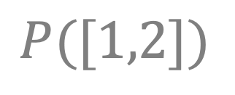

2
3
1
$$P([2,3])$$
3
2
$$P([1,2,3])$$
1
3
2
1
2
3
$$P([1,3])$$
3
1
1
2
3
$$P([1,2])$$
2
1

