Slide 1
MGTF 413 Final Project Presentation
Project 2 : Pricing European Path-Dependent Derivatives Using the Binomial Model vs. Monte-Carlo Simulation
Group 6
Haoning Qiu
Xiangji Kong
Xuefeng Yang
Ying Zhang
Zhenghua Ye
Zhuoer Jin
Date: March 16 2022

Slide 2
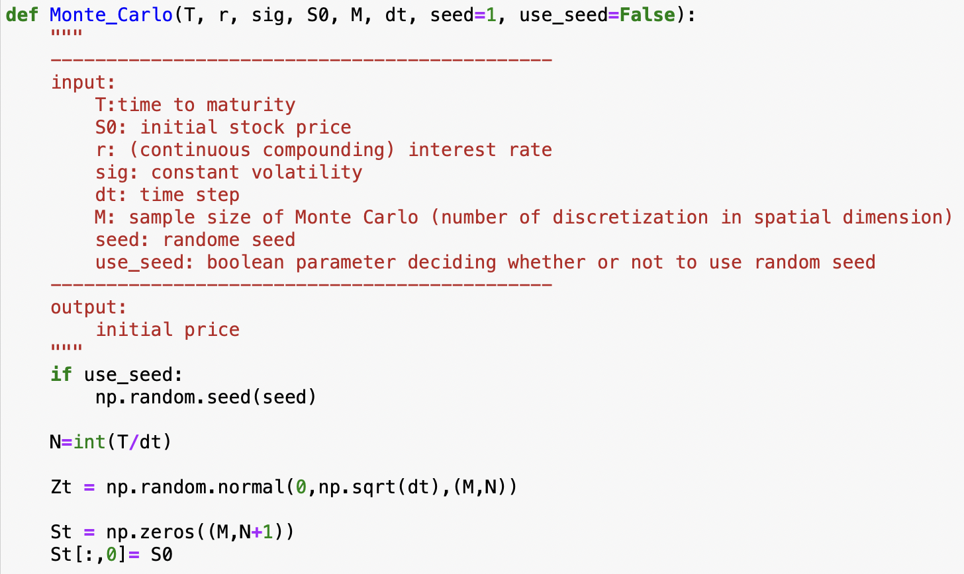
Monte Carlo Simulation
Calculate the increment in discretization
Simulate Brownian motion matrix that are i.i.d with size M, N.
Set a zero matrix for stock price.
Fill in the first column of St.

Slide 3
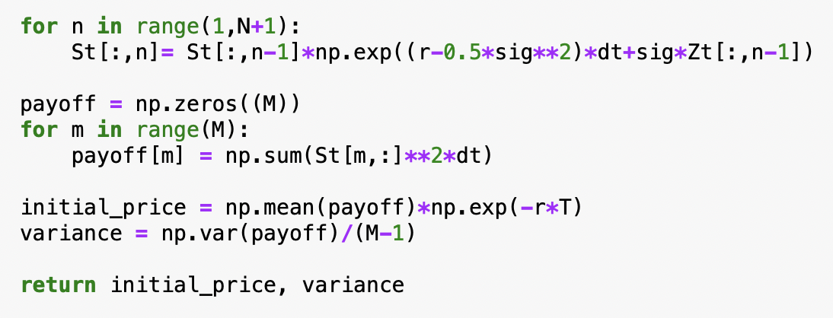
Monte Carlo Simulation
Fill in the rest columns after iterative repetition.
Set a zero matrix of payoff.
Compute the payoff based on the stock price for each row.
Return the initial price and variance.

Slide 4
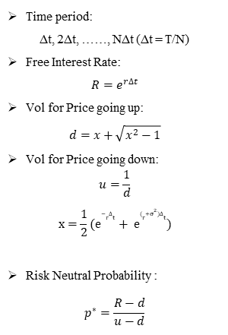
Non-recombining Binomial Tree: Scheme
Stock Price under Non-Recombining Tree
Subject Conditions
Time period:
∆t, 2∆t, ……, N∆t (∆t = T/N)
Free Interest Rate:
$$R=e^{r∆t}$$
Vol for Price going up:
$$d=x+\sqrt{x^{2}−1}$$
Vol for Price going down:
$$u=\frac{1}{d}$$
$$x=\frac{1}{2}(e^{−r∆t}+ e^{(r+σ^{2})∆t})$$
Risk Neutral Probability :
$$p^{∗}=\frac{R−d}{u−d}$$
S_{2j,t+1} = S_{j,t} * d S_{2j+1,t+1} = S_{j,t} * u
j = 0, 1, 2, ……，N-1
Non-Recombining Tree

Slide 5

Non-recombining Binomial Tree: Scheme
Price for European Derivative under Non-Recombining Tree
Calaulation for Initial Arbitrage Free Price
Payoff Value: X_{t}
Price for European Derivative: V_{t}
Intitial Arbitrage Free Price: V₀
By the final payoff formula in question$X=\int_{0}^{T}{S_{t}^{2}}dt$
At maturity,
5

Slide 6
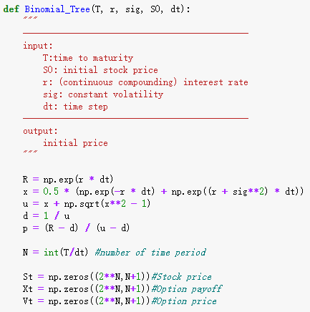
Non-recombining Binomial Tree: Code
Create a function to price the option using non-recombining binomial tree.
First, set up the parameters based on the inputs and create matrices for stock price, option payoff and option price.

Slide 7
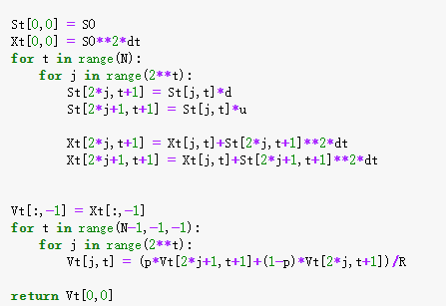
Non-recombining Binomial Tree: Code
The first for loop is used to generate the tree of stock price and option payoff, working forward from initial point to maturity.
The second for loop is used to generate the tree of option price, working backward from maturity to initial point.
Finally, return the initial price.

Slide 8
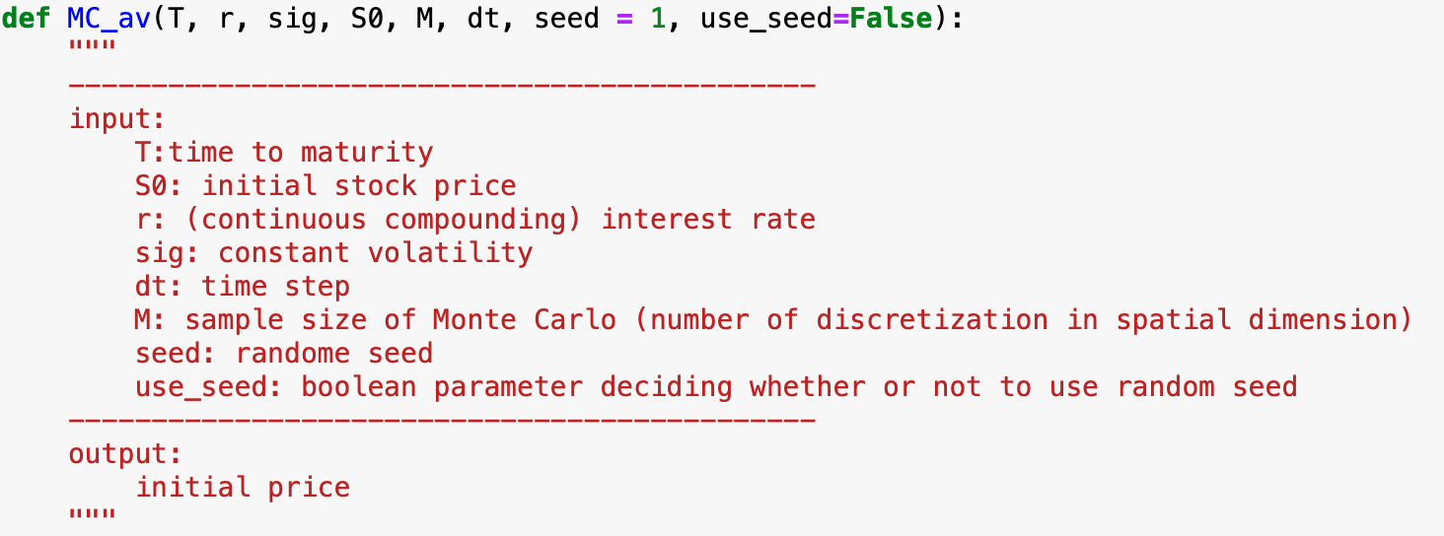
Antithetic Method：Code
create a function of Monte-Carlo Antithetic Method using all these inputs.

Slide 9
Code Testing and Computation Time Comparison
 | Initial arbitrage free price of Monte Carlo method (in dollars) | Initial arbitrage free price of binomial method (in dollars)
1.0 | 75.841584 | 76.218974
0.5 | 62.988541 | 63.300640
0.4 | 60.311746 | 60.727303
0.2 | 55.320988 | 55.590971
0.1 | 52.791926 | 53.027978

Slide 10
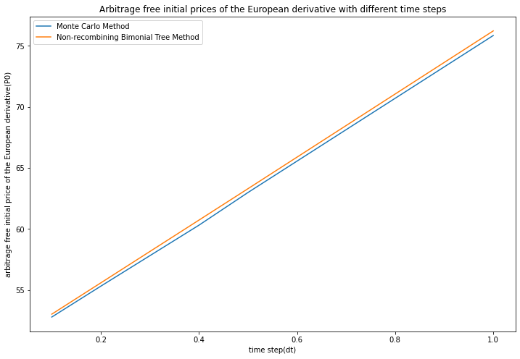
Code Testing and Computation Time Comparison

Slide 11
Code Testing and Computation Time Comparison
 | Computation time of Monte Carlo method (in seconds) | Computation time of binomial method (in seconds)
1.0 | 0.006091 | 0.000000
0.5 | 0.005543 | 0.000000
0.4 | 0.004963 | 0.000000
0.2 | 0.004000 | 0.000000
0.1 | 0.006181 | 2.887901
Notes:
Here, we are fixing all other variables and only alter the time discretization, since the time discretization. This has the most influence on our algorithm’s performance. Since as the time discretization increases, the computation time must increase for both the Monte Carlo method and the non-recombing binary tree method. Since there are more time steps in the Monte Carlo case as well as more nodes which increase exponentially (In fact, total number of nodes for non recombining tree is ) for the binomial model.

Slide 12
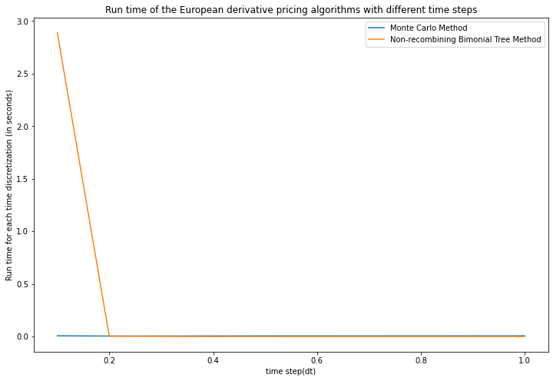
Code Testing and Computation Time Comparison
Notes:
Here, we are fixing all other variables and only alter the time discretization, since the time discretization. This has the most influence on our algorithm’s performance. Since as the time discretization increases, the computation time must increase for both the Monte Carlo method and the non-recombing binary tree method. Since there are more time steps in the Monte Carlo case as well as more nodes which increase exponentially (In fact, total number of nodes for non recombining tree is ) for the binomial model.

Slide 13
Code Testing and Computation Time Comparison
 | Initial arbitrage free price of Monte Carlo method (in dollars) | Initial arbitrage free price of binomial model (in dollars)
5.0 | 540.193368 | 552.914570
2.0 | 382.174441 | 402.744772
1.0 | 344.626660 | 357.146738
0.5 | 326.030554 | 335.207216
0.4 | 327.819552 | 330.888386
Notes:
So, we basically increase the time period five times, and double the volatility, and keeping the other conditions (i.e., initial stock price and the risk-free interest rate) the same.
We found that as the time to maturity and the volatility increases, the arbitrage free price of the options increase significantly, so as the dispersion of the initial arbitrage free price with different time discritizations

Slide 14
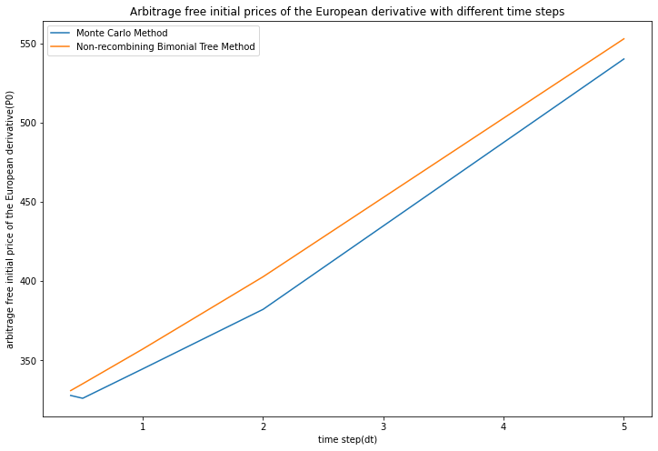
Code Testing and Computation Time Comparison
Notes:
So, we basically increase the time period five times, and double the volatility, and keeping the other conditions (i.e., initial stock price and the risk-free interest rate) the same.
We found that as the time to maturity and the volatility increases, the arbitrage free price of the options increase significantly, so as the dispersion of the initial arbitrage free price with different time discritizations

Slide 15
Code Testing and Computation Time Comparison
 | Computation time of Monte Carlo method (in seconds) | Computation time of binomial method (in seconds)
5.0 | 0.006039 | 0.000000
2.0 | 0.003998 | 0.000000
1.0 | 0.005513 | 0.002995
0.5 | 0.005008 | 3.049201
0.4 | 0.005999 | 122.207999
Notes:
Here, we are fixing all other variables and only alter the time discretization, since the time discretization. This has the most influence on our algorithm’s performance. Since as the time discretization increases, the computation time must increase for both the Monte Carlo method and the non-recombing binary tree method. Since there are more time steps in the Monte Carlo case as well as more nodes which increase exponentially (In fact, total number of nodes for non recombining tree is ) for the binomial model. Hence, we measure the total amount of run-time instead of the average or standard deviation of runtime.

Slide 16
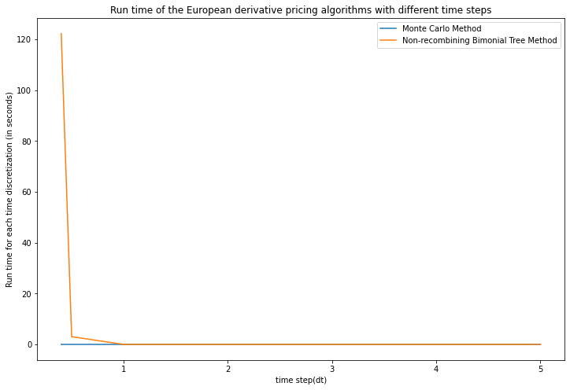
Code Testing and Computation Time Comparison
Notes:
Here, we are fixing all other variables and only alter the time discretization, since the time discretization. This has the most influence on our algorithm’s performance. Since as the time discretization increases, the computation time must increase for both the Monte Carlo method and the non-recombing binary tree method. Since there are more time steps in the Monte Carlo case as well as more nodes which increase exponentially (In fact, total number of nodes for non recombining tree is ) for the binomial model. Hence, we measure the total amount of run-time instead of the average or standard deviation of runtime.

Slide 17
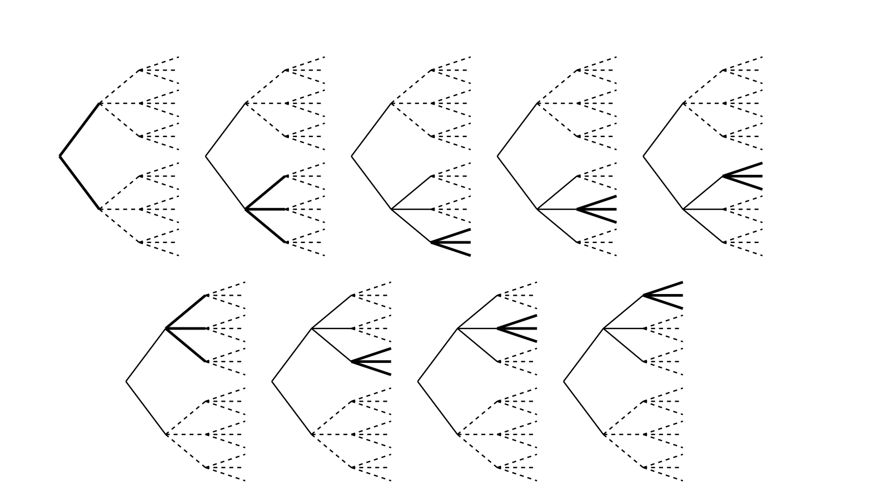
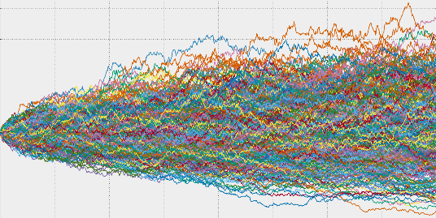
Code Testing and Computation Time Comparison
Conclusion:
The binomial model is a straightforward but powerful technique to solve complex pricing problems. On the other hand, the Monte Carlo method is very flexible in handling high-dimensional financial issues.
The binomial model with a non-recombining tree may take less time to run with larger time discretizations. However, as we reduce our time discretizations to smaller values, it is clear that the Monte Carlo method converges to the initial arbitrage-free price of the European contingent claim faster. Also, the results obtained from the Monte Carlo Method are more accurate than the Binomial Method with the non-recombining tree. The observation will be amplified if we have more periods (T) and significant volatility (σ).
Notes:
Here, we are fixing all other variables and only alter the time discretization, since the time discretization. This has the most influence on our algorithm’s performance, especially for the non-recombing binominal model.

Slide 18
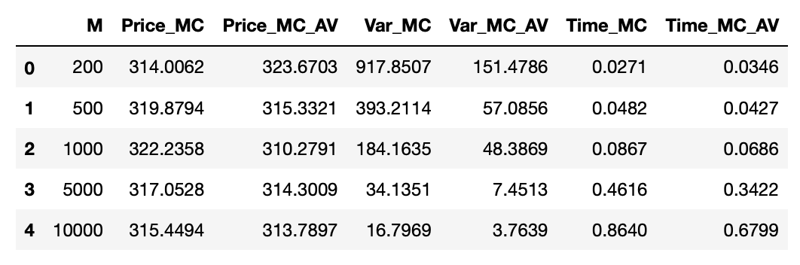
Antithetic Method：Object & Results
monotone function
improve the accuracy of estimation
reduce the variance

Slide 19
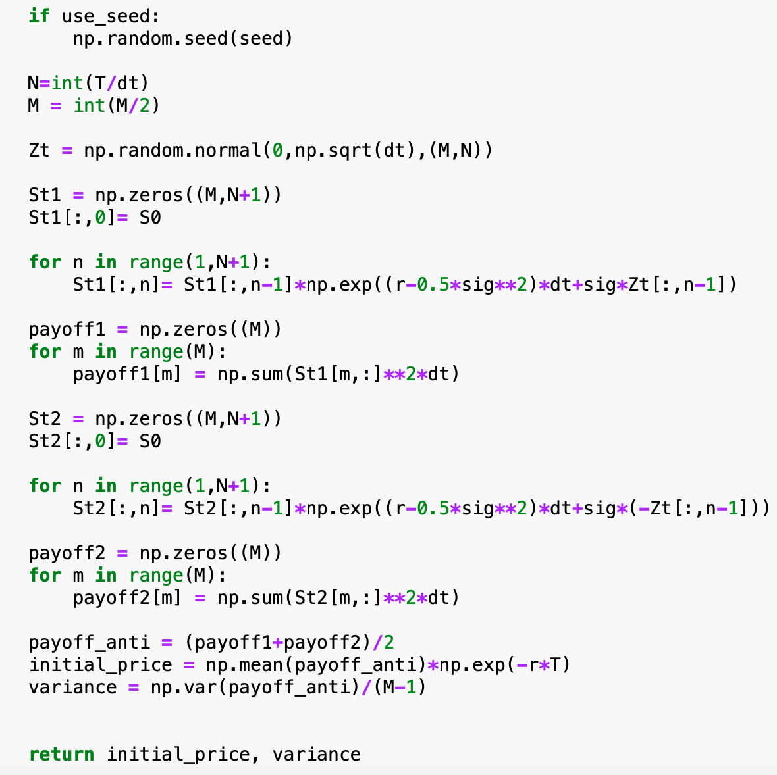
Antithetic Method：Code
1.set up parameters and matrixes
2.zt and (-zt) are negatively correlated
3.derive the new variance and price from payoff1 and payoff2

Slide 20
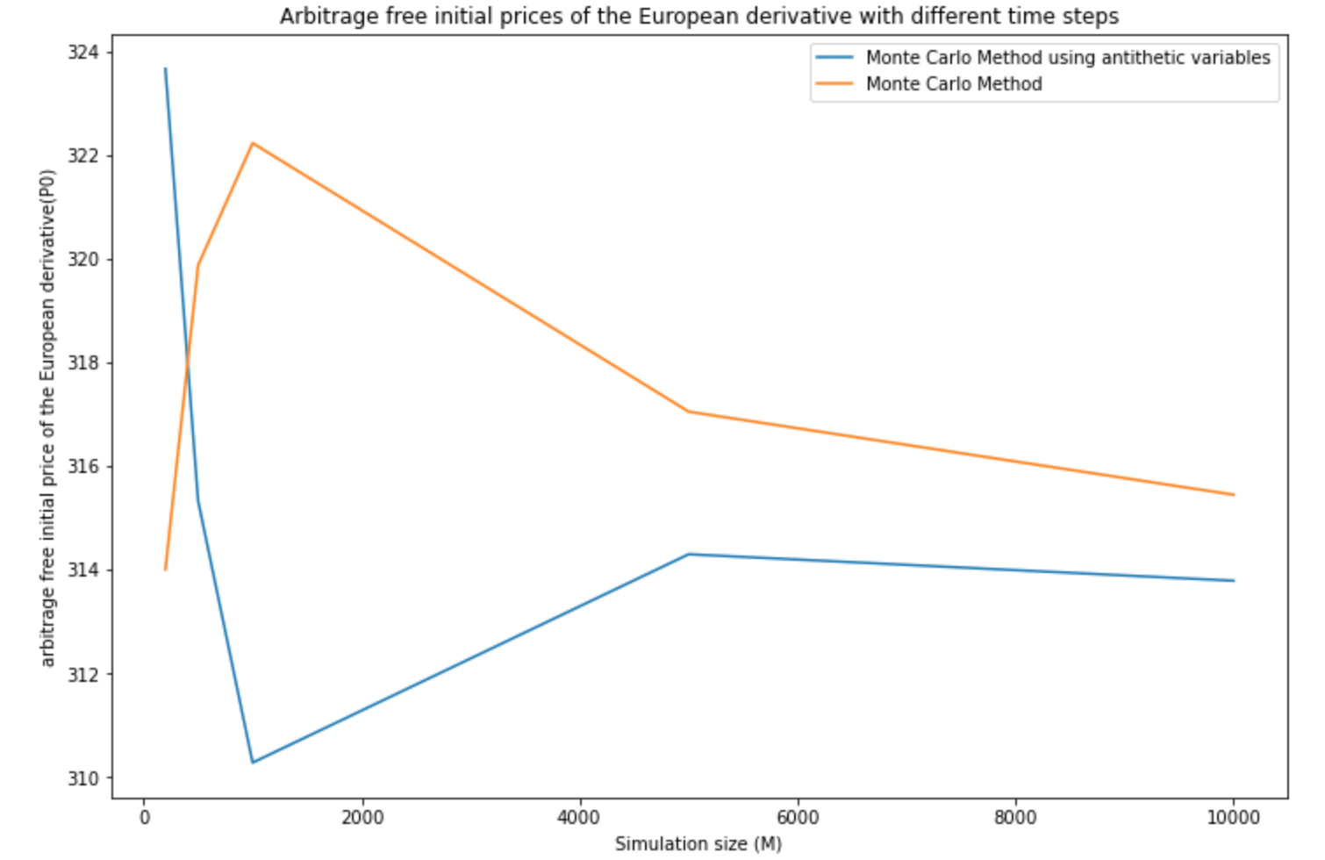
Antithetic Method：Improvements

Slide 21
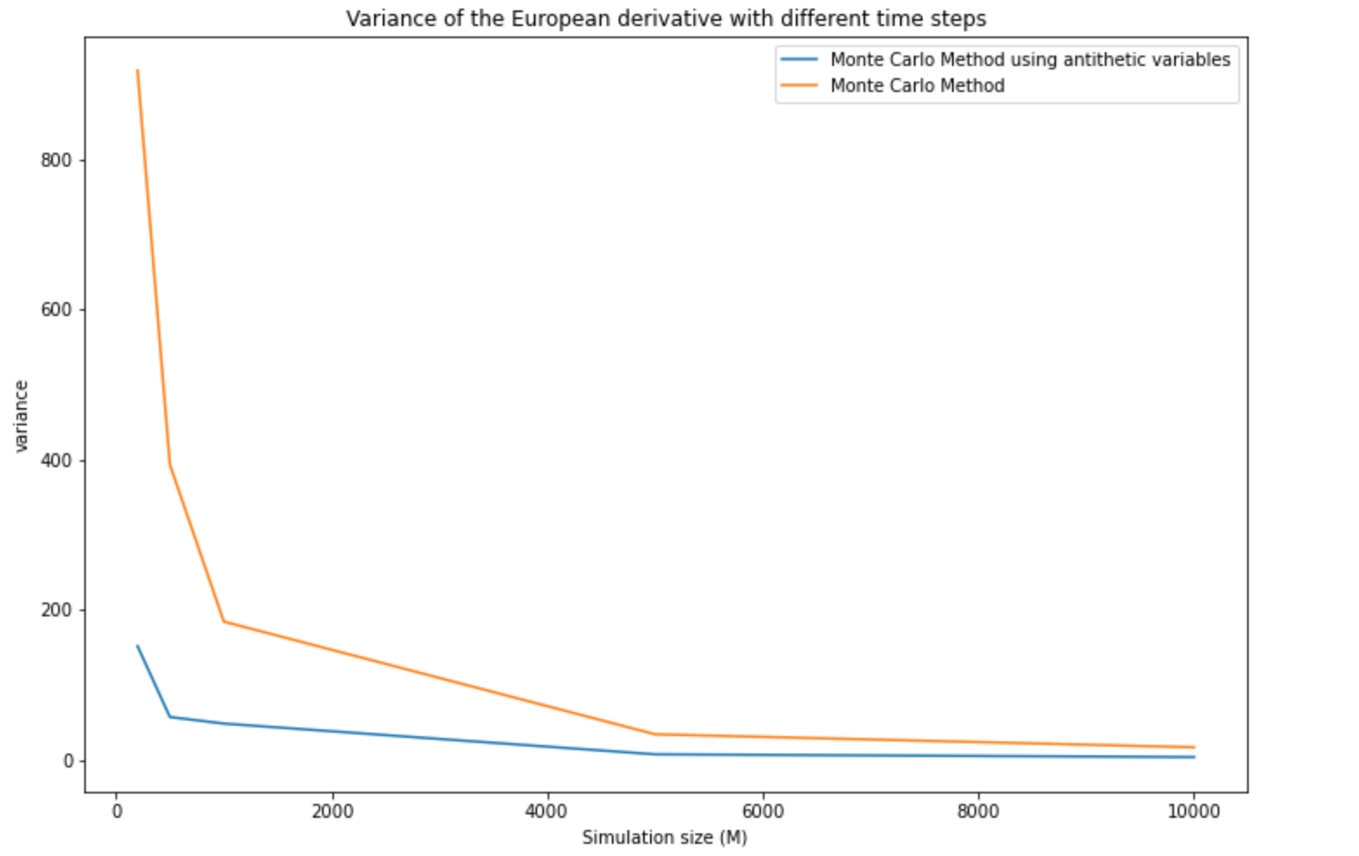
Antithetic Method：Improvements

Slide 22
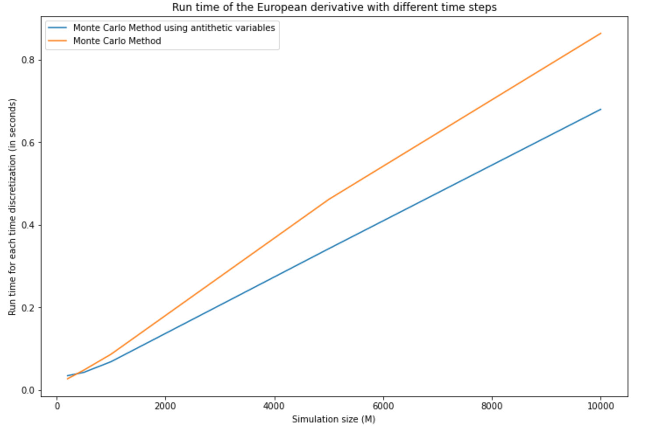
Antithetic Method：Improvements

