Slide 1
Lloyds Banking Group Data Challenge
Haoran (Samuel) Jie
Task2

Slide 2
Study design
Data Pre-processing
Prediction Model construction
Result evaluation
Eliminated unsuitable features
Converts alphanumeric data to numerical data
Extract data for training and testing
Extract X and Y
Implemented (classifiers)
Logistic regression
Random forest
Gradient boosting decision tree
Parameter Tuning
Extract feature importance
Plotted Bar/Pie chart
Compare between linear and non-linear models
Overfitting/Underfitting

Slide 3
Coding
IDE: VScode - Jupyter Notebook
Programming Language: Python
Packages: Pandas, NumPy, Matplotlib, Sklearn
Source Code: https://github.com/Haoran-Jie/LloydsDataChallenge

Slide 4
Models’ Performance Metrics
Logistic Regression |  | Random Forest |  | Gradient Boosting Decision Tree
Training set accuracy | Testing set accuracy | Training set accuracy | Testing set accuracy | Training set accuracy | Testing set accuracy
79.25% | 76.97% | 97.53% | 79.13% | 100.00% | 77.70%
Analysing the Training set accuracy of Logistic Regression compared to the other two models, it is obvious that the relationship is non-linear
Gradient Boosting Decision Tree has a training set accuracy of 100%, showing an overfitting
Random Forest has the highest accuracy out of the three models

Slide 5
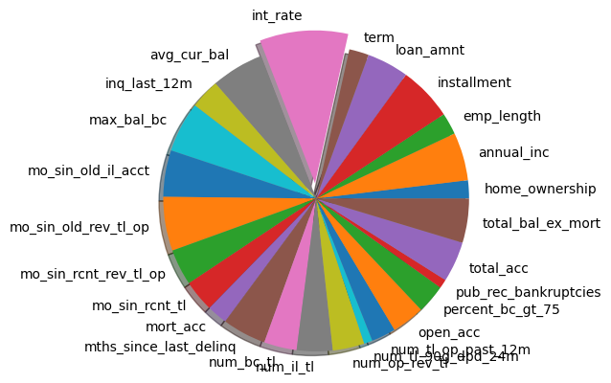
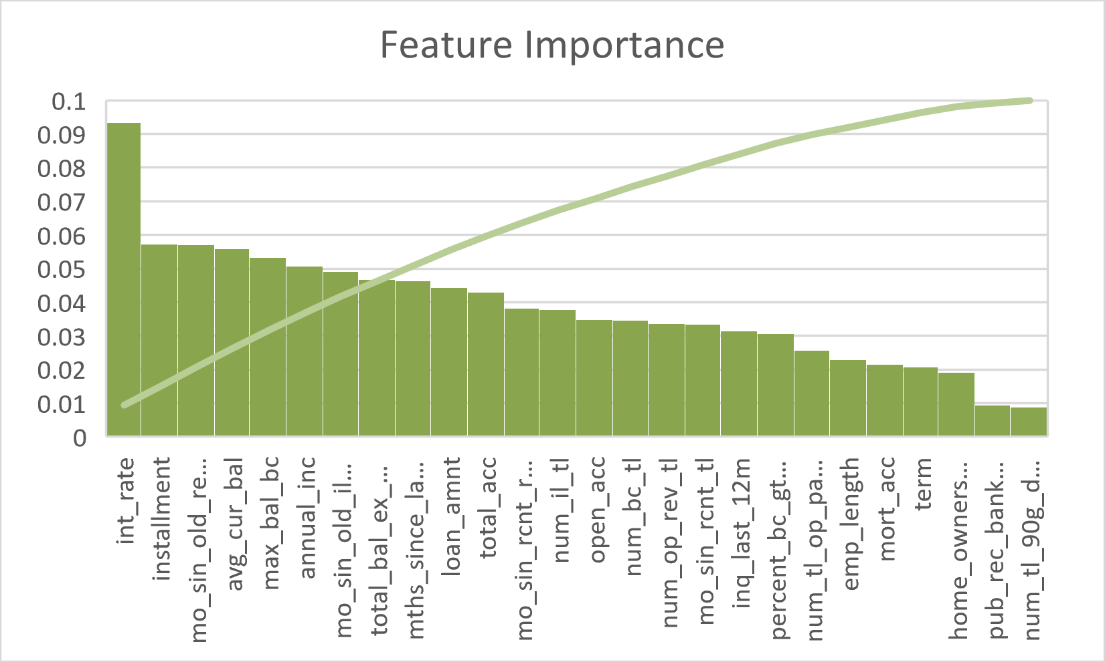
Feature Importance
The interest rate on the loan has the highest feature importance among all features
This is sensible since higher interests rate means harder to fully paid back the loan

Slide 6
Future Work
Try include other features that have been eliminated in the data pre-processing process
Use feature selection algorithm
Try dimensionality reduction (PCA) due to the high number of features

