Slide 1




PART III DISSERTATION PRESENTATION
Fedctl: A Heterogeneous Testbed for Realistic Federated Learning
Haoran Jie
Department of Computer Science and Technology | University of Cambridge | June 2026
fedctl.cl.cam.ac.uk
Deployment-aware evaluation of heterogeneous FL

Slide 2
RATIONALE
Heterogeneous FL Needs Deployment-Aware Evaluation
In deployed FL, a client is a device—not just a data partition. Device capability, update timing, network conditions, influence, submodel quality, and parameter coverage all shape outcomes.
data split on one machine
one network; equal devices
mixed devices and networks
Takeaway: deployment behaviour is part of the experiment
02

Slide 3
IMPLEMENTATION
fedctl Run Lifecycle
implementation: reusable control plane for Flower experiments
03

Slide 4
IMPLEMENTATION
Controlling Heterogeneity
Typed client placement
Assign logical clients to device classes.
--supernodes
Scheduler
Runtime pair
Evidence
rpi4=10, rpi5=10
→
device-type constraints
→
SuperNode + ClientApp
→
device-labelled metrics
Network impairment
Apply controlled network conditions per client.
Deploy config
--net
Wrapper:
Runtime:
define network profile
→
rpi4[∗]=mild,
rpi5[1]=none
→
apply tc/netem before SuperNode
→
unchanged Flower interface
implementation: deployment-side heterogeneity controls
04

Slide 5
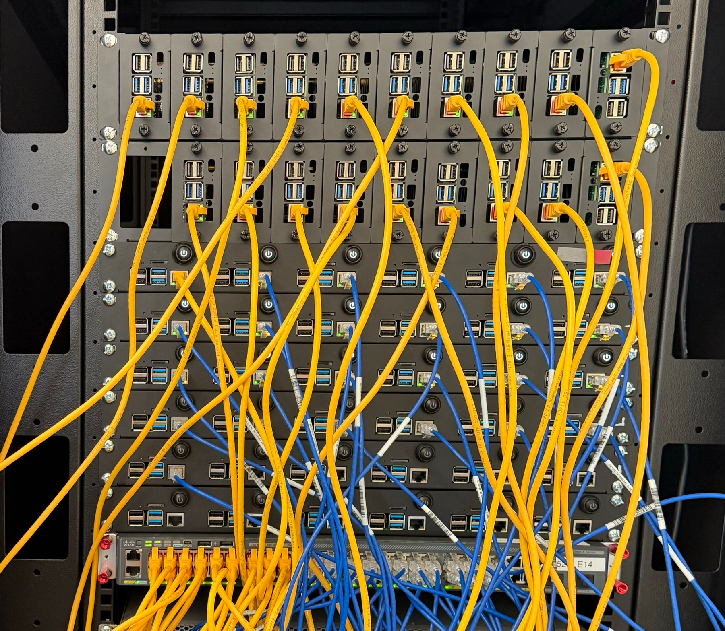
IMPLEMENTATION
Physical Heterogeneous Cluster
50-device worker pool
30 rpi4 + 20 rpi5 for real heterogeneous execution
repeatable deployment
rerun the same workload with controlled placement and network conditions
shared-lab control
queueing, resource checks, and artifacts replace manual SSH deployment
extensible devices
add a Jetson class and image; reuse placement and network controls
implementation: physical heterogeneous testbed
05

Slide 6
BACKGROUND
Submodel FL for Compute Heterogeneity
method background: submodel FL baselines
06

Slide 7
BACKGROUND
Asynchronous FL for Straggler-Induced Heterogeneity
method background: asynchronous FL baselines
07

Slide 8
FEDCOVER
Coverage Mismatch in Asynchronous Submodel FL
Low-coverage parameter blocks can skew the buffered update direction.
FedCover treats coverage as an aggregation variable: amplify observed under-covered deltas without imputing missing updates.
method: FedCover coverage mismatch
08

Slide 9
FEDCOVER
FedCover Coverage Correction
Server-side correction
Scale only covered deltas; do not impute missing updates.
stale-weighted buffer weight
observed coverage mass
capped coverage gain
method: FedCover coverage correction
09

Slide 10
EVALUATION
Weak-Client Inclusion Without Full-Model Cost
Reduced-rate submodels include weaker clients without the full-model runtime cost.
C1
CIFAR-10 non-IID | 5 rpi5 + 10 rpi4 | 20 rounds | compare exclusion, full inclusion, reduced-rate inclusion
Realistic non-IID deployment
Measured trade-off
HeteroFL/FedRolex keep all partitions at much lower runtime; FIARSE gives stronger reduced-rate accuracy, but no dense-kernel speedup.
C1: weak-client inclusion decision
10

Slide 11
EVALUATION
Local Submodel Performance Diagnostics
Local submodel evaluation reveals client-side quality gaps across submodel FL methods.
C3
CIFAR-10 non-IID + California Housing | local evaluation of extracted rate-specific submodels
CIFAR-10 local accuracy
California Housing local R²
FIARSE gives higher and more balanced accuracy across submodel sizes.
Smaller submodels often underperform larger ones; FIARSE narrows this gap.
C3: local submodel quality
11

Slide 12
EVALUATION
Asynchronous FL Under Stragglers
Asynchronous FL helps only when client completion times are genuinely unequal.
S1
CIFAR-10 | IID/non-IID × homogeneous/mixed | target: 60% | FedAvg, FedAsync, FedBuff, FedStaleWeight
Homogeneous control
Mixed topology: time to 60% target
IID
Non-IID
IID
FedAvg
2097s
FedAvg
4043s
FedAvg 651s
best async 715s
FedAsync
622s
FedAsync
1264s
FedBuff
1138s
FedBuff
2388s
Non-IID
FedSW
865s
FedSW
1771s
FedAvg 1320s
best async 1486s
Asynchronous FL is slower in the homogeneous case.
Mixed topology: asynchronous FL reduces time to target.
S1: target time and slow-device influence
12

Slide 13
FEDCOVER EVIDENCE
FedCover Improves Time to Target
FedCover improves target time; the ablation links correction strength to speedup.
A1/A2
CIFAR-10/Fashion-MNIST | IID/non-IID | async submodel FL | target time + gamma sweep
Time to task-specific target (min)
FedCover Correction-Strength Ablation
Task / data
HeteroFL
Async-HeteroFL
FedCover gamma=1.5
CIFAR-10 IID
24.2 ± 2.9
33.9 ± 16.0
13.7 ± 2.1
CIFAR-10 non-IID
51.6 ± 19.2†
38.2 ± 9.1
16.3 ± 0.3
Fashion-MNIST IID
12.9 ± 1.1
11.8 ± 1.4
6.0 ± 0.7
Fashion-MNIST non-IID
22.6 ± 2.8†
20.5 ± 6.4†
11.0 ± 2.3
Among capacity-matched methods, FedCover reaches target fastest in all four settings.
† target not reached in all seeds
Speedup generally grows with correction strength, supporting coverage correction as the mechanism.
A1-A2: FedCover target-time evidence
13

Slide 14
Conclusions
Heterogeneous FL must be evaluated through both model performance and deployment behaviour.
Deployment-aware evaluation
Compute and straggler-induced heterogeneity create trade-offs between wall-clock time, participation, submodel quality, and fairness.
Future work
Broader workloads, devices, and runtimes.
fedctl contribution
Repeatable Flower-to-Nomad runs preserve run/deploy configs, typed placement, network profiles, logs, metrics, and artefacts.
Representation-aware async training.
Hardware-aware sparse submodel execution.
Trace-driven straggler evaluation.
FedCover contribution
Async submodel FL is feasible, but stale partial replies make parameter coverage an aggregation variable; capped inverse coverage improves time to target.

