Slide 1
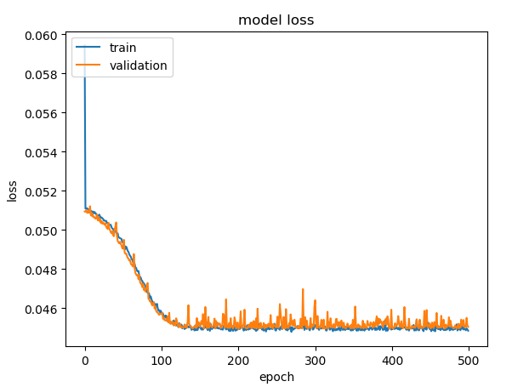
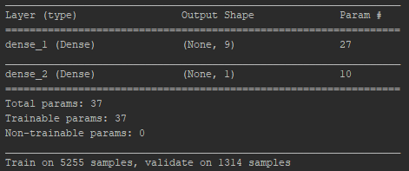

Input: On_stream_hrs & Avg_choke_size
Output: Bore_oil_vol

Slide 2
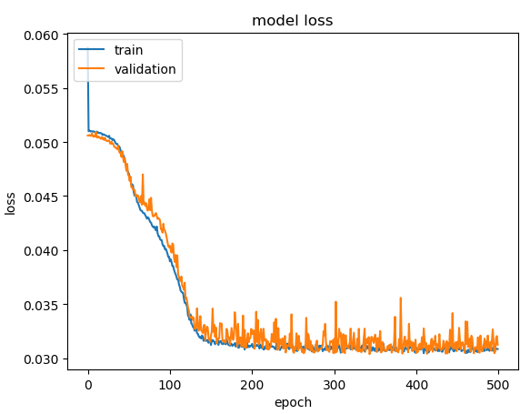
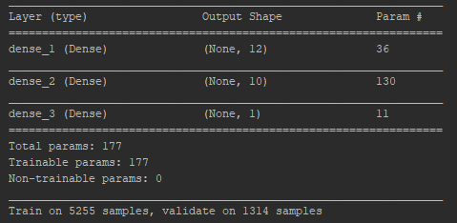

Input: On_stream_hrs & Avg_choke_size
Output: Bore_oil_vol

Slide 3
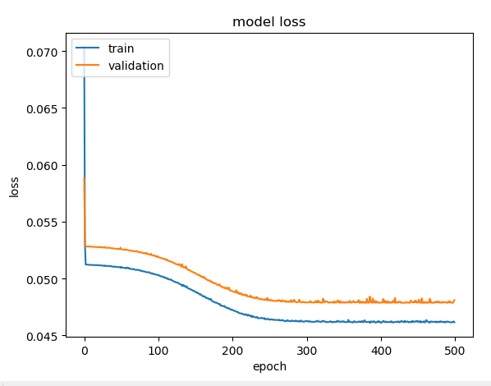
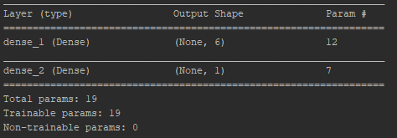

Input: On_stream_hrs
Output: Bore_oil_vol

Slide 4
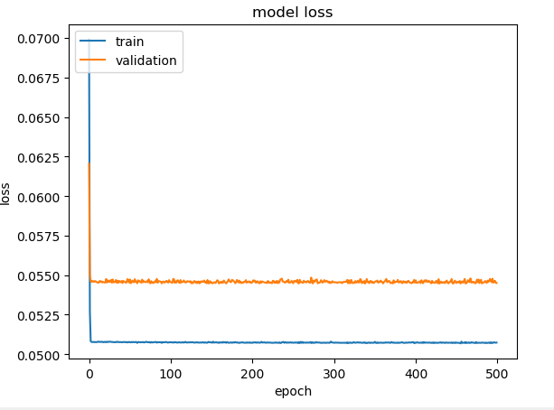

Input: Avg_choke_size
Output: Bore_oil_vol

