Slide 1
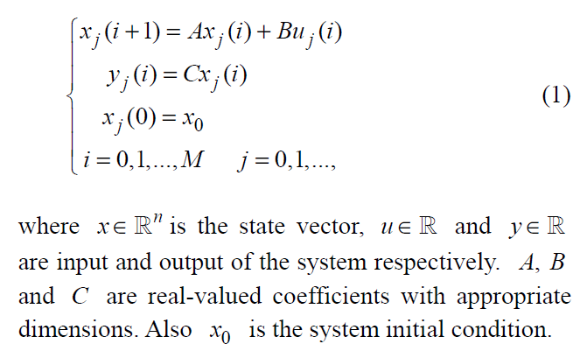

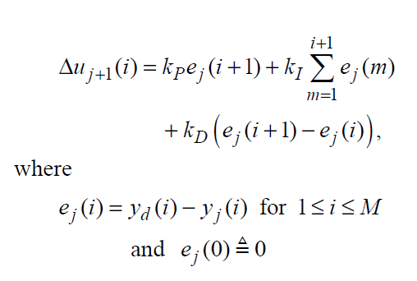
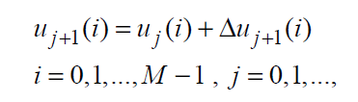
@article{madady2008pid, title={PID type iterative learning control with optimal gains}, author={Madady, Ali}, journal={International Journal of Control, Automation, and Systems}, volume={6}, number={2}, pages={194--203}, year={2008} }
Assumption:
A1) The system initial condition x0 is unknown.
A2) The scalar CB is nonzero.
A3) A desired output trajectory yd (i) is given.

Slide 2
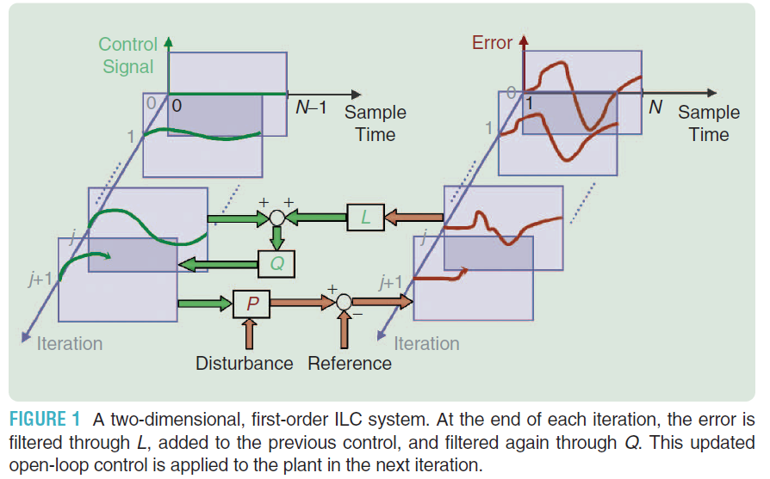
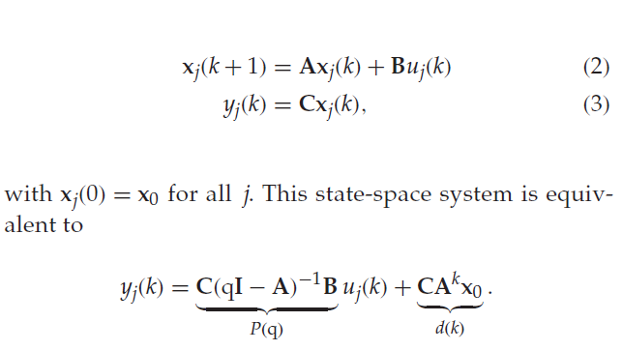

ITERATIVE LEARNING CONTROL

Slide 3
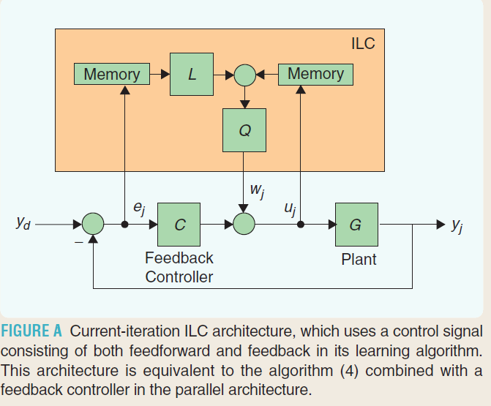
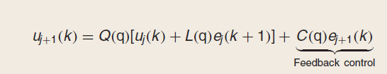
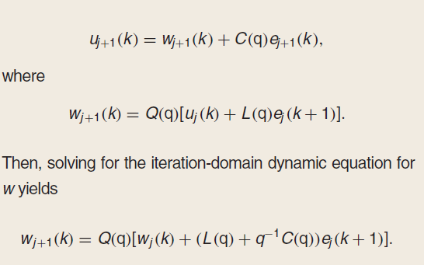
@article{bristow2006survey, title={A survey of iterative learning control}, author={Bristow, Douglas A and Tharayil, Marina and Alleyne, Andrew G}, journal={IEEE Control Systems}, volume={26}, number={3}, pages={96--114}, year={2006}, publisher={IEEE} }
Current-Iteration Iterative Learning Control

Slide 4
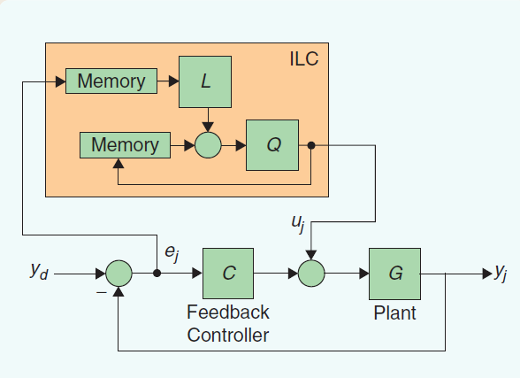
Using Feedback Control with Iterative Learning Control

Slide 5




ILC
$$Y_{d}$$
Memory
L
Q
$$e_{j}$$
$$Y_{ILC}$$
Controller
Plan
$$Y_{j}$$
K

