Slide 1
Loglock project
Member: Matthew Salazar, salazams@mail.uc.edu
Yage Bai, baiyg@mail.uc.edu
Haoran Wang, wang3hr@mail.uc.edu

Slide 2
Project purposes: the project is to build a log in website that professors and students can log into and the attendances could be checked so the professor can verify attendance, the professor will provide a code and the students will use that code to log in and their attendance is checked.
Goal statements: we are planning on adding a functionality that checks with students' IP address, using facial recognitionor ID. With this we also are thinking about using the student’s approximate location to ensure they are in campus when they log in their attendance.

Slide 3
Project Abstract
This project aims to design a web-based platform where both professors and students can log in to facilitate attendance verification. To counteract potential misuse, where students might share login codes, multiple layers of validation are introduced: IP address checking, facial recognition, and student ID validation. Furthermore, to ensure physical presence on campus during attendance logging, the student's approximate location will be gauged. This multi-faceted approach not only streamlines the attendance process but also enhances its reliability and integrity by leveraging contemporary technological advancements. Key terms: attendance verification, IP address, facial recognition, location-based validation, web-based platform.

Slide 4
Useer Stories
User Story: As a professor, I want to generate a unique code for each class session, so that my students can log in to verify their attendance. Benefit: This ensures that only students attending the particular session can mark their attendance.
User Story: As a student, I want to enter the provided code on the attendance platform, so that my presence for the session is logged and acknowledged. Benefit: This provides an efficient and digital way for students to confirm their attendance without manual.
User Story: As the attendance system, I want to check the IP address of the studentwhen they log in, so that I can verify the authenticity of the student's location. Benefit: This adds an additional layer of verification, ensuring students are genuinely attending from a legitimate location.

Slide 5
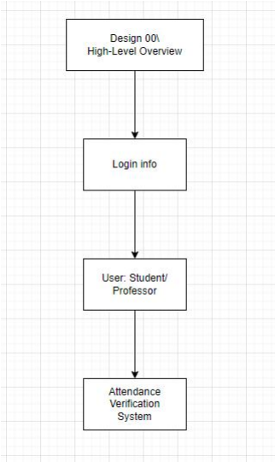
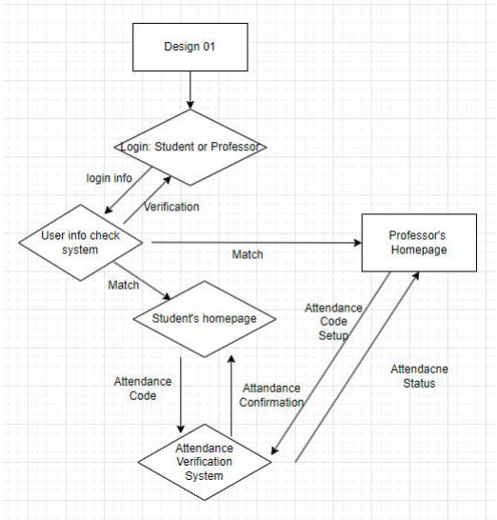
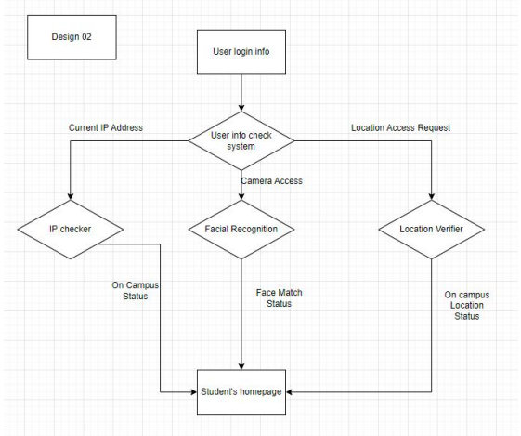

Slide 6
Major Project Constraints.
Economic Constraints: Limited financial resources have led us to depend on open-source tools, potentially affecting our system's features and sophistication. Relying solely on UC resources might compromise server capabilities and user experience due to bandwidth constraints.
Ethical Concerns: The system uses IP checking, facial recognition, and location tracking to validate attendance. This introduces potential privacy breaches, necessitating transparency in data collection and stringent security measures against unauthorized use.
Legal Impediments: Deploying facial recognition and location services may present legal challenges, especially in regions with strict data protection laws. We must secure explicit student consent and be wary of intellectual property issues associated with open-source tools.
Data Security: With the responsibility of collecting data comes the challenge of preventing data breaches and unauthorized access, requiring robust security mechanisms.
Social Implications: While aimed at bolstering the academic process, our system could be perceived as intrusive, potentially affecting its social acceptability.

Slide 7
Current state of project
We are currently working on the foundational code, the database, and the functional code, all of which have made notable progress.

Slide 8
Expected Accomplishments for the end of this term
By the end of this term, we anticipate completing the basic framework of the project, implementing the envisioned features, and conducting debugging tests.

Slide 9
Division of Work
The roles discussed go’s as follows, Haoran will work on the Database and UI, Matthew and Yage will work on AI facial recognition and IP location (GPS – if included), as of right now these are the planned roles.

Slide 10
Expected Demo at Expo.
I hope we can implement most of the features we envision during the demo, such as a full database, login verification functionality, and sign-in functionality.

