Slide 1

LogLock
University of Cincinnati Project Advisor: William Hawkins III
Haoran Wang
Yage Bai
Mathew Salazar

Slide 2
Goals and background of LogLock
Accuracy: To create a platform that enables both students and professors to conduct more accurate attendance checks.
Ease to understand: The simplified UI ensures that both students and professors can navigate the platform effortlessly without the need for extensive training or technical expertise.
Ease to use: We are a website based project so all you need to do is go to our website and log in. No download needed!
Time Efficiency: With an intuitive interface, users can quickly complete attendance checks or record attendance without wasting time navigating complex menus or instructions.

Slide 3
Intellectual Merits
Our platform offers a secure and highly accurate method for both students and professors to manage attendance without the need to track or request any personal information, thus ensuring full privacy compliance. While traditional methods may struggle to verify students' identity.
The motivation behind creating this project stemmed from the recognition of the complexity and inefficiency of traditional attendance check-in systems, particularly for small-scale schools lacking sophisticated platforms like Canvas. By simplifying every step of the attendance tracking process, our aim is to address the specific needs of these institutions and provide them with a user-friendly solution that enhances efficiency and accuracy.

Slide 4
Achievement
Enhanced Education Quality: By ensuring accurate attendance tracking, the project fosters a more accountable learning environment, leading to improved educational outcomes for students.
Privacy Protection: The project prioritizes privacy by not requiring any personal information, thus setting a standard for data protection in educational technology. This contributes to building trust between institutions and students, promoting a culture of privacy awareness.
Increased Engagement: With a secure and accurate attendance system in place, students are more likely to actively participate in class discussions and activities, leading to higher engagement levels and a more vibrant learning atmosphere.
Improved Academic Performance: With better attendance monitoring, educators can identify students who may be struggling early on and provide timely support, leading to improved academic performance and reduced dropout rates.

Slide 5
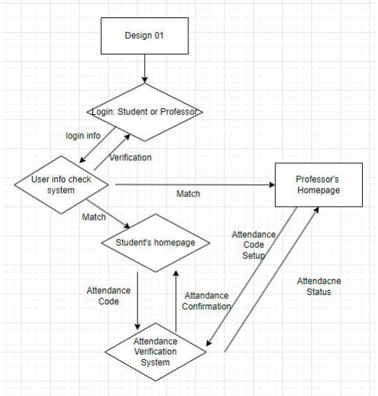
Design Specifications
User Interface (UI): A clean and user-friendly web interface that prompts users for their login credentials (UserID and Password) and an attendance keyword.
Authentication Server: Processes login requests by validating UserID and Password against the stored data in the system's database.
Database: A robust and secure database that stores user credentials (UserID and Password) and attendance keywords. It is designed for quick retrieval and verification of user information to ensure swift login processes.
Attendance Verification: A special module within the system that checks the entered attendance keyword against a predefined set of valid keywords to mark user attendance.

Slide 6
Technologies
Front-end: Utilizes HTML, CSS, and JavaScript to create an interactive and responsive user interface.
Back-end: Python, with Flask frameworks, handles server-side logic, including authentication and database interactions.
We use MySQL, it stores user credentials and attendance keywords. These databases support complex queries and secure data management.
We are running the website by using the Amazon AWS server.
This project integrates front-end technologies for user interface design, Python and its frameworks for back-end processing, and secure database systems for data storage.

Slide 7

Milestones
Database built – achieved 11/15/2023
Front end built – achieved 12/10/2023
Fuction tests – 1/15/2024
AWS server test – achieved 2/10/2024
UI design – still working to get a better looks UI
Gradescope – Further functions
IP check – Further fuctions

Slide 8
Results
A complete Database that can remember all our customers accounts.
A complete Database that can remember the attendance codes.
Our project is website based so the front-end is definitely completed.
Attendance check and grade record functions.
AWS server is running.
We want to put more functions in in the further.

Slide 9

Challenges
The biggest challenges we had so far were relevant to the data management, which involves structuring data for students, classes, attendance records, dates, and related information. Ensuring data accuracy, integrity, and scalability as the number of users and attendance records grows was something to keep in mind while expanding the project.
Another challenge we faced was related to UI and time management among everyone in the group, having a busy senior school schedule and working on LogLock was tough to navigate through, although at the start of the semester we had small goals to reach every 2 weeks, which helped us get through some hurdles we faced during development.

