Slide 1

A Deep Learning-Based Smartphone App for Real-Time Detection of Retinal Abnormalities in Fundus Images
Haoran Wei, Abhishek Sehgal, and Nasser Kehtarnavaz
University of Texas at Dallas
SPIE Conference on Real-Time Image Processing and Deep Learning April 15, 2019
Signal and Image Processing (SIP) Lab

Slide 2
Introduction
As part of an eye exam, fundus images are often taken by a fundus camera which costs $5000-$10,000. A fundus camera consists of a microscope and a video camera. Fundus images are used for the diagnosis and treatment of eye diseases such as diabetic retinopathy (DR).
Many papers have appeared in the literature discussing image processing techniques to detect retinal abnormalities from fundus images. More recently, due to the effectiveness of deep neural networks (DNNs) in various object recognition applications, they have been deployed to detect abnormalities associated with eye retina from fundus images, e.g. [1, 2].
[1] Xu, K., Feng, D., and Mi, H., "Deep convolutional neural network-based early automated detection of diabetic retinopathy using fundus image," Molecules, vol. 12, p. 2054 (2017).
[2] Lam, C., Yu, C., Huang, L., and Rubin, D., "Retinal lesion detection with deep learning using image patches," Investigative Ophthalmology & Visual Science, vol. 59, pp. 590-596 (2018).
Signal and Image Processing (SIP) Lab

Slide 3
Problem Statement
As a low-cost and universally accessible alternative to fundus cameras, smartphones which are widely available together with lenses that are commercially available (e.g., D-EYE lens about $400) can be used to not only capture fundus images but also carry out self-care at home or at a clinic with no access to a fundus camera/an ophthalmologist.
This work involves the development of a deep learning-based smartphone app to process smartphone-captured fundus images in real-time or in an on-the-fly manner. The motivation behind this work is to use smartphones instead of fundus cameras as a first-pass examination of the retina. This approach enables a first-pass eye examination to be widely conducted in a cost-effective manner by merely using a smartphone and a lens attachment.
Signal and Image Processing (SIP) Lab

Slide 4
Datasets used for DNN training
The EyePACS organization provides a relatively large dataset of high-resolution retina images taken under a variety of imaging conditions (e.g., underexposed, overexposed, out-of-focus) and camera types. This dataset consists of 35,126 images of both left and right eyes. The severity level of DR is provided on a scale of 0 to 4; 0 denoting no DR, 1 mild DR, 2 moderate DR, 3 severe DR, and 4 proliferative DR.
Besides the EyePACS dataset, the) STARE (STructured Analysis of the Retina dataset is also used here for training a deep neural network. This dataset consists of 397 images placed into 13 conditions covering various types of vein/artery occlusion and retinopathy.
Signal and Image Processing (SIP) Lab

Slide 5
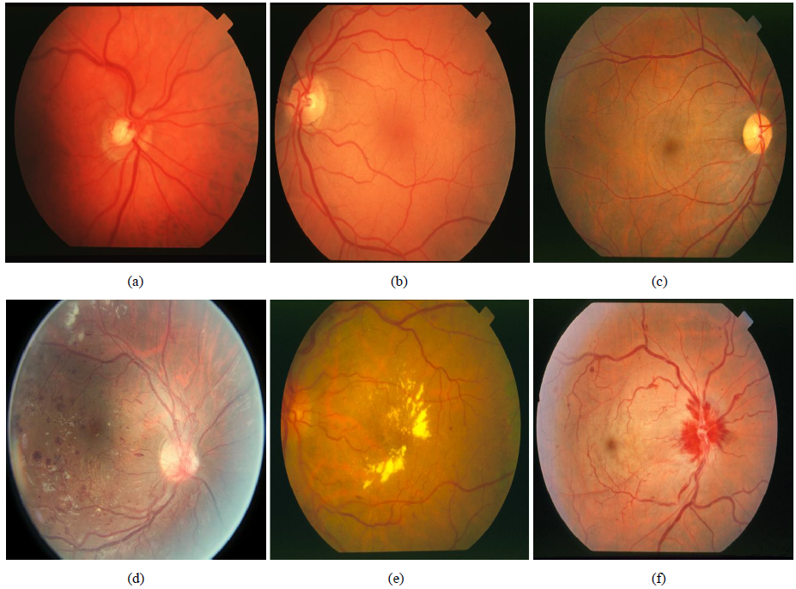
Sample images of datasets
Image samples from the EyePACS and STARE datasets: (a) Normal, (b) Normal, (c) Normal, (d) Diabetic Retinopathy, (e) Early Stage Diabetic Retinopathy, (f) Central Retinal Artery and Vein Occlusion
Signal and Image Processing (SIP) Lab

Slide 6
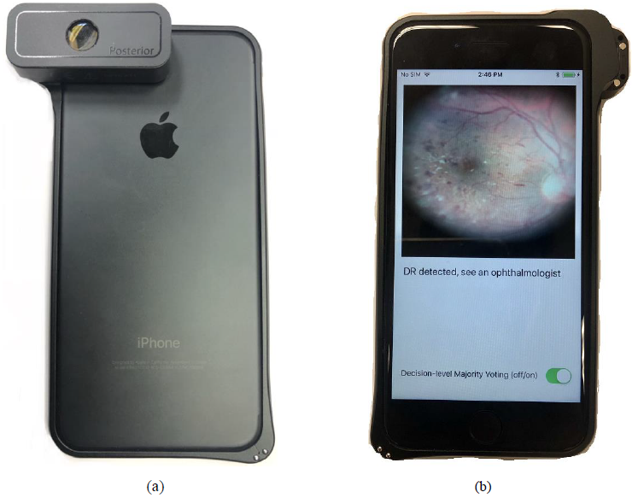
D-Eye Lens
Several lenses are commercially available as attachments to smartphones for examining retina. In this work, the D-Eye lens was used.
A D-Eye lens attached to a smartphone (a) back and (b) front.
Signal and Image Processing (SIP) Lab

Slide 7
Training of DNN for detection of retinal abnormality (1)
The main advantage of using a deep learning network (Convolutional Neural Netwrok - CNN) is that retina images are fed into the network without the need to carry out any handcrafted feature extraction.
Such networks require a considerable amount of data in order to get trained well. Since the amount of data in our case is relatively small for training, the transfer learning method is utilized here.
In transfer learning, a pre-trained CNN model is used. This pre-trained model is trained using a huge image dataset involving various objects. The layers of the pre-trained model are used up to the last fully connected layer. The last fully connected layer is then trained using the retinal image datasets.
Signal and Image Processing (SIP) Lab

Slide 8
Training of DNN for detection of retinal abnormality (2)
Here, the transfer learning method based on the pre-trained Xception (Extreme version of Inception) [3] model is considered. Xception is a modification of Inception-v3 model [4] involving convolutional layers, inception layer, depthwise separable convolutions, and residual connections.
The pre-trained Xception model was trained using the ImageNet dataset [5]. This dataset consists of 1.2 million images grouped into 1,000 classes.
[3] Chollet, F., "Xception: Deep learning with depthwise separable convolutions," arXiv:1610-02357 (2017).
[4] Szegedy, C., Vanhoucke, V., Ioffe, S., Shlens, J., and Wojna, Z., "Rethinking the inception architecture for computer vision," Proceedings of IEEE Conference on Computer Vision and Pattern Recognition, Las Vegas, NV (2016).
[5] Deng, J., Dong, W., Socher, R., Li, L.-J., Li, K., and Li, F., "ImageNet: A large-scale hierarchical image database, " Proceedings of IEEE Conference on Computer Vision and Pattern Recognition, Miami Beach, FL (2009).
Signal and Image Processing (SIP) Lab

Slide 9
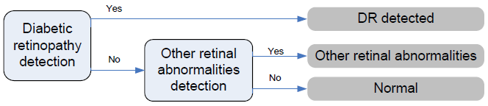
Two-step approach
A two-step approach is considered in the smartphone app. In the first step, the detection is focused on diabetic retinopathy (DR). In the second step, if no DR is detected, then the image is examined for other retinal abnormalities. This two-step approach is adopted due to the fact that DR constitutes a major portion of retinal abnormalities and the publicly available datasets do not contain a large number of images corresponding to other types of abnormalities.
Two-step approach to detect retinal abnormalities
Signal and Image Processing (SIP) Lab

Slide 10
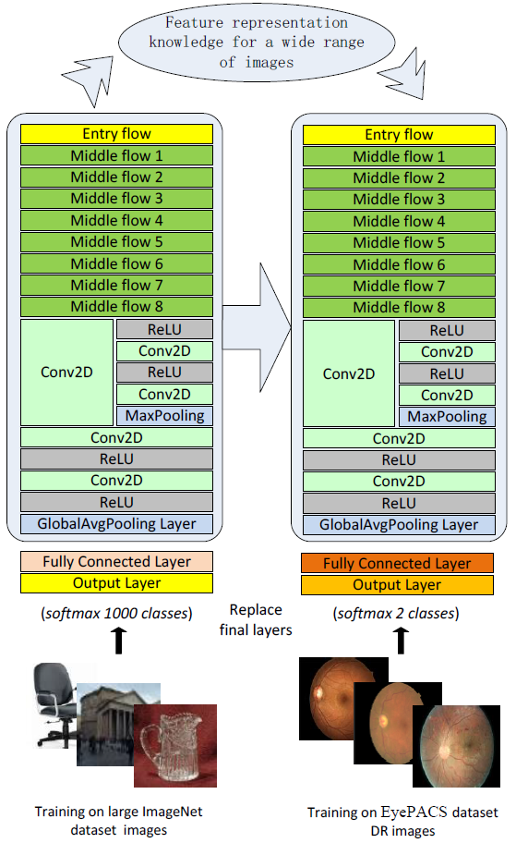
Architecture of the Xception transfer learning for diabetic retinopathy detection
Signal and Image Processing (SIP) Lab

Slide 11
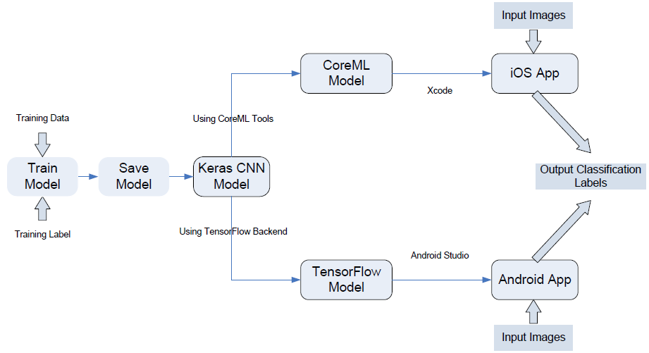
Real-time implementation as a smartphone app (1)
After training the above transfer learning CNN model, the model is ported to a smartphone and made to run in real-time. The steps to achieve the real-time implementation of the model are illustrated in this figure and are discussed in detail in [6].
Steps involved in creating real-time smartphone apps of trained deep neural networks
[6] Sehgal, A., and Kehtarnavaz, N., "Guidelines and benchmarks for deployment of deep learning models on smartphones as real-time apps," Machine Learning and Knowledge Extraction, vol.1, pp.450-465 (2019).
Signal and Image Processing (SIP) Lab

Slide 12
Real-time implementation as a smartphone app (2)
TensorFlow is an open-source programming library developed by Google for defining, training and testing of deep learning models. Keras is an open-source library written in Python which allows TensorFlow to be used as its backend for generating an Android app. TensorFlow Mobile is designed for deployment of deep learning model on mobile devices. Andriod Studio is the integrated software development environment (IDE) for Android app development based on the Java programming language.
CoreML is developed by Apple and allows translating existing trained Keras models into CoreML models, which can then be deployed on iOS devices. Xcode is the integrated development environment (IDE) which is used for iOS app development based on the Objective-C or Swift programming language.
All of these tools are free and are well maintained by their respective organizations.
Signal and Image Processing (SIP) Lab

Slide 13
Real-time implementation as a smartphone app (3)
To generate an iOS smartphone app, first the CNN model is trained in Keras.
Then, it is saved as an HDF (Hierarchical Data Format .h5) file. The architecture and the connection weights of the CNN model are saved in the HDF file as numerical arrays.
Next, the HDF file is converted to a so-called .mlmodel file using CoreML. CoreML provides the option of defining the input as images or as multi-dimensional arrays. Choosing images as input is used here since this way the pre-processing parameters of the model can be easily defined. This option allows deep learning models to be applied to raw images and avoids explicitly performing pre-processing for different models.
As the final step, the .mlmodel file is interfaced with Swift through the Xcode IDE. The CoreML API can handle all the underlying deep learning model computations.
Signal and Image Processing (SIP) Lab

Slide 14
Real-time implementation as a smartphone app (4)
To generate an Android smartphone app, first the CNN model is trained in Keras.
Then, a TensorFlow model is extracted from the Keras model. Extracting the TensorFlow model from the Keras model include the following steps. Initially, a TensorFlow graph from the underlying TensorFlow session needs to be extracted by the backend module in Keras. The variables in the Keras model need to be converted to constants by using the utility graph_util in TensorFlow.
After extracting the TensorFlow model, it needs to be saved as a Protocol Buffer (.pb) file by using the input/output utility graph_io.
Next, TensorFlow Mobile is used to create a model based on the .pb file.
As the final step, this model is interfaced with Java through the Android Studio IDE.
Signal and Image Processing (SIP) Lab

Slide 15
Smartphones used
The real-time results reported here are based on the iPhone 7/iPhone XR iOS smartphones and Pixel 2/Pixel 3 Android smartphones.
In the iOS version of the developed app, 30 frames are captured per second and two detection decisions are made per second. A decision-level majority voting option is also included in the app in order to smooth out fluctuations in detecting abnormalities when examining video data in real-time.
Signal and Image Processing (SIP) Lab

Slide 16
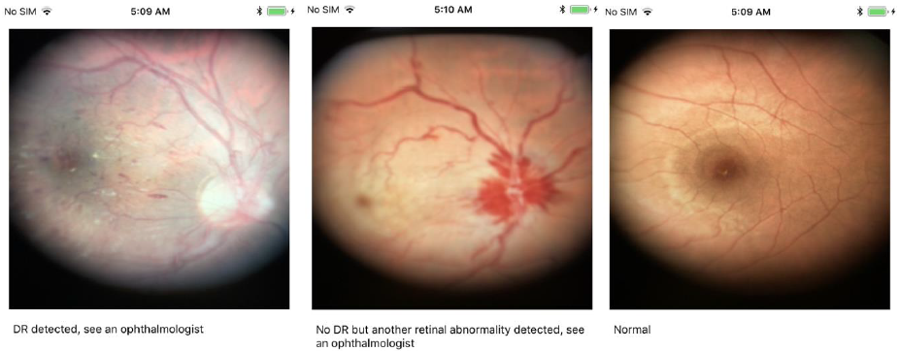
App screen
Samples of the app screen shots shown below. When diabetic retinopathy is detected, the app screen displays “DR detected, see an ophthalmologist”. When other retinal abnormalities are detected, the app screen displays “No DR but another retinal abnormality detected, see an ophthalmologist”. In the absence of any abnormality, it displays “Normal”.
App screenshots for three cases
Signal and Image Processing (SIP) Lab

Slide 17
Real-time processing
On iPhone 7, the processing time for each decision is about 430ms with 25% of the CPU and 101MB of the memory getting used by the app. On iPhone XR, the processing time for each decision is about 70ms with 55% of the CPU and 34MB of the memory getting used by the app.
On Pixel 2, the processing time for each decision is about 2,600ms with 50% of the CPU and 500MB of the memory getting used by the app. On Pixel 3, the processing time for each decision is about 2,000ms with 50% of the CPU and 500MB of the memory getting used by the app.
The efficiency of the processing time on iPhone XR is due to its utilization of the onboard GPU for the neural network computations. The processing time of iPhone 7 is better than the processing times of the Android smartphones since the optimized CoreML is only available for iOS smartphones. TensorFlow Mobile is not yet available for utilizing the onboard GPU. This is expected to be addressed in TensorFlow Lite, which is still experimental at this time and does not support as many operations as TensorFlow Mobile.
Signal and Image Processing (SIP) Lab

Slide 18
Detection accuracy
In terms of detection accuracy, the following two issues need to be taken into consideration. First, the training of the network needs to be conducted on a very large dataset of retina images. Second, a clinical evaluation needs to be conducted by comparing the outcome of the app to an ophthalmologist evaluation. These issues were not the focus of this work rather the focus of this work has been on how to make an app out of a trained CNN model (assuming adequately trained) that would run in real-time on smartphones processing retina images captured by their cameras. Planning to work with an eye clinic with IRB to run the app on patients visiting the clinic.
To examine the accuracy aspect, a simulation study was carried out noting that to obtain the true accuracy, a very large dataset needs to be considered for training and a clinical evaluation needs to be conducted. This simulation consisted of pointing the smartphone camera with the lens attached to retina images. The accuracy was obtained by comparing the class labels of the testing images with the ground truth labels.
Signal and Image Processing (SIP) Lab

Slide 19
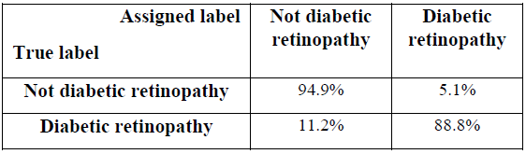
Detection results (1)
The diabetic retinopathy CNN model was trained and tested on the retina images from the EyePACS dataset corresponding to no diabetic retinopathy (label 0), and the severe diabetic retinopathy (labels 3 and 4). 23,354 retina images were used for training and 4,037 images selected at random were considered for testing. The confusion matrix associated with the diabetic retinopathy detection is shown in Table 1. The overall accuracy of the diabetic retinopathy detection was found to be 94.6%.
Table 1. Confusion matrix of diabetic retinopathy detection
Signal and Image Processing (SIP) Lab

Slide 20
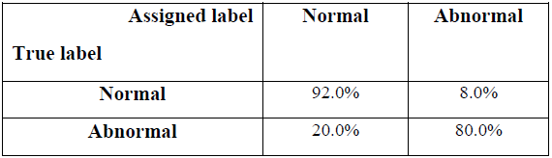
Detection results (2)
The other retinal abnormalities detection CNN model was trained and tested on the STARE dataset, 387 retina images (29 normal, 358 abnormal) was used for training and 10 images (5 normal, 5 abnormal) selected at random were considered for testing. Since the numbers of the training images were not balanced for the two classes, the images for the normal class were repeated 12 times to make them balanced with the abnormal class. The training and testing were repeated 5 times, each time selecting a different training and testing set. The confusion matrix associated with the other retinal abnormalities detection is shown in Table 2. The overall accuracy of the other retinal abnormalities detection was found to be 86%.
Table 2. Confusion matrix of other retinal abnormalities detection
Signal and Image Processing (SIP) Lab

Slide 21
Summary and Conclusion
In this paper, two transfer learning-based convolutional neural networks have been developed and trained for detection of retinal abnormalities.
These networks are then implemented as a smartphone app running in real-time. Both Android and iOS versions of the app are developed. The app operates by providing detection decisions from video that gets captured by the smartphone camera in an on-the-fly manner.
This work has enabled smartphones to be used as an alternative to fundus cameras allowing a first-pass eye examination of the retina to be conducted in a cost-effective and widely accessible way.
Signal and Image Processing (SIP) Lab

Slide 22
Thank you Q&A www.utdallas.edu/~kehtar
Signal and Image Processing (SIP) Lab

