Slide 1
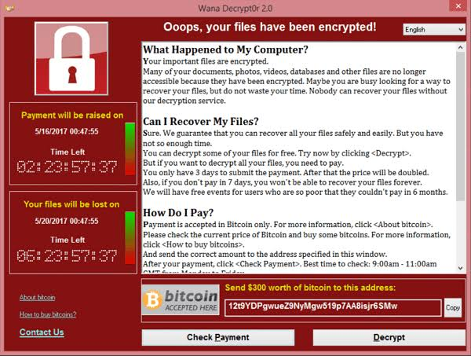
Buffer overflow allows ransomware to run privileged code
“What is WannaCry | Ransomware Attack Examples | Imperva,” Learning Center. Accessed: Aug. 21, 2026. [Online]. Available: https://www.imperva.com/learn/application-security/wannacry-ransomware/
Notes:
Picture citations needed!

Slide 2
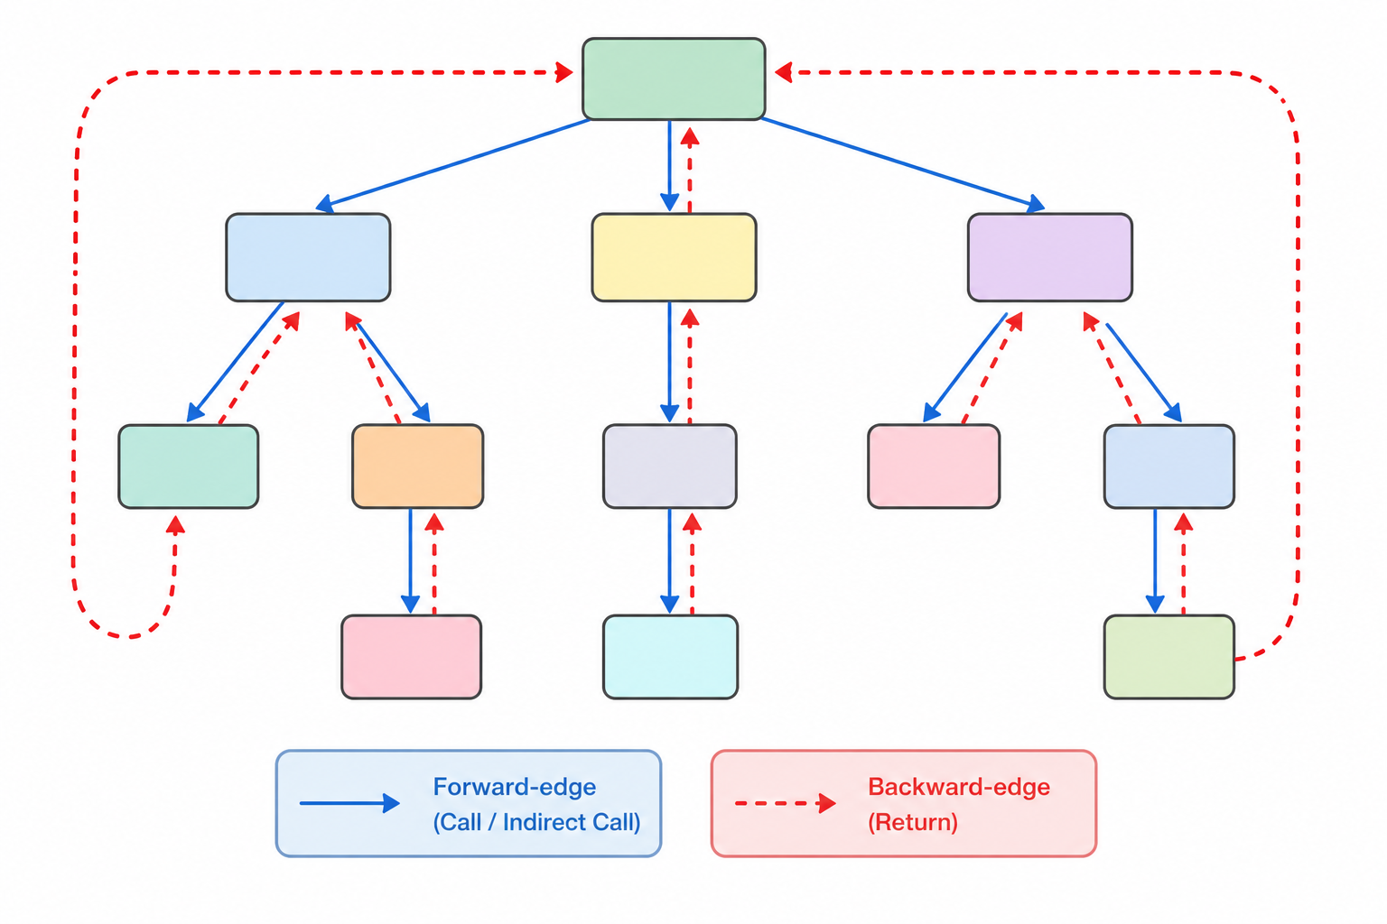
Image created using ChatGPT with prompt “generate a colored diagram to illustrate a control-flow graph, and in this graph illustrate forward-edge control-flow transfer vs backward control-flow transfer, Use minimal to no text”
Notes:
Replace with a colored diagram. Illustrate forward vs backward control flow transfer

Slide 3
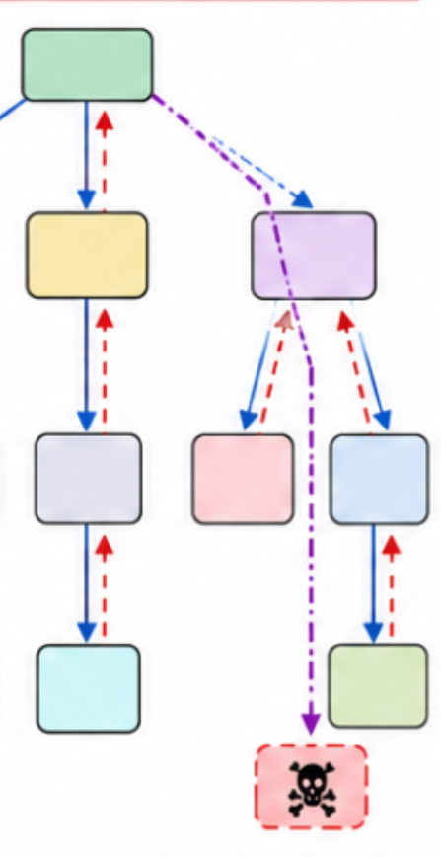
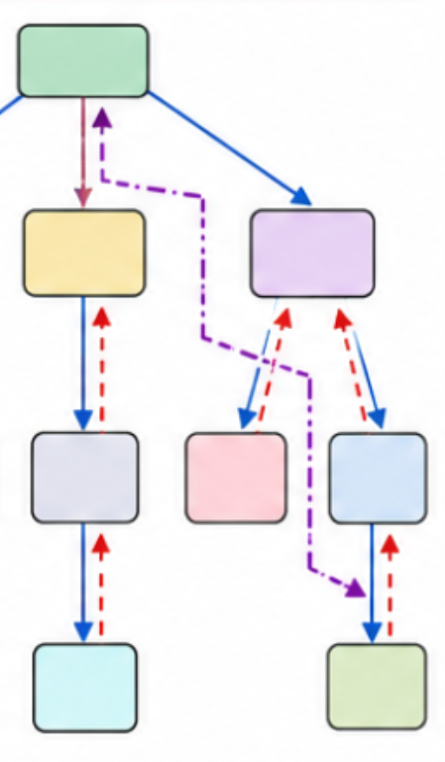
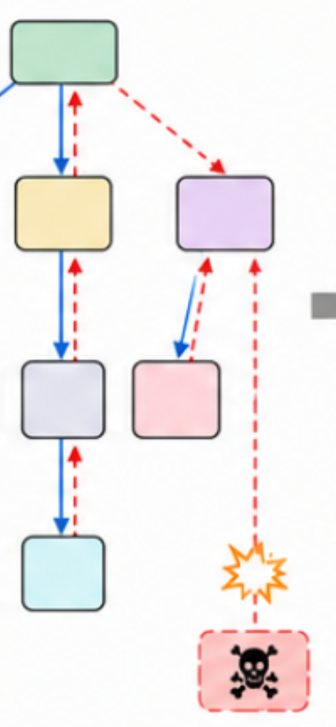
Image created using ChatGPT with prompt “based on this image, generate a diagram to illustrate how control-flow diverting can occur, such as control-flow bending, etc. Use other arrows and lines to represent the diverted control flow. This is intended for an academic presentation ”
Notes:
Replace with a colored diagram. Illustrate forward vs backward control flow transfer

Slide 4
Hardware-assisted
Control Flow Integrity (CFI)
= Dedicated hardware support
+
Software monitoring
Notes:
Again, replace with colored figure.
Insert a Venn chart: Universal = Backward and Forward

Slide 5
A New Taxonomy
Forward-Edge
Backward-Edge
Universal

Slide 6
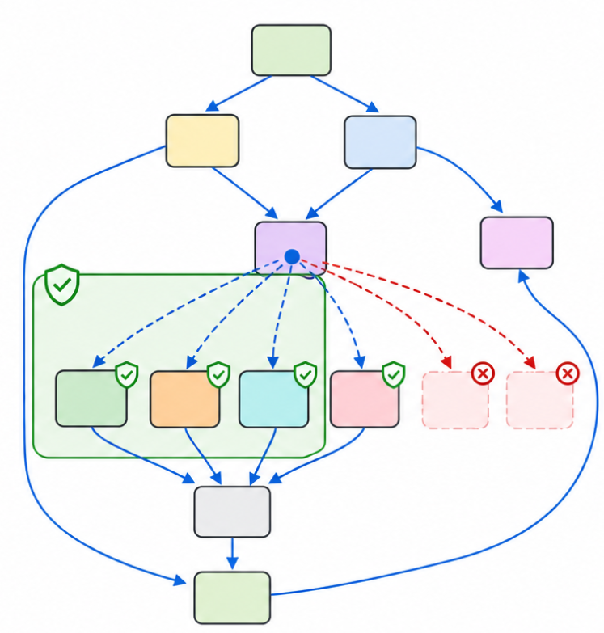
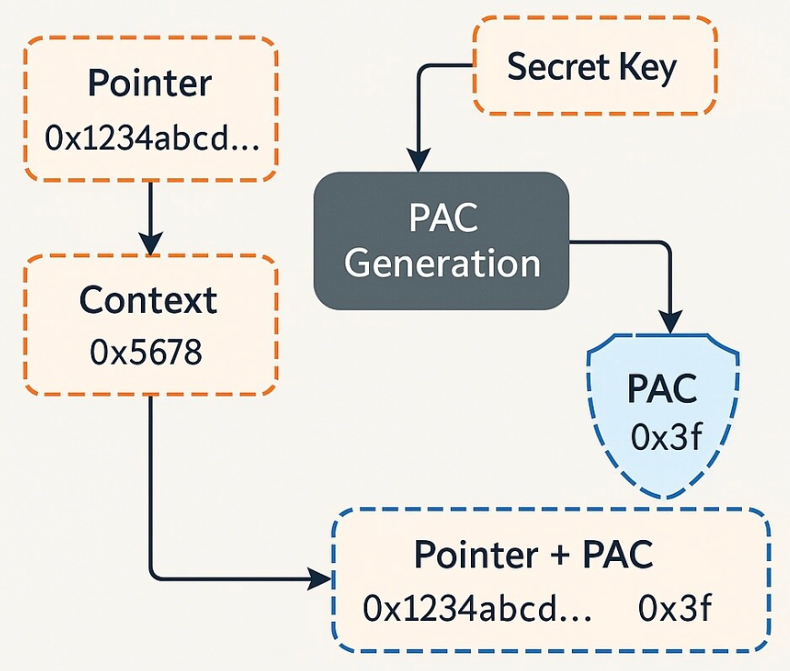
Forward-Edge Protection
Core idea: Mark legitimate targets / Harden Function Pointers
Image created using ChatGPT with prompt “Generate a image to illustrate control-flow integrity defenses that protect indirect calls: generate a graph-like not tree-like CFG, illustrate how CFI marks legitimate indirect jump targets. Use no text.” (left);“Untangling Pointer Authentication (PAC) - The Deeper Dive! | LinkedIn.” Accessed: Aug. 30, 2026. [Online]. Available: https://www.linkedin.com/pulse/untangling-pointer-authentication-pac-deeper-dive-samarth-parikh-kycyc/ (right)
Notes:
Replace with other fine grained cfi

Slide 7
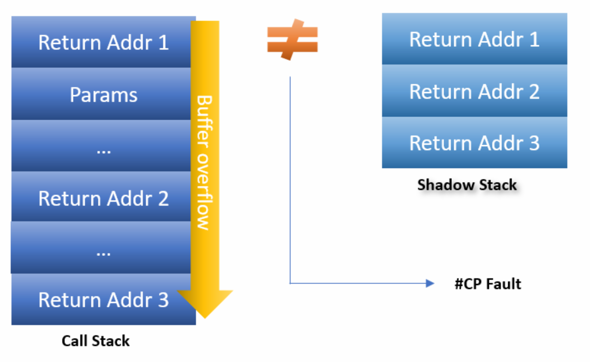
Backward-Edge Protection
“Understanding Hardware-enforced Stack Protection | Microsoft Community Hub,” TECHCOMMUNITY.MICROSOFT.COM. Accessed: Aug. 21, 2026. [Online]. Available: https://techcommunity.microsoft.com/blog/windowsosplatform/understanding-hardware-enforced-stack-protection/1247815
Notes:
Storage overhead (in-place signing); Deep recursion (move to isolated memory)

Slide 8
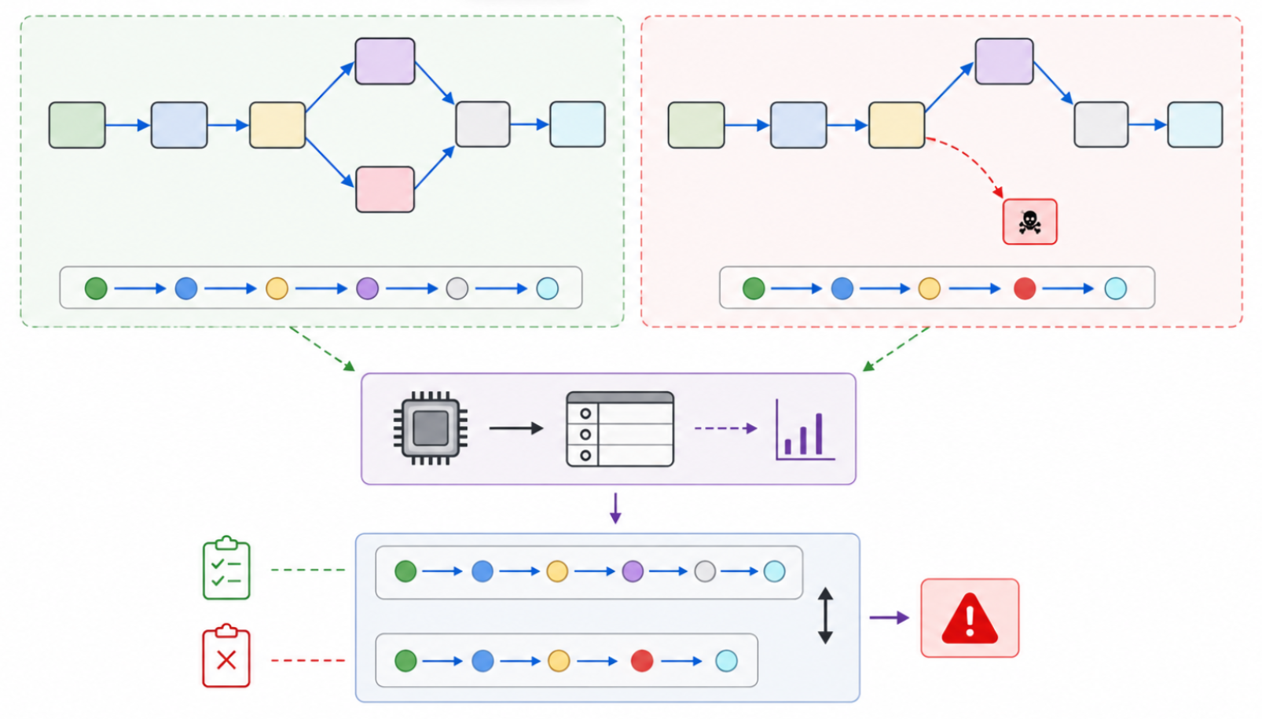
Universal Protection
A diverse category
Image created using ChatGPT with prompt “Generate a diagram to illustrate how can branch tracing (such as last branch record or intel performance monitoring unit) be used to identify a disparity in the expected and actual control flow. Make the diagram simplistic but clear. Use no text”
Notes:
Replace with better diagrams

Slide 9
Observation & Conlusion
* CFG generation is the bottleneck
* Universal protections: awkward position
* Defenses are retrofitting hardware primitives
* Unsatisfactory portability
* Composability is underexplored
Notes:
Replace with actual conclusions

