Slide 1
Person-reidentification
Feature & GAN

Slide 2


Our key idea
Many re-identification model rely on clothing information, especially the color, and some detail parts of the clothing.
To reduce the influence of clothing information, we consider using outline drawing (sketch) and gray scale image of the origin image for training.
Sketch is used in paper Person Re-identification by Contour Sketch under Moderate Clothing Change, where sketch is proved to be effective to be used as training input in reid under clothing change.
We think that using gray scale image as input may make the model focus less on clothing color.
sketch
gray scale

Slide 3

Our key idea
However, using only sketch or gray scale image may also lose some information
Therefore, we consider combining original image, sketch and gray scale image for training (“use them all”)
origin
sketch
gray scale

Slide 4
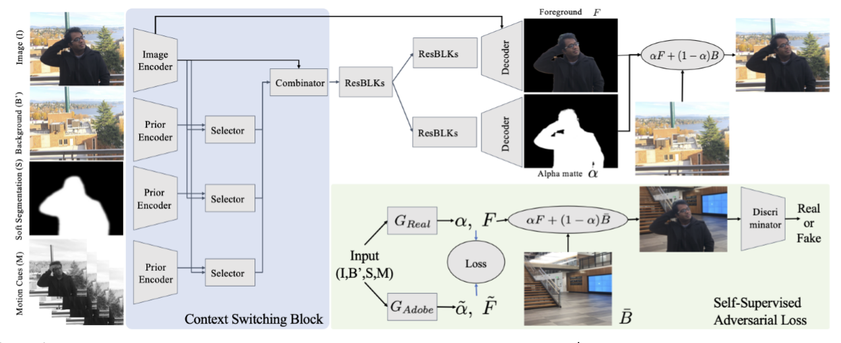
Introduction to Context Switching Block
This model comes from paper Background Matting: The World is Your Green Screen, which is about semantic segmentation, not person re-identification. We just want to borrow a part of the model——Context Switching Block.

Slide 5
Introduction to Context Switching Block
In this model, to get an accurate segmentation of image, the image itself, background, rough segmentation mask and some gray scale frames are used as input, viewed as different cues of input.
Context Switching Block aims to combine information from all the cues selectively and output combined features for further training.

Slide 6
Introduction to Context Switching Block
Context Switching Block aims to combine information from all the cues selectively. 有选择性地合并多种输入线索提供的特征
In person re-identification, original image, sketch and gray scale image can also be viewed as different input cues of a person.
We consider borrowing & modifying this model to combine significant reid information from all these cues selectively.

Slide 7
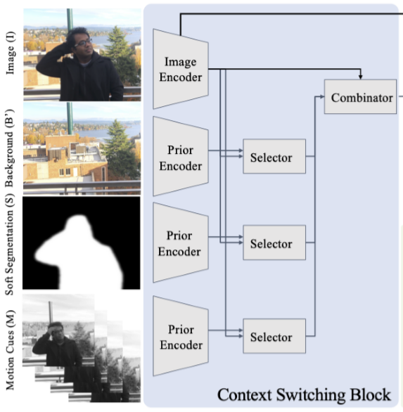
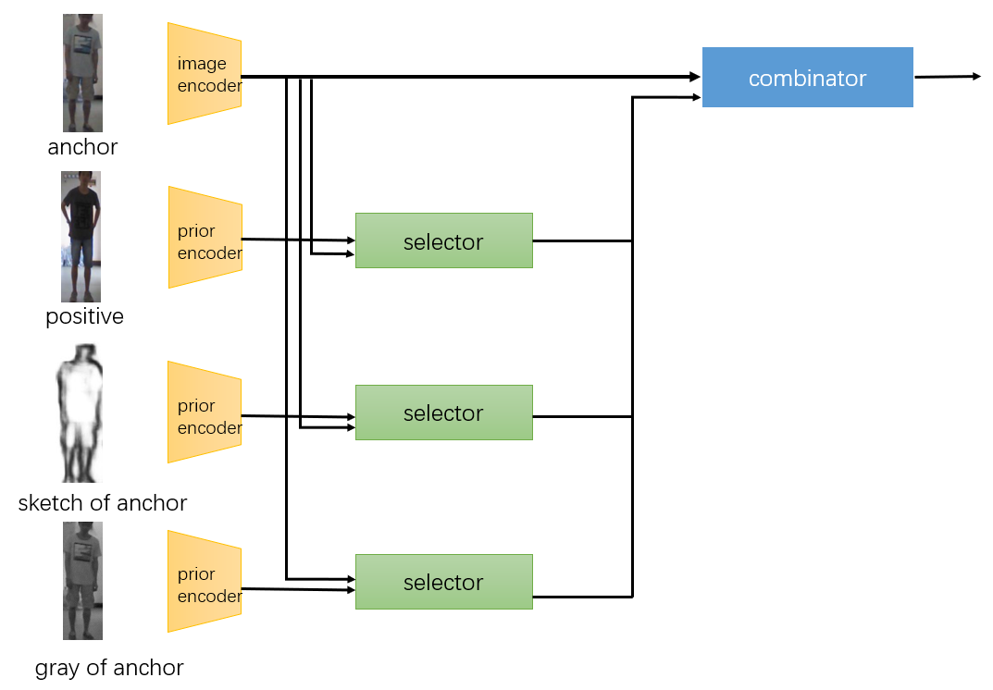
Context Switching Block from the paper
Our idea of using Context Switching Block in reid

Slide 8
Our first design model of context switching block
Input:
Original image (anchor)
Positive image (same id as anchor, but different clothing)
Sketch of anchor
Grayscale image of anchor
We hope to select and combine features from these four cues, to get features more significant for person re-identification.
Output features from context switching block, which we hope to contain useful reid information extracted from all four cues.
The features will be fed to classification network.

Slide 9
Experiment: Context Switching Block + MGN
We did an experiment: first we combine features from four input cues of a same person, then use the features to train a classification network.
MGN model is used as the classification network.
That is, we connect context switching block with MGN together in this reid experiment.
麻烦把MGN模型剪一下贴到这里

Slide 10
Experiment result and analysis

Slide 11

image encoder
combinator
anchor
prior encoder
selector
positive
prior encoder
selector
sketch of anchor
prior encoder
selector
gray of anchor

