Slide 1
Final Project Kick-Off Presentation
Zhenyu Li
Chenghao Wang
Siqi Hu

Slide 2
Trajectory Generator
Input
Position data from touchpad
Output
Continues trajectory with a certain velocity
LED signal
Properties of input data:
Noisy
Unpredictable
No velocity and acceleration
Handwriting can be fast

Slide 3
Preprocessing
Distance between two points
Too large distance:
Consider as gap between trajectories
Interpolate the gap with certain velocity
Turn off the LED
Large distance:
Consider as gap inside one trajectory
Interpolate the gap with certain velocity
Turn on the LED
Normal distance:
Set as next point in current trajectory
Turn on the LED
Small distance:
Ignore

Slide 4
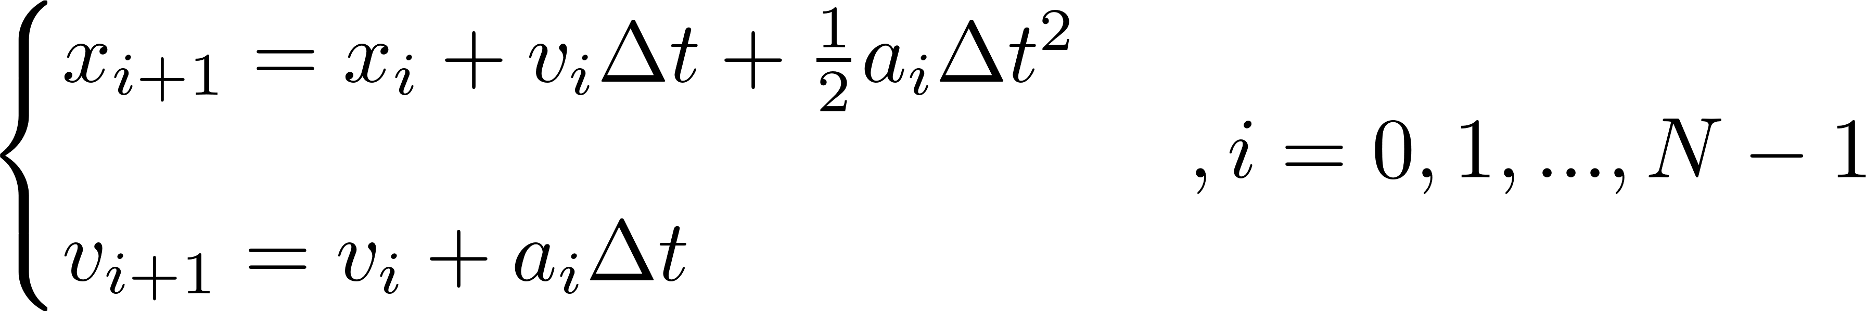

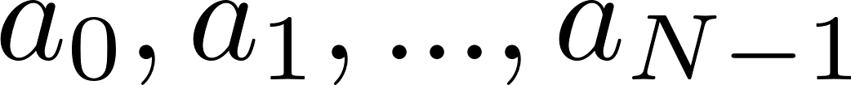

Velocity and Acceleration
Problem:
The controller needs velocity and acceleration
Velocity and acceleration have limits
Method from model predictive control:
Dynamic model:
Initial condition:
Input:
Goal (take preprocessed trajectory as reference):

Slide 5
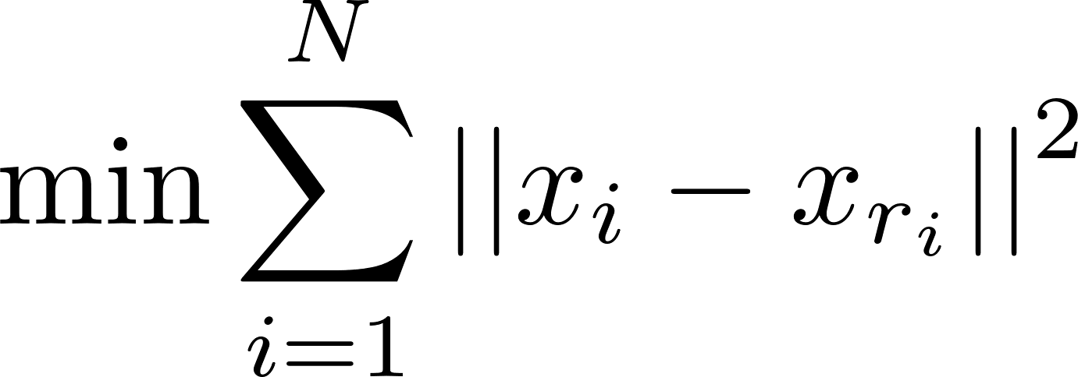
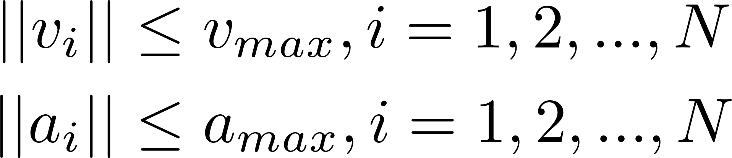
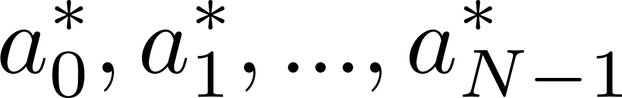



Velocity and Acceleration
Optimization problem:
Cost function:
With constrains:
Solution:
Result:
Only use as acceleration for time 0
Calculate as initial condition to optimize
Repeat the process

