Slide 1
Final Project Kick-Off Presentation
Zhenyu Li
Chenghao Wang
Siqi Hu

Slide 2


Slide 3
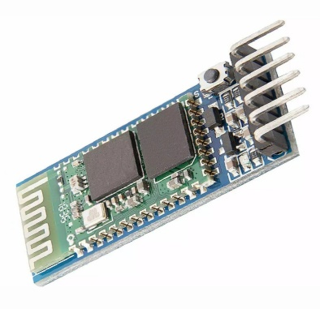
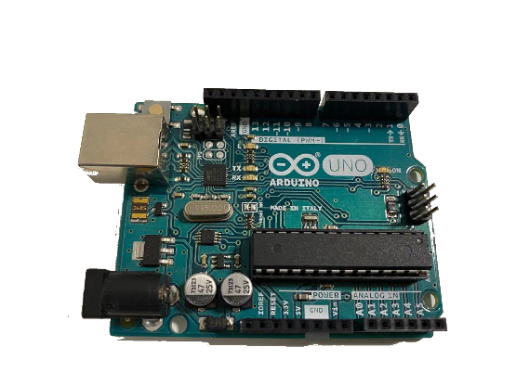
Devices
Bluetooth module
Type: HC-05
Arduino
An open source electronic prototyping controller [1]
LED
Laptop
UR10
[1] https://www.arduino.cc/en/guide/introduction

Slide 4
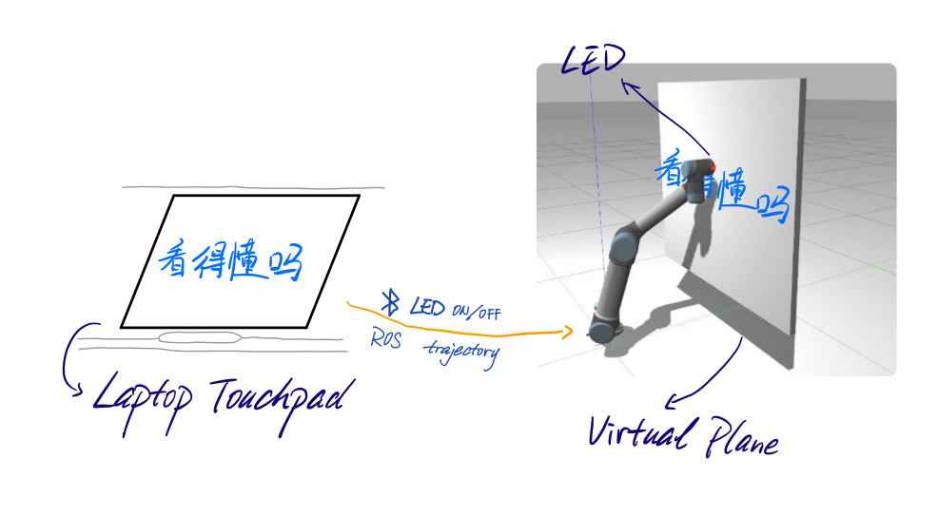
Proposed Approach

Slide 5
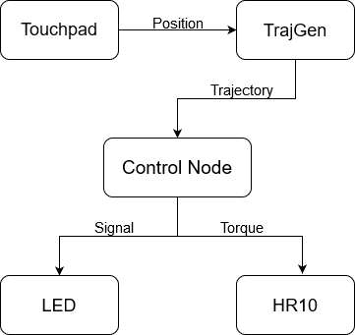
Proposed Approach

Slide 6
Plan
Step 1. Design a control algorithm.
Step 2. Verify the control algorithm on a predefined trajectory in simulation and real robot.
Step 3. Use a touchpad to generate trajectory and verify the control algorithm.
Step 4. Enjoy!

Slide 7

Questions?

