Slide 1
Robot Light Painting Final Presentation
Zhenyu Li
Chenghao Wang
Siqi Hu

Slide 2


Slide 3
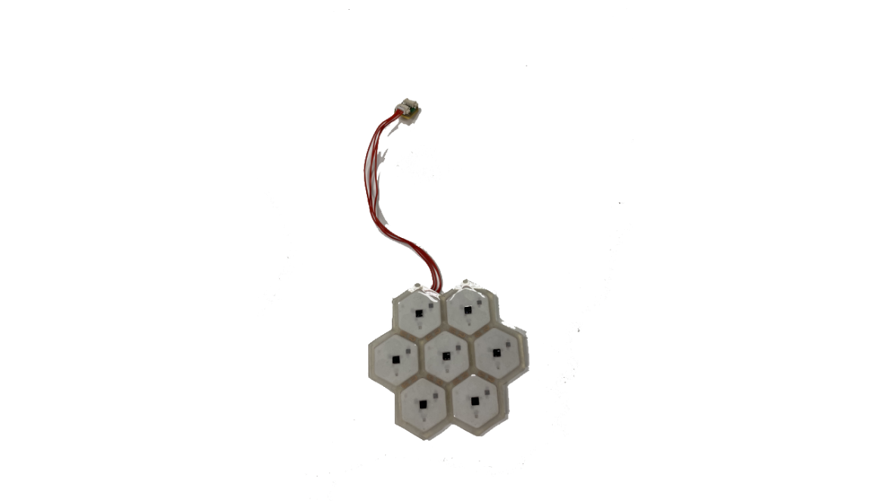
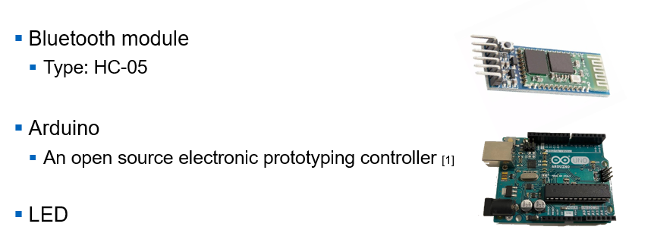
Devices
Laptop (Touchpad), PC
UR10

Slide 4
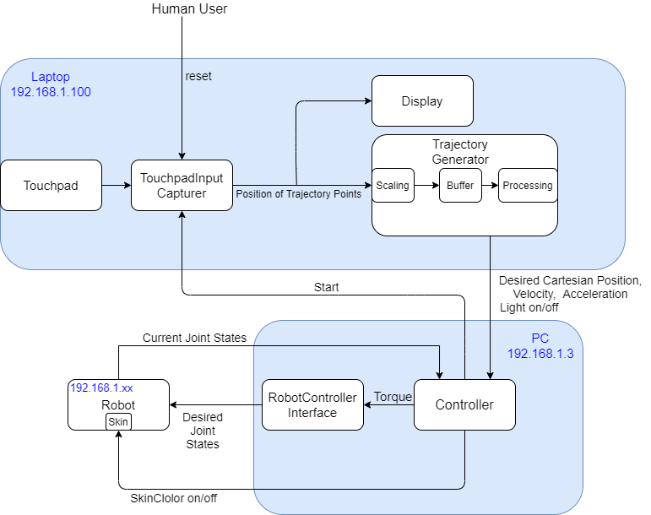
System Overview

Slide 5
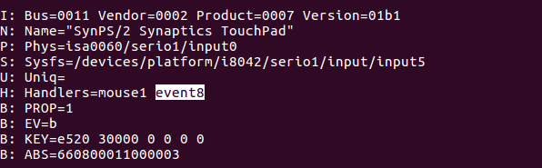
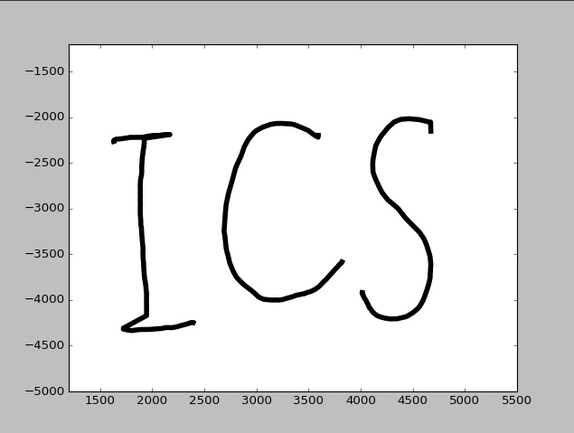

Capture and Display Touchpad Input
[2]
[2] https://matplotlib.org/

Slide 6
Trajectory Generator
Input
Position data from touchpad
Properties of input data:
Noisy
Unpredictable
Discontinuous
No velocity and acceleration
Handwriting can be fast
Output
Continuous trajectory with a certain velocity
LED signal

Slide 7
Preprocessing
Distance between two points
Too large distance:
Consider as gap between trajectories
Interpolate the gap with certain velocity
Turn off the LED
Large distance:
Consider as gap inside one trajectory
Interpolate the gap with certain velocity
Turn on the LED
Normal distance:
Set as next point in current trajectory
Turn on the LED
Small distance:
Ignore

Slide 8
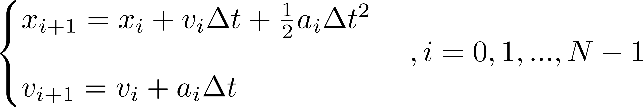

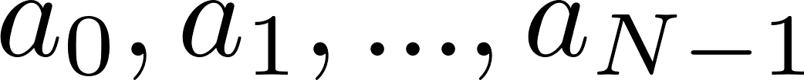
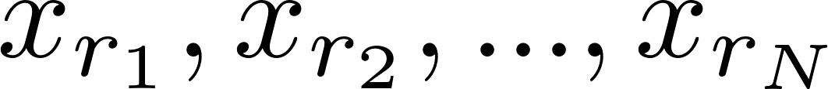
Velocity and Acceleration(MPC)
Problem:
The controller needs velocity and acceleration
Velocity and acceleration have limits
Method from model predictive control:
Dynamic model:
Initial condition:
Input:
Goal (take preprocessed trajectory as reference):

Slide 9
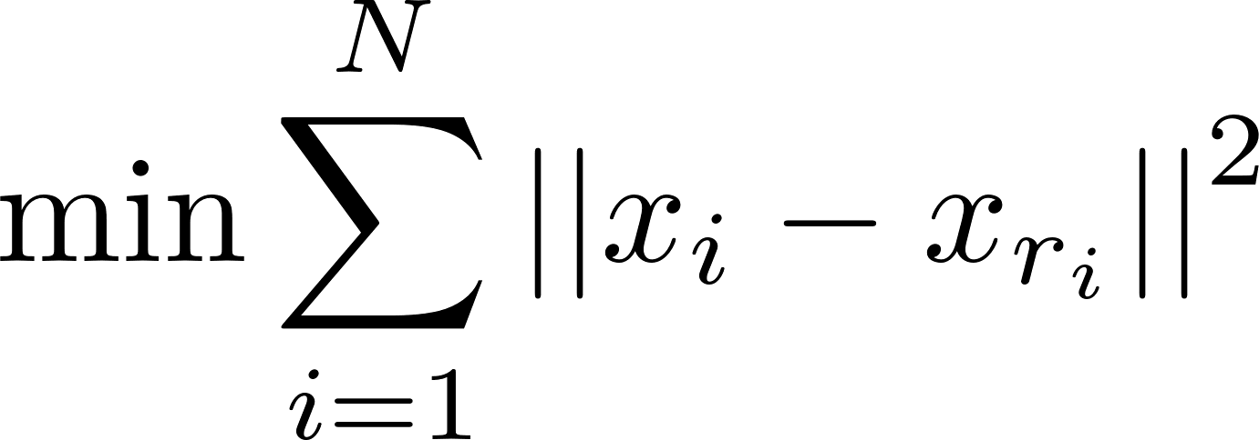
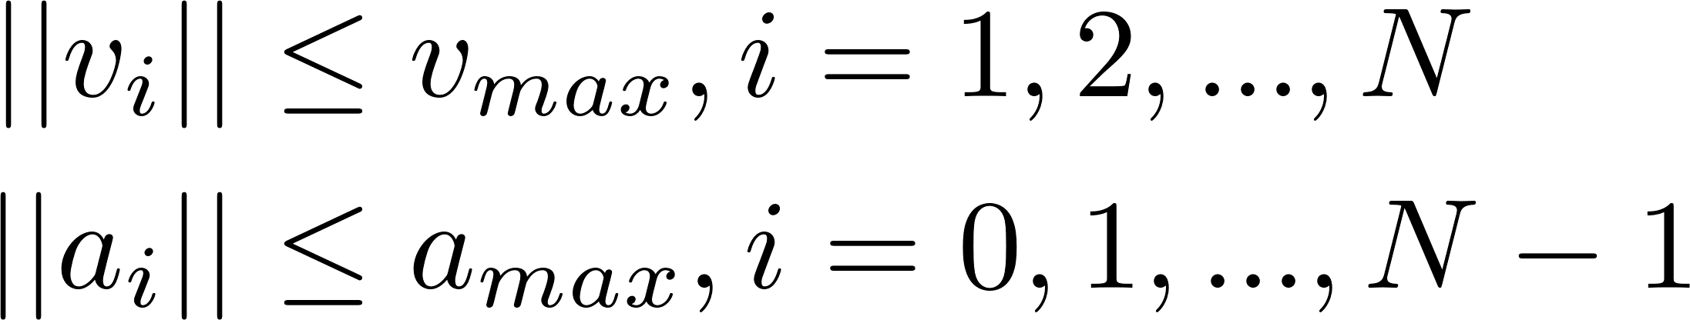
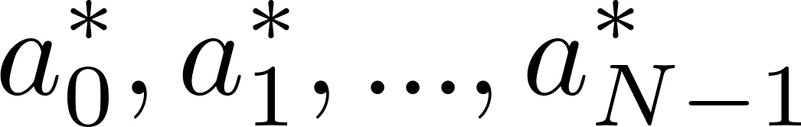
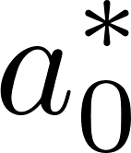


Velocity and Acceleration(MPC)
Optimization problem:
Cost function:
With constrains:
Solution:
Result:
Only use as acceleration for time 0
Calculate as initial condition to optimize
Repeat the process

Slide 10
This robot is not a toy !!!
Robust Implementation
Verified State Machine

Slide 11
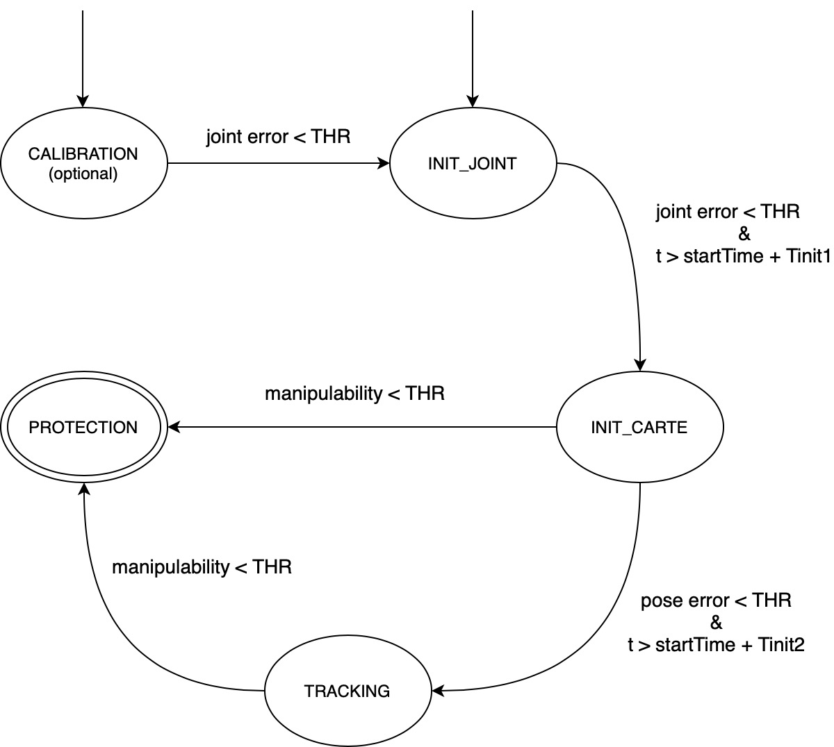
Controller::state_machine
CALIBRATION(optional):
Tracking a designed trajectory in joint space, until the error is lower than a threshold. (adaptive controller)
INIT_JOINT:
Get out of singular region.
INIT_CARTE:
Go to the virtual plane.
TRACKING:
have fun!
PROTECTION:
reached singular region.

Slide 12
Controller
Joint Space Controller:
Calibration
Joint initialization: get rid of the initial singular pose
Singularity protection
Cartesian Space Controller:
Cartesian initialization: go to the predefined virtual plane
Tracking your finger trajectory
Both controller: 6-DOF Model based PID-like adaptive controller

Slide 13

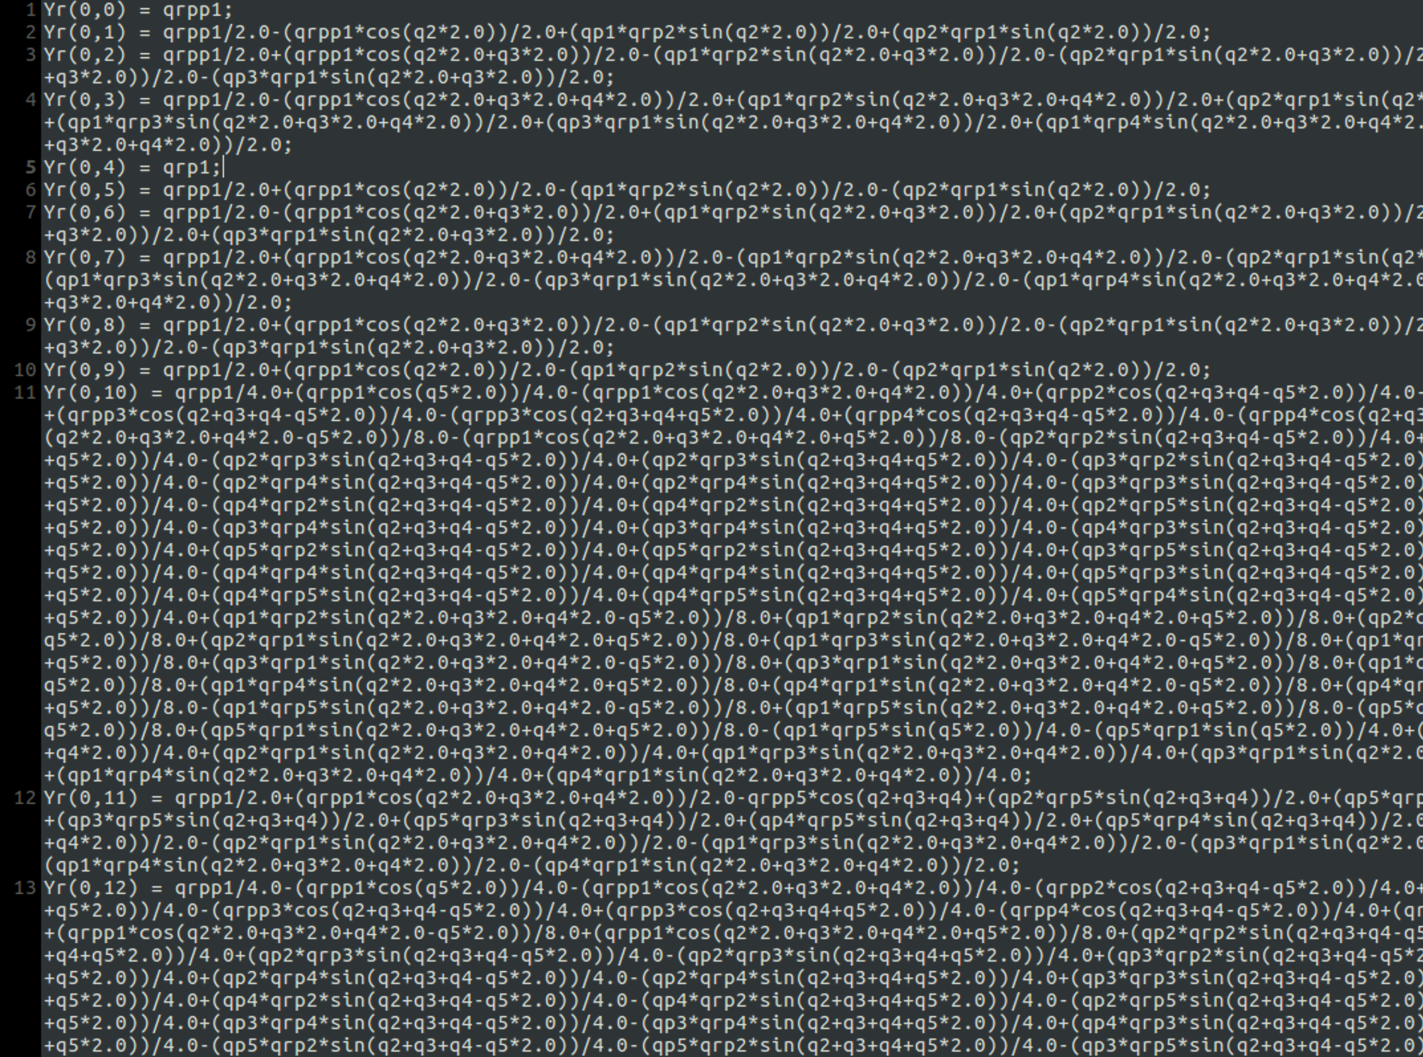

Slide 14
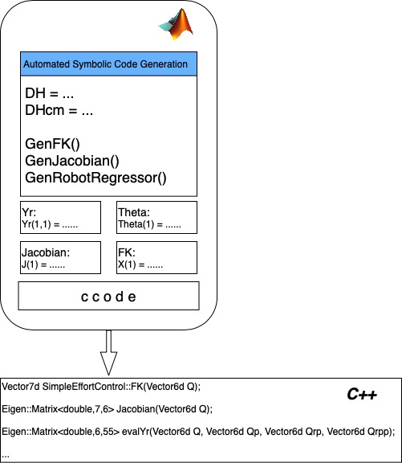
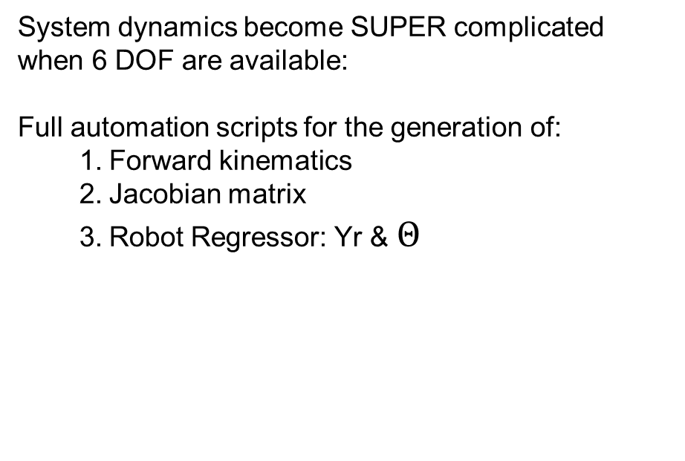
Controller
System dynamics become SUPER complicated when 6 DOF are available:
Full automation scripts for the generation of:
Forward kinematics
Jacobian matrix
Robot Regressor: Yr & $Θ$

Slide 15
Does it work?

Slide 16
NO

Slide 17
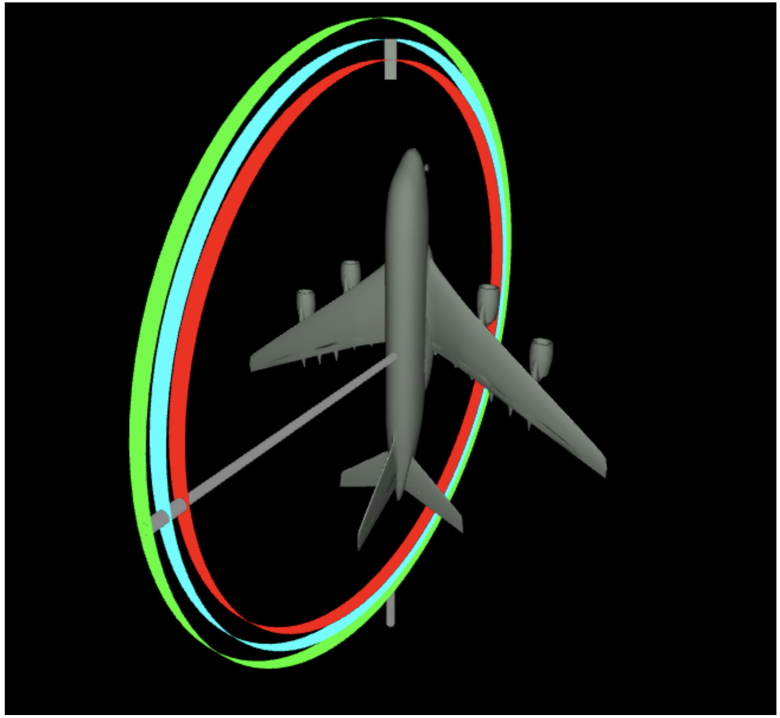
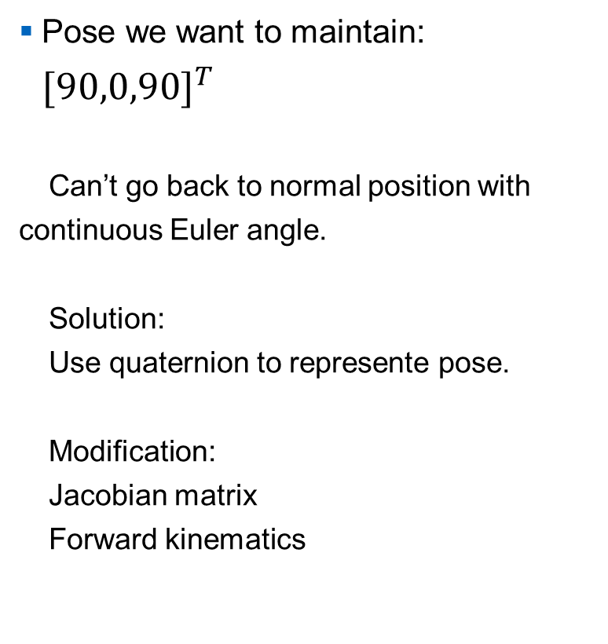
Controller::Problem::Gimbal_Lock
Pose we want to maintain: $[90,0,90]^{T}$
Can’t go back to normal position with continuous Euler angle.
Solution:
Use quaternion to represente pose.
Modification:
Jacobian matrix
Forward kinematics

Slide 18

Questions?

