Slide 1


Walmart Recruiting - Store Sales analysis & Forecasting
Haotian Yu
Final Project
EMES 6992
GWU

Slide 2



Slide 3
Background
Data Analysis and Prediction is very important in the Selling industry
Walmart is a very good data resource for the analysis. It’s useful for the application in business.

Slide 4
INTRODUCTION
Analyze what factors can decide the sale of a Walmart store.
prediction and forecasting of sales in 45 Walmart stores
The data analysis is done based on the sale data for different departments in different weeks for each location in the past time

Slide 5
~ What can significantly decide the sales for a Walmart store?
~ How will be sale in holidays?
~ What will the sale for each store be like in future?
What’s your guess for these questions?

Slide 6
data variables
historical sales data for 45 Walmart stores in different areas.
Store - the store number
Date - the week
Temperature - average temperature in the region
Fuel_Price - cost of fuel in the region
CPI - the consumer price index
Unemployment - the unemployment rate
IsHoliday - whether the week is a special holiday week

Slide 7
Data structure
 | Store | Dept | Date | Weekly Sales | isHoliday | Type | Size | Temperature | Fuel_ Price | CPI | Unemployment
0 | 1 | 1 | 2010-02-05 | 24924.50 | False | A | 151315 | 42.31 | 2.572 | 211.096358 | 8.106
1 | 1 | 1 | 2010-02-12 | 46039.49 | True | A | 151315 | 38.51 | 2.548 | 211.242170 | 8.106
2 | 1 | 1 | 2010-02-19 | 41595.55 | False | A | 151315 | 39.93 | 2.514 | 211.289143 | 8.106
3 | 1 | 1 | 2010-02-26 | 19403.54 | False | A | 151315 | 46.63 | 2.561 | 211.319643 | 8.106
4 | 1 | 1 | 2010-03-05 | 21827.90 | False | A | 151315 | 46.50 | 2.625 | 211.350143 | 8.106

Slide 8
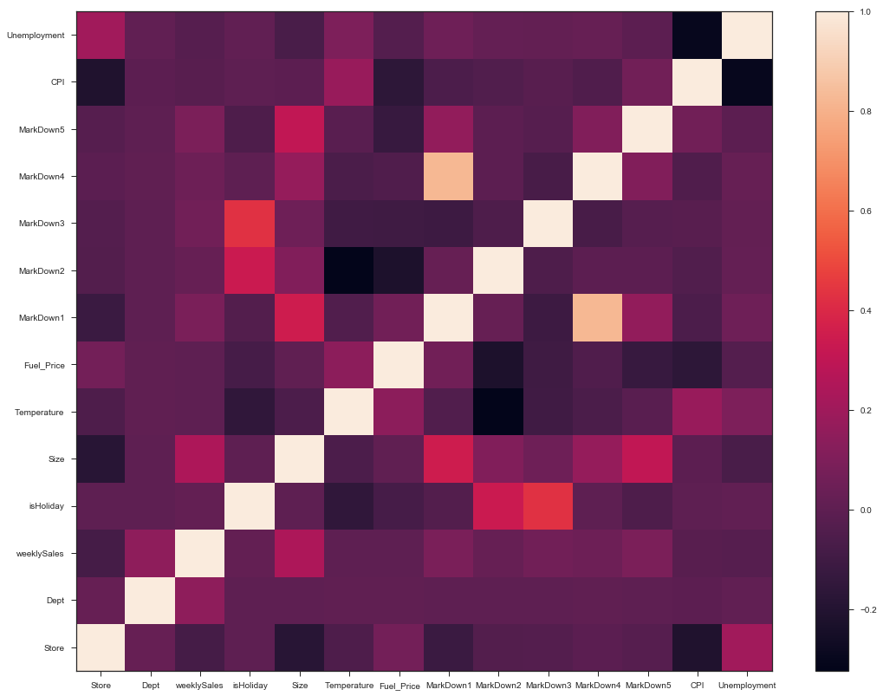
Correlation

Slide 9
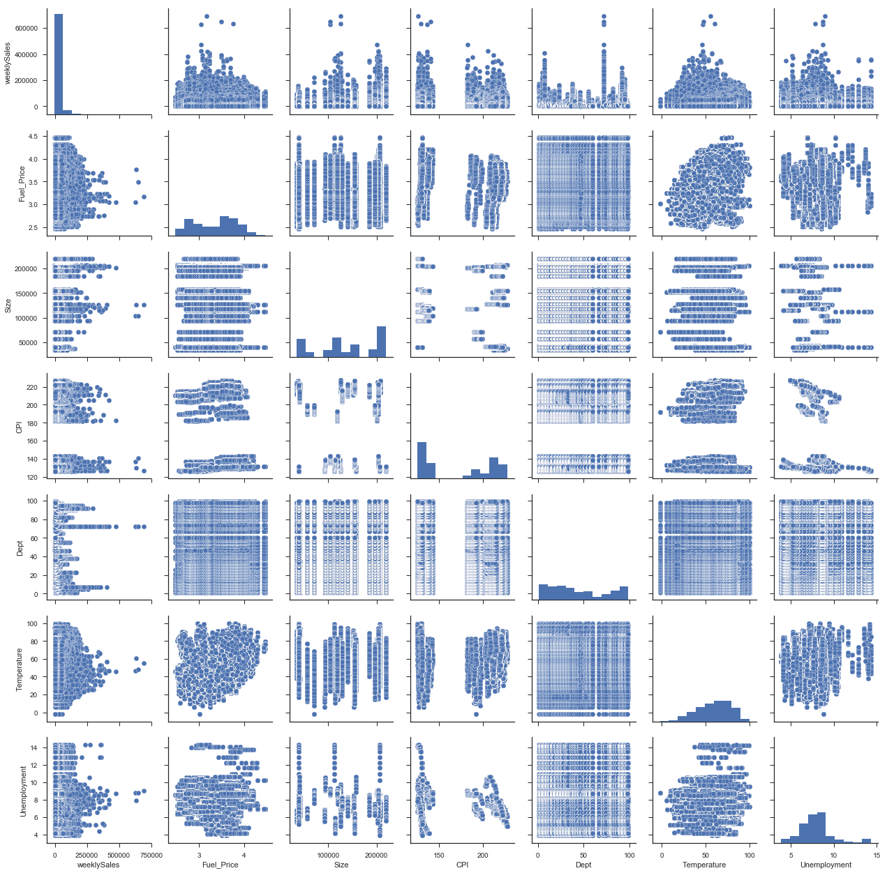
Pair scatter Plots
Weekly sale
Fuel Price
Size
CPI
Department
Temperature
Unemployment

Slide 10
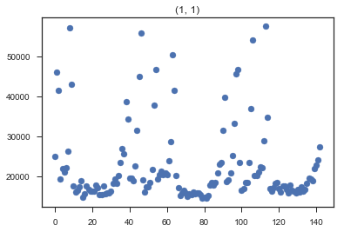
Weekly sale in departments of stores group by Store and Dept

Slide 11
Data Analysis
Relationship between Weekly sale and
'Store’, 'Date’, 'Dept’, 'Fuel_Price’, 'CPI’, 'Unemployment’
in two different isHoliday Group(True or False).
Relationship between Weekly sale and
'Store’, 'Date’, 'Dept’, 'Fuel_Price’, 'CPI’, 'Unemployment’
in different Size Group.

Slide 12
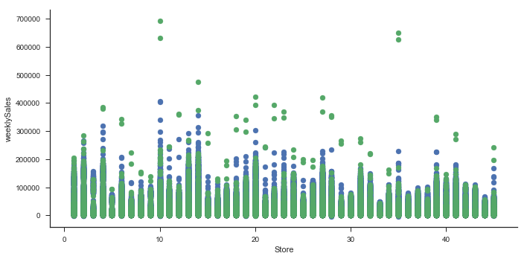
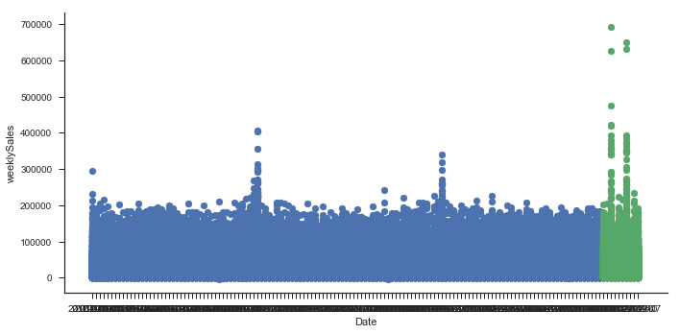
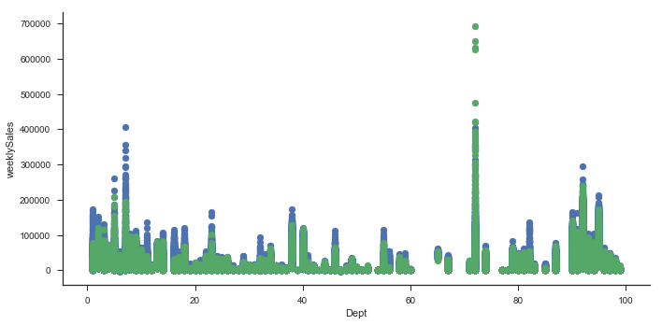
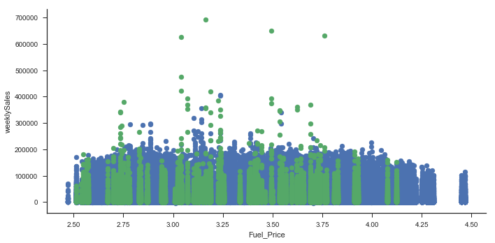

Slide 13
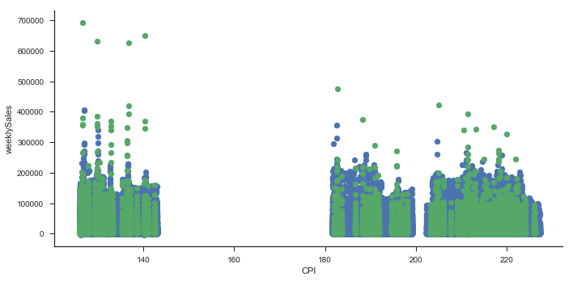
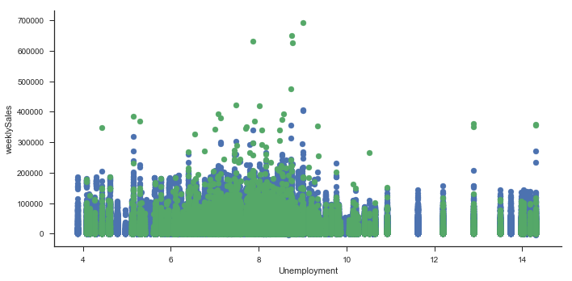
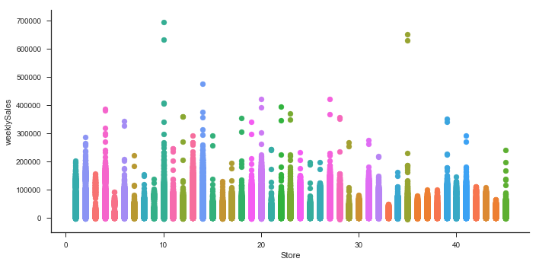
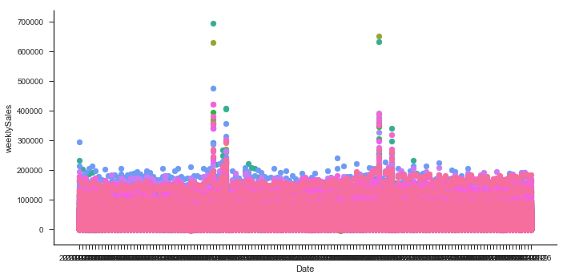

Slide 14
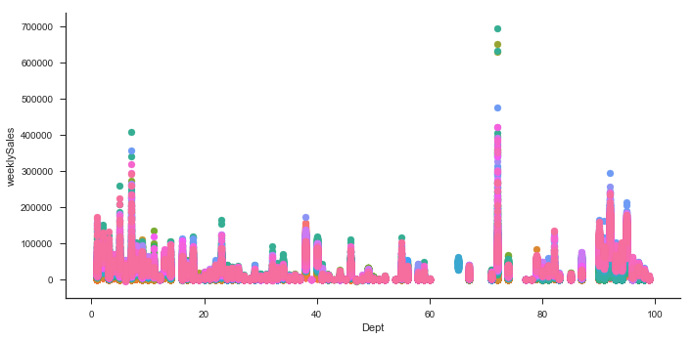
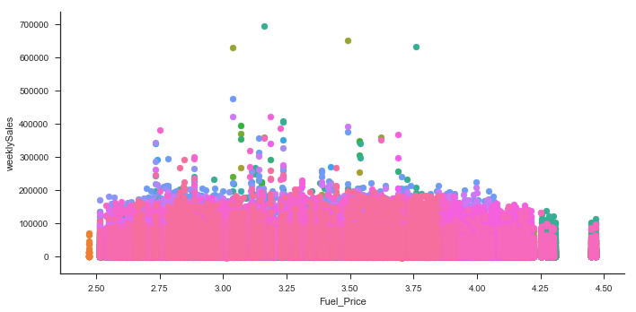
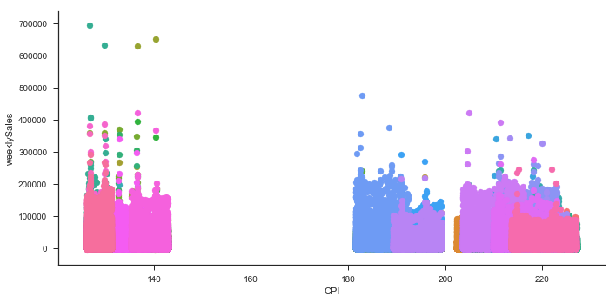
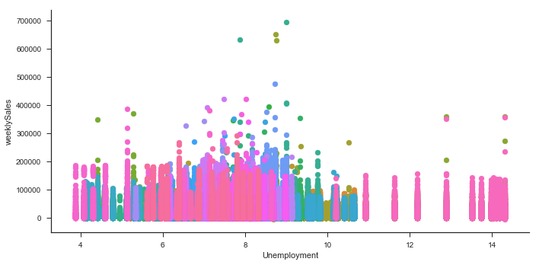

Slide 15
DATA ANALYSIS
Relationship between Weekly sale and
'Fuel_Price’, 'CPI’, 'Unemployment’
in different Stores.
Relationship between Weekly sale and
'Fuel_Price’, 'CPI’, 'Unemployment’
in different Date.
Relationship between Weekly sale and
'Fuel_Price’, 'CPI’, 'Unemployment’
in different Dapartrments.

Slide 16
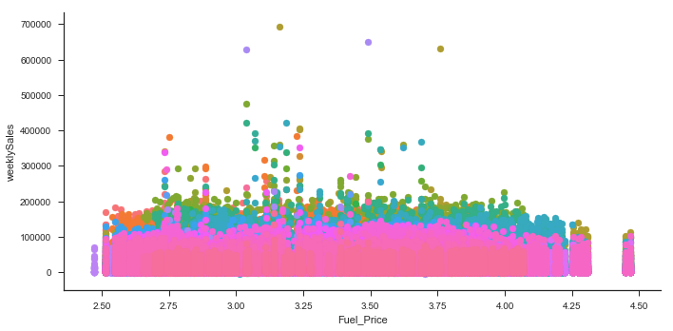
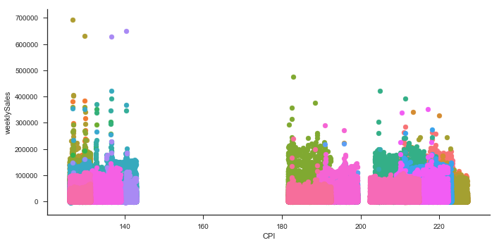
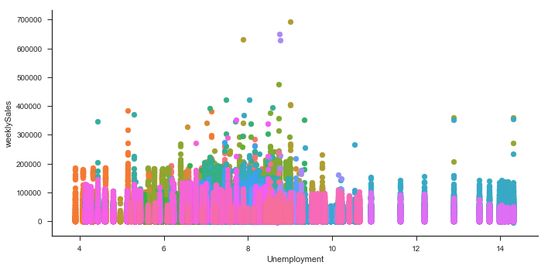
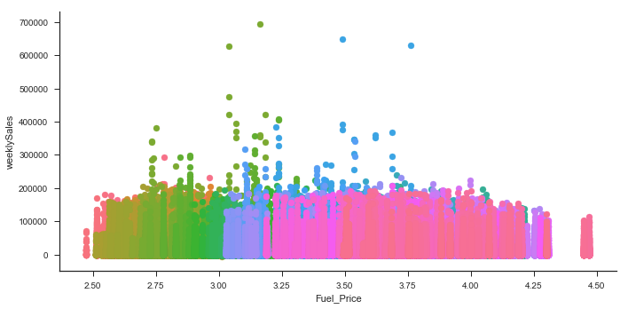

Slide 17
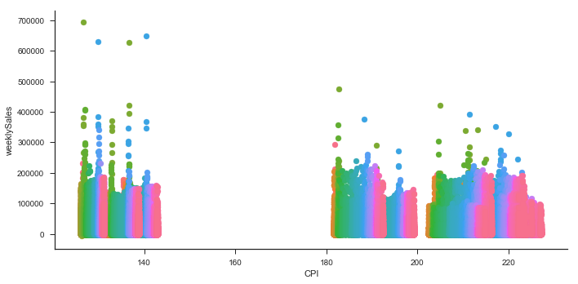
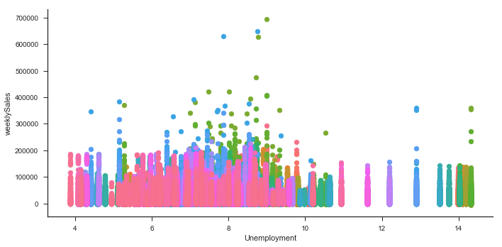
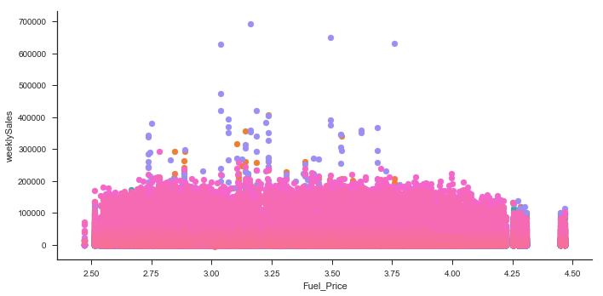
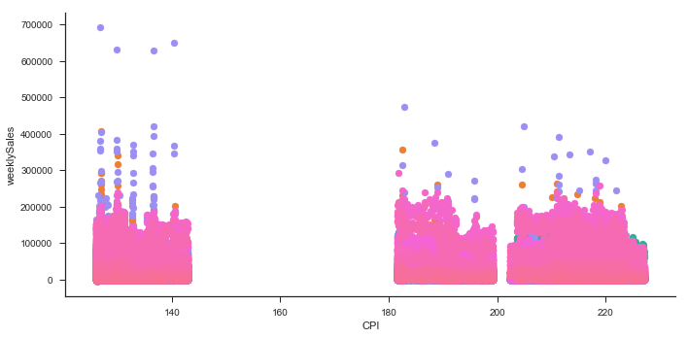

Slide 18
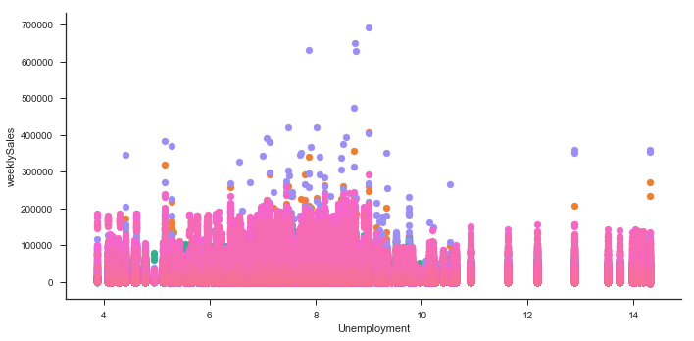
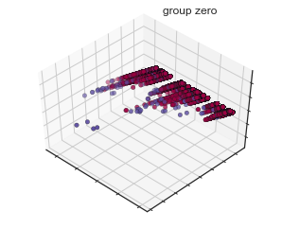
What We get from these graphs?

Slide 19
conclusion
1. The situation of sale for different store are different. The sale of several specific holidays is much better than non-holidays. Some holidays even have less sale than regular non-holidays.
2. The end of the year has lots of holiday, and the sale of stores increase.
3. Different department have different sales. Most departments sell better in holiday than regular days.
4. For different stores (sizes is also different), the CPI is different.
5. Different sizes of stores have different unemployment situation.
6. For different Date, Fuel_Price and CPI are different.
7. If the Fuel price is very high in holiday, the weekly sale just decrease and be very little.

Slide 20
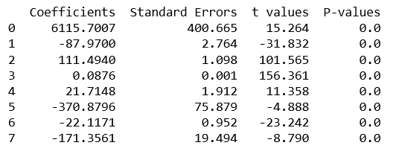
Linear Regression

Slide 21
Conclusion& Prediction
The sale in the whole year is not with big up and down. Big increase of sale is in holiday.
I only get the prediction with continuous variables.
Weekly sale = 6115.7007- 87.9700*Store + 111.4940*Dept + 0.0876* Size+ 21.7148* Temperature -370.8796* Fuel_Price -22.1171*CPI -171.3561* Unemployment

Slide 22
Evaluation

Slide 23
THANK YOU!!!

