Slide 1
Multi-View Geo-Localization: Drone-Satellite Matching
Ghinwa Bdeir
Hawraa Sweidan
July 2, 2025

Slide 2
Sample4Geo

Slide 3
Project Overview
This project addresses the problem of multi-view geo-localization, which is the task of predicting the location of a drone-view or street-view image by matching it with a geo-tagged satellite image.
We chose to work on the University-1652 challenge using an existing open-source solution: Sample4Geo

Slide 4
Multimedia Drone Satellite Matching
Challenge: Multimedia Drone Satellite Matching Challenge.
Core Task: Given a drone (query) image, retrieve the most relevant satellite (gallery) images from a large dataset.
Key Deliverable: A submission file (answer.txt) for CodaLab, containing ranked lists of retrieved gallery images for each query.
Metrics: Evaluation based on Recall@k, Mean Average Precision (mAP), and Recall@top1%.

Slide 5
Core Methodology & Implementation
Framework: PyTorch (Deep Learning).
Feature Extraction:
Utilizing a predict function to extract features for both query and gallery images.
Inputs: query_loader, gallery_loader.
Outputs: img_features_query, ids_query, img_features_gallery, ids_gallery.
Similarity Calculation:
Dot product of extracted features to compute similarity scores.
Ranking gallery images based on similarity to each query.
Evaluation Metrics Calculation (evaluate function):
Computation of Cumulative Matching Characteristics (CMC) for Recall@k (e.g., R@1, R@5, R@10).
Calculation of Mean Average Precision (mAP).

Slide 6
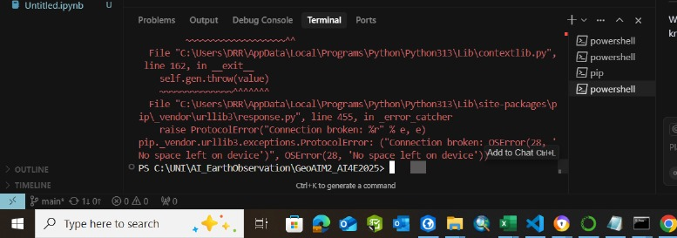
Initial Runtime & Resource Constraints
Initial local execution of the eval_university.py script took 8 hours +.
Configuration → Load Model & Weights → Prepare Transforms & Datasets → Evaluate Retrieval Performance
Implication: This indicates a significant computational load, requiring GPU acceleration and substantial memory.
Initial Strategy: Leverage cloud resources (Google Colab) to overcome local limitations and utilize powerful GPUs.

Slide 7
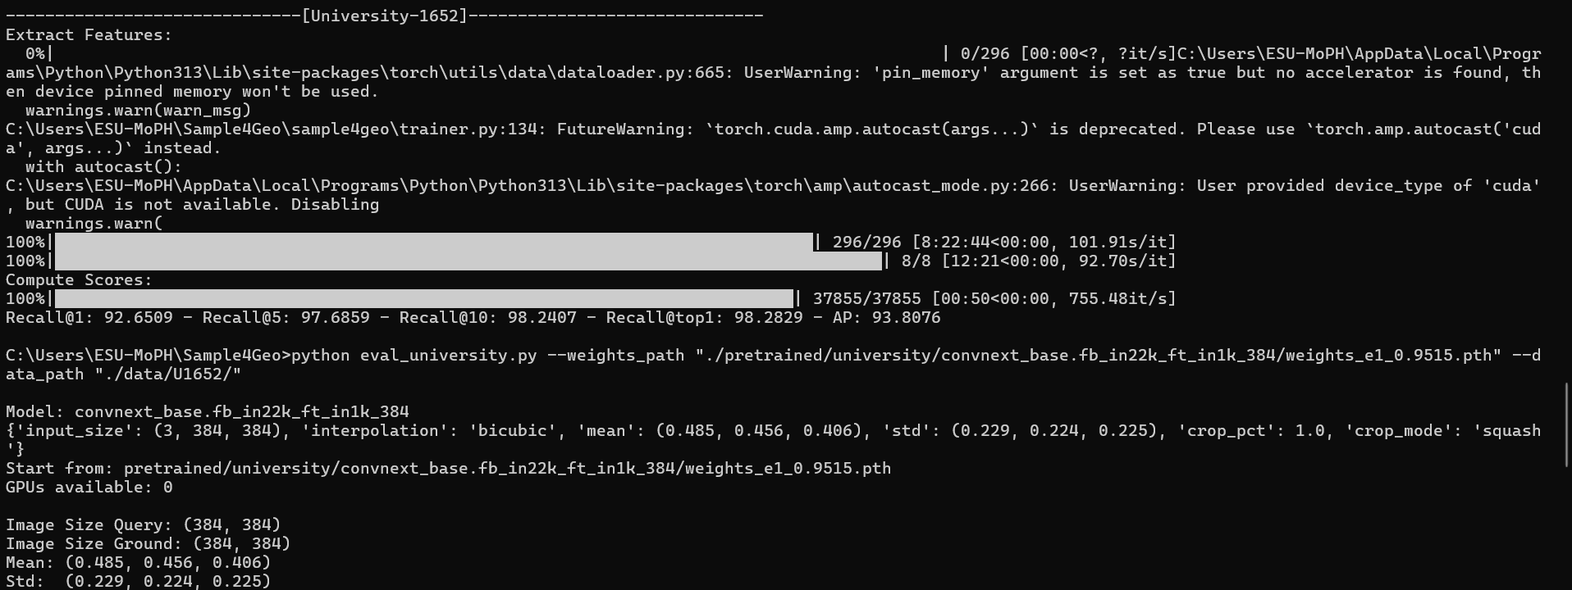
Extract Features

Slide 8
Results
Recall@1 (R@1): 92.6509%
Recall@5 (R@5): 97.6859%
Recall@10 (R@10): 98.2407%
Recall@top1: 98.2829% (This might be a slightly different way of calculating R@1 or a rounded value from the internal compute_mAP function, as it's very close to R@1).
Average Precision (AP): 93.8076%
R@1 (92.65%): For over 92.6% of your query images, the absolutely correct corresponding gallery image was the very first one returned by the model.
R@5 (97.69%): For almost 97.7% of the queries, the correct image was found within the top 5 retrieved results.
R@10 (98.24%): For over 98.2% of the queries, the correct image was found within the top 10 retrieved results.
Notes:
These increasing values are expected and show that as you allow more predictions, the model is very likely to find the correct match. The high R@1 indicates that it's often the best match right away.

Slide 9
CodaLab Submission File
Purpose: The ultimate output required for official challenge evaluation.
Required Format: A text file (answer.txt) where each line represents a query, followed by its alphanumeric ID and space-separated alphanumeric IDs of its top-ranked gallery matches.
Example: query_id_XYZ gallery_id_A gallery_id_B gallery_id_C ...
Challenge Integration: The evaluate function needs to not only compute metrics but also generate this specific file format.

Slide 10
Correct ID Mapping for answer.txt
Problem: The exact format and source of image IDs (e.g., e6kXgz36E8nOY2n) required by CodaLab for answer.txt is still not fully confirmed from the code.
Technical Detail: The predict function returns ids_query and ids_gallery which are then converted to numerical NumPy arrays for internal evaluation.

Slide 11
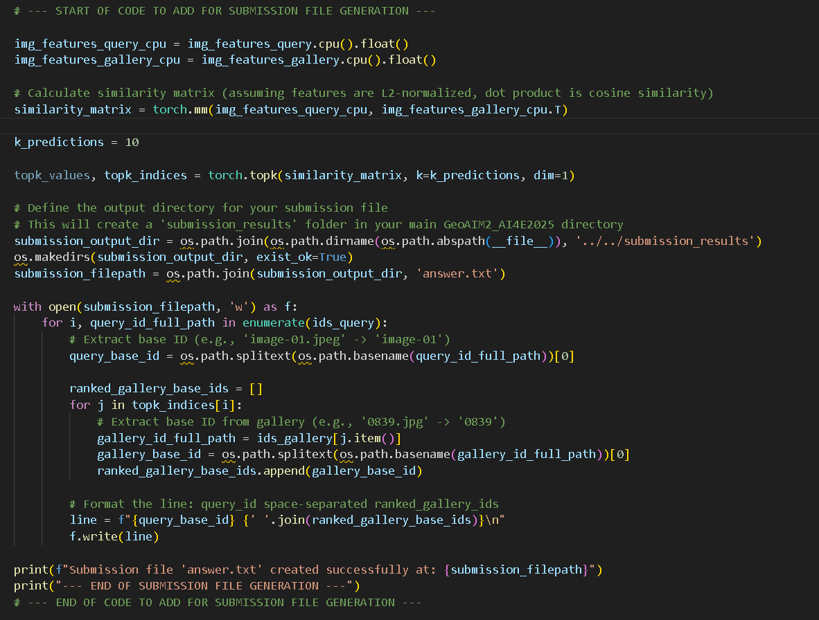
univesity.py
Integrate code into university.py to generate answer.txt crucial debug output from a successful run to confirm the ids_query and ids_gallery content/type.

Slide 12
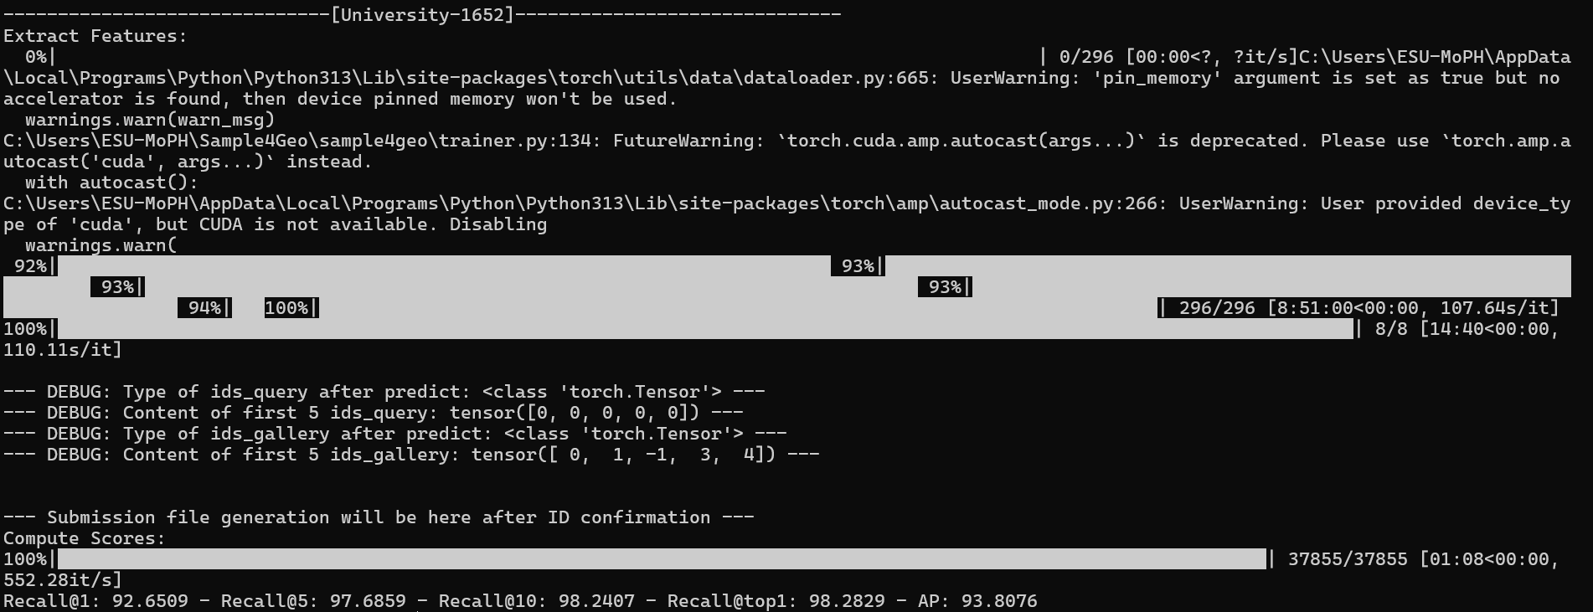
Debug

Slide 13
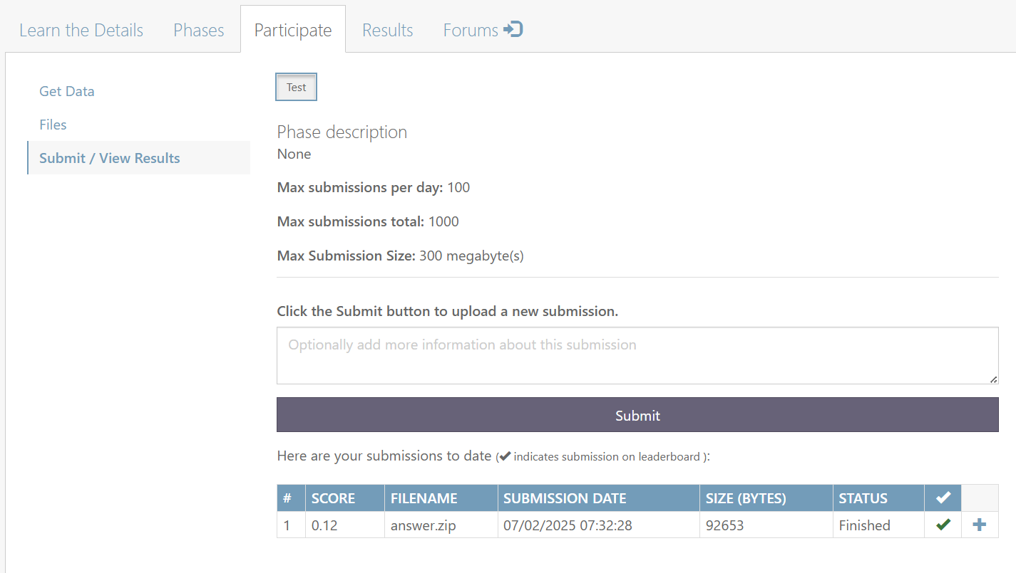
CodaLab Submission File (baseline)

Slide 14
Environment Setup - Google Colab Hurdles
Goal: Port project to Google Colab for GPU acceleration.
Data Accessibility for Large Datasets:
The U1652 dataset is large (implied by runtime).
Initial recommendation: Upload to personal Google Drive and mount (drive.mount()).
Estimated 32 hours upload time to Google Drive, making this approach impractical.

Slide 15
Data Source Complexity - OneDrive Link
The U1652 dataset was available via a public OneDrive link, not a Google Drive link.
Manually download the dataset from GoogleDrive to local machine.
Upload the dataset from local machine to personal Google Drive.
Then, mount personal Google Drive in Colab.
This workaround reintroduced the lengthy upload time (32 hours).

Slide 16
Transition to Local Development (VS Code)
Confirmation of possessing an NVIDIA GPU (GeForce MX550) on the local machine.
While the MX550 is an entry-level GPU (slower than Colab's high-end GPUs), it's significantly faster than CPU-only processing and avoids the data transfer bottleneck. The 8-hour runtime from Colab will likely be longer, but manageable.

Slide 17
Local GPU Environment Setup
Complexity: Setting up a functioning deep learning environment locally with GPU acceleration requires meticulous steps.
Key Components & Dependencies:
NVIDIA Drivers: Ensuring latest, compatible drivers for MX550.
CUDA Toolkit: Core library for GPU computing; selection based on PyTorch compatibility.
Python Virtual Environment: For isolated project dependencies.
PyTorch (CUDA-enabled): Installing the correct PyTorch build that leverages the installed CUDA Toolkit.
Verification: Confirming torch.cuda.is_available() is True.

Slide 18
Actions taken
Immediate Action: Complete the local NVIDIA GPU environment setup (drivers, CUDA, cuDNN, PyTorch).
Run Locally: Execute the eval_university.py script on the local machine (with debug prints active).
Provide Debug Output: Share the exact output of --- DEBUG: lines from the script's run.

Slide 19
------------------------------[University-1652]------------------------------
Extract Features:
0%| | 0/296 [00:00<?, ?it/s]C:\Users\ESU-MoPH\GeoAIM2_AI4E2025\sample4geo\trainer.py:134: FutureWarning: `torch.cuda.amp.autocast(args...)` is deprecated. Please use `torch.amp.autocast('cuda', args...)` instead.
with autocast():
1%|█▍ | 3/296 [01:23<2:18:12, 28.30s/it]

Slide 20
