Slide 1
Sprint #2 Report
Cuong Nguyen Kris-Jorge Munoz
Issac Sanchez Kritika Jain

Slide 2
Sprint backlog
Task Name | Priority | Status | Deadline
Request Computer for Lab | High | In Progress | Mon Oct 9th
Testing (Capabilities and Requirements) | High | Not Started
→Gather Data from Kinect | High | In Progress | Wed Oct 11th
→Kinect Capabilities (Large sweater, multiples) | High | Not Started | Wed Oct 11th
→Test Kinect Data API’s (Vitruvius, OpenNI) | Medium | Not Started | Fri Oct 13th
→Data Tracking Prototype (Bicep Curl) | Medium | Not Started | Fri Oct 20th
→→DB / Base workout data model | Medium | Not Started | Fri Oct 20th
Power needed for Image Processing (PC) | Medium | Not Started | Fri Oct 20th
Find & order mini PC | Medium | In Progress | Fri Oct 20th
Mobile UI Prototyping | Low | Not Started | Fri Oct 20th

Slide 3
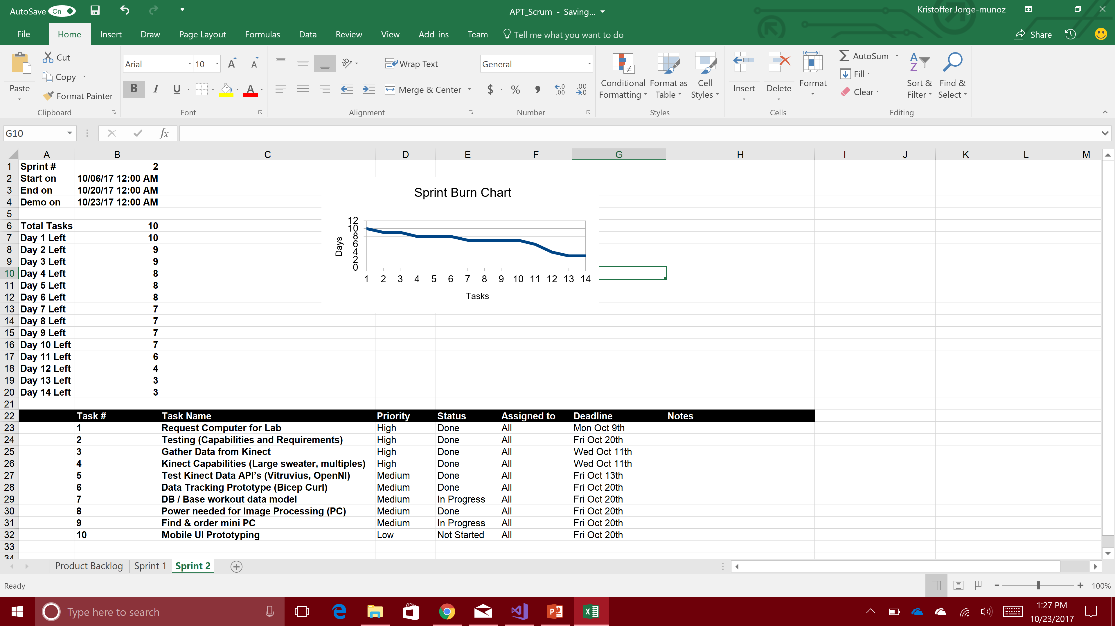

Slide 4
Sprint backlog Update
Task Name | Priority | Status | Deadline
Request Computer for Lab | High | Done | Mon Oct 9th
Testing (Capabilities and Requirements) | High | Done | Fri Oct 20th
→Gather Data from Kinect | High | Done | Wed Oct 11th
→Kinect Capabilities (Large sweater, multiples) | High | Done | Wed Oct 11th
→Test Kinect Data API’s (Vitruvius, OpenNI) | Medium | Done | Fri Oct 13th
→Data Tracking Prototype (Bicep Curl) | Medium | Done | Fri Oct 20th
→→DB / Base workout data model | Medium | In Progress | Fri Oct 20th
Power needed for Image Processing (PC) | Medium | Done | Fri Oct 20th
Find & order mini PC | Medium | In Progress | Fri Oct 20th
Mobile UI Prototyping | Low | Not Started | Fri Oct 20th

Slide 5
Issues
Kinect skeletal and vector tracking is faulty when user has medium ~ thick jacket/sweater.
Kinect join tracking is limited to 3 points for the back area. Unable to add custom joints.
When tracking from the side, the Kinect is unable to track the other half of the body.
Some workouts might require the Kinect to be in different positions.

Slide 6
Solutions
Users must wear clothing that will show the elbow and arms.
We have learned to use other joints in order to track certain workouts instead of relying on the back angles.
Instead of side tracking for workouts that will need to see both arms, we will be tracking from above the user, looking down.
Another solution could be to get multiple Kinects and sync the data
For different position, the Kinect will be mounted on a moveable mount to achieve wanted position.

