Slide 1
Sprint #4 Report
Cuong Nguyen Kris Jorge-Munoz
Issac Sanchez Kritika Jain

Slide 2
Sprint backlog #4
Task Name | Priority | Status | Assigned To | Deadline
Voice Recognition | Medium | In Progress | Issac S. | Friday Nov. 24
→Start and Stop Command | High | In Progress | Kritika J. | Friday Nov. 24
Dynamic Time Warping Algorithm | High | In Progress | Cuong N. | Friday Dec. 1
→Return Accuracy Percentage | High | In Progress | Kris J. | Friday Dec. 1
Finish ADS | High | In Progress | All
Update DB Workout Model | Medium | In Progress | Issac S./Kris J. | Friday Dec. 1

Slide 3
Sprint backlog #4 – After Sprint
Task Name | Priority | Status | Assigned To | Deadline
Voice Recognition` | Medium | Void | Issac S. | Friday Nov. 24
→Start and Stop Command | High | Void | Kritika J. | Friday Nov. 24
Dynamic Time Warping Algorithm | High | In Progress | Cuong N. | Friday Dec. 1
→Return Accuracy Percentage | High | Done | Kris J. | Friday Dec. 1
Finish ADS | High | Done | All | Monday Dec. 4
Update DB Workout Model | Medium | In Progress | Issac S./Kris J. | Friday Dec. 1
Mobile UI Design | Medium | In Progress | Cuong N./Kris J.

Slide 4
Issues
DTW Algorithm not 100% accurate

Slide 5
Possible solutions
Break DTW down further to include start / stop detection.
Break DTW down further to include rep detection.

Slide 6

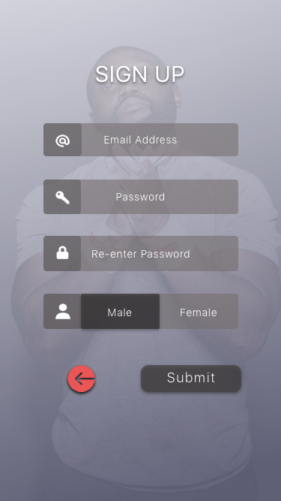
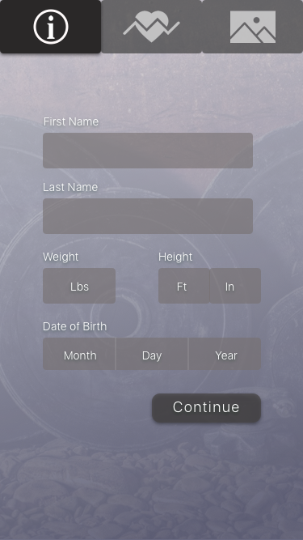
UI Design

