Slide 1
UTXO动画脚本

Slide 2



开场（5s）
越炫越好: SciEcon, Bitcoin, Blockchain etc.
“Research, Innovation, Service”

Slide 3
画面1（15-20s）：
The life of a “UTXOer”
Bitcoins exist in the form of Unspent Transaction Output
When a Bitcoin is transferred from A to B, the old UTXO of A is “dead”, and a new UTXO of B is “born”
Analogy to human life

Slide 4


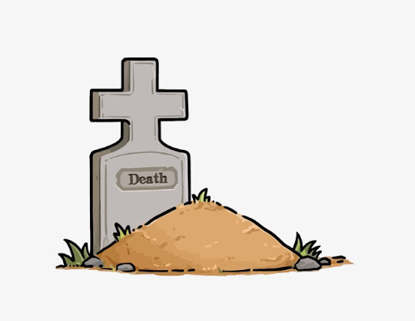
UTXOer: The life of an UTXO
Born
Dead
Block rewards
The Lifespan of STXO
Input for another transaction.
Spent Transaction Output (STXO)
Output from
one transaction
Now
The Age of UTXO

Slide 5
画面2（15-20s）：
Age Distribution of Alive UTXOers
Please adjust from “UTXO Video”
只截取中间的图像部分，把日期调得大一些放到右上角一起播放
请把视频做的好看一点，加一点配乐或者外围背景
加速

Slide 6
画面3（10-15s）：
Relationship with Bitcoin Prices?
Weighted average lifespan (WAL) and Bitcoin Prices (See next page)
Make this an animation please.

Slide 7
