Slide 1
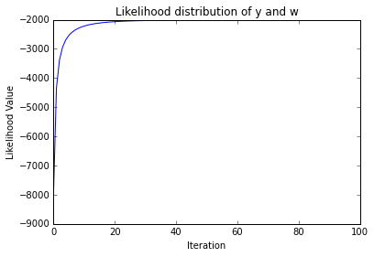
Problem 2
a. See Python code attached.
b.
c.
 | Actual = 4 | Predicted = 9
Predicted = 4 | 930 | 52
Predicted = 9 | 77 | 932

Slide 2
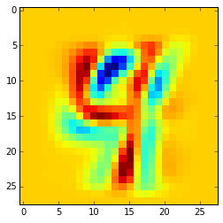
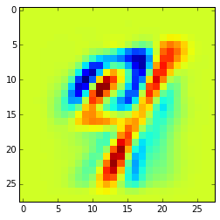
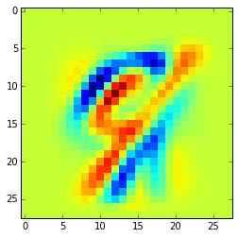
d. Misclassified digits
Observation 40
Observation 46
Observation 340
Predicted Class = 9
Actual Class = 4
E[Y=9|X] = 0.754821
Predicted Class = 9
Actual Class = 4
E[Y=9|X] = 0.78199
Predicted Class = 9
Actual Class = 4
E[Y=9|X] = 0.50465

Slide 3
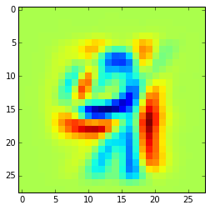
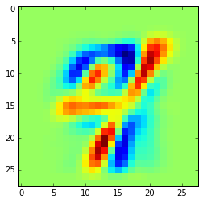
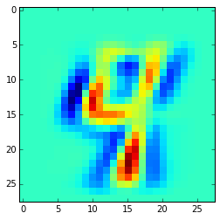
e. Most ambiguous predictions
Observation 586
Observation 340
Observation 210
Predicted Class = 9
Actual Class = 4
E[Y=9|X] = 0.50026
Predicted Class = 9
Actual Class = 4
E[Y=9|X] = 0.50465
Predicted Class = 9
Actual Class = 4
E[Y=9|X] = 0.506176

Slide 4
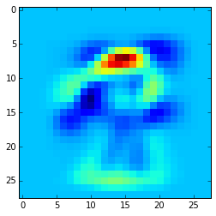

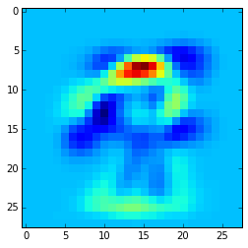
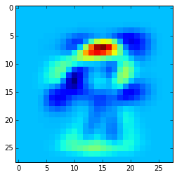

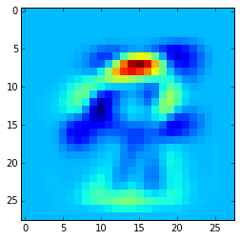
f. Reconstructed w_t
t = 1
t = 5
t = 10
t = 25
t = 50
t = 100

