Slide 1
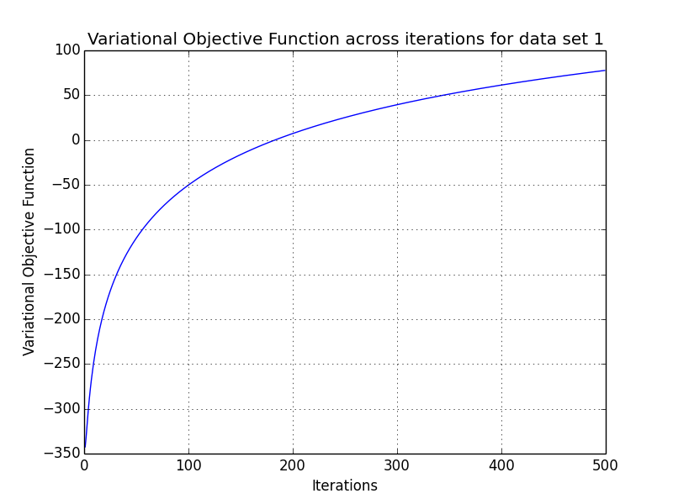
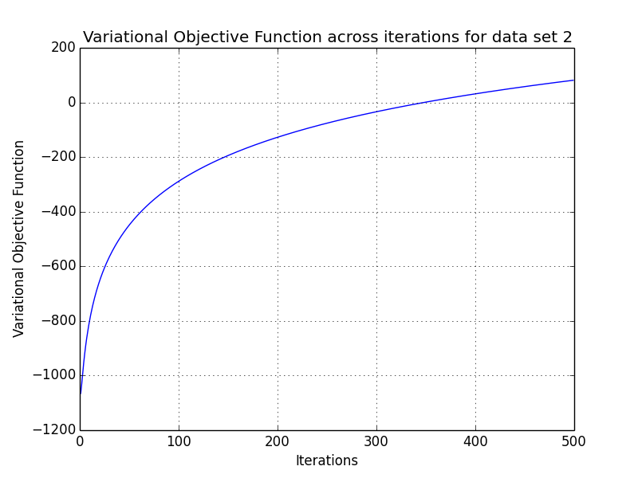
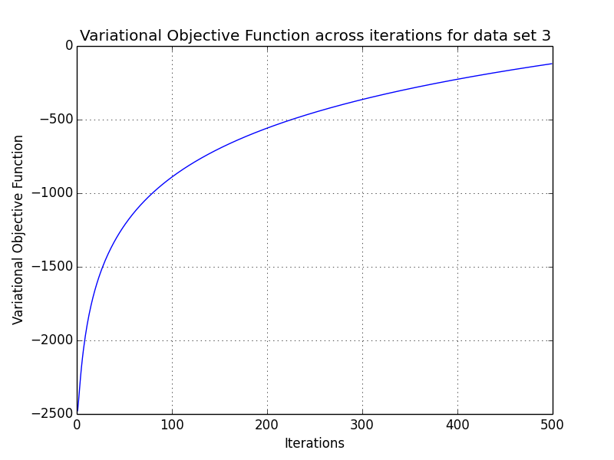
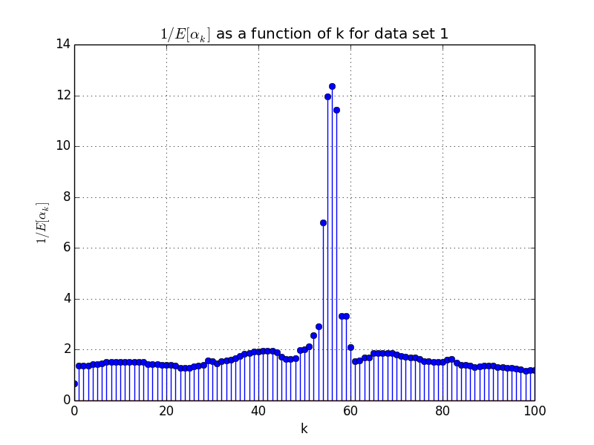
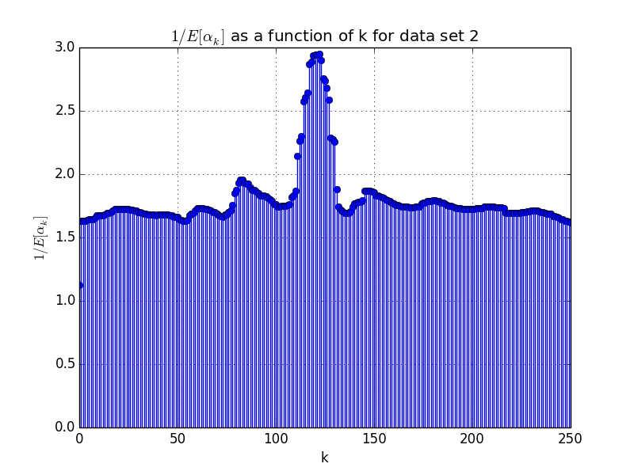
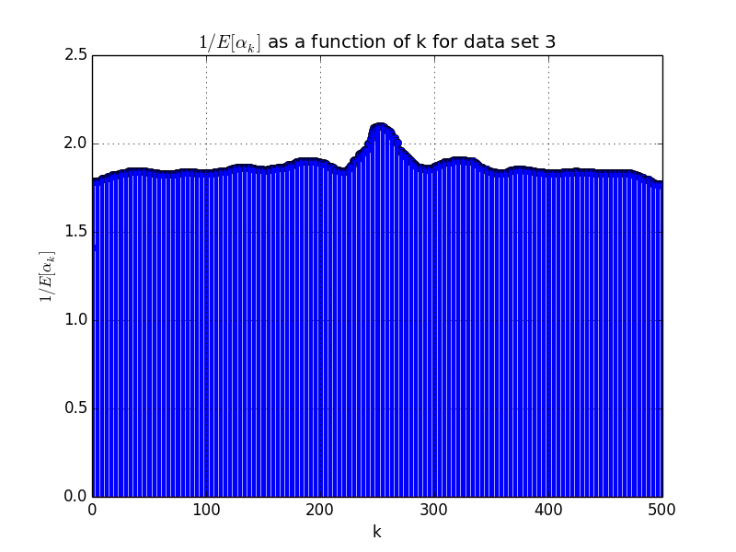

Problem 2
a)
Data Set 1
Data Set 2
Data Set 3
b)
Data Set 1
Data Set 2
Data Set 3
c)
Data Set 1
Data Set 2
Data Set 3
= 3.67329015015
= 10.2601623179
= 33.4137810438

Slide 2
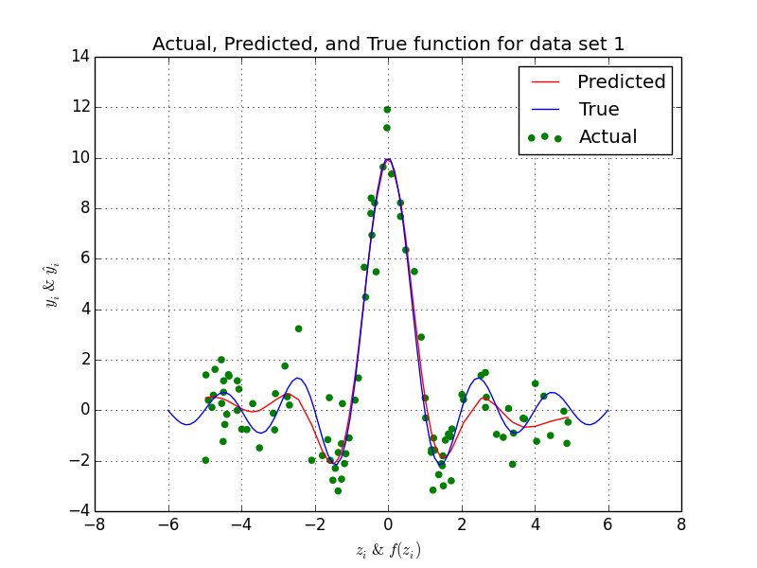
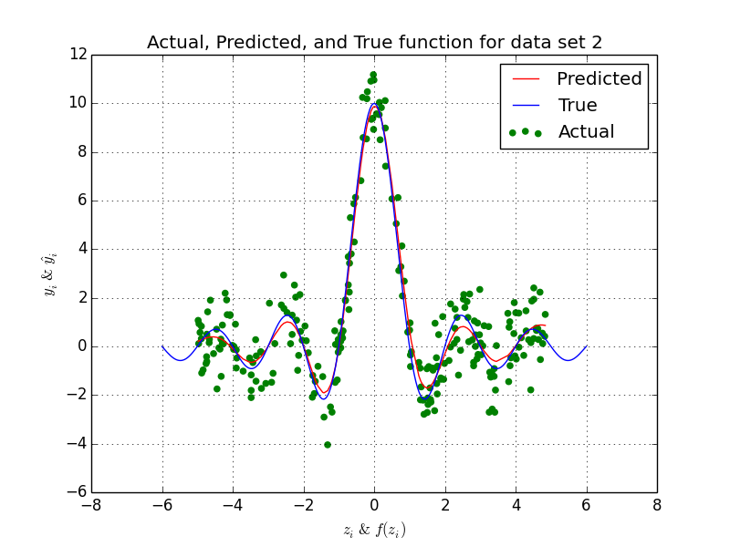
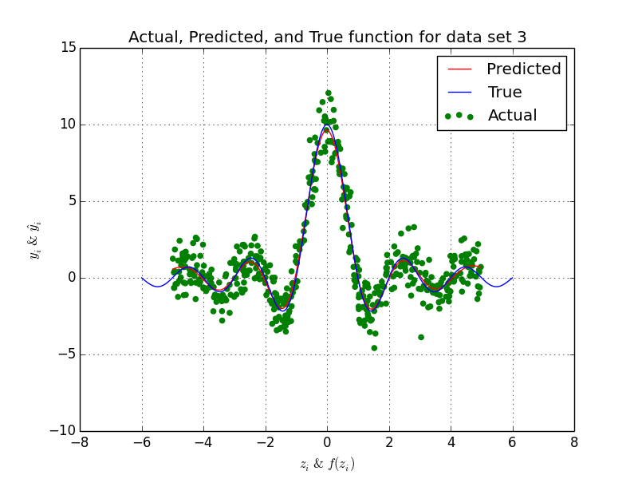
d)
Data Set 1
Data Set 2
Data Set 3

